Slide 1
Maximum Flow_1
Instructor: Dr. Wei (Lisa) Li
Department of Computer Science, GSU

Slide 2
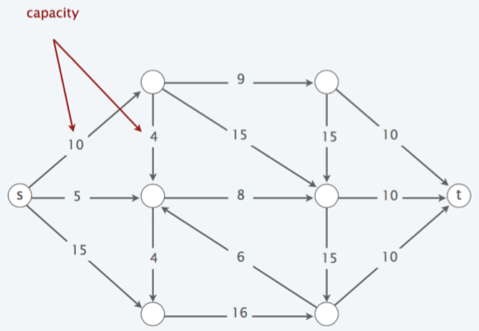
Flow Networks
Abstraction for material flowing through the edges
Digraph G = (V, E) with source s ∈ V and sink t ∈ V. (no parallel edges; no edge enters s; no edge leaves t)
Nonnegative integer capacity c(u, v) for each (u, v) ∈ E.

Slide 3
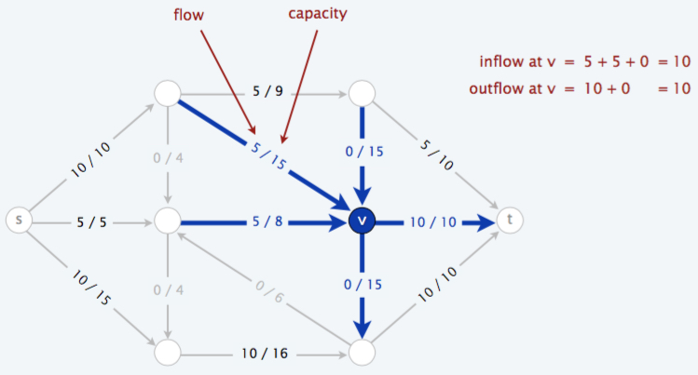
Flows
Capacity Constraint: flow of an edge cannot exceed its capacity, i.e., 0 ≤ f(u, v) ≤ c(u, v)
Flow Conservation: volume of in-flow = volume of out-flow, i.e., Σ_{u∈V} f(u, v) = Σ_{w∈V} f(v, w)

Slide 4
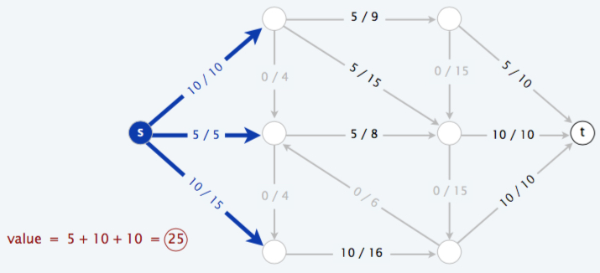
Value of Flows
Value of a flow = volume of out-flows from source
i.e., val(f) = Σ_{u∈V} f(s, u)

Slide 5
Maximum-Flow Problem
Given: a flow network G with source S and sink t
Objective: find a flow of maximum value
Constraints: capacity constraint & flow conservation

Slide 6
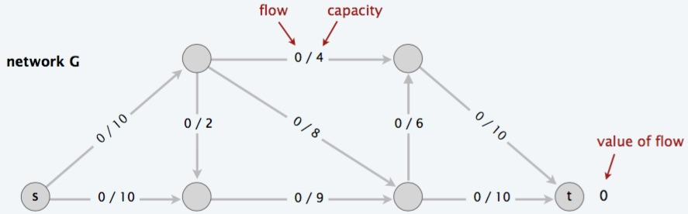
Greedy Algorithm
Start with f(e) = 0 for all edge e ∈ E.
Find a path P(s, t) where each edge has f(e) ≤ c(e).
Augment flow along path P(s, t).
Repeat until you get stuck.
a
c
b
d

Slide 7
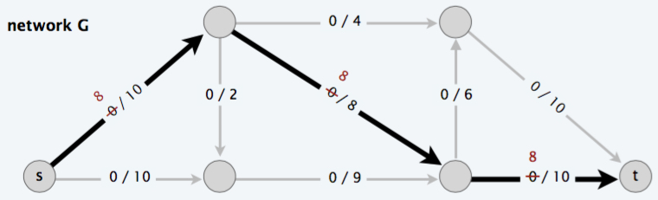
Greedy Algorithm (cont.)
Start with f(e) = 0 for all edge e ∈ E.
Find a path P(s, t) where each edge has f(e) ≤ c(e).
Augment flow along path P(s, t).
Repeat until you get stuck.
a
c
Val(f) = 8
b
d

Slide 8
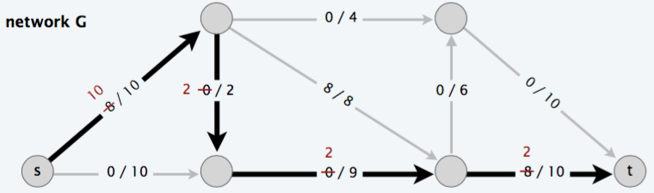
Greedy Algorithm (cont.)
Start with f(e) = 0 for all edge e ∈ E.
Find a path P(s, t) where each edge has f (e) ≤ c(e).
Augment flow along path P(s, t).
Repeat until you get stuck.
a
c
Val(f) = 8 + 2 = 10
b
d

Slide 9
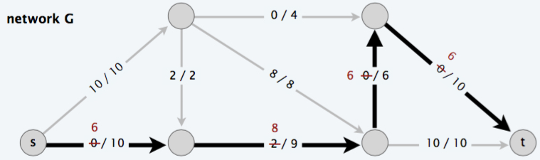
Greedy Algorithm (cont.)
Start with f(e) = 0 for all edge e ∈ E.
Find a path P(s, t) where each edge has f (e) ≤ c(e).
Augment flow along path P(s, t).
Repeat until you get stuck.
a
c
Val(f) = 10 + 6 = 16
b
d

Slide 10
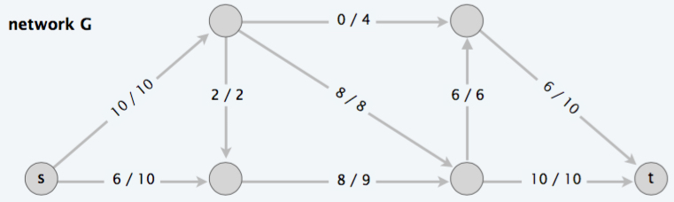
Greedy Algorithm (cont.)
Start with f(e) = 0 for all edge e ∈ E.
Find a path P(s, t) where each edge has f (e) ≤ c(e).
Augment flow along path P(s, t).
Repeat until you get stuck.
a
c
Val(f) = 8 + 2 + 6 = 16
b
d

Slide 11
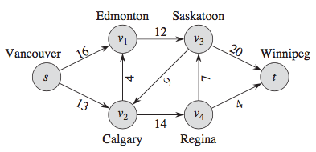
Exercise
A flow network G = (V, E) for the Lucky Puck Company’s trucking problem. The Vancouver factory is the source s, and the Winnipeg warehouse is the sink t. The company ships pucks through intermediate cities, but only c(u, v) crates per day can go from city u to city v. Each edge is labeled with its capacity.
How to find a maximum flow from s to t?

Slide 12
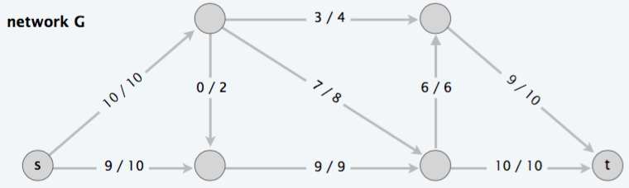
Can we do better?
Val(f) = 16
Max-Value = 19

