Slide 1
Maximum Flow_2
Instructor: Dr. Wei (Lisa) Li
Department of Computer Science, GSU

Slide 2
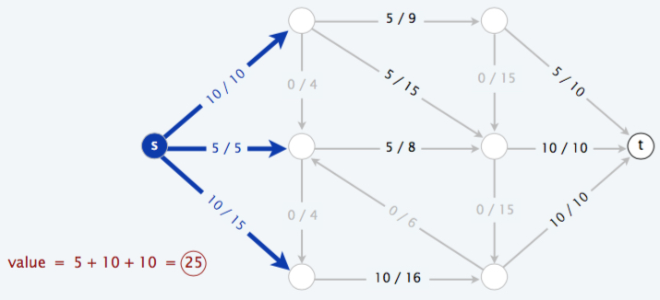
Maximum-Flow Problem
Given: a flow network G with source S and sink t
Objective: find a flow of maximum value
Constraints: capacity constraint & flow conservation

Slide 3
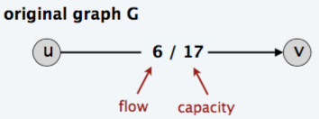
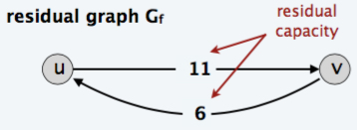
Residual Graph
Original edge: e(u, v) ∈ E.
Capacity: c(u, v)
Flow: f(u, v)
Residual edge: e_{f}(u, v) (undo flow set)
Residual Capacity: c_{f}(u, v) = c(u, v) – f(u, v)
Residual Graph G_{f}(V, E_{f})
0 ≤ c_{f}(u, v) ≤ c(u, v)
f(v, u) in G_{f} indicates a decrease of flow f(u, v)

Slide 4
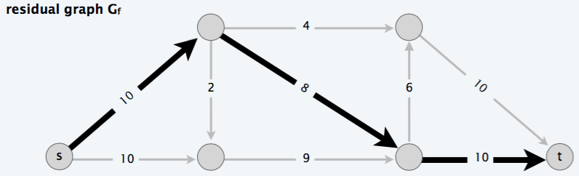
Augmenting Paths
Augmenting Path: a simple path P(s, t) in residual graph G_{f}.
Residual Capacity of P(s, t): minimum residual capacity of any edge in path P(s, t)

Slide 5
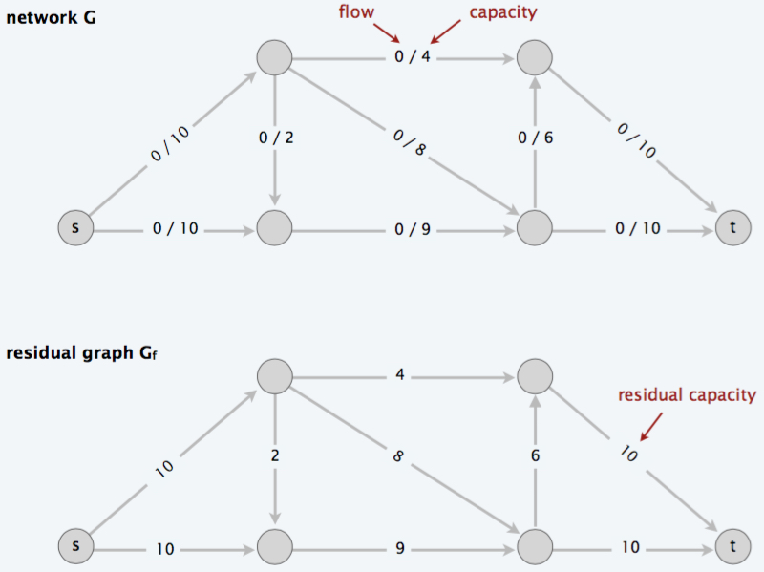
Ford-Fulkerson Alg.
Start with f (e) = 0 for all edge e ∈ E.
Find an augmenting path P in residual graph G_{f}.
Augment flow along path P.
Repeat until you get stuck.

Slide 6
Ford-Fulkerson Alg. (cont.)
Start with f (e) = 0 for all edge e ∈ E.
Find an augmenting path P in residual graph G_{f}.
Augment flow along path P.
Repeat until you get stuck.
Val(f) = 8

Slide 7
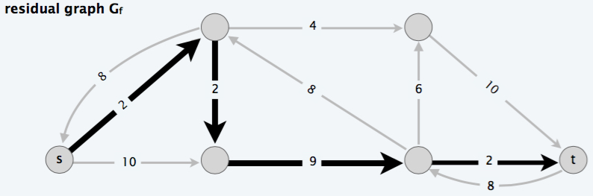
Ford-Fulkerson Alg. (cont.)
Start with f (e) = 0 for all edge e ∈ E.
Find an augmenting path P in residual graph G_{f}.
Augment flow along path P.
Repeat until you get stuck.
Val(f) = 8 + 2 = 10

Slide 8
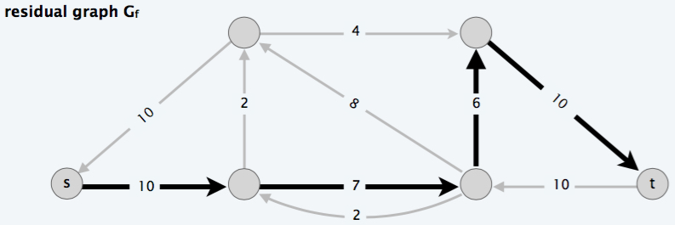
Ford-Fulkerson Alg. (cont.)
Start with f (e) = 0 for all edge e ∈ E.
Find an augmenting path P in residual graph G_{f}.
Augment flow along path P.
Repeat until you get stuck.
Val(f) = 10 + 6 = 16

Slide 9
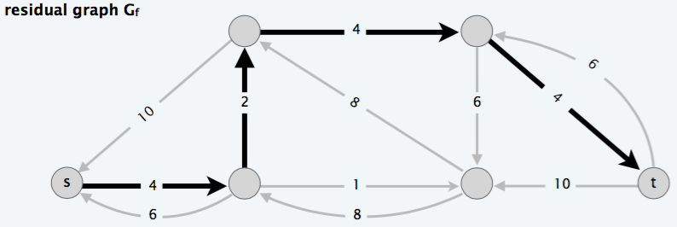
Ford-Fulkerson Alg. (cont.)
Start with f (e) = 0 for all edge e ∈ E.
Find an augmenting path P in residual graph G_{f}.
Augment flow along path P.
Repeat until you get stuck.
Val(f) = 16 + 2 = 18

Slide 10
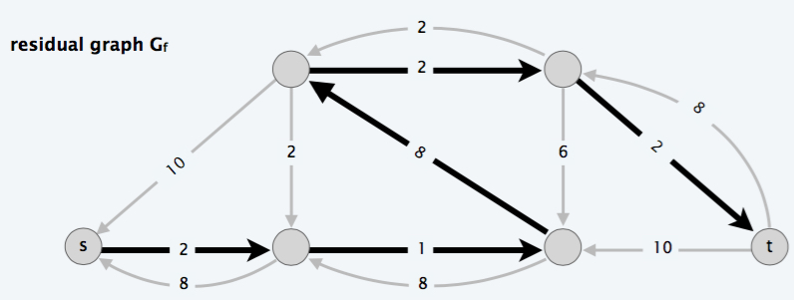
Ford-Fulkerson Alg. (cont.)
Start with f (e) = 0 for all edge e ∈ E.
Find an augmenting path P in residual graph G_{f}.
Augment flow along path P.
Repeat until you get stuck.
Val(f) = 18 + 1 = 19

Slide 11
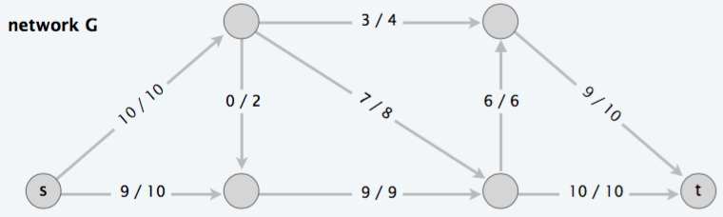
Ford-Fulkerson Alg. (cont.)
Start with f (e) = 0 for all edge e ∈ E.
Find an augmenting path P in residual graph G_{f}.
Augment flow along path P.
Repeat until you get stuck.
Max-Value = 19

Slide 12
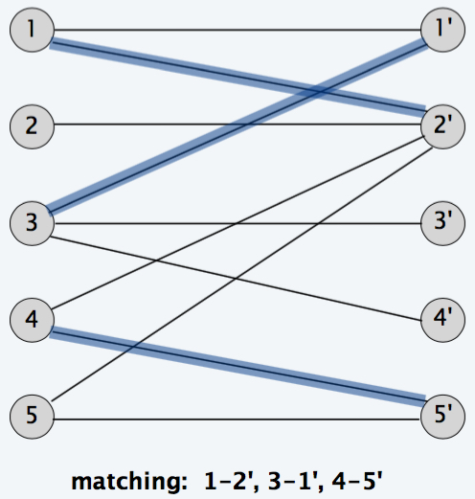
Bipartite Matching
Bipartite Graph G(V, E): V = L U R
Bipartite matching: given a bipartite graph G = (L ∪ R, E), find a matching M.
L
R

Slide 13
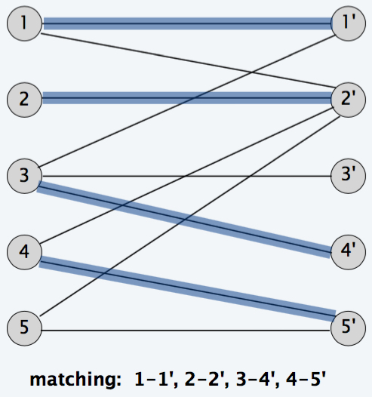
Maximum Bipartite Matching
Maximum Bipartite matching: given a bipartite graph G = (L ∪ R, E), find a maximum matching M; i.e., the cardinality of a match, |M| is maximized.
L
R
L
R
Maximum Matching

Slide 14
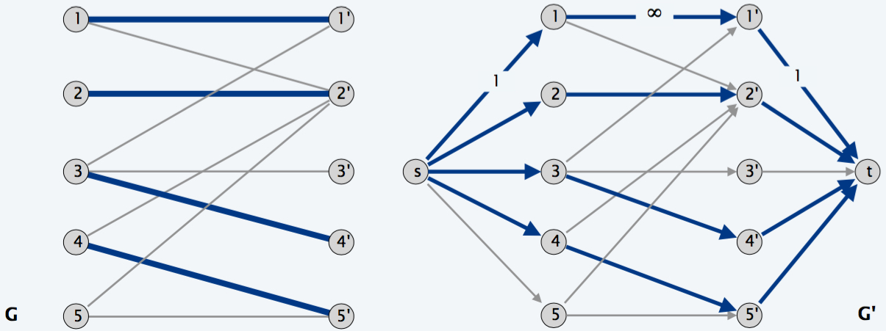
Bipartite Matching & Max Flow
Max cardinality of a matching in G = value of max flow in G’, i.e., |M| = val(f).
Given a max matching M of cardinality k.
Consider flow f that sends 1 unit along each of k paths.
f is a flow, and has value k.

Slide 15
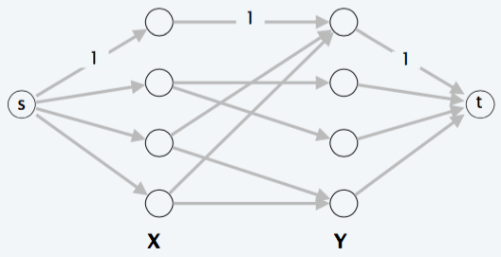
Bipartite Matching Methods
Key Idea: solve via reduction to maximum flow
Steps:
Direct all edges from L to R, and assign unit capacity.
Add source s, and unit capacity edges from s to each node in L.
Add sink t, and unit capacity edges from each node in R to t.

Slide 16
Notes
Residual graph G_{M}: (property of bipartite matching)
If (x, y) is not in M, then (x, y) is in G_{M}
If (x, y) is M, then (y, x) is in G_{M}
Augmenting path simplifies to: (property of bipartite matching)
Edge from s to an unmatched node x in X
Edge from unmatched node y in Y to t.

