Slide 1
Introduction to Algorithm
Instructor: Dr. Wei (Lisa) Li
Department of Computer Science, GSU

Slide 2
Course Information
CSC 4520/6520: Design and Analysis of Algorithm
Instructor: Dr. Wei (Lisa) Li
Office Hours: TR 1:30 pm - 2:30 pm
Office Room: Room 733, 25 Park Place
Email: wli28@gsu.edu
Phone: (404) 413-6658
TA: Korn Sooksatra
Email: ksooksatra1@student.gsu.edu
Office Hours: Wed. 3:00 pm – 5:00 pm
Office Room: 641A, 25 Park Place

Slide 3
Course Information (cont.)
CSC 4520: CSC 2720 and Math 3030 with grades of "C" or higher
CSC 6520: CSC 3410 and Math 3030
“The department will strictly enforce all prerequisites. Students without proper prerequisites will be dropped from the class, without any prior notice, at any time during the semester. ”

Slide 4
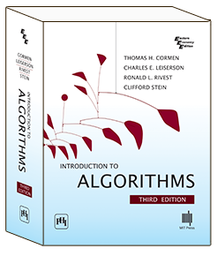
Course Information (cont.)
Textbook:
Introduction to Algorithms (3rd Edition),
Thomas H. Cormen, Charles E. Leiserson,
Ronald L. Rivest, and Clifford Stein
Grading Policy:
Attendance 10%
Homework Assignments 30%
Midterm Exam (TBA) 30%
Final Exam (TBA) 30%

Slide 5
Course Information (cont.)
Late-Submission Policy
For each late submission, 10% will be deducted from your score.
Assignments will NOT be accepted after one week.
Make-Up Exams
Make up exams will be given only for absences discussed with the instructor prior to the exam. If no arrangements are made, your grade will be a ZERO.

Slide 6
What is algorithm?
“An algorithm is any well-defined computational procedure that takes some value, or set of values, as input and produces some value, or set of values, as output.”
Inputs
Algorithm Procedure
Outputs

Slide 7
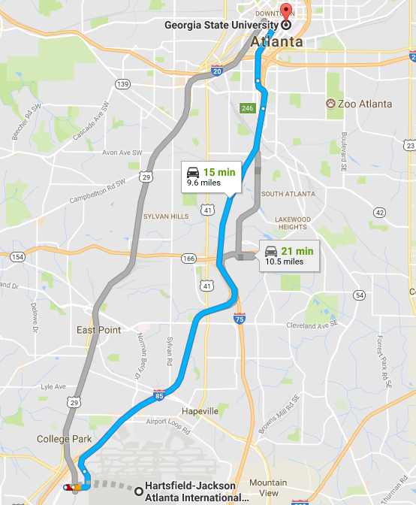
Why algorithm?
Examples
Compute summation from 1 to 100, i.e.,
Sum = 1 + 2 + , … + 99 + 100
Find the shortest path from GSU campus to ATL airport
How to effectively and efficiently obtain solutions?

Slide 8
What to cover in this course?
What are the basics of algorithm?
Input, output, and procedure
How to evaluate an algorithm?
Good or bad?
Fast or slow?
How to implement an algorithm?
How to apply an algorithm?

Slide 9
Course Outline
Fundamentals of Algorithm Design and Analysis
Basic Concepts
Time Complexity (How good/efficient is an algorithm?)
Data Structure
Important Data Structures: stack, queue, list, tree
Operations: search, insert, delete
Divide-and-Conquer
Key Idea
Recurrence Analysis

Slide 10
Course Outline (cont.)
Typical Algorithms:
Sorting Algorithms, Dynamic Programming, Greedy Algorithms, and Graph Algorithms
Key Ideas
Time Complexity
Selected Topics:
Matching Problem
Vertex-Cover Problem
Traveling-Salesman Problem
etc.

Slide 11
Objectives & Outcomes
Upon successful completion of this course, students should have the knowledge to:
Understand the fundamentals of time complexity and major characteristics of data structure
Understand the main ideas, advantages, and disadvantages of various algorithms
Understand various algorithm implementations

Slide 12
Example: Insertion Sort
Problem: resorting a sequence number in a non-decreasing order
Input: a sequence with n numbers
Output:

Slide 13
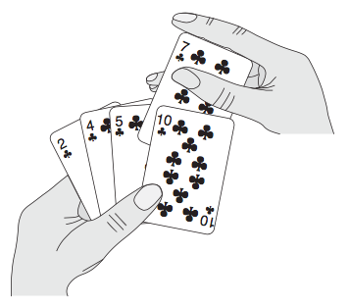
Insertion Sort: Main Idea
Insert cards in a non-decreasing order

Slide 14
Insertion Sorting
Key Idea: insert current number A[j] into sorted sequence A[1, 2, …, j-1].
Procedure:
for j = 2 to n do // j is index of current number for sorting
key = A[j]
i = j - 1 //use i as index to scan sequence
while i > 0 & A[i] > key do
A[i + 1] = A[i] //move a larger number backward
i = i - 1 //scan sequence from j-1 to 1
A[i + 1] = key //A[i] <= key and insert key at the i+1 position

Slide 15
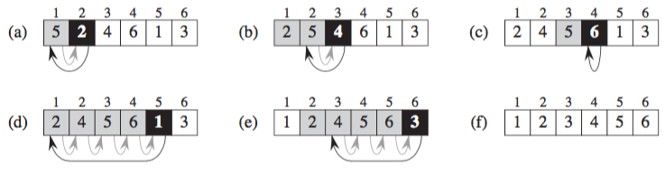
Insertion Sorting (cont.)
i
key
i
key
i
key
i
key
i
key

Slide 16
Exercises
Given a sequence of number with size of n
Resort the sequence in a non-increasing order (Sorting Problem)
Find the maximum number of a sequence number (Maximum Problem)

Slide 17
Hints
Sorting Problem:
Key Idea: use the method similar to that applied for resorting sequence in non-decreasing order
Maximum Problem:
Key Idea: compare any two neighboring numbers
n-1 comparisons for n numbers

