Slide 1
NP-Completeness
Instructor: Dr. Wei (Lisa) Li
Department of Computer Science, GSU

Slide 2
Runtime Complexity Classes
Runtime Order:
constant
almost constant
Logarithmic
sublinear
linear
pseudolinear
quadratic
Polynomial
exponential
superexponential
Example:
O(1), adding an element in a queue/stack
inverse Ackerman function = O(loglog…log n)
n times
O(log n), extracting minimum from binary search tree
n^{1/2}
kn, traversing binary search tree, list
O(n log n) sorting n numbers, MST
n², selection sort
n^{k}
e^{n} , 2^{n}, n!
Ackerman function
2
.
.
.
2
2
n times

Slide 3
Polynomial Time Algorithms
Definition: on inputs of size n, the worst-case running time is O(n^{k}) for some constant k.
Classes:
Constant: O(k) = O(1)
Almost constant: O(loglog…log n)
Logarithmic: O(log n)
Sublinear: O(n^{k}), 0< k < 1
Linear: O(kn) = O(n)
Pseudolinear: O(n log n)
Polynomial: O(n^{k}), k>1
n times
3

Slide 4
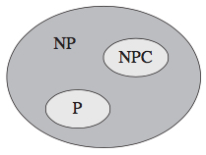
Nondeterministic Polynomial Time
NP Problem:
Its status is unknown
No polynomial-time algorithm has been discovered for it.
NP-hard Problem:
At least as hard as the hardest problems in NP
It do not have to be elements of NP
NP-complete Problem (NPC):
It is NP-hard.
It has to be in NP.

Slide 5

P ≠ NP or N = NP ?
Millennium prize: $1 million for resolution of P versus NP problem.

Slide 6
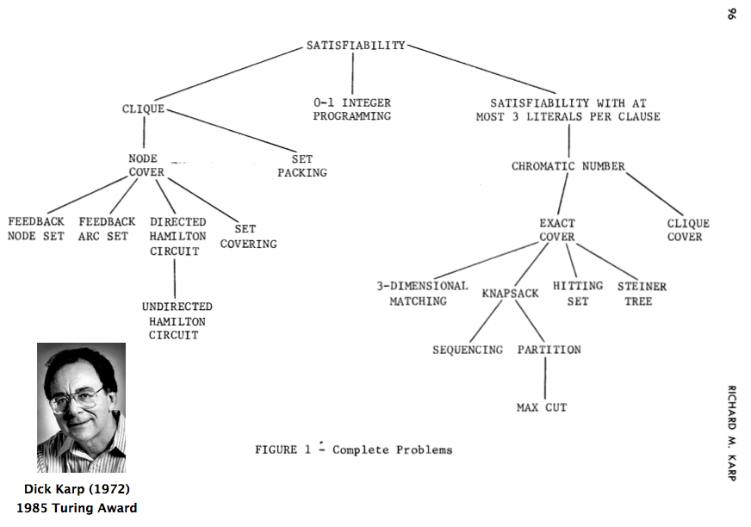
Karp’s 21 NPC Problems

Slide 7
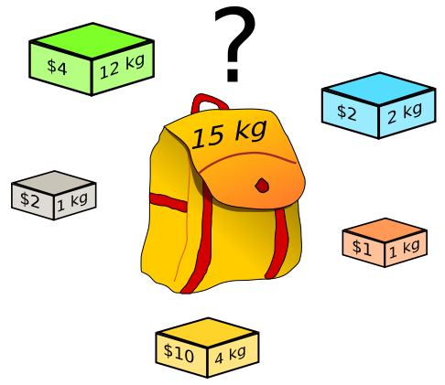
0-1 Knapsack Problem
Given: n items with profit P=(p₁, p₂, …, p_{n}) and weight W=(w₁, w₂, …, w_{n}), and a knapsack with capacity C.
Goal: fill in the knapsack such that
The total profit is maximized
The total weight does exceed the capacity
Hardness
0-1 programming
NP-complete problem

Slide 8
Vertex Cover
Vertex Cover:
The set of vertices which has at least one endpoint in each edge
Minimum Vertex Cover (MVC):
The size of a vertex cover is minimum
Min Vertex Cover is NPC
If C is vertex cover, then V - C is an independent set
red independent set
blue vertex cover

Slide 9
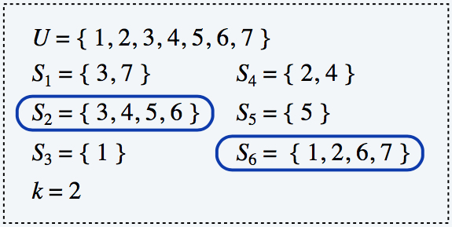
Set Cover
Given a set X of elements, a collection S₁, S₂, ..., S_{m} of subsets of X, the union of S₁, S₂, ..., S_{m} is equal to X, i.e, X = S₁ U S₂ U, …, U S_{m}
Set cover problem: find a set cover that has the minimum size
Applications:
m available pieces of software.
Set X of n capabilities that we would like our system to have.
The i-th piece of software provides the set S_{i} ⊆ X of capabilities.
Goal: achieve all n capabilities using fewest pieces of software.

Slide 10
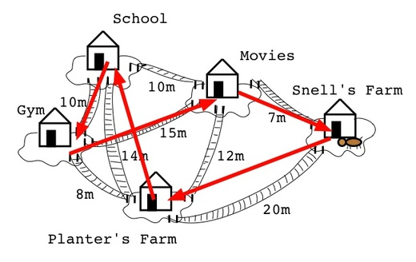
Traveling Salesman Problem
G is an undirected graph with edge cost c(u, v) > 0.
A tour of G is a simple cycle that includes every vertex of G.
The cost of a tour is the sum of the edge costs on the tour.
The traveling salesperson problem is to find a tour of minimum cost.

Slide 11
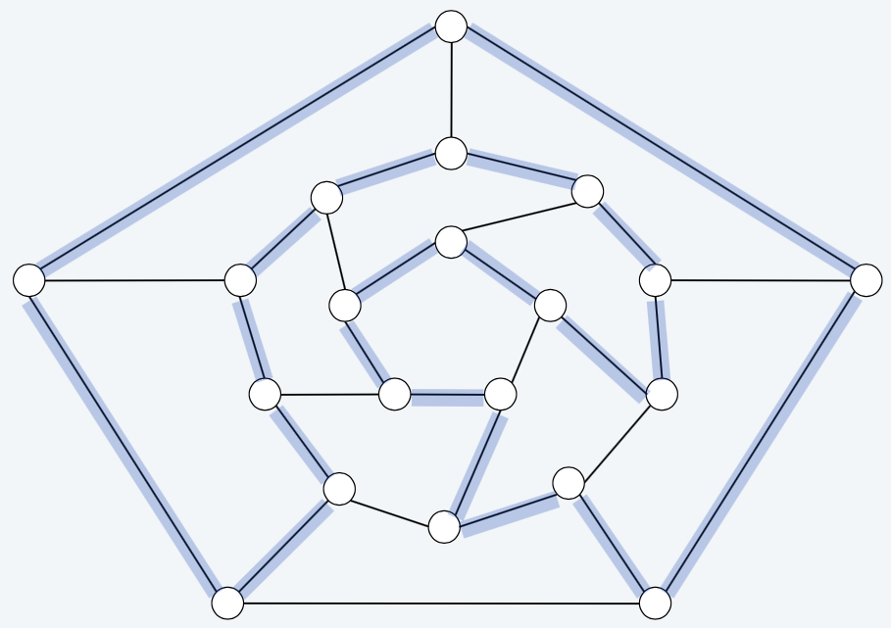
Hamilton Cycle
Given an undirected graph G
Find a cycle which visits each point exactly once

Slide 12
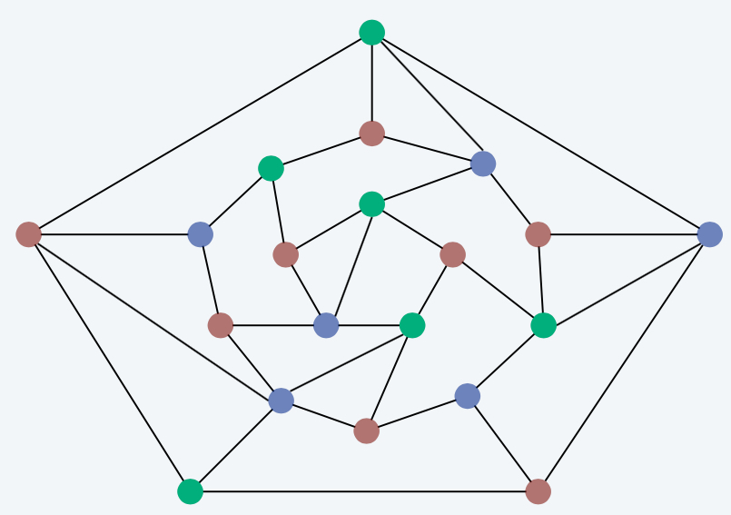
Graph Coloring
Given an undirected graph G, can the nodes be colored in k colors so that no adjacent nodes have the same color?
An example of 3-Coloring Graph

Slide 13
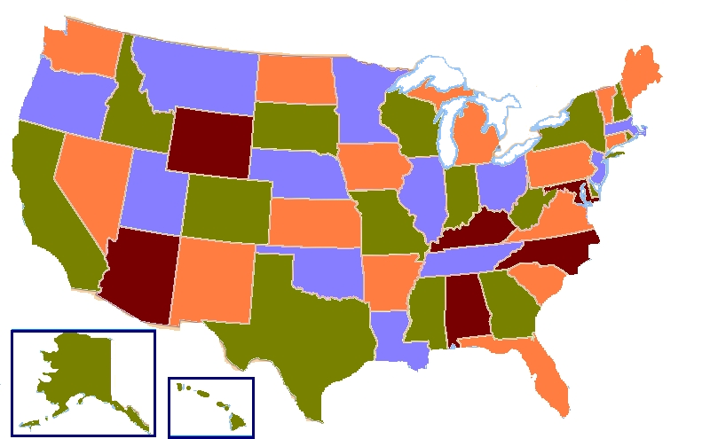
Four Color Map Theorem
“No more than four colors are required to color the regions of the map so that no two adjacent regions have the same color.”
A Four-Coloring Map of USA

Slide 14
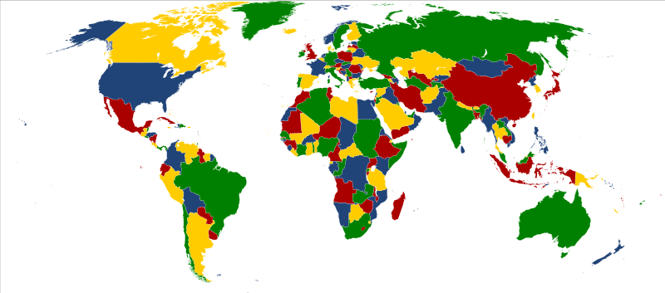
Four Color Map Theorem (cont.)
“No more than four colors are required to color the regions of the map so that no two adjacent regions have the same color.”
A Four-Coloring Map of the World

Slide 15
Applications
Exam Time Schedule
How to schedule the exam so that no two exams with a common student are scheduled at the same time?
How many minimum time slots are needed to schedule all exams?
Radio Frequency/Channel Assignment
Each tower has a interference region
Two towers cannot assigned the same frequency/channel if they are within interference region
How to assign frequency/channel without interference among towers?

