Slide 1
Covering Problem
Instructor: Dr. Wei (Lisa) Li
Department of Computer Science, GSU

Slide 2
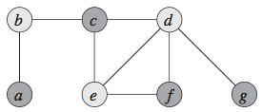
Vertex Cover Problem
Vertex Cover:
A subset of vertices V’ of V on undirected graph G(V, E)
If e(u, v) in E, u is in V’, or v is in V’, or both
Vertex Cover Problem: find a vertex cover of minimum size in a given undirected graph
Optimal Vertex Cover V’={b, d, e}

Slide 3
Approximate Vertex Cover
Key Idea: iteratively add nodes to cover set via edge selection
Process:
V’ = ⏀ //Initial vertex cover is empty
E’ = E //copy the edge set
while E’ is not empty
choose an edge e(u, v) from E’
V’ = V’ U {u, v} //add nodes u and v into cover set
remove from E’ every edge incident on either u or v
//delete all edges in E’ that are covered by either u or v to avoid repeated selection
return V’

Slide 4
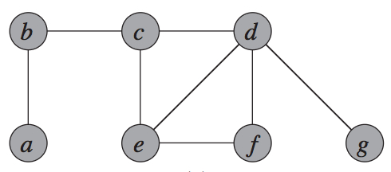
Example:
Initially,
V’ = ⏀ //Initial vertex cover is empty
E’ = E //copy the edge set

Slide 5
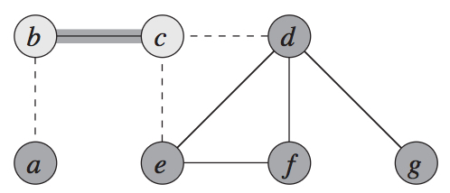
Example (cont.):
At the 1st iteration:
choose edge e(b, c) from E’;
add nodes b and c into V’ → V’ = {b, c};
delete edges e(b, a), e(c, d) and e(c, e) from E’;

Slide 6
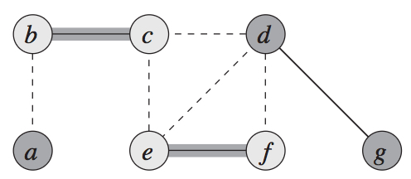
Example (cont.):
At the 2nd iteration:
choose edge e(e, f) from E’;
add nodes e and f into V’ → V’ = {b, c, e, f};
delete edges e(e, d) and e(f, d) from E’;

Slide 7
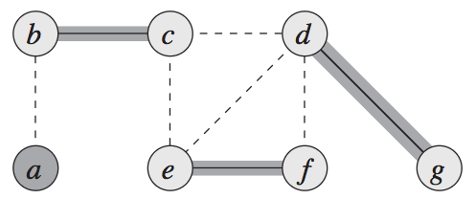
Example (cont.):
At the 3rd iteration:
choose edge e(d, g) from E’;
add nodes e and f into V’ → V’ = {b, c, e, f, d, g};

Slide 8
Performance Analysis
Running Time: O(V+E)
At most |E| edges are selected from E’
For every selected edge, each endpoint will be checked one time
Approximation Ratio:
Output of approximate algorithm: V’
An optimal vertex cover: V*
|V’| ≤ 2|V*|
V’ = {b, c, e, f, d, g}
Optimal Vertex Cover V*={b, d, e}

Slide 9
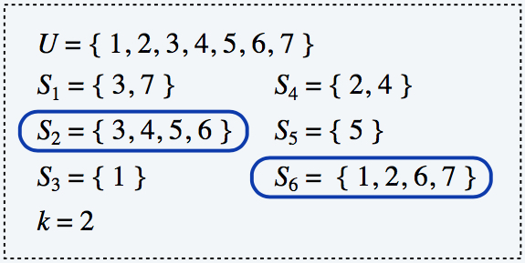
Set Cover Problem
Given a set X of elements, a collection S₁, S₂, ..., S_{m} of subsets of X, the union of S₁, S₂, ..., S_{m} is equal to X, i.e, X = S₁ U S₂ U, …, U S_{m}
Set cover problem: find a set of subsets S to cover X such that this cover has the minimum size

Slide 10
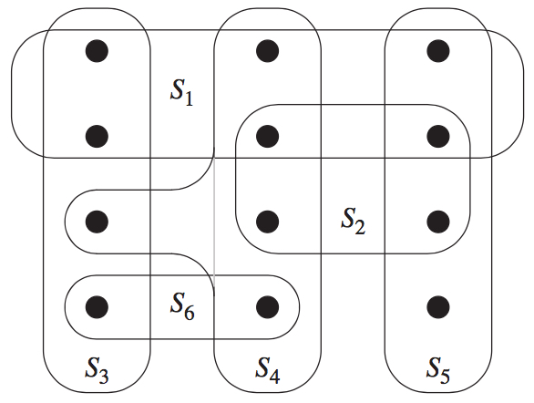
Example:
X: 12 black points
Subset Collection: S₁, S₂, S₃, S₄, S₅, S₆

Slide 11
Example (cont.):
Optimal Set Cover: {S₃, S₄, S₅}
Set Cover: {S₁, S₄, S₅, S₆}

Slide 12
Greedy Set Cover
Key Idea: at each stage, choose a set S that covers the largest number of remaining uncovered elements.
Process:
A = X //initially, all elements are uncovered
C = ⏀ //initial set cover is empty
while U is not empty
select a subset S that maximizes |S ⋂ A|
// S ⋂ A is the set of uncovered elements that is included in S
A = A – S
C = C U {C}
return C

Slide 13
Example:
Initially,
A = X and C = ⏀; //cover set is empty
Subset Collection: S₁, S₂, S₃, S₄, S₅, S₆;

Slide 14
Example (cont.):
Covered by S₁
Remaining Uncovered Elements
At the 1st iteration:
Select subset S₁;
A = A - S₁; C = C U S₁ = {S₁}

Slide 15
Example (cont.):
Covered by S₁ and S₄
Remaining Uncovered Elements
At the 2nd iteration,
Select subset S₄;
A = A - S₄; C = C U S₄ = {S₁, S₄}

Slide 16
Example (cont.):
Covered by S₁, S₄, and S₅
Remaining Uncovered Elements
At the 3rd iteration,
Select subset S₅;
A = A - S₅; C = C U S5 = {S₁, S₄, S₅}

Slide 17
Example (cont.):
At the 4th iteration,
Select subset S₆;
A = A - S₆; C = C U S₆ = {S₁, S₄, S₅, S₆}

Slide 18
Approximation Ratio
Greedy-Set-Cover is a polynomial-time p-approximation algorithm, where p = H(max{|S_{i}|}) and H(d) = Σ^{d}_{i=1} 1/i.
Optimal Set Cover: {S₃, S₄, S₅}
Set Cover: {S₁, S₄, S₅, S₆}

