Slide 1
Graph Coloring
Instructor: Dr. Wei (Lisa) Li
Department of Computer Science, GSU

Slide 2
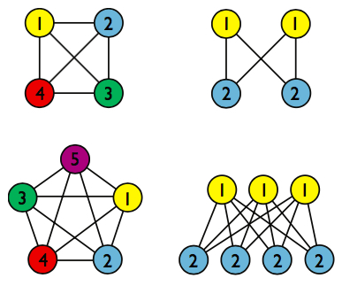
Coloring Problem
Graph Coloring: assign colors to certain elements of a graph subject to certain constraints.
Vertex Coloring
Most common graph coloring problem
Given k colors, find a way to color
the vertices of a graph such that
no two adjacent vertices have the
same color

Slide 3
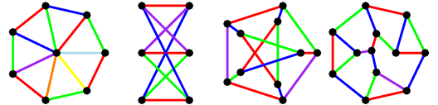
Coloring Problem (cont.)
Edge Coloring
Given k colors, find a way to color the edges of a graph such that no vertex is incident to two edges of the same color
Can be transformed into vertex coloring

Slide 4
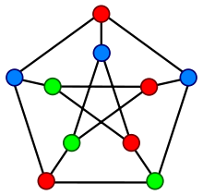
Chromatic Number
The smallest number of colors needed to color a graph
The problem to find the chromatic number of a given graph is NP complete
A graph colored minimum 3 colors

Slide 5
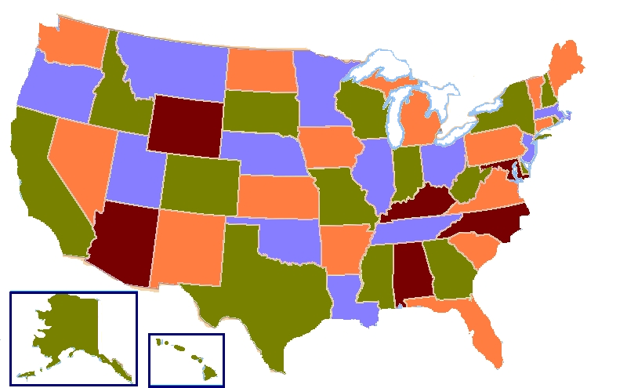
Applications
Map Coloring: four colors are sufficient to color any map (Four Color Theorem)
A Four-Coloring Map of USA

Slide 6
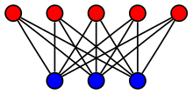
Applications (cont.)
Bipartite Graph: check if a graph is bipartite or not by using two colors
A given graph is 2-colorable if and only if it is bipartite;
Otherwise, it is not.
A bipartite graph colored 2 colors

Slide 7
Applications (cont.)
Exam Time Schedule
How to schedule the exam so that no two exams with a common student are scheduled at the same time?
How many minimum time slots are needed to schedule all exams?
Problem Transformation
View each exam as a vertex
Two vertices are adjacent (connected with an edge) if they have one or more common students
Color vertices
The number of necessary colors is the number of time slots

Slide 8
Applications (cont.)
Radio Frequency/Channel Assignment
Each tower has a interference region
Two towers cannot assigned the same frequency/channel if they are within interference region
How to assign frequency/channel without interference among towers?
Problem Transformation
View each tower as a vertex
There exists an edge between two vertices if and only if they are within interference region (conflicting graph)
Color the vertices of the conflicting graph
The number of necessary colors is the number of frequencies/channels

Slide 9
Greedy Coloring Algorithm
Given:
|V| vertices
Key idea:
Color first vertex with first color
Do the following for the remaining |V|-1 vertices
For current picked vertex, color it with the lowest numbered color that has not been used on any previously colored vertices adjacent to it.
If all previously colors have been used on its adjacent vertices, assign a new color to current vertex.

Slide 10
Example:
B
A
D
E
C
Color 1: Red
Color 2: Yellow
Color 3: Blue
Color 4: Green
Color 5: Purple

Slide 11
Example (cont.):
B
A
D
E
1
C
Color 1: Red
Color 2: Yellow
Color 3: Blue
Color 4: Green
Color 5: Purple

Slide 12
Example (cont.):
2
B
A
D
E
1
C
Color 1: Red
Color 2: Yellow
Color 3: Blue
Color 4: Green
Color 5: Purple

Slide 13
Example (cont.):
2
B
A
D
E
1
C
3
Color 1: Red
Color 2: Yellow
Color 3: Blue
Color 4: Green
Color 5: Purple

Slide 14
Example (cont.):
2
B
A
D
E
1
4
C
3
Color 1: Red
Color 2: Yellow
Color 3: Blue
Color 4: Green
Color 5: Purple

Slide 15
Example (cont.):
2
B
A
D
E
1
4
5
C
3
Color 1: Red
Color 2: Yellow
Color 3: Blue
Color 4: Green
Color 5: Purple
Totally, 3 colors are needed.

Slide 16
Example (cont.):
Change order of coloring:
B
A
D
E
C
Color 1: Red
Color 2: Yellow
Color 3: Blue
Color 4: Green
Color 5: Purple

Slide 17
Example (cont.):
Change order of coloring:
B
A
D
E
1
C
Color 1: Red
Color 2: Yellow
Color 3: Blue
Color 4: Green
Color 5: Purple

Slide 18
Example (cont.):
Change order of coloring:
2
B
A
D
E
1
C
Color 1: Red
Color 2: Yellow
Color 3: Blue
Color 4: Green
Color 5: Purple

Slide 19
Example (cont.):
Change order of coloring:
2
B
A
D
E
1
C
3
Color 1: Red
Color 2: Yellow
Color 3: Blue
Color 4: Green
Color 5: Purple

Slide 20
Example (cont.):
Change order of coloring:
2
B
A
D
E
1
4
C
3
Color 1: Red
Color 2: Yellow
Color 3: Blue
Color 4: Green
Color 5: Purple

Slide 21
Example (cont.):
Change order of coloring:
2
B
A
D
E
1
5
4
C
3
Color 1: Red
Color 2: Yellow
Color 3: Blue
Color 4: Green
Color 5: Purple
Totally, 4 colors are needed.

Slide 22
Degree of Vertex
Degree of a vertex: number of edges associated to a vertex
Maximum degree of a given graph: the maximum degree of vertices in the given graph
B
A
D
E
C
A graph with maximum degree of 3

Slide 23
Welsh-Powell Algorithm
Key Idea: color vertices in decreasing order of degrees.
Steps:
Compute the degree for each vertex
Sort vertices in decreasing order in terms of degrees
Color first vertex with first color
Do the following for the remaining |V|-1 vertices
For current picked vertex, color it with the lowest numbered color that has not been used on any previously colored vertices adjacent to it.
If all previously colors have been used on its adjacent vertices, assign a new color to current vertex.

Slide 24
Example:
Degrees: d(A)=2, d(B)=3, d(C)=3, d(D)=3, d(E)=1
Order: d(B)=3, d(C)=3, d(D)=3, d(A)=2, d(E)=1
B
A
D
E
C
Color 1: Red
Color 2: Yellow
Color 3: Blue
Color 4: Green
Color 5: Purple

Slide 25
Example (cont.):
Degrees: d(A)=2, d(B)=3, d(C)=3, d(D)=3, d(E)=1
Order: d(B)=3, d(C)=3, d(D)=3, d(A)=2, d(E)=1
1
B
A
D
E
C
Color 1: Red
Color 2: Yellow
Color 3: Blue
Color 4: Green
Color 5: Purple

Slide 26
Example (cont.):
Degrees: d(A)=2, d(B)=3, d(C)=3, d(D)=3, d(E)=1
Order: d(B)=3, d(C)=3, d(D)=3, d(A)=2, d(E)=1
1
B
A
D
E
C
2
Color 1: Red
Color 2: Yellow
Color 3: Blue
Color 4: Green
Color 5: Purple

Slide 27
Example (cont.):
Degrees: d(A)=2, d(B)=3, d(C)=3, d(D)=3, d(E)=1
Order: d(B)=3, d(C)=3, d(D)=3, d(A)=2, d(E)=1
1
B
A
D
E
3
C
2
Color 1: Red
Color 2: Yellow
Color 3: Blue
Color 4: Green
Color 5: Purple

Slide 28
Example (cont.):
Degrees: d(A)=2, d(B)=3, d(C)=3, d(D)=3, d(E)=1
Order: d(B)=3, d(C)=3, d(D)=3, d(A)=2, d(E)=1
1
B
A
D
E
4
3
C
2
Color 1: Red
Color 2: Yellow
Color 3: Blue
Color 4: Green
Color 5: Purple

Slide 29
Example (cont.):
Degrees: d(A)=2, d(B)=3, d(C)=3, d(D)=3, d(E)=1
Order: d(B)=3, d(C)=3, d(D)=3, d(A)=2, d(E)=1
1
B
A
D
E
4
3
5
C
2
Color 1: Red
Color 2: Yellow
Color 3: Blue
Color 4: Green
Color 5: Purple
Totally, 3 colors are needed.

Slide 30

Final Arrangement
Final Review
Two review sessions: 11/28 and 11/30
Final Exam
Time: 13:30 – 16:00, Tuesday, 12/05/2017
Location: classroom
Exam Policies:
Calculator and paper materials (e.g., lecture slides, notes, textbook) are allowed
Any electronic device is prohibited

