Slide 1
Basics of Algorithm
Instructor: Dr. Wei (Lisa) Li
Department of Computer Science, GSU

Slide 2
Correctness of Algorithm
“An algorithm is said to be correct if, for every input instance, it ends with the correct output.”
Counter Example:
Computing the result of a divided by b.
Algorithm: return a/b as output
Input: a=6 and b=2 → Output: 6/2=3
Input: a=5 and b=0 → Output: error
Corrected Algorithm: if b is non-zero, return a/b; otherwise, return infinity.

Slide 3
Time Complexity
Definition
Number of operations
Running time
Depends on
input size (the number of input)
input quality (order of input)
Kinds of analysis
Worst case (standard)
Average case (sometimes)
Best case (never)

Slide 4
Asymptotic Notations
BIG O: O
f = O(g) if f is no faster then g
f / g ≤ some constant
O(g) indicates an asymptotic upper bound
BIG OMEGA: Ω
f = Ω(g) if f is no slower then g
f / g ≥ some constant
Ω(g) indicates an asymptotic lower bound
BIG Theta: Θ
f = Θ(g) if f has the same growth rate as g
some constant ≤ f / g ≤ some constant

Slide 5
Asymptotic Analysis
Simple operations (e.g., insert, move, add, etc.) are usually assumed to run in O(1) time
Ignore all constants which are dependent on machine and programming languages.
Analyze limiting behavior of complexity when the input size increases, i.e., n → ∞
O(1) < O(log n) < O(n) < O(n log n) < O(n²)
< O(n³) < O(2^{n})

Slide 6
Date Structure
-- the way to organize/store data

Slide 7
Data Structure
Dynamic sets (Data structures):
Change a dictionary, add/remove words
Reuse of structured information
On-line algorithms - very fast updating
Elements:
Index: element ID
Key: value of element
Operations
Query/Search: return information about the set, e.g., maximum, minimum
Modifying Operations: change data sets, e.g., insert, delete
record
index→
key

Slide 8
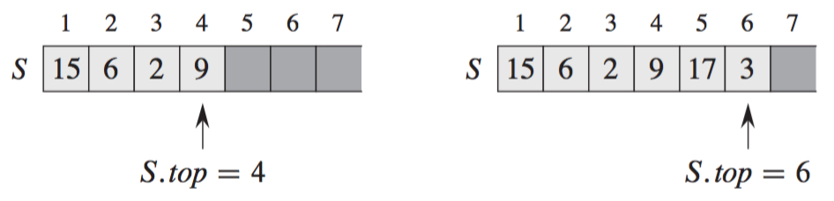
Stack
Stack: S[1, 2, …, S.top]
S.top points to the most recently inserted element
LIFO (last-in first-out) policy
Insert: O(1)
Push(S, x)
S.top = S.top + 1
S[S.top] = x
Push(S, 17) and Push(S, 3)

Slide 9
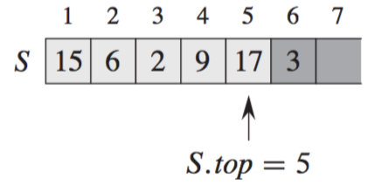
Stack (cont.)
Empty: O(1)
Stack-Empty(S)
if S.top == 0 return TRUE
else return FALSE
Delete: O(1)
Pop (S, x)
if S.top == 0
Return Empty else S.top = S.top -1
Return S[S.top+1]
Pop(S)

Slide 10
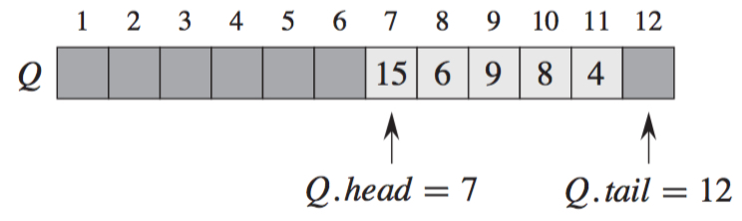
Queue
Queue: Q[1, 2, …, n]
Q.head points to head
Q.tail points to location at which a newly arriving element will be inserted into the queue
Empty: Q.head == Q.tail
Full: Q.head == Q.tail + 1
FIFO (first-in first-out) Policy
Out from head
In to tail

Slide 11
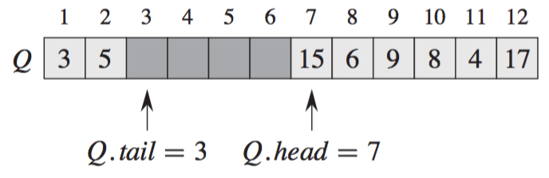
Queue (cont.)
Insert: O(1)
Enqueue(Q, x)
Q[Q.tail] = x
if Q.tail == Q.length //Q.tail is at the end
Q.tail = 1 //Place Q.tail in a circular order
else Q.tail = Q.tail + 1
Enqueue(Q, 17), Enqueue(Q, 3), and Enqueue(Q, 5)

Slide 12
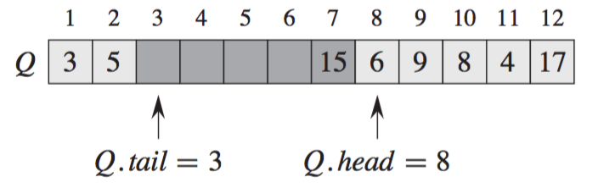
Queue (cont.)
Delete: O(1)
Dequeue(Q)
x = Q[Q.head]
if Q.head == Q.length //Q.head is at the end
Q.head = 1 //Place Q.head in a circular order
else Q.head = Q.head + 1
return x
Dequeue (Q)

Slide 13
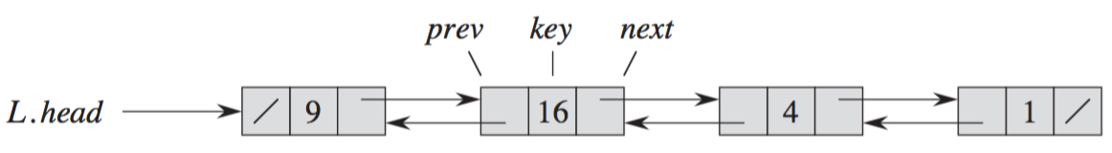
Linked List
Doubly Linked List: prev and next
Head: x.prev == NIL
Tail: x.next == NIL
Empty: x.head == NIL

Slide 14
List Search
List-Search(L, k): O(n)
x = L.head
while x ≠ NIL and x.key ≠ k
x = x.next
return x

Slide 15
List Insertion
List-Insert(L, x): O(1)
x.next = L.head
if L.head ≠ NIL
L.head.prev = x
L.head = x
x.prev = NIL

Slide 16
List Deletion
List-Delet(L, x): (any element O(1); a given element O(n))
if x.prev ≠ NIL
x.prev.nex = x.next
else L.head = x.next //x is head of list
if x.next ≠ NIL
x.next.prev = x.prev

Slide 17
Exercise
Sort the following time complexity in a non-increasing order
O(n⁴), O(logn), O(n), O(n!), O(n logn)

