Slide 1
Binary Search Tree
Instructor: Dr. Wei (Lisa) Li
Department of Computer Science, GSU

Slide 2
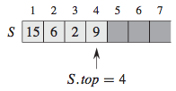
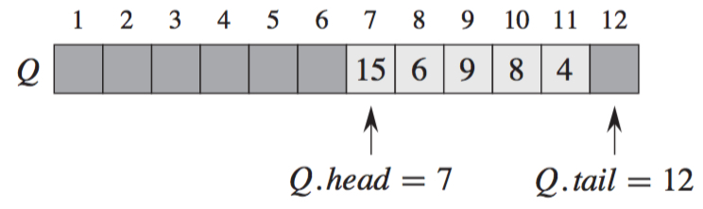
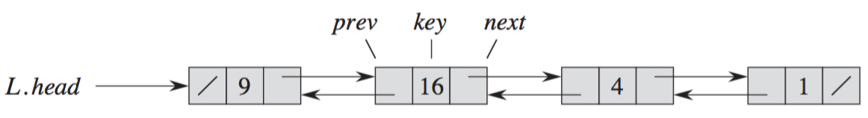
Linear Data Structure
Stack: first-in-last-out
Queue: first-in-first-out
Linked List: prev & next

Slide 3
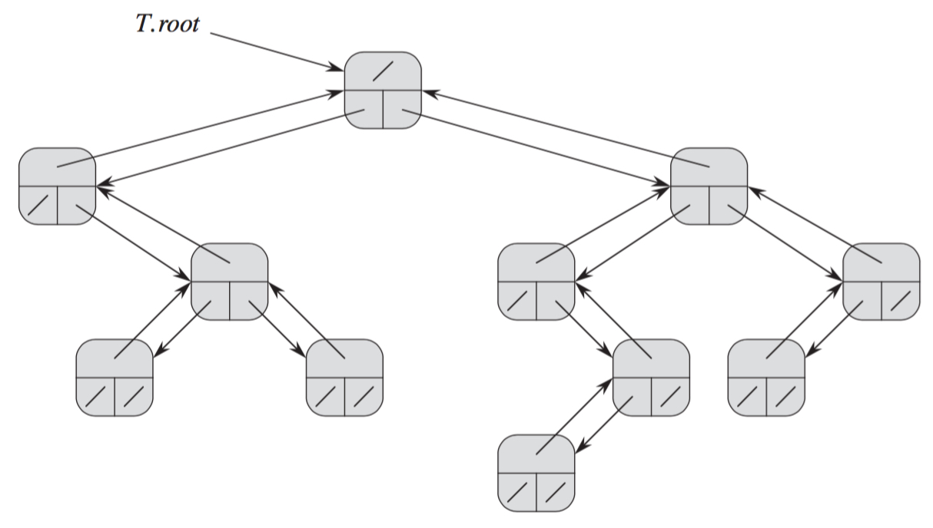
Binary Tree
Structure Attributes: parent (p), left child (left), and right child (right)
Root: x.p == NIL
Leaf: x.left == x.right == NIL
Empty: T.root == NIL

Slide 4
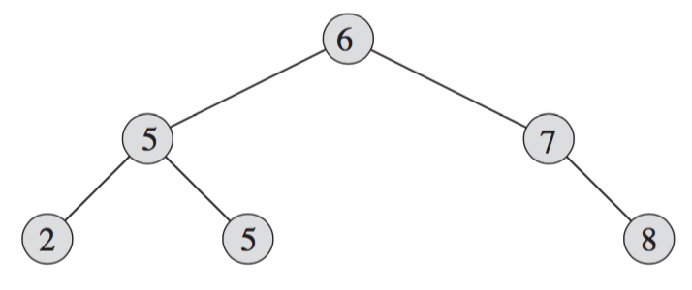
Binary Search Tree
Structure:
Key (data)
Parent
Left Child
Right Child
Operations: search, insertion, deletion

Slide 5
Properties
Keys (if any) in the left subtree are smaller than or equal to the key in the root.
Keys (if any) in the right subtree are larger than or equal to the key in the root.
Left and right subtrees are also binary search trees.

Slide 6
Properties (cont.)
Root of a binary tree is on level 1.
The maximum number of nodes on level h of a binary tree is 2^{h-1}.
The maximum number of nodes in a binary tree of height h is 2^{h} − 1 for h ≥ 1
h=1
h=2
h=3

Slide 7
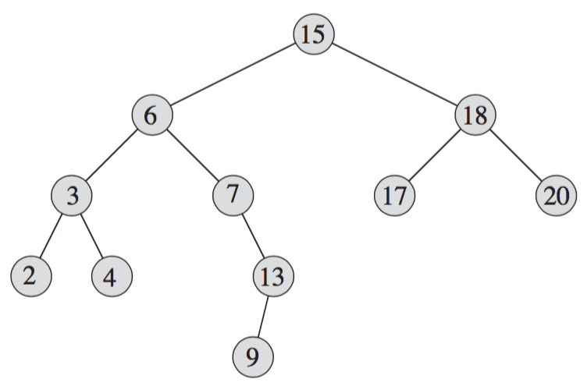
In-Order-Tree Walk
Visit all keys of a binary search tree in a non-decreasing order in a recursive way
Procedure In-Order-Tree(x): (O(n))
if x ≠ NIL // Tree is non-empty
In-Order-Tree(x.left)
Print x.key
In-Order-Tree(x.right)

Slide 8
Tree Search
Tree-Search(x, k): O(log(n)) //n is total number of nodes in tree
if x == NIL or k == x.key
return x
if k < x.key //search in left subtree
return Tree-Search (x.left, k)
else //search in right subtree
return Tree-Search (x.right, k)

Slide 9
Maximum & Minimum
Tree-Minimum(x): O(log(n))
while x.left ≠ NIL
x = x.left
//mininum is the most left child
return x
Tree-Maximum(x): O(log(n))
while x.right ≠ NIL
x = x.right
//maximum is the most right child
return x

Slide 10
Successor & Predecessor
Successor of node x: the node with the smallest key greater than x
Tree-Successor (x)
if x.right ≠ NIL
//successor is on its right subtree
return Tree-Minimum(x.right)
y = x.p
//no right subtree,
successor is its oldest parent
while y ≠ NIL and x == y. right
x = y
y = y.p
return y

Slide 11
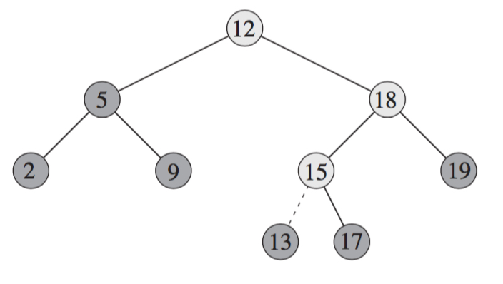
Insertion
Tree-Insert(T, z)
y = NIL and x = T.root
while x ≠ NIL
y = x
//y points to currently visiting key
if z.key < x.key
x = x.left
else x = x.right
z.p = y
if y == NIL
T.root = z //tree is empty
elseif z.key < y.key //tree has one node
y.left = z
else y.right = z

Slide 12
Deletion
z has only one child: put its only child in its position
7
7
5
8
5
9
3
6
9
3
6
2
4
6
2
4
6

Slide 13
Deletion (cont.)
z has two children: put its successor in its position
7
7
7
5
8
5
8
5
8
2
6
9
3
6
9
3
6
9
1
3
6
1
6
1
4
6
4
4
7
7
7
5
8
5
8
5
8
2
6
9
3
6
9
3
6
9
1
4
6
1
4
6
1
4
6
3
4
4
4

Slide 14
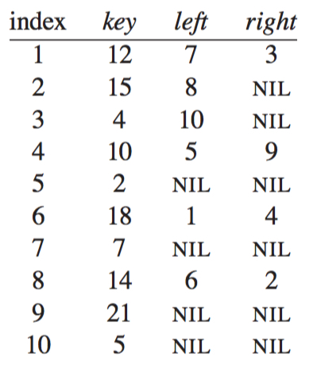
Exercise 1
Draw the binary tree rooted at index 6 that is represented by the following attributes:

Slide 15
Exercise 2
For the set of {1; 4; 5; 10; 16; 17; 21} of keys, draw binary search trees of heights 3, 4, 5, and 6.

