Slide 1
Heapsort
Instructor: Dr. Wei (Lisa) Li
Department of Computer Science, GSU

Slide 2
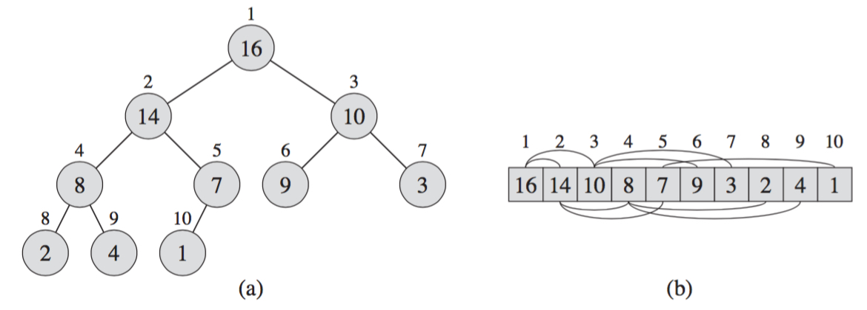
Max Heap
Binary Tree Structure:
Parent(i): i/2 if i is even; (i-1)/2, otherwise
Children(i): left child 2i and right child 2i+1
Child ≤ Parent
0 <= size of heap <= length of list

Slide 3
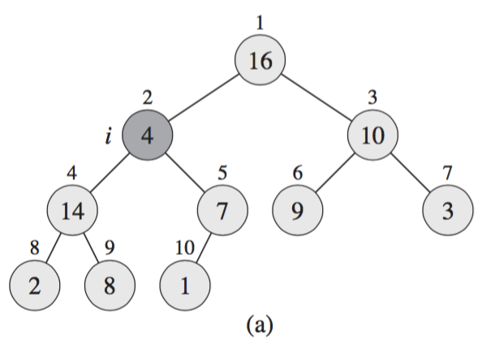
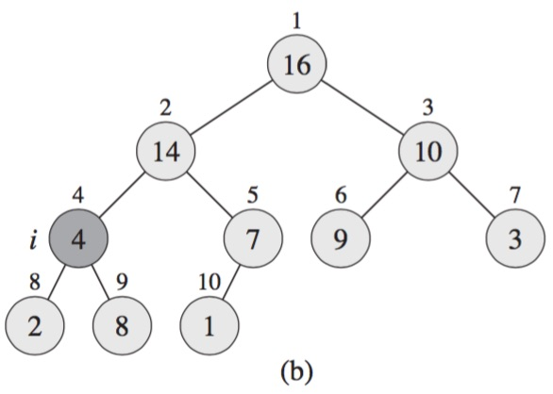
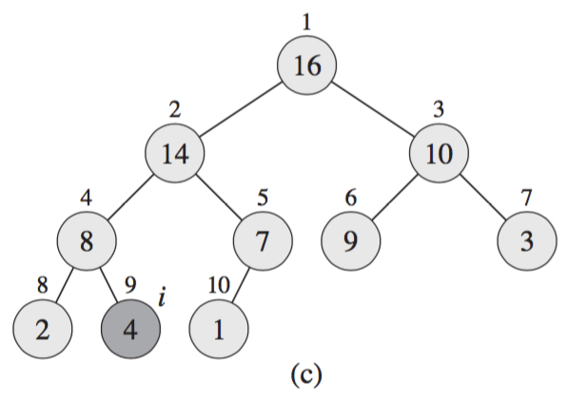
Max-Heapify (A, i)
Float down the violating value with index i in max heap:

Slide 4
Max-Heapify (A, i)
Max-Heapify (A, i)
l = left (i)
r = right (i)
if l ≤ A.heapsize and A[l] ≥ A[i]
largest = l
else largest = i
if r ≤ A.heapsize and A[r] ≥ A[largest]
largest = r
if largest ≠ i
exchange A[i] with A[largest]
Max-Heapify (A, largest)
Running Time: O(h)=O(log n)
(h: height of heap; n: number of nodes)

Slide 5
Insert(A, i)
Add a new node at the end of tree and then heapify it from bottom to top: O(h)=O(log n)
16
16
16
14
10
14
10
15
10
8
7
9
3
8
15
9
3
8
14
9
3
2
4
1
15
2
4
1
7
2
4
1
7

Slide 6
Extract-Max(A)
Return head, replace head key with the last, and call
Max-Heapify
16
1
15
10
15
10
8
14
9
3
8
14
9
3
2
4
1
2
4
15
15
1
10
14
10
8
14
9
3
8
1
9
3
2
4
2
4

Slide 7
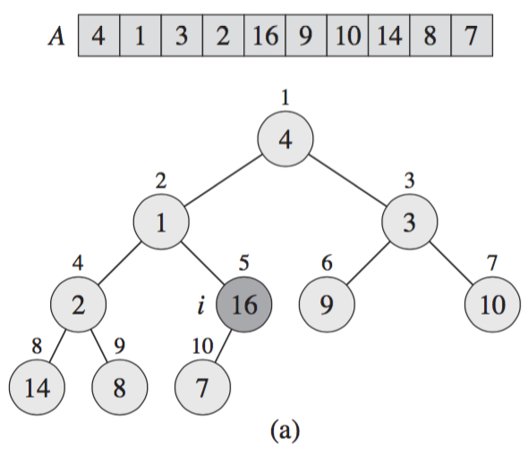
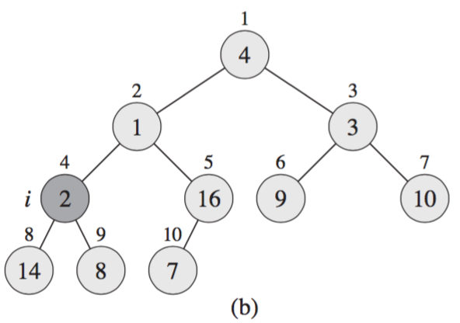
Build Heap
Call Max-Heapify(A, i) in a bottom-up manner (from i = length/2 down to 1) to convert array A[1, 2, …, length] to a max-heap A: O(n logn)

Slide 8
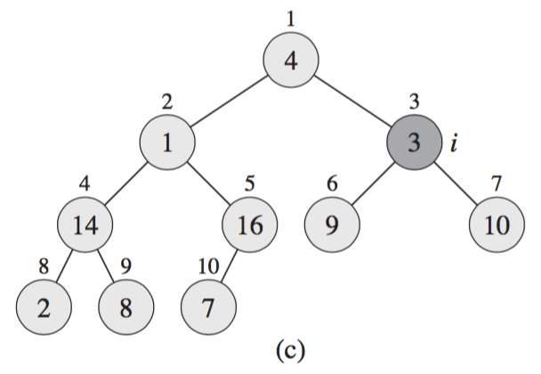
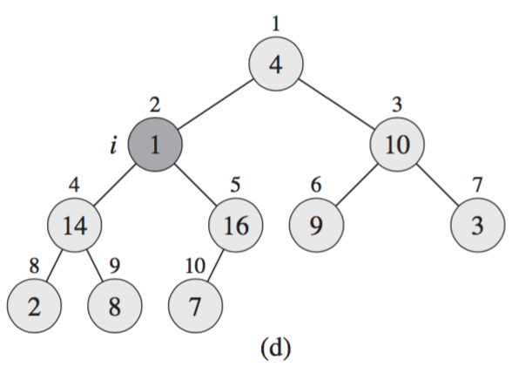
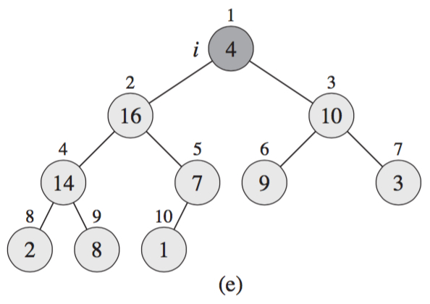
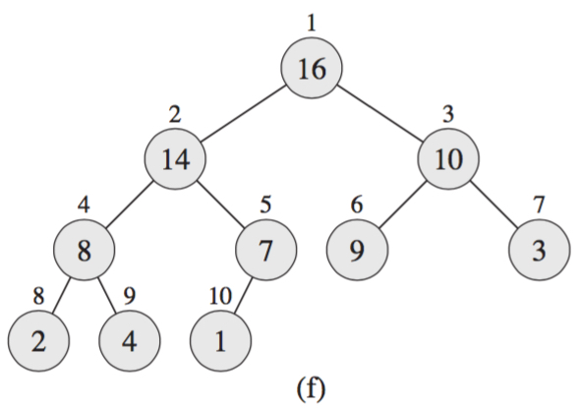
Build Heap (cont.)

Slide 9
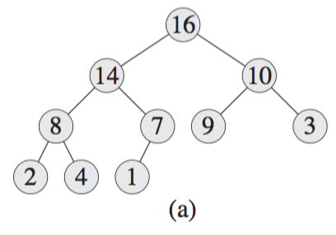

Example: Heapsort
Build a max heap

Slide 10
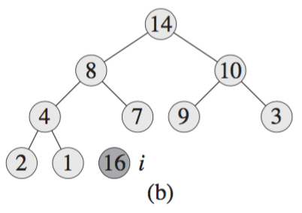
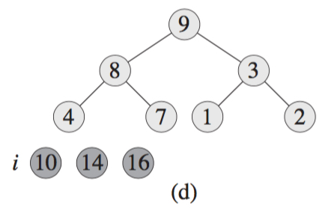
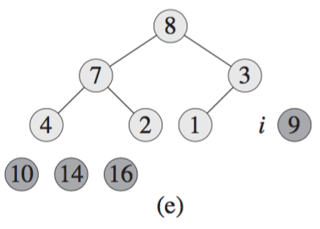
Example: Heapsort (cont.)
Iteratively calls Max-Heapify(A, i): extract the maximum number at each round

Slide 11
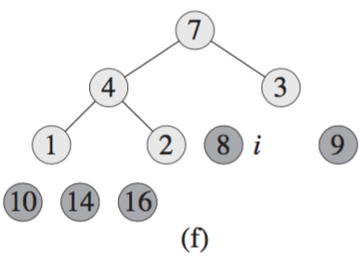
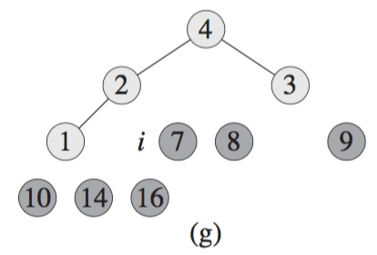
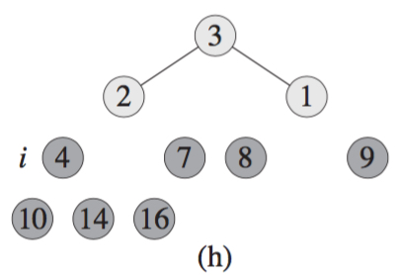
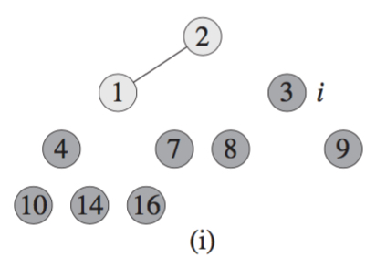
Example: Heapsort (cont.)

Slide 12
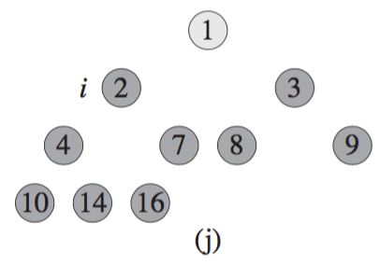

Example: Heapsort (cont.)

Slide 13
Heapsort(A)
Heapsort(A)
Build-Heap(A)
For (i = length ... 2) do
Exchange A[1] with A[i]
A.heapsize = A.heapsize-1
Max-Heapify(A, 1)
Time Complexity: O(n logn)
Build-Heap: O(n logn)
MaxHeapify: (n-1) x O(logn)

Slide 14
Exercise
Illustrate the operations of Heapsort(A) on the array A={5, 13, 2, 25, 7, 17, 20, 8, 4}

Slide 15
Assignments
Homework 1
Posted in iCollege
Submit via iCollege
Due by next Thursday, 09/07
Readings
Ch. 6 and Ch. 12 in Textbook

