Slide 1
Divide-and-Conquer
Instructor: Dr. Wei (Lisa) Li
Department of Computer Science, GSU

Slide 2
Divide-and-Conquer
Divide: partition the problem into sub-problems of the same type of the original problem
Conquer: find the solutions to sub-problems
Combine: merge the solutions of sub-problems into one for the original problem
A divide-and-conquer algorithm displays in a recursive form, and solves the problem in a bottom-up manner.

Slide 3
Merge Sort
Problem: sort a sequence number in a non-decreasing order
Input:
Output:
Key Idea:
Merge-Sort(A, p, r)
if p < r
q = floor[(p+r)/2] //divide into two small parts
Merge-Sort(A, p, q) //separately sort two small parts
Merge-Sort(A, q+1, r)
Merge(A, p, q, r) //combine two small parts

Slide 4
Merge Subsequences
Two Subsequences:
X[1, 2, …, m] and Y[1, 2, …, n]
Merge Procedure:
i =1, j = 1
for k = 1 to m+n do
if X[i] < Y[j]
Z[k] = X[i], i = i+1
else
Z[k] = Y[j], j = j+1
Time Complexity: O(m+n)

Slide 5
Example: Merge Subsequences
X={1, 4} and Y={2, 3, 6}
i
i
i
i
i
{1, 4}
{2, 3, 6}
{1, 4}
{2, 3, 6}
{1, 4}
{2, 3, 6}
{1, 4}
{2, 3, 6}
{1, 4}
{2, 3, 6}
j
j
j
j
j
Z={1}
Z={1, 2}
Z={1, 2, 3}
Z={1, 2, 3, 4}
Z={1, 2, 3, 4, 6}

Slide 6
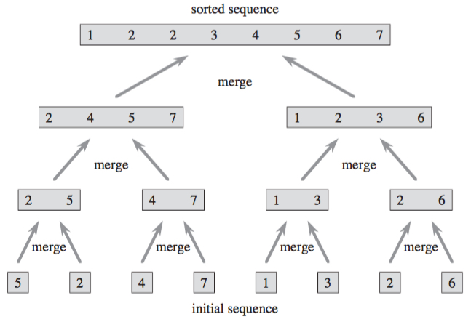
Example: Merge Sort
Divide
Process

Slide 7
Time Complexity of Merge Sort
Level 1: 1 x n
Level 2: 2 x n/2
Level 3: 4 x n/4
Level 4: 8 x n/8
Level k: 2^{k-1} subsequences with each containing n/2^{k-1} numbers;
“n” comparing operations
# of Division: log₂ n = log n
Total Time Complexity: O(n logn)

Slide 8
Recurrence
Divide-and-Conquer:
Divide the problem into sub-problems of the same type of the original problem
Find the solutions to sub-problems
Merge the solutions of sub-problems into one for the original problem
Time complexity of Divide-and-Conquer algorithms can be estimated via their recurrences.

Slide 9
Recursion Tree
Each node represents cost of a single sub-problem.
Structure of Recursion Tree
T(n) = aT(n/b) + f(n)
a: number of children
n/b: size of each child
Height of tree: log_{b}(n)
f(n): computational costs
Estimate time complexity through recursion tree
T(n) = sum of costs at each level in recursion tree

Slide 10
Example: Recursion Tree of Merge Sort
T(n) = 2T(n/2) + n

Slide 11
Example: Recursion Tree of Merge Sort
Computational Cost at Each Level
1 x n
2 x (n/2)
4 x (n/4)
8 x (n/8)

Slide 12
Example: Recursion Tree of Merge Sort
# of levels:
log₂(n) = log (n)
Total
n log(n)
Cost of each level: n

Slide 13
Substitution
Identify the recursive form of the solution
Solve the recursive form via substitution
Common Pattern:
T(n)=aT(n/b)+f(n)
a: number of sub-problems
n/b: size of each sub-problem
f(n): computational costs

Slide 14
Example: Substitution for Merge Sort
Recursive Form: T(n) = 2T(n/2) + n
Induction Process (assume n=2^{k} → k=log₂n ):
T(n) = 2T(n/2) + n
= 2[ 2T(n/2²) + n/2 ] + n = 2²T(n/2²) + 2n
= 2² [ 2T(n/2³) + n/2²] + 2n = 2³T(n/2³) + 3n
=…
= 2^{k}T(n/2^{k}) + k x n
= n T(1) + log₂n x n
= n + log₂n x n
T(n) = O(n log (n))

Slide 15

Exercise
Show that the solution of T(n) is O(n)
(assume n=2^{k} → k=log₂n )

Slide 16
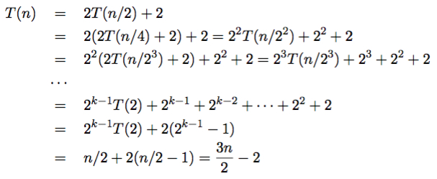
Answer
Recursive Formula:
T(n) = O(n)

