Slide 1
Greedy Algorithm_2
Instructor: Dr. Wei (Lisa) Li
Department of Computer Science, GSU

Slide 2

Binary Code
Binary-code representation in computer
How many bits are needed to represent a file?
Which coding method is better?

Slide 3
How many bits?
For each character c:
Necessary bit = Frequency of c x Length of c
For all characters in a file:
Bit of a file = Sum of bits of all characters

Slide 4
Comparison of Binary Code
Binary-code representation in computer
100 characters
Fixed-length code: 100 x 3 = 300 bits
Variable-length code: (45x1 + 13x3 + 12x3 + 16x3 + 9x4 + 5x4) = 224 bits

Slide 5
Decoding
Identify initial codeword
Translate it back to original character
Repeat decoding process on remainder of encoded file
Fixed-length codeword: what is the original message of binary string “101000010100”?
Variable-length codeword: what is the original message of binary string “110001001101”?

Slide 6
Prefix Codes
NO codeword is a prefix of any other
Easily identify initial codeword
Simplifies decoding process
For example:
{010, 011}: prefix property ✓
{010, 01, 0}: prefix property ✗ What is meaning of 010?

Slide 7
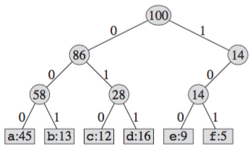
Tree Representation
Left child: 0; Right child 1
Encoded string = “number string along path from root to leaf”
Fixed-length Code:

Slide 8
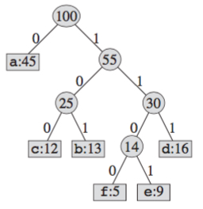
Tree Representation (cont.)
Variable-length Code:

Slide 9
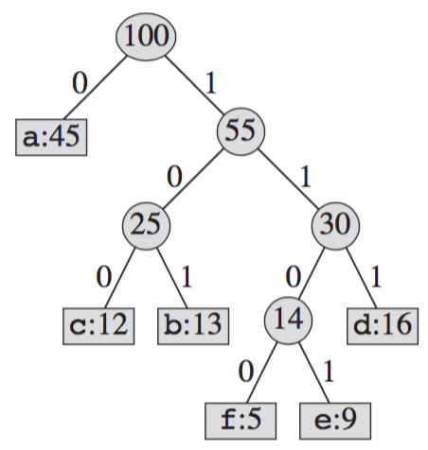

Huffman Codes
A greedy algorithm for optimal code (i.e., build a full binary tree).
It builds tree T corresponding to the optimal code in a bottom-up manner.
It begins with a set of n leaves and performs a sequence of n-1 “merging” operations to create the final tree.

Slide 10
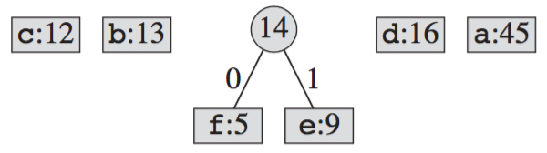
Huffman Tree Construction
At each round, merge two least-frequent nodes
A new node who is the parent of the two merged nodes is generated
Frequency of the new node is the sum of the frequencies of the two nodes that were merged.

Slide 11
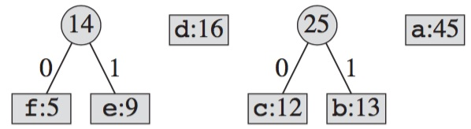
Huffman Tree Construction

Slide 12
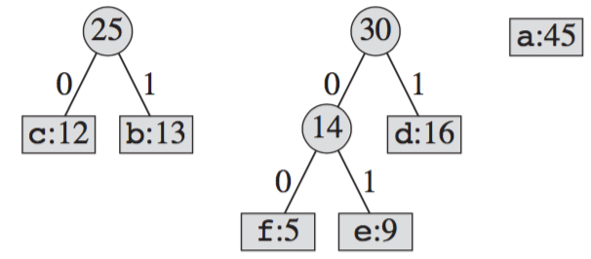
Huffman Tree Construction

Slide 13
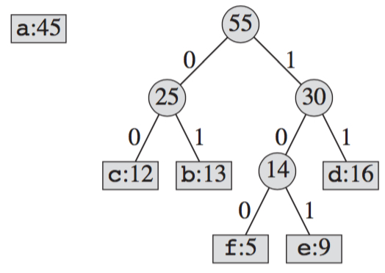
Huffman Tree Construction

Slide 14
Huffman Tree Construction

Slide 15
Exercise
What is an optimal Huffman code for the following set of frequencies?
A:5; B:9; C:11; D:15; E:18; F:20; G:22.

Slide 16
Readings
Ch 16.1, 16.2 and 16.2 in textbook

