Slide 1
Midterm Review
Instructor: Dr. Wei (Lisa) Li
Department of Computer Science, GSU

Slide 2
Running Time Analysis
Ignore all the constants which are dependent on machine and programming languages.
Analyze limiting behavior of complexity when the input size increases, i.e., n → ∞
O(1) < O(log n) < O(n) < O(n log n) < O(n²) < O(n³) < O(2^{n})

Slide 3
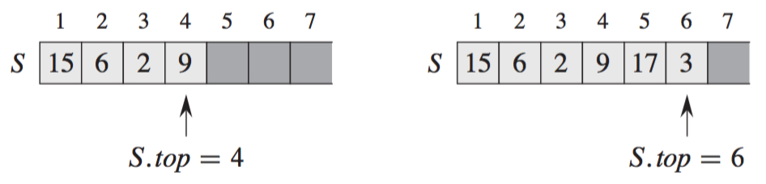
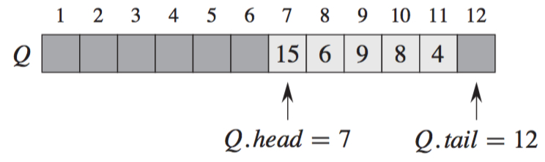
Data Structure
Stack: first in last out (FILO)
Queue: first in first out (FIFO)

Slide 4
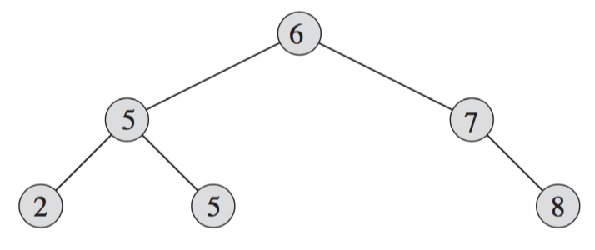
Binary Search Tree
Property:
Left Child ≤ Parent ≤ Right Child
Operations: search, insertion, deletion

Slide 5
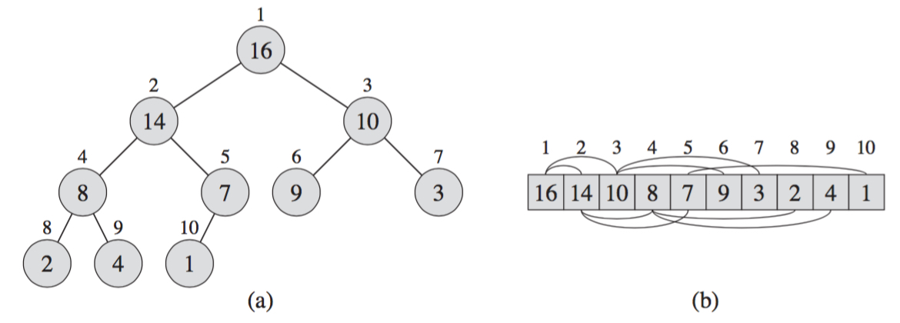
Max Heap
Binary Tree Structure:
Parent(i): i/2 if i is even; (i-1)/2, otherwise
Children(i): left child 2i and right child 2i+1
Child ≤ Parent
Operations: Max-Heapify, Insertion, Deletion, Build-Heap

Slide 6
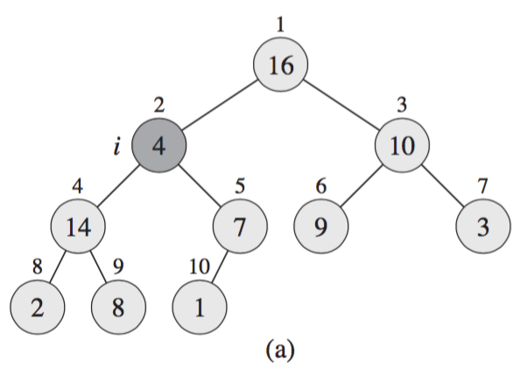
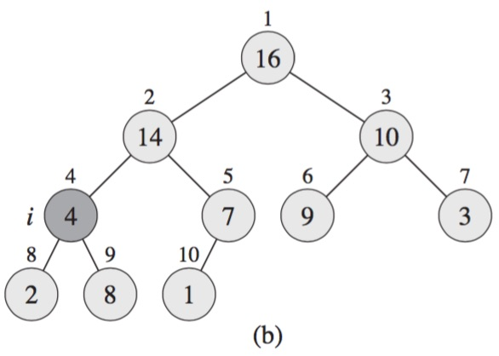
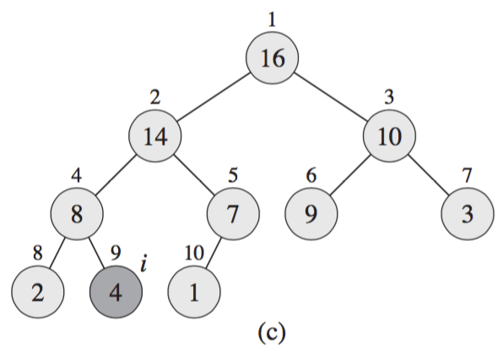
Max-Heapify (A, i)
Float down the violating value in max heap: O(h)=O(log n)

Slide 7
Divide-and-Conquer
Divide: partition the problem into sub-problems of the same type of the original problem
Conquer: find the solutions to sub-problems
Combine: merge the solutions of sub-problems into one for the original problem
A divide-and-conquer algorithm displays in a recursive form, and solves the problem in a bottom-up manner.

Slide 8
Merge Sort
Problem: sort a sequence number in a non-decreasing order
Input:
Output:
Key Idea:
Merge-Sort(A, p, r)
if p < r
q = floor[(p+r)/2] //divide into two small parts
Merge-Sort(A, p, q) //separately sort two small parts
Merge-Sort(A, q+1, r)
Merge(A, p, q, r) //combine two small parts

Slide 9
Quicksort
Key Idea:
Given a list A, partition A into two parts A1 and A2, where all the elements ∈ A1 ≤ those ∈ A2, and then recursively sort each part. Quicksort(A, 1, n) is called to sort n elements.
Quicksort(A, p, r):
if p < r
Then q = Partition(A, p, r) //divide list A
Quicksort(A, p, q-1) //conquer left part
Quicksort(A, q+1, r) //conquer right part

Slide 10
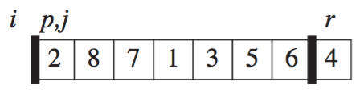
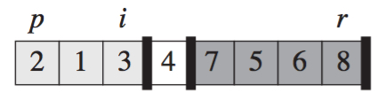
Partition (A, p, r)
Partition A from A[p] to A[r] with pivot A[r]
Result:
If p ≤ k ≤ i, A[k] ≤ pivot A[r] // i indicates boundary of two parts
If i + 1 ≤ k ≤ j – 1, A[k] > pivot A[r]
x = A[r]
i = p - 1
for j = p to r – 1 // j is used to scan list
if A[j] ≤ x
i = i +1
exchange A[i] with A[j] //move smaller number forward
exchange A[i+1] with A[r] // put pivot A[r] in middle after partition
return (i+1)

Slide 11
Bubble Sort
Key Idea: compares each pair of adjacent items and swap them if they are in the wrong order.
Bubble Sort(A):
n = length(A)
repeat
swapped = false
for i = 1 to n-1
if A[i-1] > A[i]
swap A[i-1] and A[i]
// float down larger number
swapped = true
until not swapped //stop loop when swapped is false
8
5
5
8
2
2
7
7

Slide 12
Greedy Algorithm
Problem Statement
Identify the objective (e.g., maximize or minimize)
Find out the constraints of the problem
Major Steps
Select a best choice from the set of available choices
Check whether the selected choice satisfies constraints
Iteratively repeat Steps 1 and 2 until no choice can be selected

Slide 13
Fractional Knapsack Problem
Given:
a list of n items with profit function P=(p₁, p₂, …, p_{n}) and weight function W=(w₁, w₂, …, w_{n}), and a knapsack with capacity C
Solution:
Compute unit profit (profit-weight ratio) p_{i}/w_{i} for each item.
Start with the largest unit profit until the knapsack is full.
50
30
10
20
1st item:
$50
2nd item:
$80
3rd item:
$180
Knapsack

Slide 14
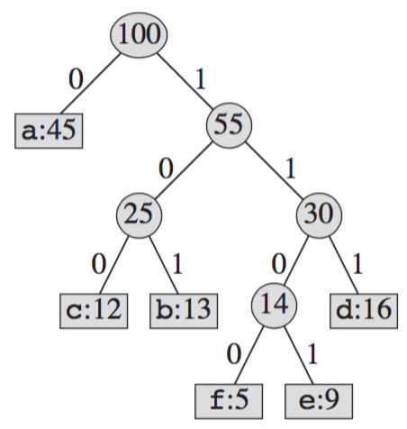

Huffman Codes
At each round, merge two least-frequent nodes
A new node who is the parent of the two merged nodes is generated
Frequency of the new node is the sum of the frequencies of the two nodes that were merged.

Slide 15

Mid-Term Exam
Exam Schedule:
Time: 2:50pm – 4:35pm, Tuesday, 10/03/2017
Location: classroom
Exam Policies:
Calculator and paper materials (e.g., lecture slides, notes, textbook) are allowed
Any electronic device is prohibited

