Slide 1
Restaurant Menu Expert
Team Members
Tirth Pandit - 2019201017
Jay Krishna - 2019201019
Smit Khanapara - 2019201021
Pratik Tiwari - 2019201023
Dharmesh Gusai - 2010201025

Slide 2
Introduction
Many Times manu contains the dishes which person can't identify form the name
In this cases visualization of food dish comes quite handy to decide the preferable dish.
Our Main Target is to tackle the problem of identifying dish names in menus and provide useful images and text according to it, such as an example picture of the dish or the translated dish name.

Slide 3
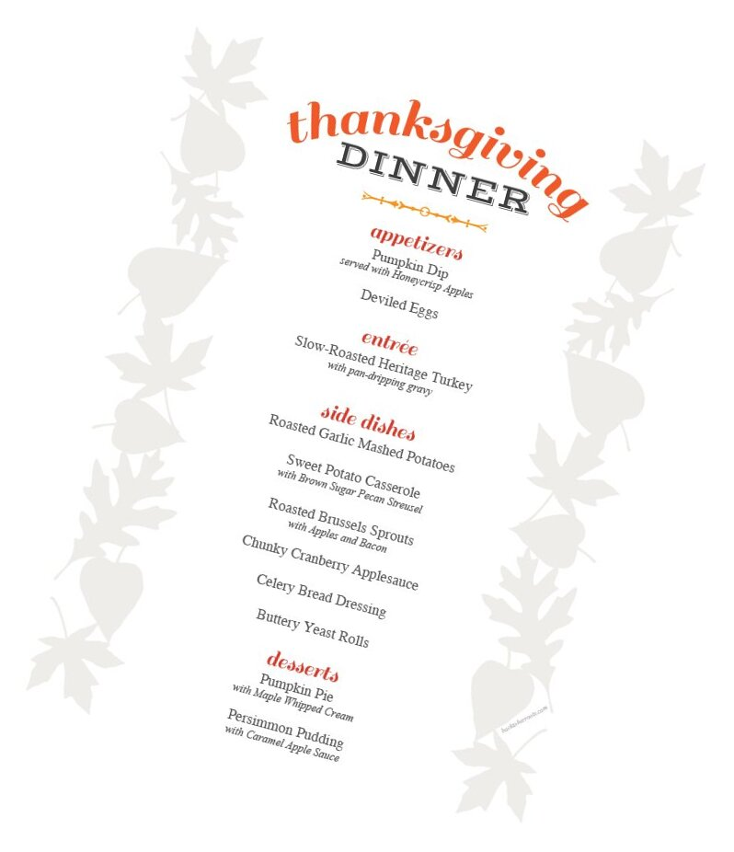
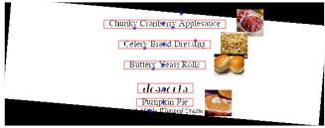
Example

Slide 4
Image Processing Pipeline
Capture Region of interest
Apply Denoising Filters and Thresholding to binarize the image
Apply morphological operations Like Dilation to make Connected components within word.
Apply Featureless Rotation
OCR Algorithm To recognize the words
Implement commonly used natural language processing techniques, such as shortest Levenshtein distance, to resolve mismatched characters within a word.
Identify the image for the dish from the local database
Display the image on the menu

Slide 5
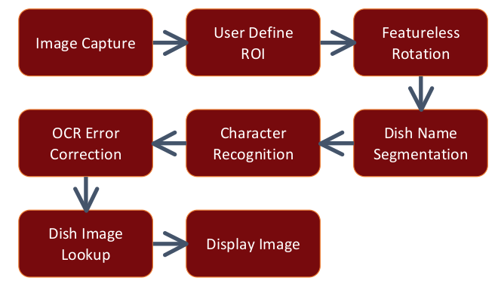

Slide 6
Image Capture
user takes a photo of the menu with a camera.
After user captures the image, we provided an interface
We assume user takes photo such that other variables that may result from the environment such as motion blur and out out-of-focus image don't effects the input image.
ROI Selection
We provides the interface through which user can select the region of interest
Then only that part of manu is cropped of from image and given to the pipeline

Slide 7
Featureless Rotation
It automatically finds out the rotation angle based on the inherent structure of
menu where most texts are horizontally aligned
First global otsu thresholding and then dilation which creates connected components and then we can create bounding boxes around them
With these bounding boxes of the connected components, we calculate the mean aspect ratios between the width and the height of the bounding boxes at every 10° from -90° to 90°
with subsequent refinement of every 1° to pinpoint the angle of rotation. From these set of rotations, we automatically find the largest mean aspect ratios, as that suggests that most bounding boxes are horizontal at that particular angle
Dish Name Segmentation
Dilation Will Create Connected components and each bounding box represents word in dish
So , all the boxes in the same line will create full dish name and we combine these small word segments and then give it to OCR Algorithm

Slide 8
Optical Character Recognition
MATLAB implementation of Tesseract algorithm, an open source OCR engine initially developed at HP Labs and currently managed by Google.
Libraries Available for python “Pytesseract”
https://pypi.org/project/pytesseract/
OCR Error Correction
OCR May generate Spelling Errors
Algorithm of finding minimum edit distance given acceptable number of character mismatch, our system is able to correct the results from the OCR engine, which increases the overall success rate of image lookup.
Such as shortest Levenshtein distance, to resolve mismatched characters within a word

Slide 9
Database Lookup and Final Image generation
With corrected word ,we lookup in out local database havin information about the dishname and its image
We fetch the image if correct dish name found
We resize dish image according to the bounding box and display it to the correct position of the dish name in the menu

Slide 10
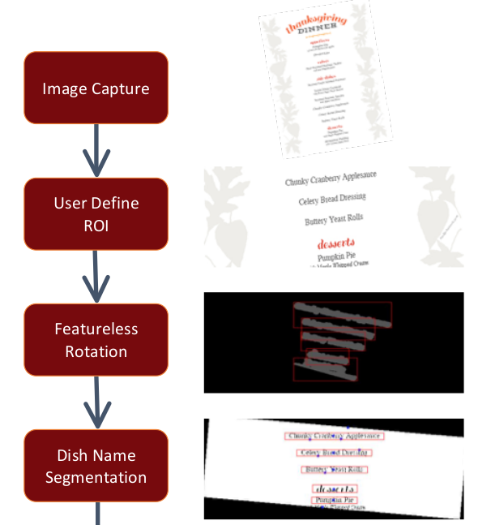
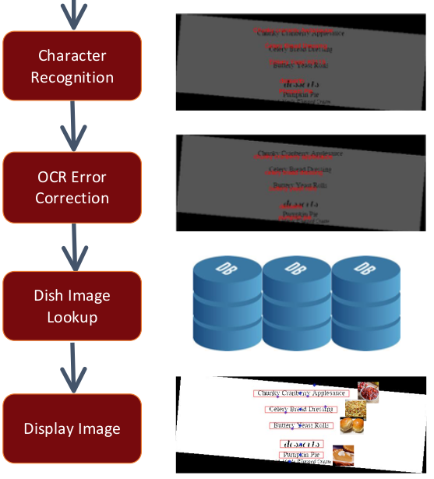
Expected Results

