Slide 1
Reproduction of Image-Inpainting model based on fractional-order non-linear diffusion
Praveen Raavi, 21007013
Jay Nidumolu, 21108165
Department of Electrical and Computer Engineering

Slide 2
Introduction
Importance:
Image Inpainting Tasks:
Restores missing or corrupted image regions.
Applications: Photo restoration, object removal, and image compression.
Traditional Techniques:
Exemplar-based: Synthesizes missing areas using similar patches.
Diffusion-based: Propagates information along intensity gradients.
Challenges:
Staircase effects in second-order diffusion.
Loss of edge connectivity and blurring.

Slide 3
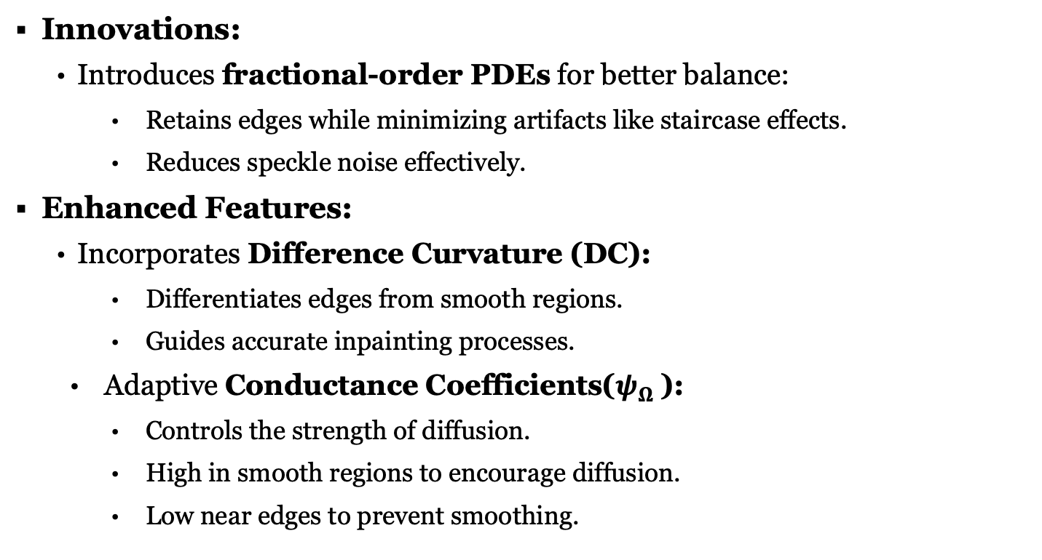
Why Fractional-Order Nonlinear Diffusion?
Innovations:
Introduces fractional-order PDEs for better balance:
Retains edges while minimizing artifacts like staircase effects.
Reduces speckle noise effectively.
Enhanced Features:
Incorporates Difference Curvature (DC):
Differentiates edges from smooth regions.
Guides accurate inpainting processes.
Adaptive Conductance Coefficients($ψ_{Ω}$):
Controls the strength of diffusion.
High in smooth regions to encourage diffusion.
Low near edges to prevent smoothing.

Slide 4
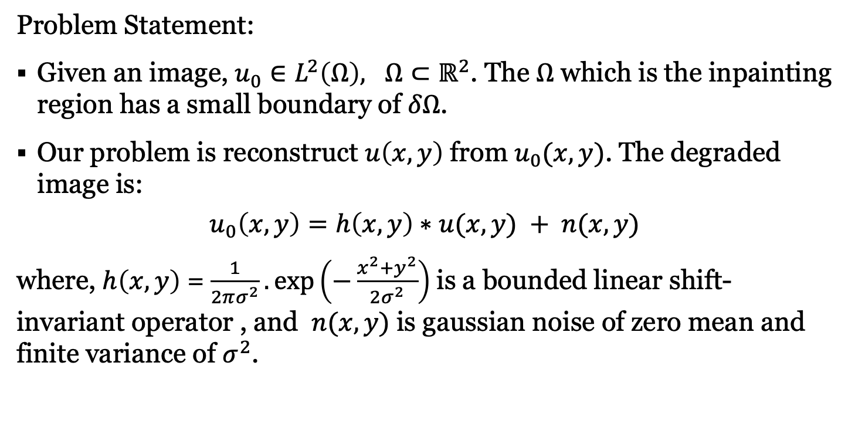
Original Paper: Proposed Methodology
Problem Statement:
Given an image, $u_{0}∈L^{2}\left(Ω\right), Ω⊂ℝ^{2}$. The $Ω$ which is the inpainting region has a small boundary of $δΩ$.
Our problem is reconstruct $u\left(x,y\right)$ from $u_{0}(x,y)$. The degraded image is:
$$u_{0}\left(x,y\right)=h\left(x,y\right)∗u(x,y) + n(x,y)$$
where, $h\left(x,y\right)$ = $\frac{1}{2πσ^{2}}.\exp\left(−\frac{x^{2}+y^{2}}{2σ^{2}}\right)$is a bounded linear shift-invariant operator , and $n(x,y)$ is gaussian noise of zero mean and finite variance of $σ^{2}$.

Slide 5
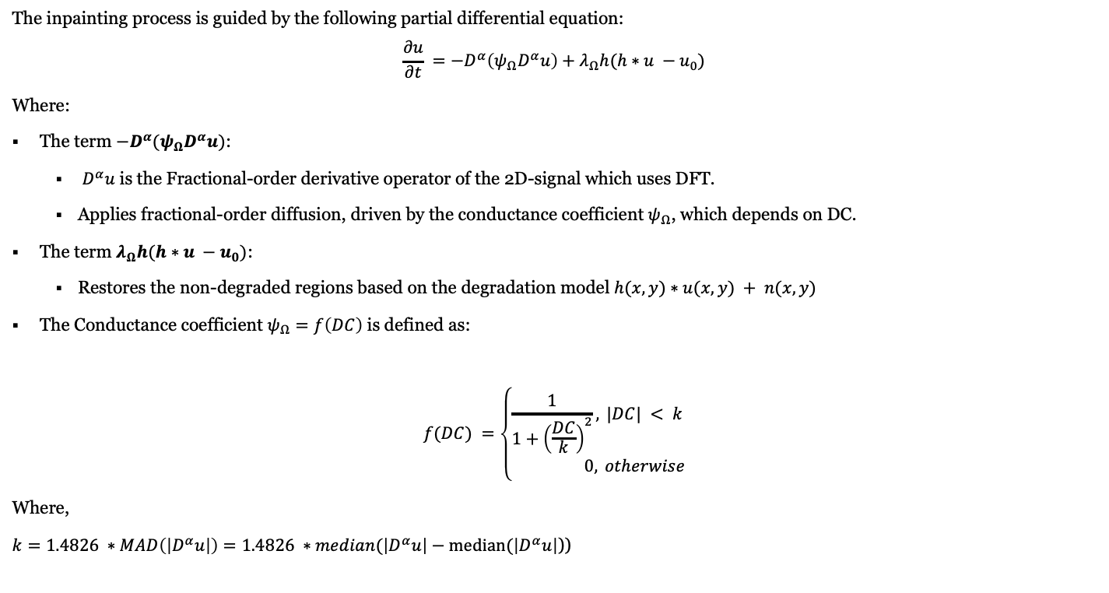
Original Paper: Proposed Methodology
The inpainting process is guided by the following partial differential equation:
$$\frac{∂u}{∂t} =−D^{α}\left(ψ_{Ω}D^{α}u\right)+λ_{Ω}h(h∗u −u_{0})$$
Where:
The term $−D^{α}(ψ_{Ω}D^{α}u)$:
$D^{α}u$ is the Fractional-order derivative operator of the 2D-signal which uses DFT.
Applies fractional-order diffusion, driven by the conductance coefficient $ψ_{Ω}$, which depends on DC.
The term $λ_{Ω}h(h∗u −u_{0})$:
Restores the non-degraded regions based on the degradation model $h(x,y)∗u(x,y) + n(x,y)$
The Conductance coefficient $ψ_{Ω}=f\left(DC\right)$ is defined as:
Where,
$k=1.4826 ∗MAD\left(\left|D^{α}u\right|\right)=1.4826 ∗median(\left|D^{α}u\right|−median(\left|D^{α}u\right|$))

Slide 6
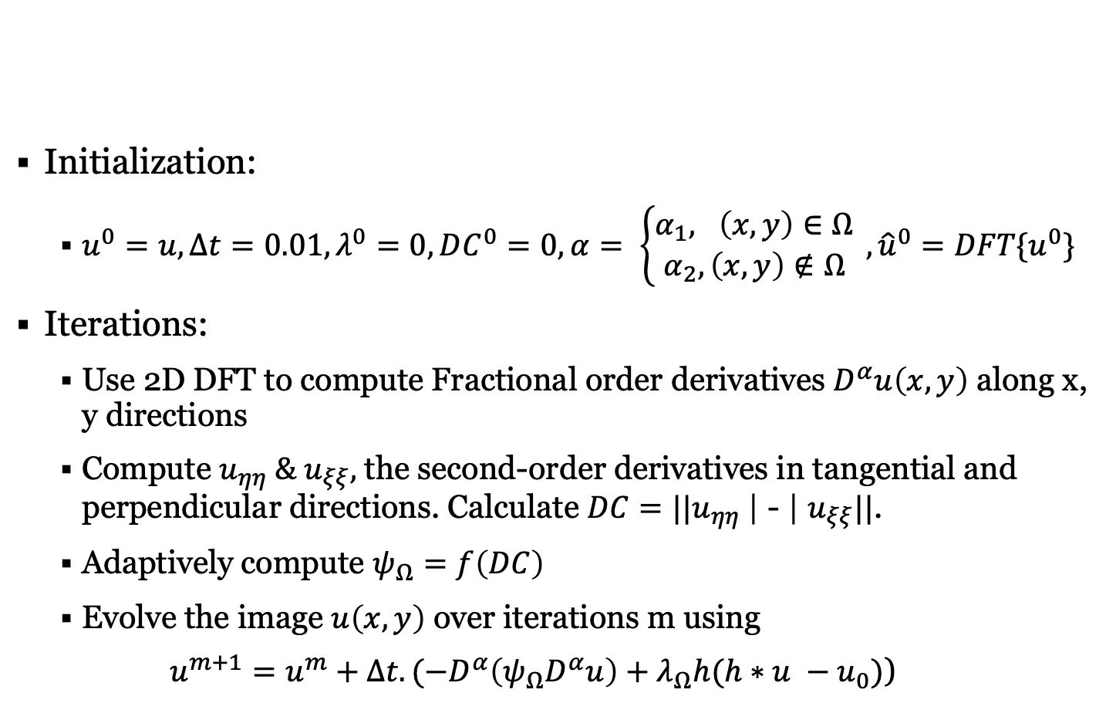
Algorithm WorkFlow:
Initialization:
$u^{0}=u, Δt=0.01, λ^{0}=0, DC^{0}=0, α= \left\{\begin{aligned}α_{1}, \left(x,y\right)∈Ω \\ α_{2}, \left(x,y\right)∉Ω\end{aligned}\right. , {\hat{u}}^{0}=DFT\{u^{0}\}$
Iterations:
Use 2D DFT to compute Fractional order derivatives $D^{α}u\left(x,y\right)$ along x, y directions
Compute $u_{ηη} \& u_{ξξ},$ the second-order derivatives in tangential and perpendicular directions. Calculate $DC=||u_{ηη} \text{| − |} u_{ξξ}\text{||}$.
Adaptively compute $ψ_{Ω}=f\left(DC\right)$
Evolve the image $u\left(x,y\right)$ over iterations m using
$u^{m+1}=u^{m}+Δt.({−D}^{α}\left(ψ_{Ω}D^{α}u\right)+λ_{Ω}h(h∗u −u_{0})$)

Slide 7
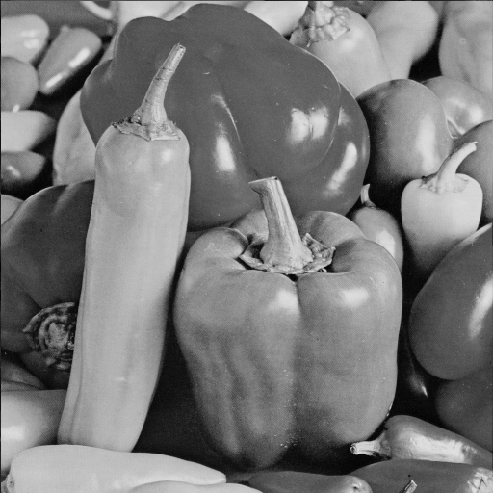
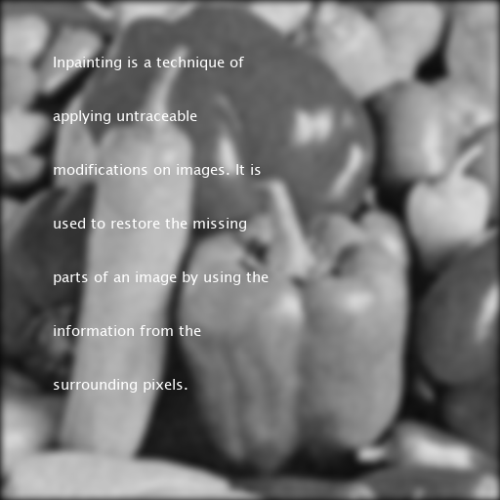
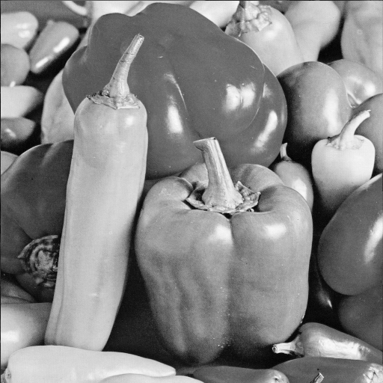


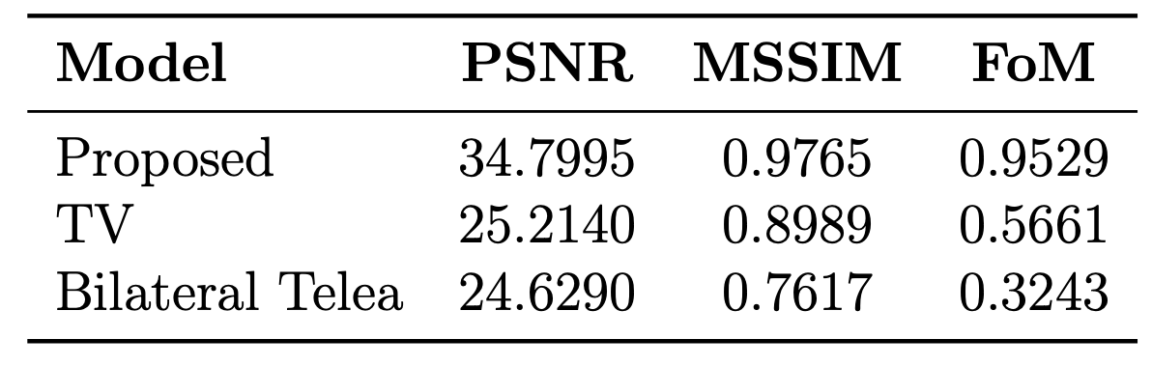
Results
Original Image Degraded Image Proposed Model Output TV output Bilateral Output

Slide 8
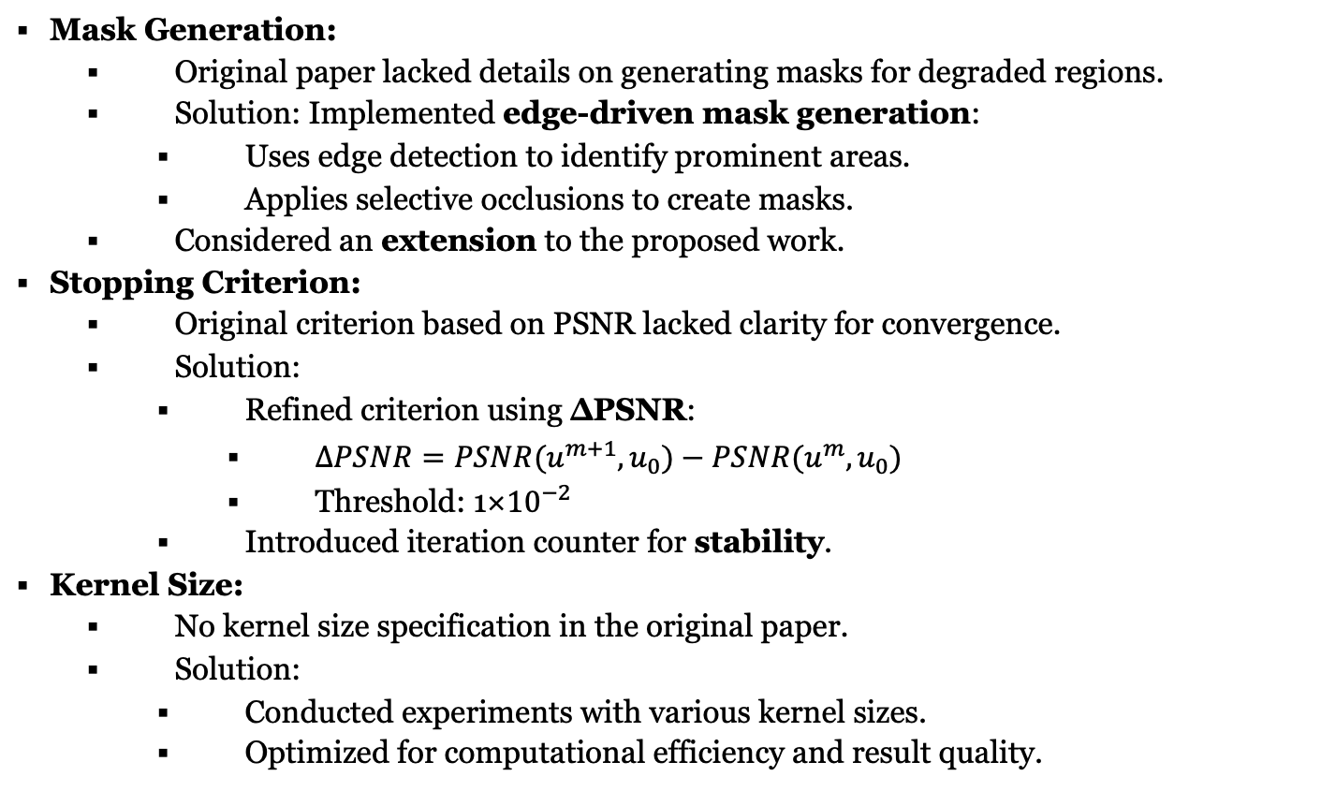
Challenges
Mask Generation:
Original paper lacked details on generating masks for degraded regions.
Solution: Implemented edge-driven mask generation:
Uses edge detection to identify prominent areas.
Applies selective occlusions to create masks.
Considered an extension to the proposed work.
Stopping Criterion:
Original criterion based on PSNR lacked clarity for convergence.
Solution:
Refined criterion using ∆PSNR:
$ΔPSNR=PSNR(u^{m+1},u_{0})−PSNR(u^{m},u_{0})$
Threshold: 1×${10}^{−2}$
Introduced iteration counter for stability.
Kernel Size:
No kernel size specification in the original paper.
Solution:
Conducted experiments with various kernel sizes.
Optimized for computational efficiency and result quality.

Slide 9
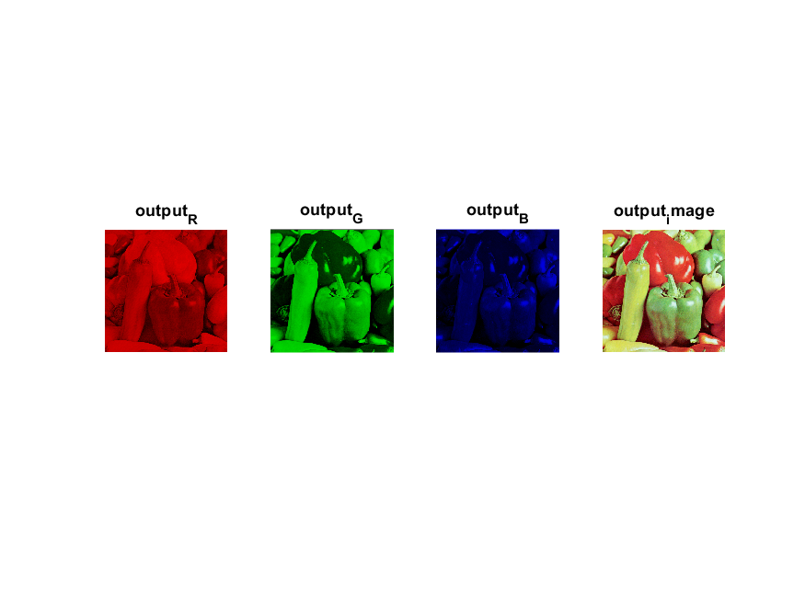
Extension Work
Handling RGB Images:
Channel Separation Approach :
Method:
Split RGB images into individual grayscale channels (Red, Green, Blue).
Apply the inpainting algorithm independently to each channel, then recombine them.
Advantages:
Simple to implement, leveraging the original 2D inpainting method.
Computational complexity remains similar to the original model.
Disadvantages:
Potential color artifacts due to inconsistencies between channels.
Does not fully exploit the interdependencies of RGB channels.

Slide 10
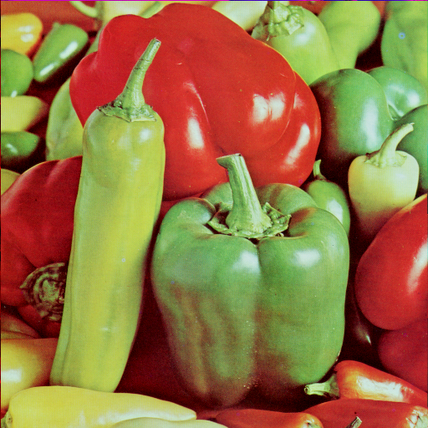
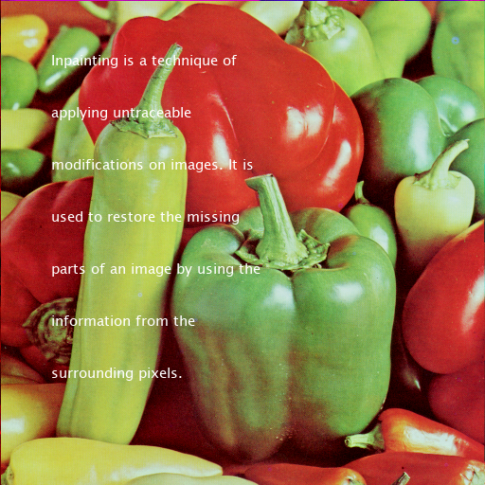

Extension Work
Handling RGB Images:
Direct 3D Approach:
Method:
Treat the RGB image as a 3D signal by adding a third dimension for color channels.
Modify conductance functions and equations to account for interactions between channels.
Advantages:
Maintains color coherence and structural integrity across RGB channels.
Better visual quality, especially for complex color details.
Disadvantages:
Higher computational complexity.
Requires significant modifications to the original algorithm.
Original Image Degraded Image. Restored Image

Slide 11
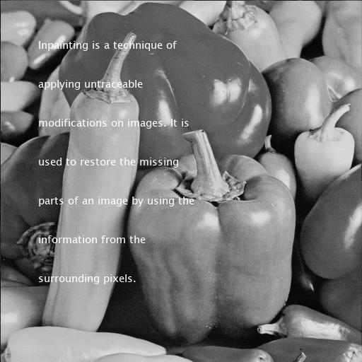
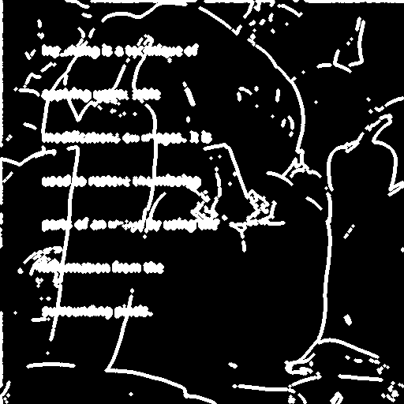
Extension Work
Edge Driven Mask Generation:
Motivation
Challenge: Masks are often unavailable in real-world scenarios.
Solution: Developed an automatic mask generation approach based on edge detection to identify inpainting regions.
Methodology:
Preprocessing: Convert to grayscale for consistent edge detection.
Edge Detection: Use Sobel operator to find intensity changes.
Morphological Dilation: Expand edges with a disk-shaped structuring element.
Mask Creation: Generate a binary mask for inpainting regions.
Visualization: Save and visualize the mask.
Degraded Image Generated Mask

Slide 12
Conclusion
Reproduced and extended the fractional-order nonlinear diffusion-based inpainting model.
Key Contributions:
Extended model to handle RGB images using channel separation and 3D signal processing.
Developed edge-driven mask generation for automatic identification of degraded regions.
Performance Highlights:
Achieved superior PSNR, MSSIM, and FoM compared to traditional methods (TV model, Bilateral Telea).
Demonstrated robust handling of noisy and degraded images with structural and color coherence.
Future Directions:
Optimize computational efficiency and explore adaptive parameter tuning.
Extend applications to hyperspectral/satellite images and integrate machine learning for enhanced adaptability.

