Slide 1
Total bias uncertainty
Calculated response uncertainty
Measured response uncertainty
Input parameter
uncertainty
Solution
uncertainty
③
Common parameter Uncertainty
Exclusive parameter Uncertainty
Modeling
uncertainty
Numerical/Precision
uncertainty
Monte-Carlo
Uncertainty*
Benchmark
uncertainty
①
②
④
* zero for deterministic models

Slide 2
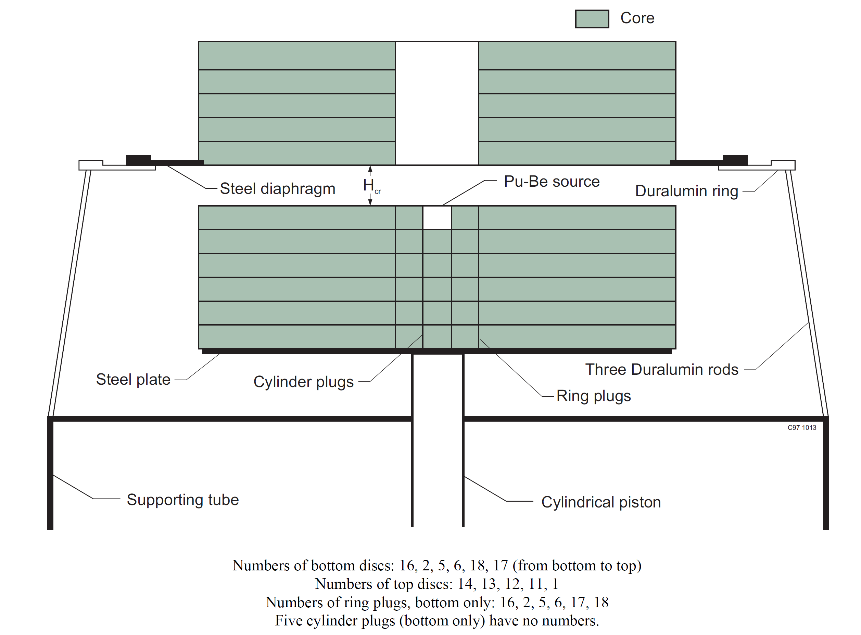
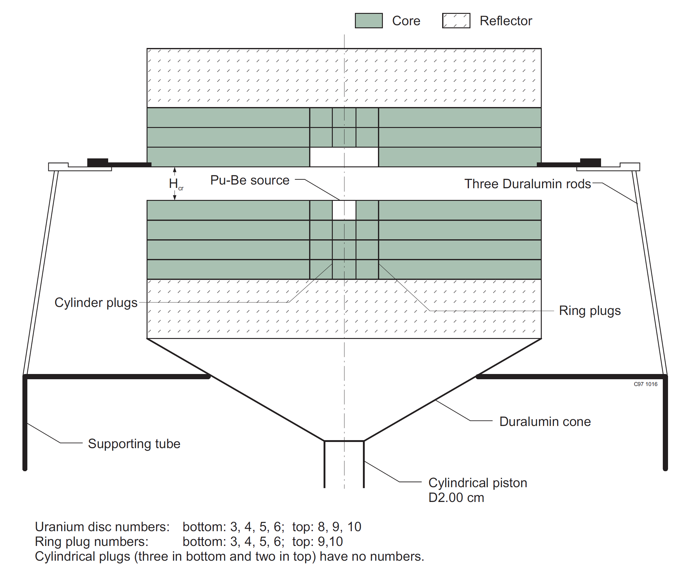
HMF-015 Critical Assembly Configuration
HMF-016 Critical Assembly Configuration

Slide 3


Application
Unexplained by experiments
$$φ_{ }$$
Explainable by experiments
Subspace of benchmark experiments
$$j_{k}=\cos{φ}$$

