Slide 1
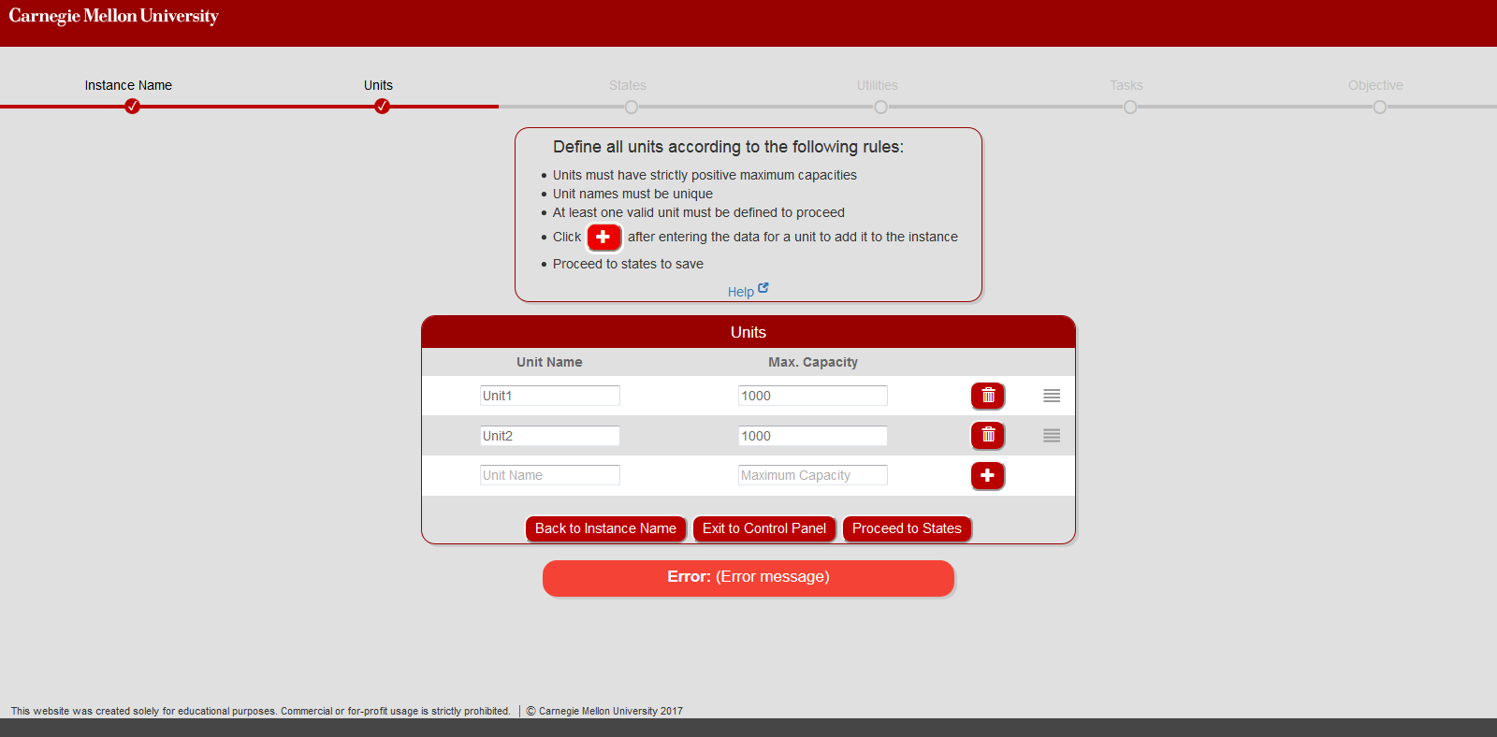
1
2
5
6
7
3
4

Slide 2
Client (browser) side
User facing
Create new blank JSON object
Edit “Name” field
Add nested JSON objects
Add Horizon or Orders to JSON
Add JSON string, event points, model to database
Server side
Add a New Instance
Define Instance name
Define parameters
Select and define objective
Select Model and event points
Submit for processing
View Results
Deserialize JSON, Generate C++ objects
Optimize model using CPLEX
Generate results and plots

Slide 3
Maximization of profit
Horizon + Prices
Complete
Units
States
Utilities
Tasks
Objective
Demands
Complete
Minimization of makespan

