Slide 1


GUJARAT TECHNOLOGICAL UNIVERSITY GOVERNMENT ENGINEERING COLLEGE BHAVNAGAR
Department Of Information Technology
A Presentation On
Phishing Attacks and Prevention Methods
Under subject of
Web Application Development
Problem-Based Learning (PBL)
B. E. III, Semester –V (Information Technology)
Submitted by:
SONI JAY ANANDKUMR
250213116014
Internal Guide
Prof. Bharat Vainsh
Academic year 2026-27

Slide 2
Problem-Based Learning (PBL)
PBL Category:Poster/Presentation
Name of Activity:Presentation on Cloud Deployment or Cyber Security
No.of Hours:06
Type: Presentation Skill

Slide 3
Certificate
This is to certify that the Problem-Based Learning (PBL) report
entitled " Phishing Attacks and Prevention Methods“ has been carried out by Mr./Ms. Soni Jay Anandkumar (Enrollment No. 250213116014 ), a student of B.E. Information Technology, Government Engineering College, Bhavnagar, during the Academic Year 2026–27, under the guidance of Prof.Bharat Vainsh.
The work presented in this report is original and has been completed as a part of the curriculum requirements for the Problem-Based Learning course.
Date of Submission:
Place: Government Engineering College, Bhavnagar
Internal Guide
Prof.Bharat Vainsh
Head Of Department
Prof.S.J.Molia

Slide 4
Index
Introduction
Objectives & Need
Core Concepts
Types / Models
Architecture & Working
Technologies & Tools
Applications
Advantages & Challenges
Case Studies & Latest Trends
Future Scope & Career Opportunities
Conclusion
References & Q&A

Slide 5
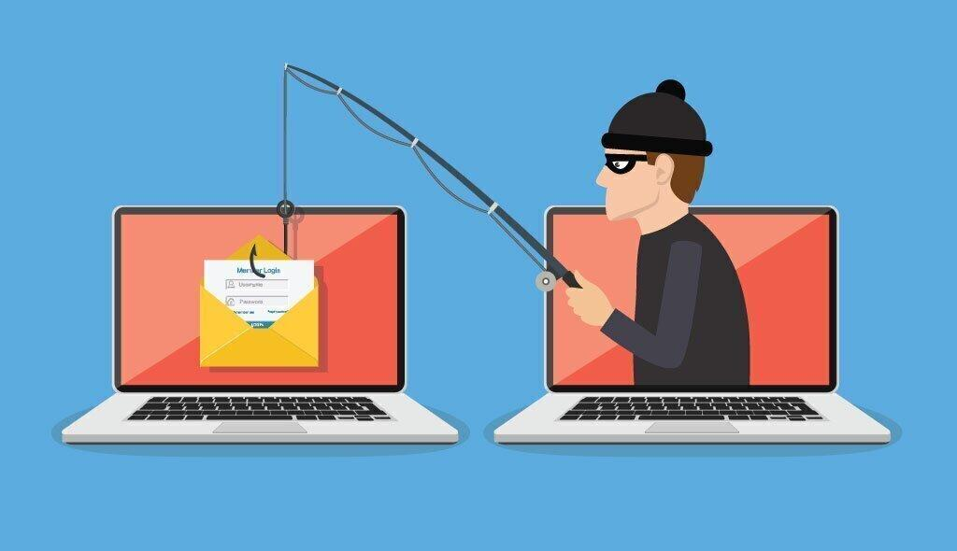
Introduction
Definition
Phishing is a cyber attack in which attackers impersonate trusted organizations or individuals to steal sensitive information such as passwords, OTPs, banking details, and personal data.
Background
Phishing is one of the most common cyber attacks and mainly targets email, SMS, and social media users.
Evolution
Email phishing
SMS phishing (Smishing)
Voice phishing (Vishing)
Spear phishing
AI-generated phishing
Importance
Protects personal information
Prevents financial fraud
Increases cyber awareness
Current Industry Scenario
Organizations worldwide face millions of phishing attacks every day, making phishing awareness essential.

Slide 6
Objectives & Need
Objectives
Understand phishing attacks.
Learn different phishing techniques.
Study prevention methods.
Increase cyber security awareness.
Protect personal and business data.
Need
Protect users from online scams.
Prevent identity theft.
Secure banking transactions.
Reduce cyber crimes.
Build trust in online communication.

Slide 7
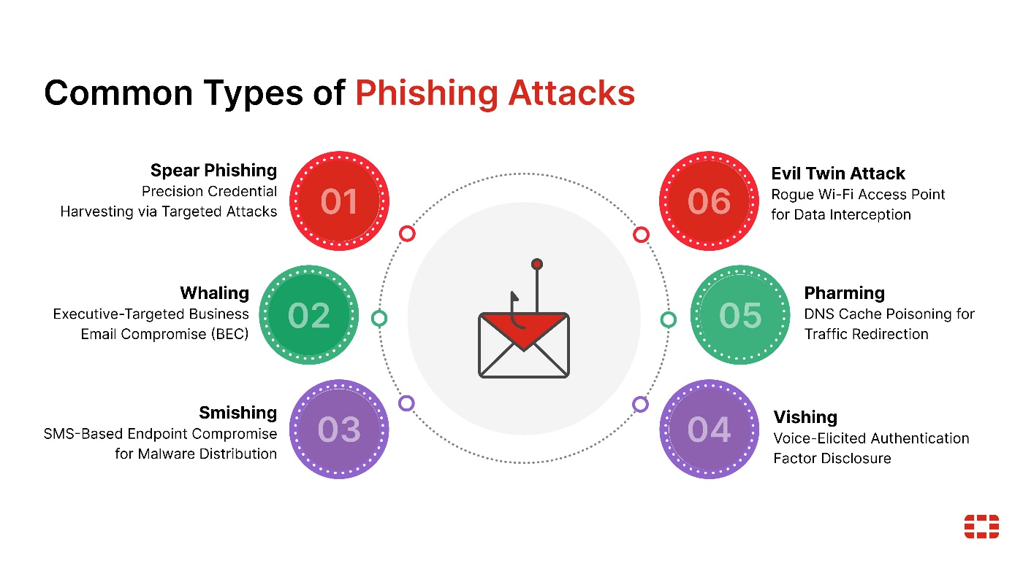
Core Concepts
Types of Phishing
Email Phishing
Spear Phishing
Smishing
Vishing
Clone Phishing
Key Concepts
Authentication
Social Engineering
Fake Websites
Email Spoofing
URL Verification

Slide 8
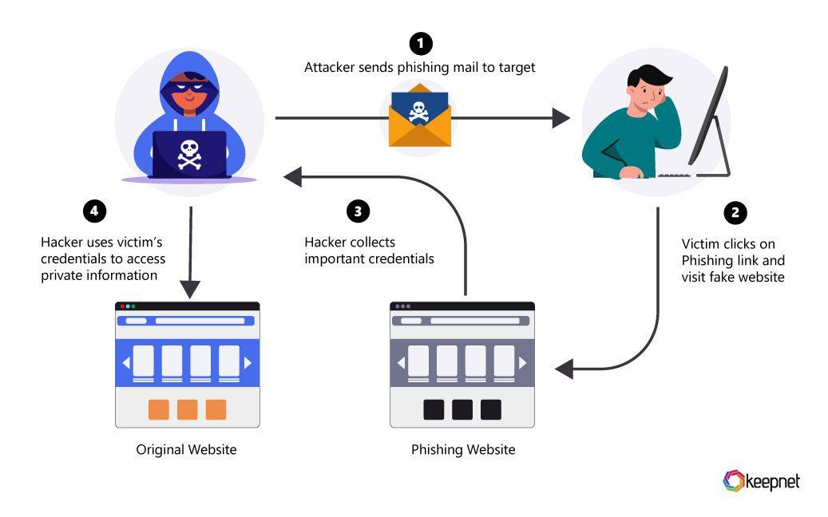
Architecture & Working Principle
Working
Attacker creates a fake email.
Victim receives the message.
Victim clicks the fake link.
Fake website collects login details.
Attacker steals sensitive information.

Slide 9
Technologies & Tools
Technologies Used to Detect Phishing
Email Spam Filters
Antivirus Software
Firewalls
Multi-Factor Authentication (MFA)
Secure Email Gateway
Browser Security
Security Tools
Microsoft Defender
Google Safe Browsing
Norton Antivirus
PhishTank
VirusTotal

Slide 10

Applications
Applications of Phishing
Banking & Finance
Healthcare
Education
Government Services
E-Commerce
Social Media
Corporate Organizations
Online Payment Systems

Slide 11
Advantages & Challenges
Advantages
Protects personal information.
Prevents financial fraud.
Reduces cyber attacks.
Improves user awareness.
Increases trust in online services.
Challenges
AI-generated phishing emails.
Human error.
New phishing techniques.
Fake websites.
Lack of cyber awareness.

Slide 12
Case Study & Latest Trends
Case Study
Google & Facebook Phishing Scam
Hackers impersonated a legitimate supplier.
More than $100 million was fraudulently obtained.
Demonstrated the importance of verifying emails and payment requests.
Latest Trends
AI-generated phishing emails
QR Code Phishing (Quishing)
Deepfake voice phishing
Zero Trust Security
AI-powered phishing detection

Slide 13
Future Scope & Conclusion
Future Scope
AI-based phishing detection
Machine Learning for email filtering
Behavioral authentication
Advanced browser protection
Zero Trust Security
Conclusion
Phishing is one of the fastest-growing cyber threats.
Awareness and verification are the best defenses.
Strong passwords, MFA, and careful browsing significantly reduce phishing risks.

Slide 14
References & Q&A
References
OWASP Foundation
NIST Cybersecurity Framework
Google Safe Browsing
Microsoft Security
Cisco Cybersecurity
PhishTank
W3Schools

