Slide 1


Shree Swami Atmanand Saraswati Institute of Technology, Surat
Affiliated with Gujarat Technological University, Ahmedabad
MICRO-SIEM
A Lightweight Security Information and Event Management System
Minor Project (BC05001081) • BCA Semester V • Academic Year 2026-27
Submitted By
Student Name
(Enrollment No)
Under the Guidance of
Internal Guide Name
Department of BCA
Notes:
Greet the panel. Introduce yourself, your guide and the project title: Micro-SIEM, a lightweight Security Information and Event Management system built from scratch.

Slide 2
Contents
1
Introduction
9
Actors & Use Cases
2
Problem Statement
10
Database Design
3
Objectives
11
Screenshots
4
Scope
12
Testing
5
Technology Stack
13
Limitations
6
System Architecture
14
Future Scope
7
Working Flow
15
Conclusion
8
Detection Rules
Micro-SIEM | Minor Project (BC05001081)
2 / 20
Notes:
Quick overview of what the presentation covers.

Slide 3
Introduction – What is a SIEM?
A Security Information and Event Management (SIEM) system collects logs from many sources into one place, analyses them with detection rules, and raises alerts so that security analysts can respond to attacks quickly.
3
log sources
Logs hold the first evidence of almost every attack
Evidence is scattered across files and formats
Commercial SIEMs are costly and complex
Micro-SIEM: a small, working, explainable SIEM
4
detection rules
6
Docker containers
Micro-SIEM | Minor Project (BC05001081)
3 / 20
Notes:
Explain SIEM in simple terms: collect logs from many places, look for attack patterns, alert the analyst. Commercial tools like Splunk and QRadar are costly and complex; Micro-SIEM shows the same idea in a small, explainable system.

Slide 4
Problem Statement
!
The Problem
✓
Our Solution
Nobody reads logs in real time
Attacks like password guessing go unnoticed
Logs are spread across many files and formats
Existing SIEMs are expensive, heavy and work like black boxes
Centralise live logs automatically
Detect attacks with clear, readable rules
Alert on role-based live dashboards
Open-source and one-command deployment
Micro-SIEM | Minor Project (BC05001081)
4 / 20
Notes:
Contrast the problem with our solution. Emphasise 'explainable' – every rule is a few lines of Python that can be defended in the viva.

Slide 5
Objectives
1
2
3
Complete pipeline
Real attack detection
Honest mapping
Collect, parse, store, detect, alert and visualise
Brute force, credential compromise and XSS
MITRE ATT&CK and OWASP / CWE
4
5
6
Clear dashboards
Explainable rules
Easy deployment
Role-based admin and viewer views
Small rules that are easy to extend
Single Docker Compose command
Micro-SIEM | Minor Project (BC05001081)
5 / 20
Notes:
Walk through the six objectives briefly.

Slide 6
Scope of the System
In Scope
Out of Scope
Multi-source log collection and parsing
Central storage and search in OpenSearch
Threshold, correlation and signature rules
MITRE ATT&CK / OWASP mapping
Live admin and viewer dashboards
Session login with role-based access
Safe demo website as attack target
Machine-learning / anomaly detection
Multi-node or cloud deployment
Automatic blocking of attackers
Windows, firewall and packet logs
Micro-SIEM | Minor Project (BC05001081)
6 / 20
Notes:
Be clear about what is included and what is intentionally left out – this shows realistic planning.

Slide 7
Technology Stack
Collection
Storage & Search
Vector (VRL parsing)
OpenSearch
Back End
Front End
Python 3.11, FastAPI, Uvicorn
HTML, JS, Tailwind CSS, Chart.js
Web Server
Deployment
Nginx – demo site, proxy, logs
Docker & Docker Compose
Threat Frameworks
Tools
MITRE ATT&CK, OWASP, CWE
Parrot OS, Git, GitHub, VS Code
Micro-SIEM | Minor Project (BC05001081)
7 / 20
Notes:
Explain why each tool was chosen: all open-source and industry-standard; the security logic itself is our own Python code.

Slide 8
System Architecture
LOG SOURCES
Web Login Log
Vector
parse + tag
OpenSearch
logs · alerts · blocked
FastAPI
Detection Engine
+ Auth API
Nginx Access Log
SSH auth.log
Admin
Dashboard
Viewer
Dashboard
writes web login + Nginx logs
Attacker Browser
Nginx Demo Portal :8080
Micro-SIEM | Minor Project (BC05001081)
8 / 20
Notes:
Follow the arrows left to right: log sources → Vector → OpenSearch → FastAPI detection engine → dashboards. The demo portal generates the web login and Nginx logs.

Slide 9
Working Flow
1
2
3
4
5
6
Collect
Parse
Store
Detect
Alert
Visualise
Vector tails live log files
VRL adds log_type + source_ip
Bulk insert into OpenSearch
Rules over last 2 minutes
Saved with MITRE / CWE ID
Live dashboards every 3 s
Example: 6 wrong passwords on the demo login from one IP → 6 login_failed events → rule finds ≥ 5 in 2 minutes → 'Web Login Brute Force' alert (T1110) appears on the admin dashboard within seconds.
Micro-SIEM | Minor Project (BC05001081)
9 / 20
Notes:
Explain the six stages with one sentence each. Dashboards refresh every 3 seconds, so alerts appear almost immediately.

Slide 10
Detection Rules
Rule | Logic | Mapping
Web Login Brute Force | ≥ 5 failed web logins from one IP in 2 min | T1110 – Brute Force
SSH Brute Force | ≥ 5 'Failed password' lines from one IP in 2 min | T1110 – Brute Force
Suspicious Login | ≥ 2 failures then a success from the same IP | T1078 – Valid Accounts
XSS Attempt | Known XSS signature in request URL (<script, onerror= …) | OWASP / CWE-79
All alerts are stored permanently with severity, attempt count and matched rule, so history stays visible after the attack ends.
Micro-SIEM | Minor Project (BC05001081)
10 / 20
Notes:
Stress honest mapping: XSS is a web vulnerability class, not an ATT&CK technique, so it is mapped to OWASP / CWE-79. Colours match the dashboard chart: red for brute force and XSS, blue for suspicious login.

Slide 11
Actors & Use Cases
A
Admin
V
Viewer
D
Demo User / Attacker
S
System
Log in / log out
View dashboard & charts
View all logs
View alerts & threats
Block IP / account (future)
Log in / log out
View dashboard & charts
Read-only access
Admin actions refused (403)
Log in to demo portal
Search on demo portal
Every attempt is logged
Collect logs (Vector)
Run detection rules
Generate & store alerts
Micro-SIEM | Minor Project (BC05001081)
11 / 20
Notes:
Four actors. Role checks are enforced by the server: a viewer calling an admin action gets HTTP 403.

Slide 12
Database Design – OpenSearch
logs-index
Every parsed log event
alerts-index
Every alert raised
blocked-index
Blocklist (future feature)
timestamp
log_type
source_ip
event / username
path / status
message
timestamp
alert_type
source_ip
attempt_count
severity
mitre_id / tactic
type (ip / account)
ip
username
blocked_at
blocked_by
Micro-SIEM | Minor Project (BC05001081)
12 / 20
Notes:
OpenSearch is a document store – JSON documents in indices instead of rows in tables. Three indices are used.

Slide 13
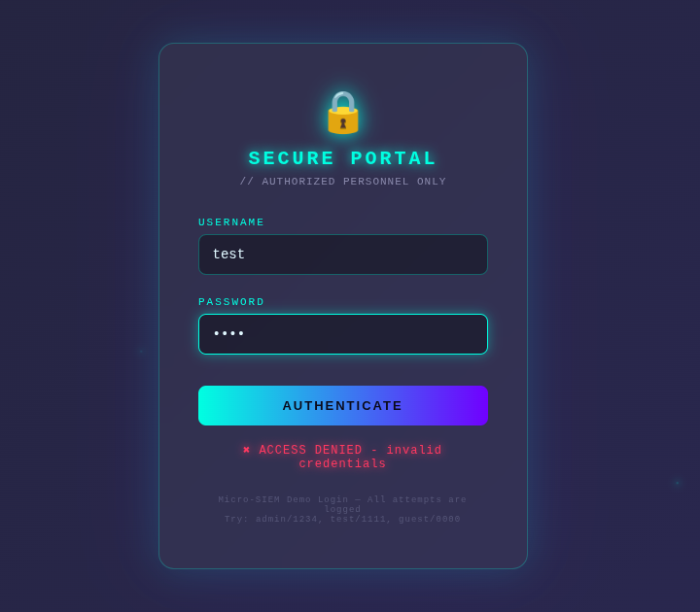
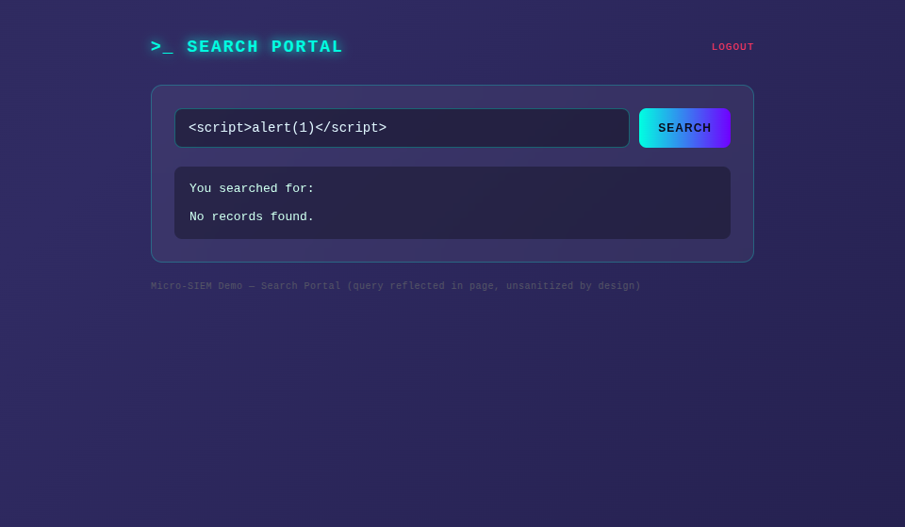
Screenshots – Demo Portal
Demo login – every failed attempt is logged
Search page – XSS payload reflected
Micro-SIEM | Minor Project (BC05001081)
13 / 20
Notes:
The demo portal is the attack target: login page (all attempts logged) and search page (intentionally reflects input, so XSS can be shown safely).

Slide 14
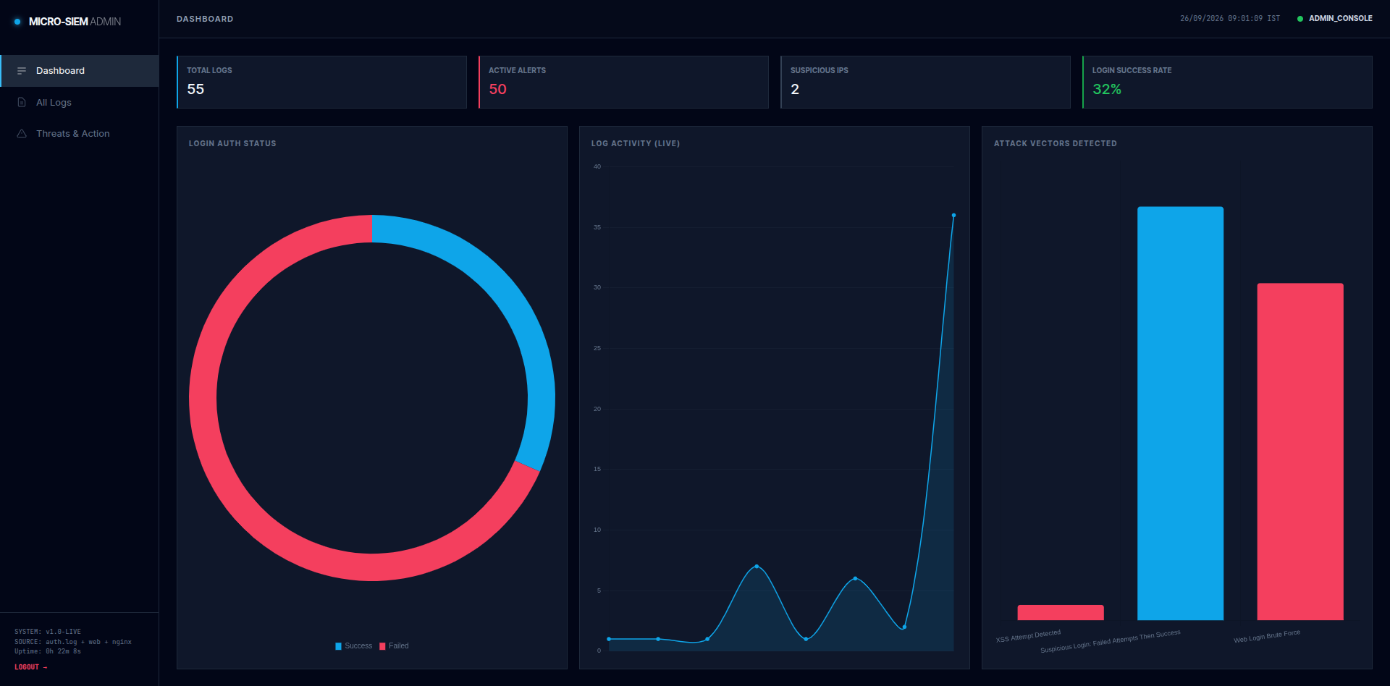
Screenshots – Admin Dashboard
Admin dashboard after the attack simulation – red: brute force / XSS, blue: suspicious login
Micro-SIEM | Minor Project (BC05001081)
14 / 20
Notes:
Point out: stat tiles, login doughnut, live activity line chart, and attack vector bar chart – red for brute force / XSS, blue for suspicious login.

Slide 15
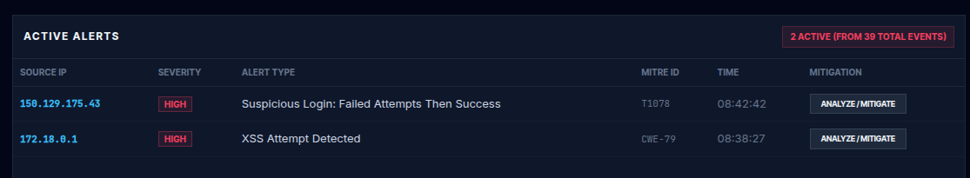
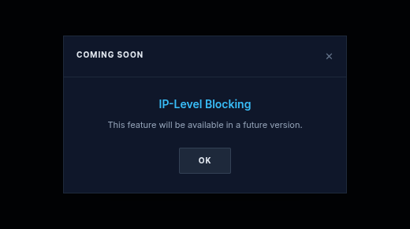
Screenshots – Alerts & Response
Active alerts grouped by source IP with MITRE / CWE ID
Blocking is planned for a future version – 'Coming Soon' pop-up
Micro-SIEM | Minor Project (BC05001081)
15 / 20
Notes:
Threats view lists alerts grouped by IP with MITRE ID. Blocking is designed but switched off – it shows a 'Coming Soon' pop-up and is part of future scope.

Slide 16
Testing
19
3
8
test cases
attack simulations
bugs fixed
Levels
Attack simulations
Unit – rule logic, sessions, IP checks
Integration – API → Vector → OpenSearch
System – full stack in the browser
Security – attacks and role checks
6 wrong logins → Brute Force alert (T1110)
Failures then success → Suspicious Login (T1078)
<script> in search → XSS alert (CWE-79)
Viewer calling block → HTTP 403
Micro-SIEM | Minor Project (BC05001081)
16 / 20
Notes:
Mention the testing levels and the three live attack simulations. Eight real bugs were found and fixed during development.

Slide 17
Limitations
Detection trigger
Duplicate alerts
1
2
Runs when the dashboard asks for alerts, not as a separate background service
Brute-force alerts are not de-duplicated like XSS alerts
Client IP source
Response actions
3
4
Taken from the X-Forwarded-For header, which a client can set
IP and account blocking are disabled in this version
Lab security
Internet needed
5
6
OpenSearch security plugin off; fixed demo credentials
Dashboards load Tailwind and Chart.js from a CDN
Micro-SIEM | Minor Project (BC05001081)
17 / 20
Notes:
Being honest about limitations shows understanding. Each one has a clear fix in future scope.

Slide 18
Future Scope
1
2
3
4
Response actions
Password spraying
Scan detection
Scheduler
Enable IP and account blocking
Many usernames from one IP (T1110.003)
Many paths hit quickly by one IP
Background detection with de-duplication
5
6
7
8
More log sources
Notifications
Threat intel
Hardening
Windows, firewall and DNS logs
E-mail / Telegram alerts
GeoIP and IP reputation
TLS, auth plugin, rate limiting
Micro-SIEM | Minor Project (BC05001081)
18 / 20
Notes:
Highlight the first two: enabling response actions (already built, switched off) and a password-spraying rule.

Slide 19
Conclusion
1
Built a complete, working SIEM pipeline from scratch – collect, parse, store, detect, alert and visualise.
2
Detects brute force, credential compromise and XSS from real log data, honestly mapped to MITRE ATT&CK and OWASP / CWE.
3
Role-based live dashboards with server-side session security, deployed with a single Docker Compose command.
4
Hands-on skills gained in log management, detection engineering, APIs, search engines and containers – directly relevant to a SOC.
19 / 20
Notes:
Summarise in four points, then move to the live demo or questions.

Slide 20
Thank You
Questions & Live Demo
Student Name • (Enrollment No) • Guide: Internal Guide Name
github.com/jay-sorathiya1/micro-siem
Notes:
Invite questions. For the live demo: open the admin dashboard, then attack the demo portal from a phone – 6 wrong logins, then the correct one, then an XSS search – and show the alerts appearing.

