Slide 1

CAREERWAY
A ROAD TO SUCCESS

Slide 2
ABOUT US
Choosing a carrier is a very important decision of life.
Because it have ability to defines any one entire life style.
In other words we can say that your carrier define your social circle and relationships.
Here we are to help you in deciding your carrier.
So that you can fly in the and can become role model for others.
We are providing the most experienced people who have been guiding people and helping them in finding the right path for their carrier.
many have achived what they dreamed for now its your turn take a look and achive your own goal with the help of our experts.

Slide 3

COURCE AFTER 10th
There are various carrier option after 10th board exam:
Science(pcm&pcb)
Commerce
Arts
Diploma
Polytechnic
Vocational cources

Slide 4

COURSE AFTER 12th
There are bunch of career option after 12th some of them are:
B.tech
MBBS
Fashion design
Management
Hotel management
Journalism
Nursing
LLB
Mass communication
Robotics
Micro Biology
Pharmacy
CA
SSC
CGL
DEFENCE
B.ED
B.COM
BCA
BA

Slide 5

CAREER AFTER GRADUATION
Different career option after graduation :
1.M.TECH
2.MBA
3.M. PHARMA
4.PGDM
5.ENTREPRENEURSHIP
6.UPSC

Slide 6

JOBS AFTER B.TECH
There are various scope after B.tech:
1.Web developer
2.App Developer
3.Software Tester
4.Data Scientist
5.Web Designer
6.civil Engineer
7.Electrical Engineer
8.Mechanical Engineer

Slide 7

JOBS AFTER MBA
There are various opportunities after MBA :
1. Marketing Manager
2.Sales Manager
3.Finance Manager
4.Accounting Manager
5.TREASURER

Slide 8
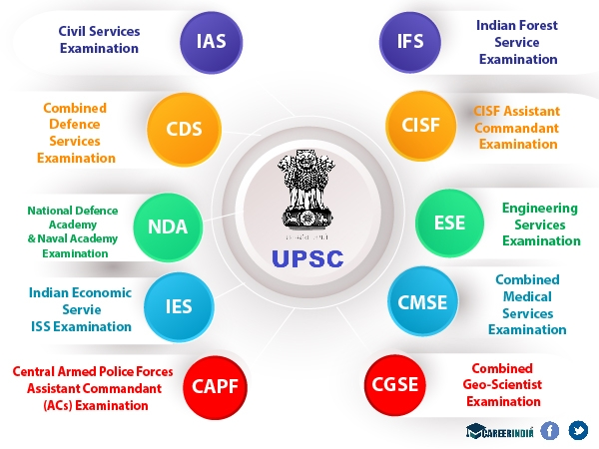
OPPORTUNITIES AFTER UPSC
IAS
IPS
IFS
IRS
CDS
NDA
IES
CAPF
CISF
ESE
CMSE
CGSE

Slide 9


Slide 10


