Slide 1
An
Artificially Intelligent
Tic Tac Toe player using Minimax Algorithm
Submitted by-
Jaspreet Singh Arora
2011CSA1448
CSE-7th Sem
Submitted to-
Er. Nitika Chowdhary
Department of CSE, GNDU

Slide 2
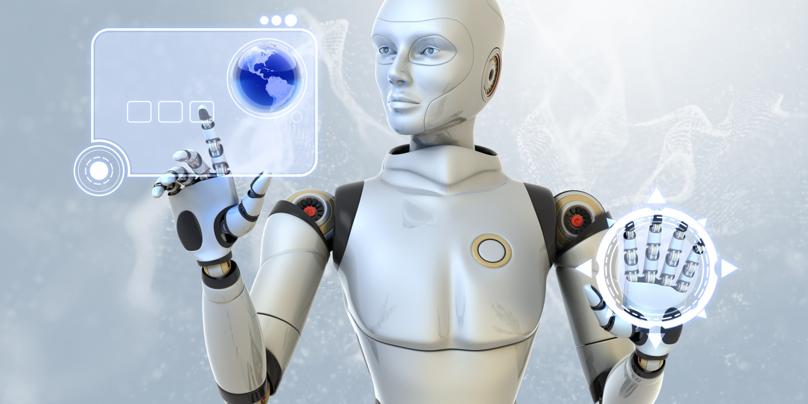
What is Artificial Intelligence?
Intelligence—the sapience of Homo sapiens—"can be so precisely described that a machine can be made to simulate it."
The intelligence of machines
“The study and design of intelligence agents” or the building of an electronic brain

Slide 3
What are expert systems?
In artificial intelligence, an expert system is a computer system that emulates the decision-making ability of a human expert.
designed to solve complex problems by reasoning about knowledge
The knowledge base represents facts and rules
The inference engine applies the rules to the known facts to deduce new facts

Slide 4
The Minimax Algorithm
Minimax is a decision rule used in decision theory.
minimizes the possible loss for a worst case (maximum loss) scenario.
Thus cutting a cake, where taking a larger piece reduces the amount of cake available for others, is a zero-sum game if all participants value each unit of cake equally.
For every two-person, zero-sum game with finitely many strategies, there exists a value V and a mixed strategy for each player, such that
(a) Given player 2's strategy, the best payoff possible for player 1 is V,
&
(b) Given player 1's strategy, the best payoff possible for player 2 is −V.
Alpha–beta pruning is a search algorithm that seeks to decrease the number of nodes that are evaluated

Slide 5
Mechanism of Working
Knowledge base – the winning states, the current state of the game board
Inference Engine – uses the minimax algorithm to process facts in the knowledge base to infer the most optimum move for the computer
Principle of working of Minimax Algorithm –
    You chose the best move for yourself(maximize)
    You assume that the opponent will choose the worst move for you (minimize)

Slide 6
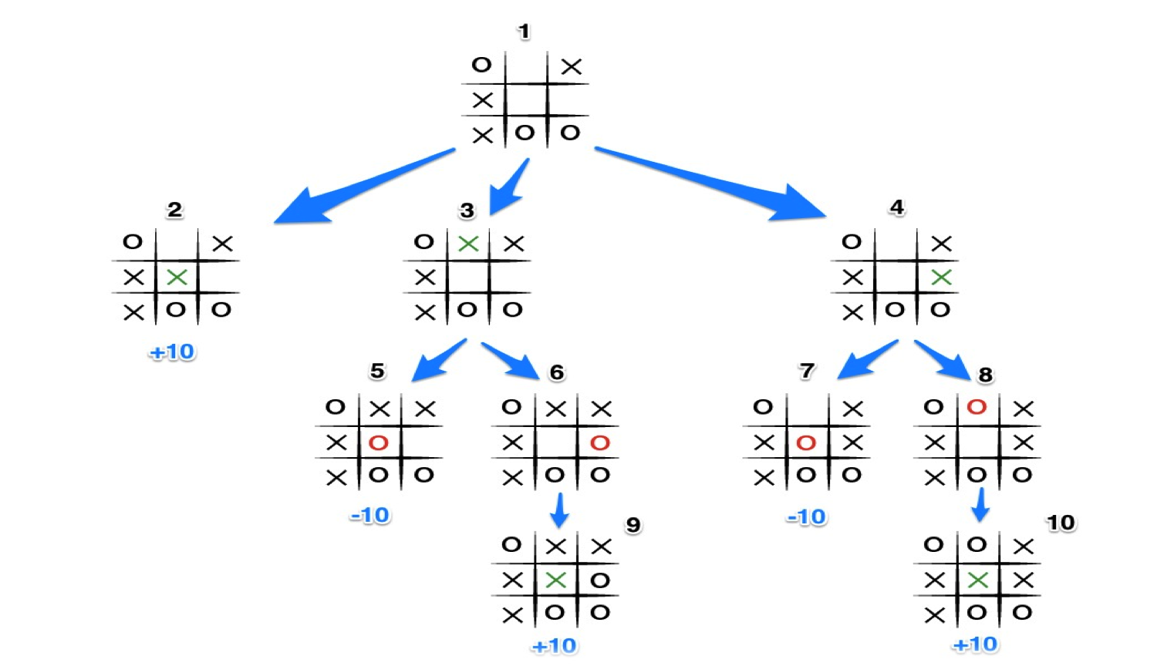
Minimax for Tic Tac Toe

Slide 7
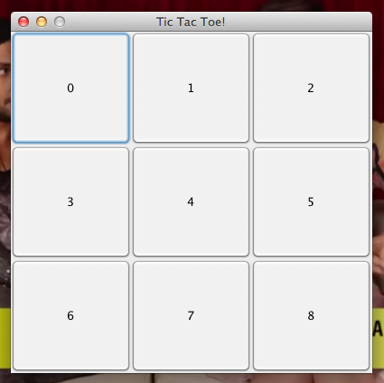
A Sample Game

Slide 8
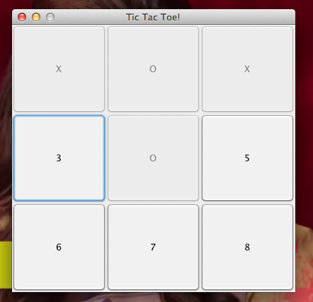
A Sample Game

Slide 9
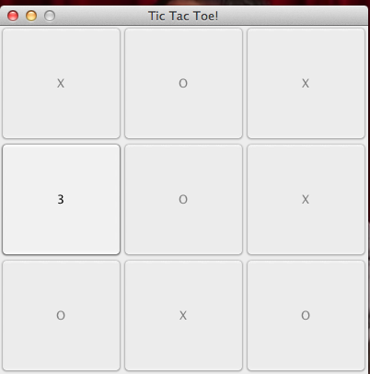
A Sample Game

Slide 10
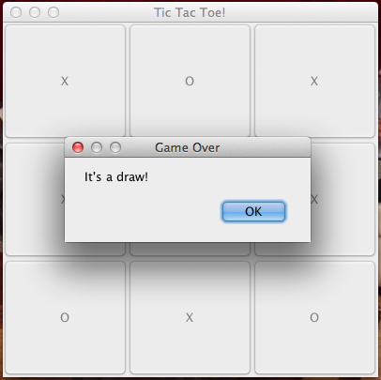
A Sample Game

Slide 11
Conclusion & Limitations
A major problem is the pessimistic approach
Assumes the opponent playing is as smart as themselves
May miss a winning move to lead to a draw
Still, it has been observed to be effective for simpler games like Tic Tac Toe
Can compute all possible outcomes, which in Tac Tac Toe, disregarding symmetric game states, are 9! = 362,880 possible outcomes
In more complex games, an exhaustive use of the minimax algorithm, tends to be hopelessly impractical

Slide 12
Future Scope
Use heuristics(add knowledge) or limit the amount of information that needs to be processed to make it effective for complex games such as chess(rules)
Some techniques used such as :
Transposition Tables
Minimax Regret (difference between payoff and best payoff)

Slide 13
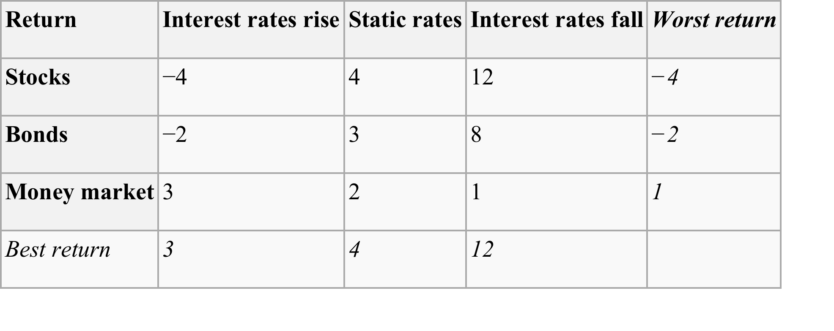
Minimax Regret

Slide 14
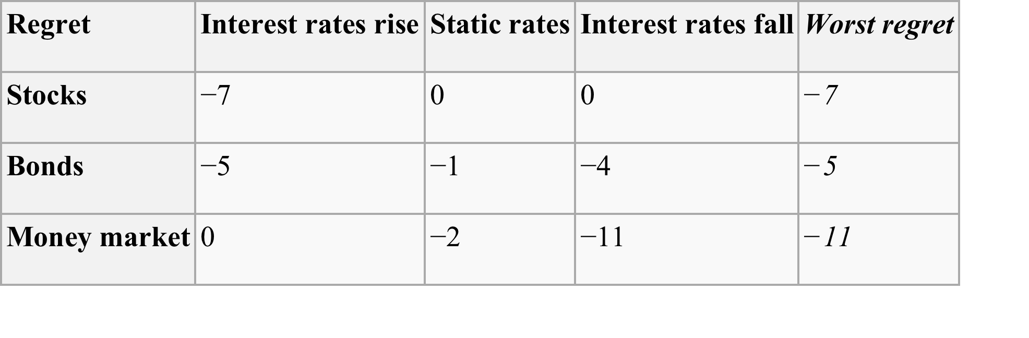
Minimax Regret

Slide 15
Thank you

