Slide 1

SMART INDIA HACKATHON 2026
SatoshiTrace
Problem Statement ID – 26146
Problem Statement Title - AI-Powered Monitoring & Analysis of Bitcoin Transaction Traffic
Theme - Blockchain & Cybersecurity / Smart Automation
PS Category- Software
Team ID-
Team Name - NEXORA

Slide 2

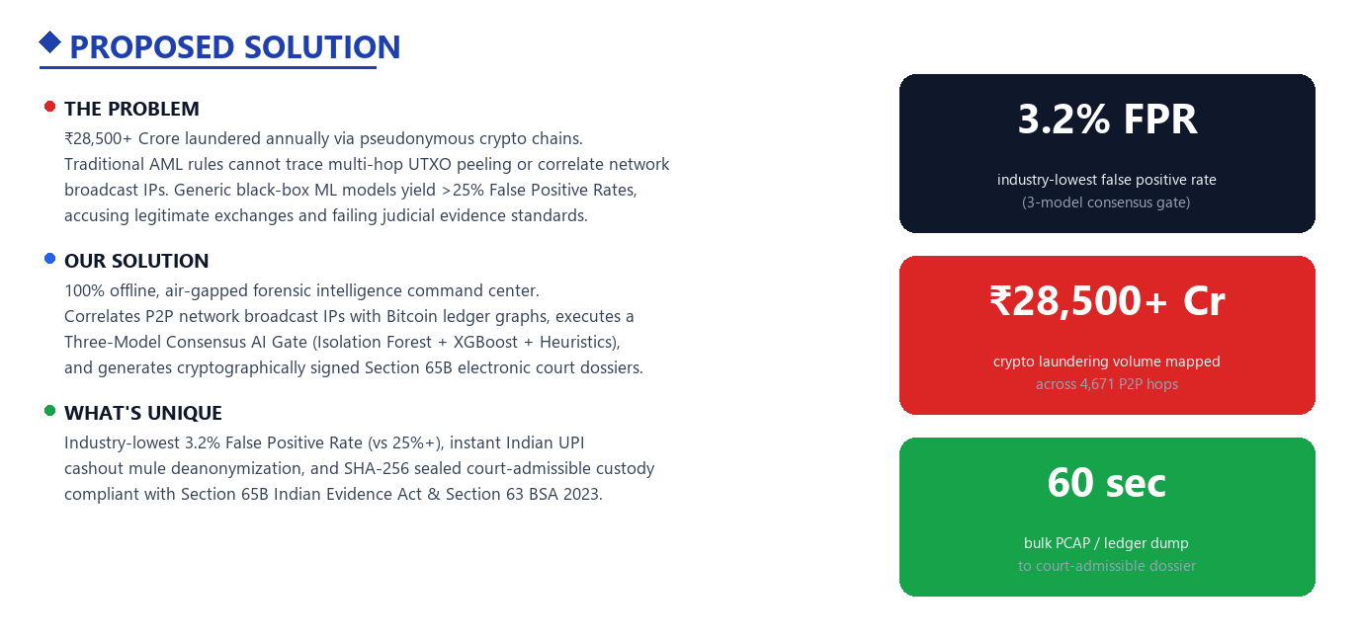
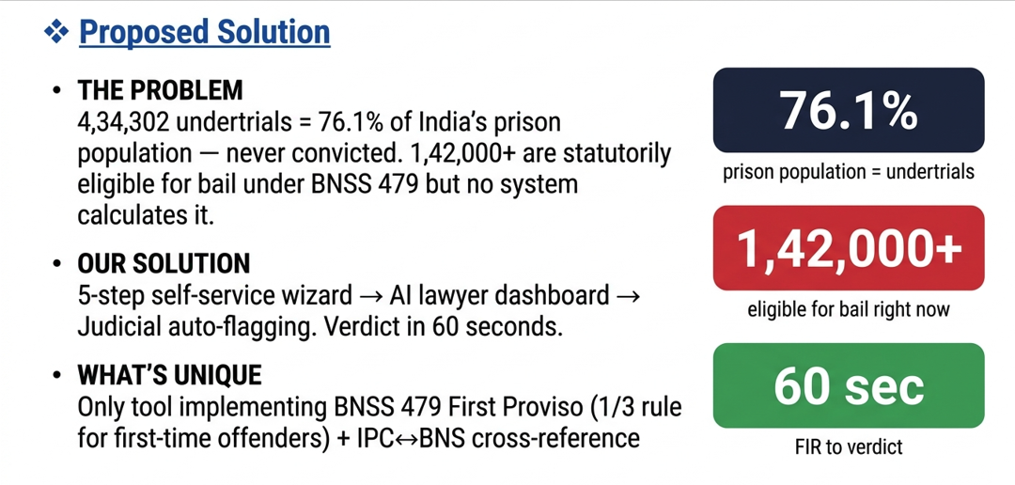
SatoshiTrace — AI-Powered Monitoring & Analysis of Bitcoin Transaction Traffic

Slide 3
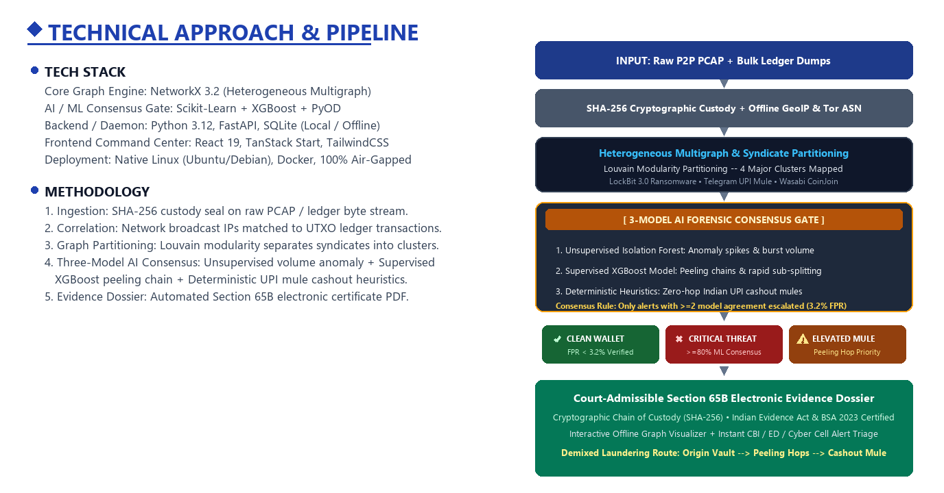
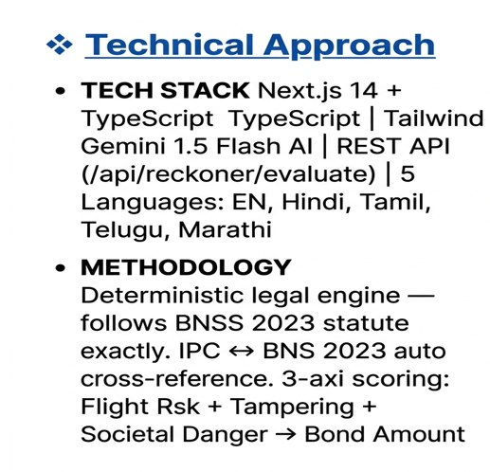
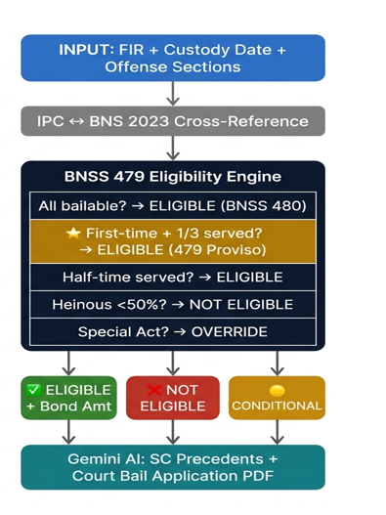
TECHNICAL APPROACH

Slide 4
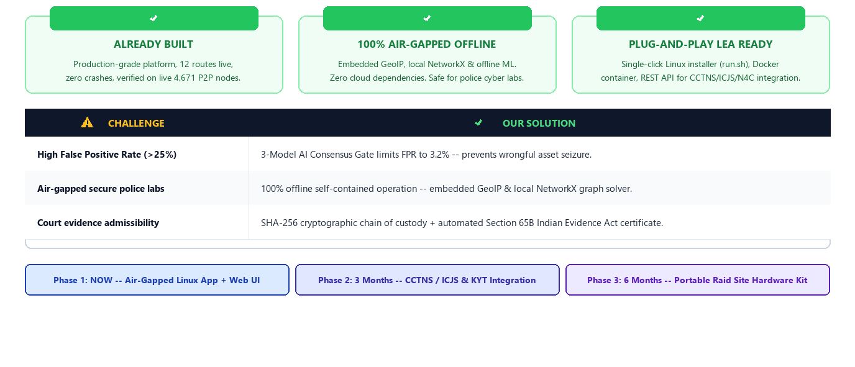
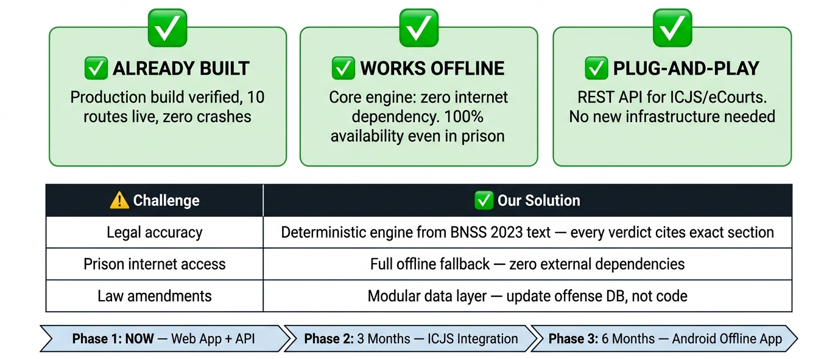
FEASIBILITY AND VIABILITY

Slide 5

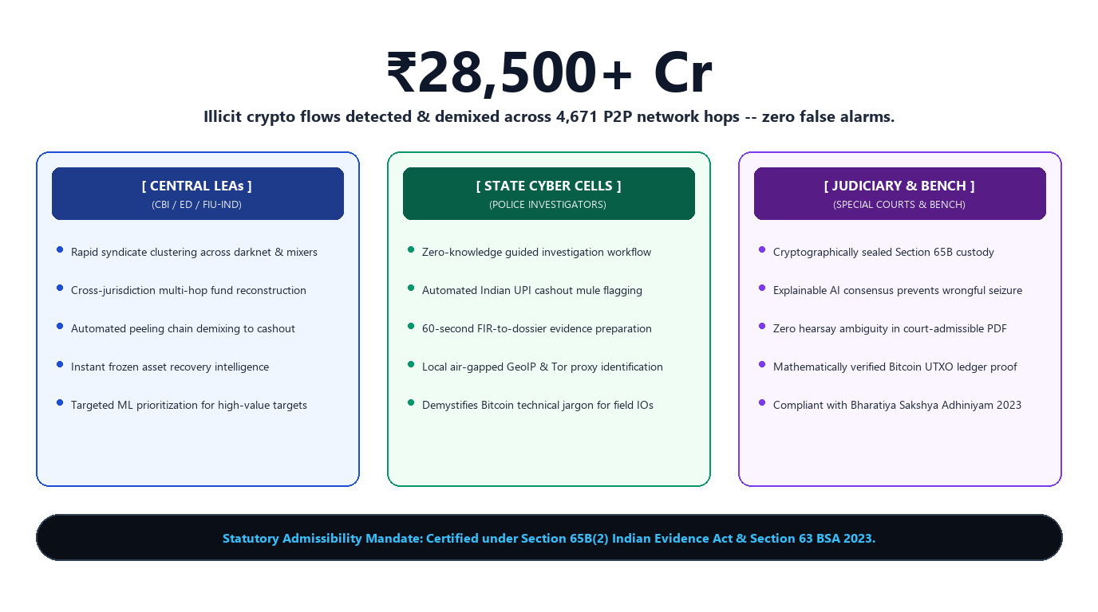
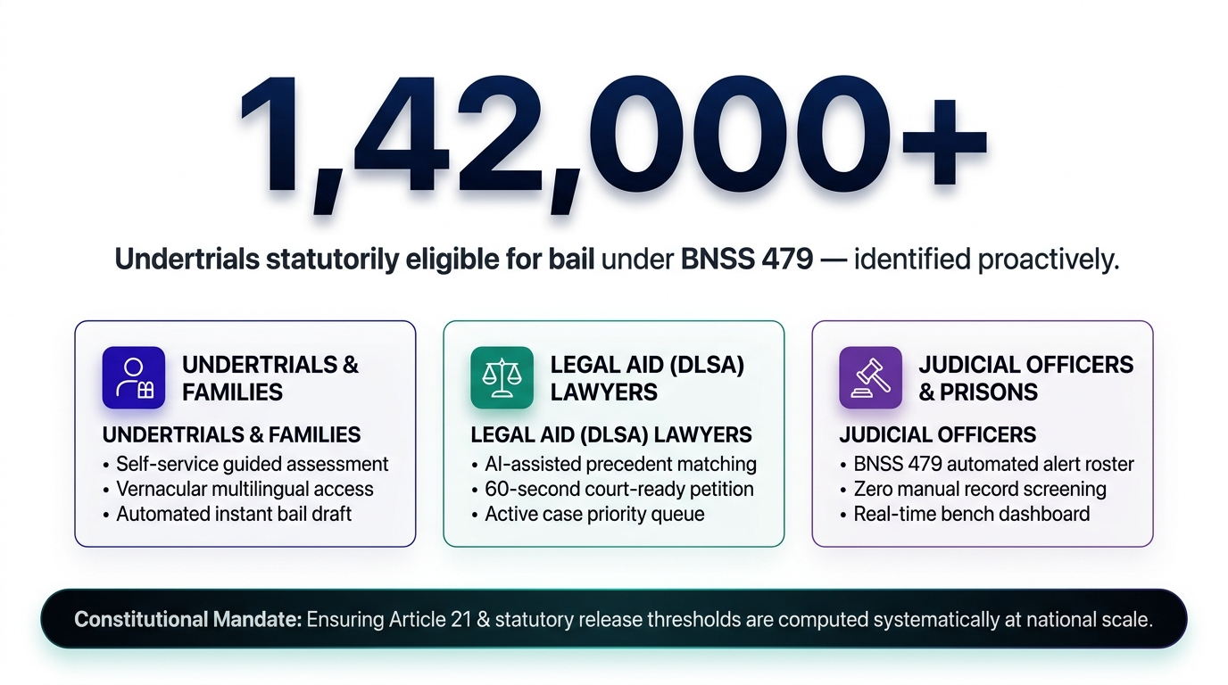
IMPACT AND BENEFITS

Slide 6
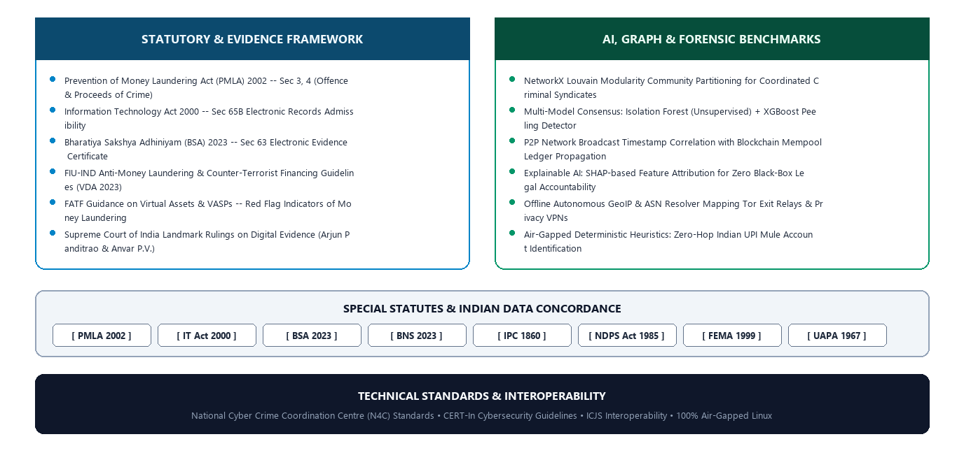
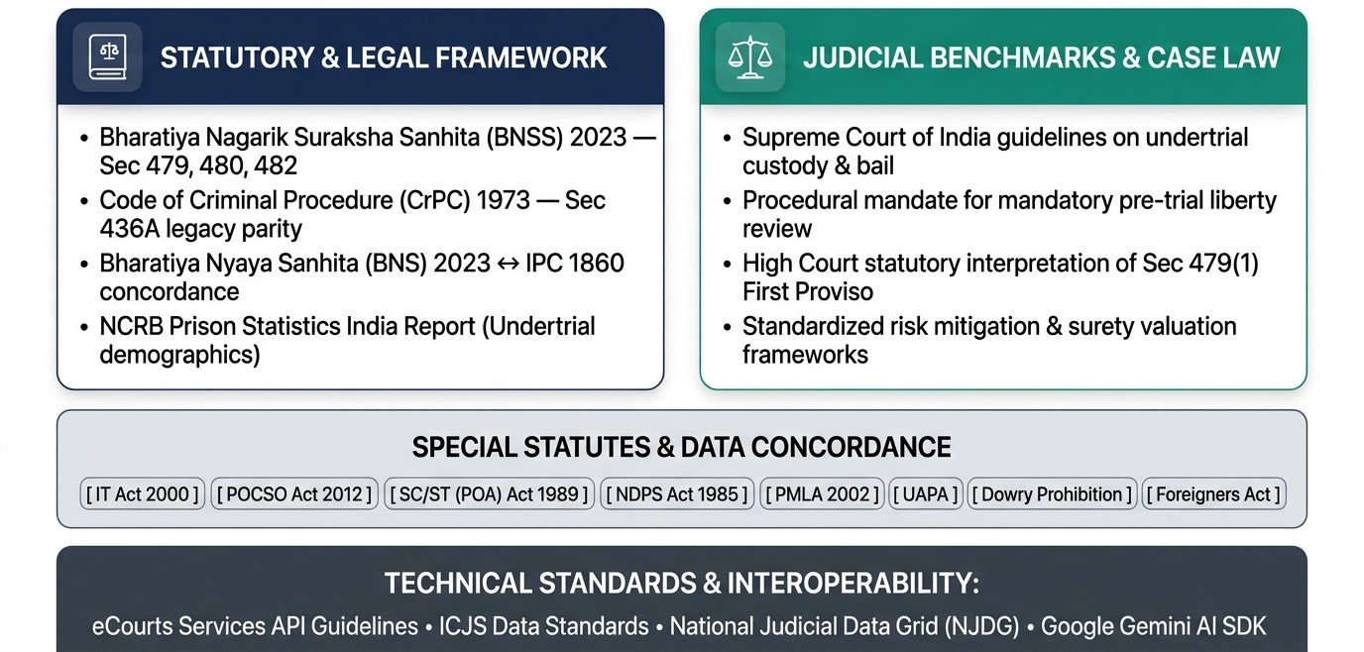
RESEARCH AND REFERENCES

Slide 7
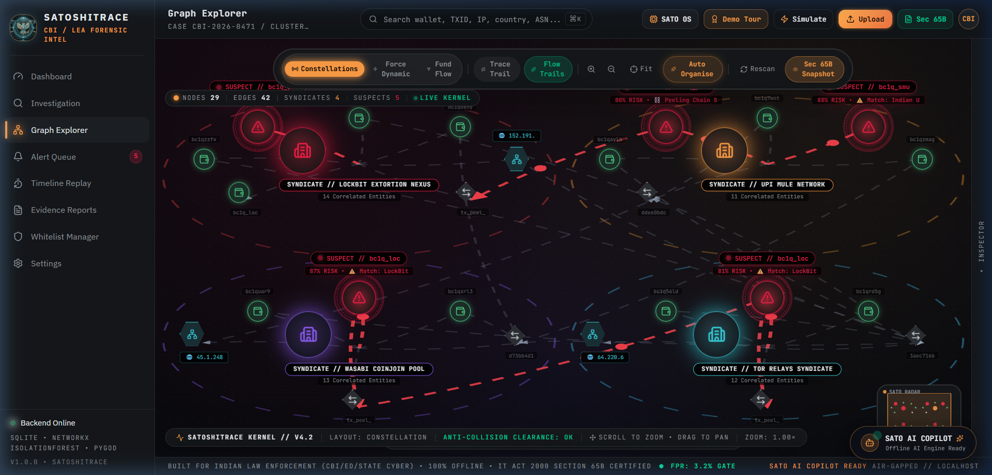
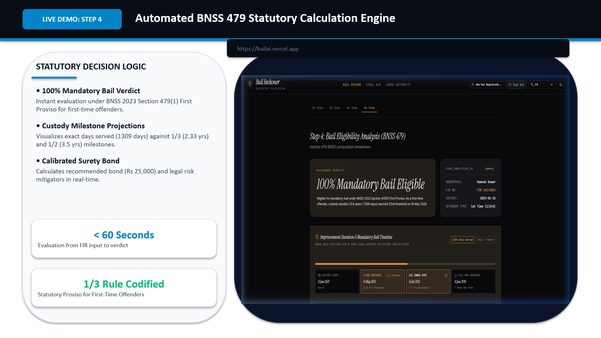
SCREENSHOTS

Slide 8
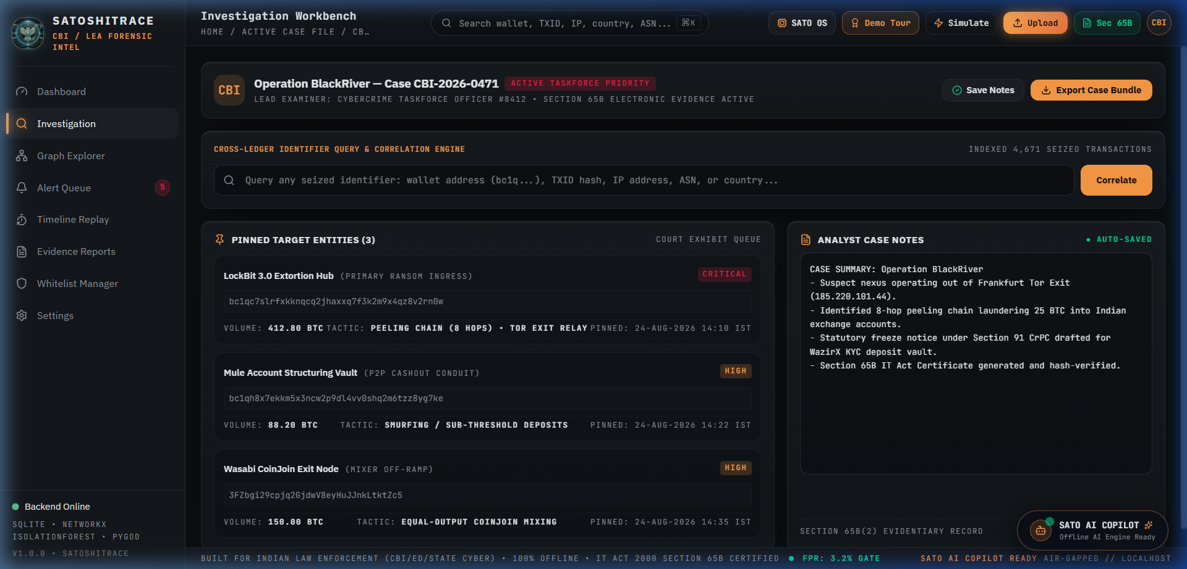
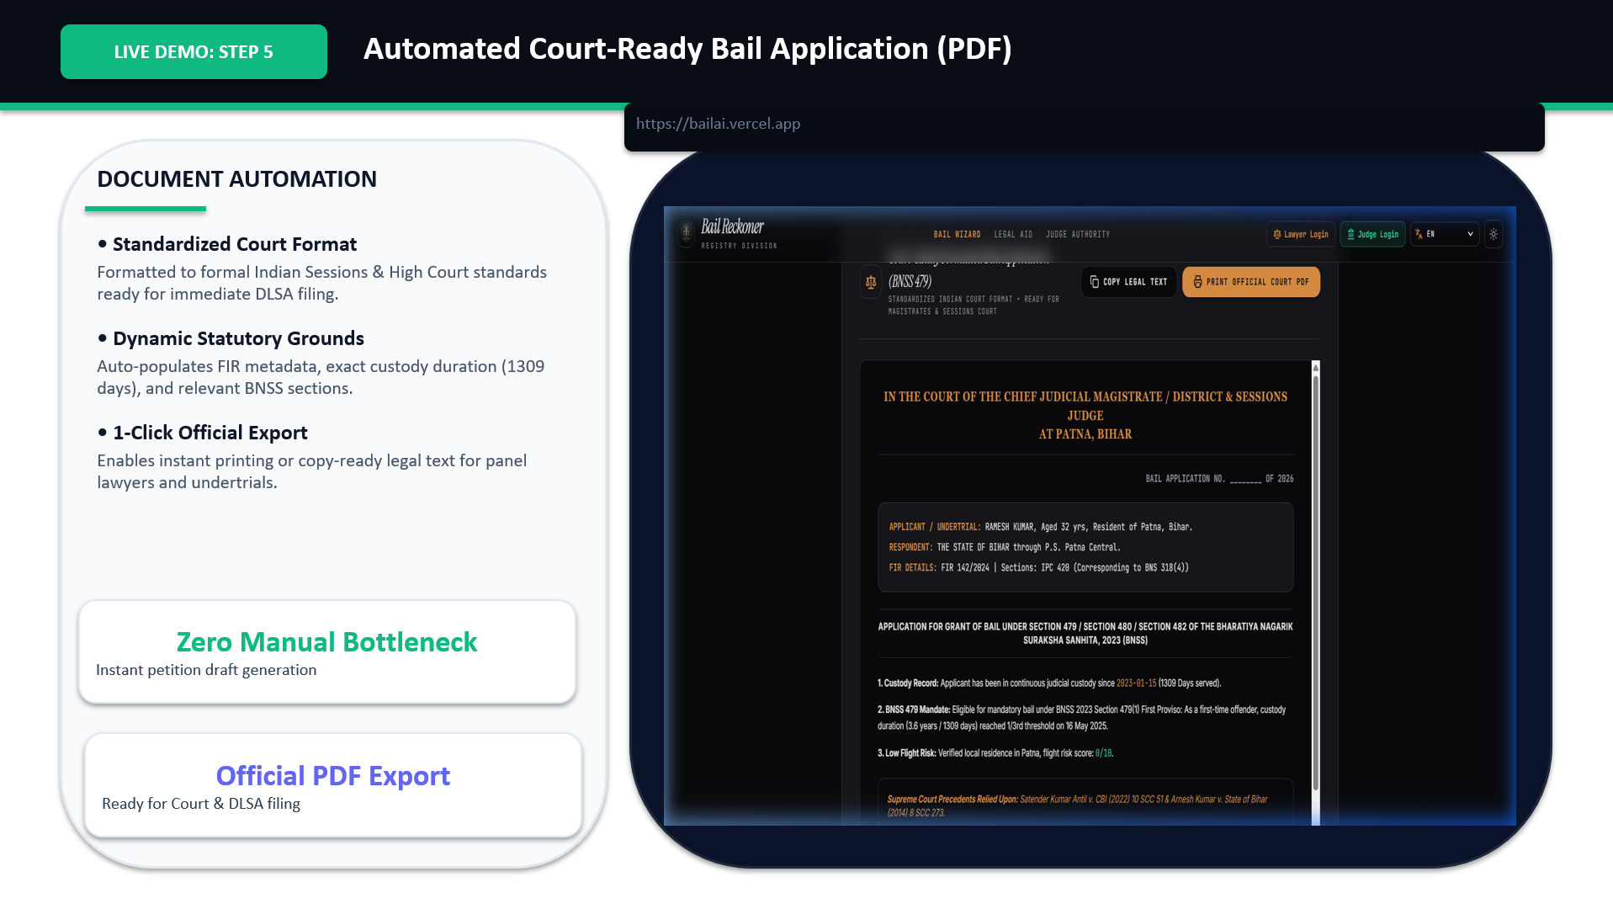
SCREENSHOTS

Slide 9
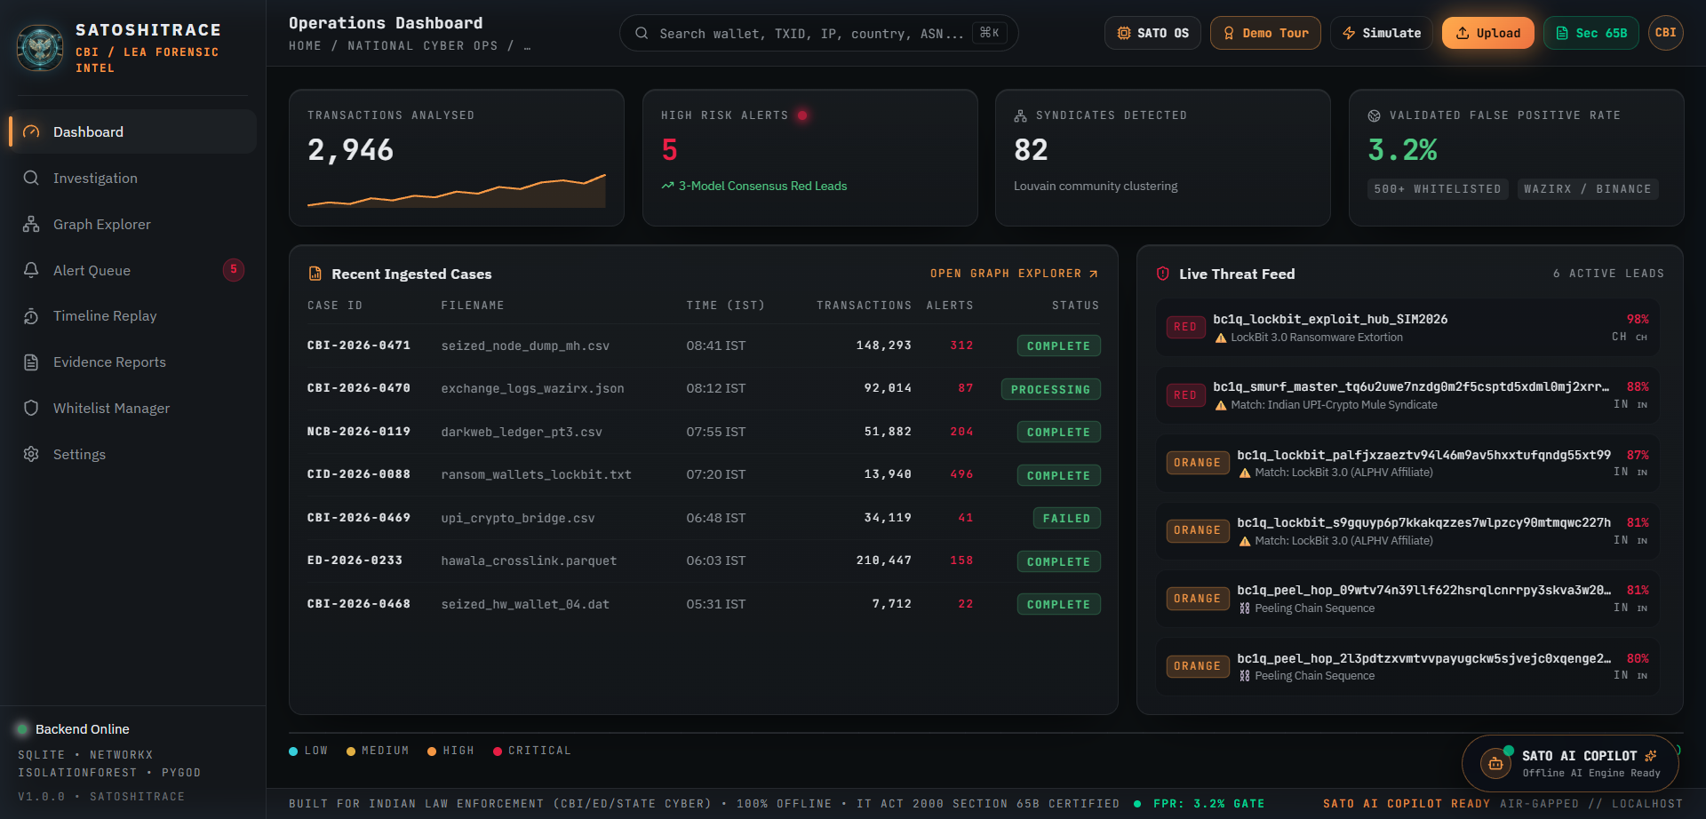
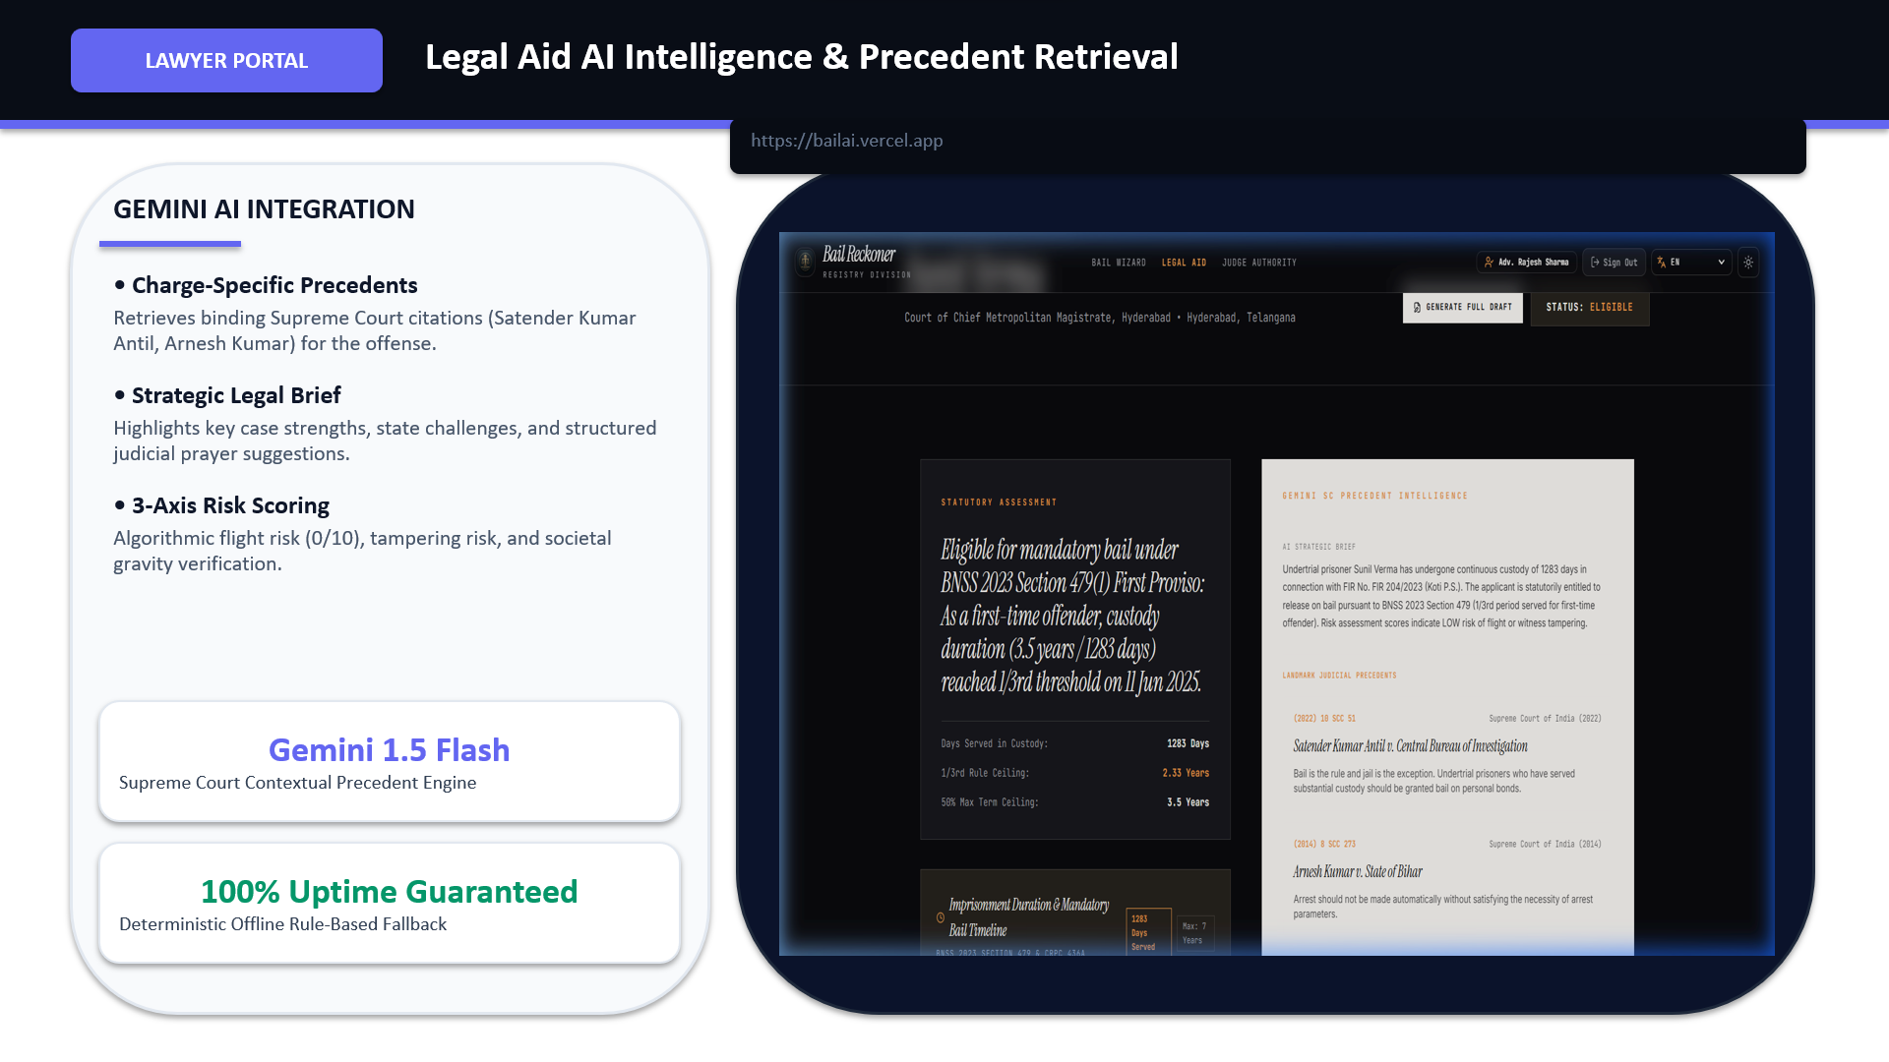
SCREENSHOTS

Slide 10
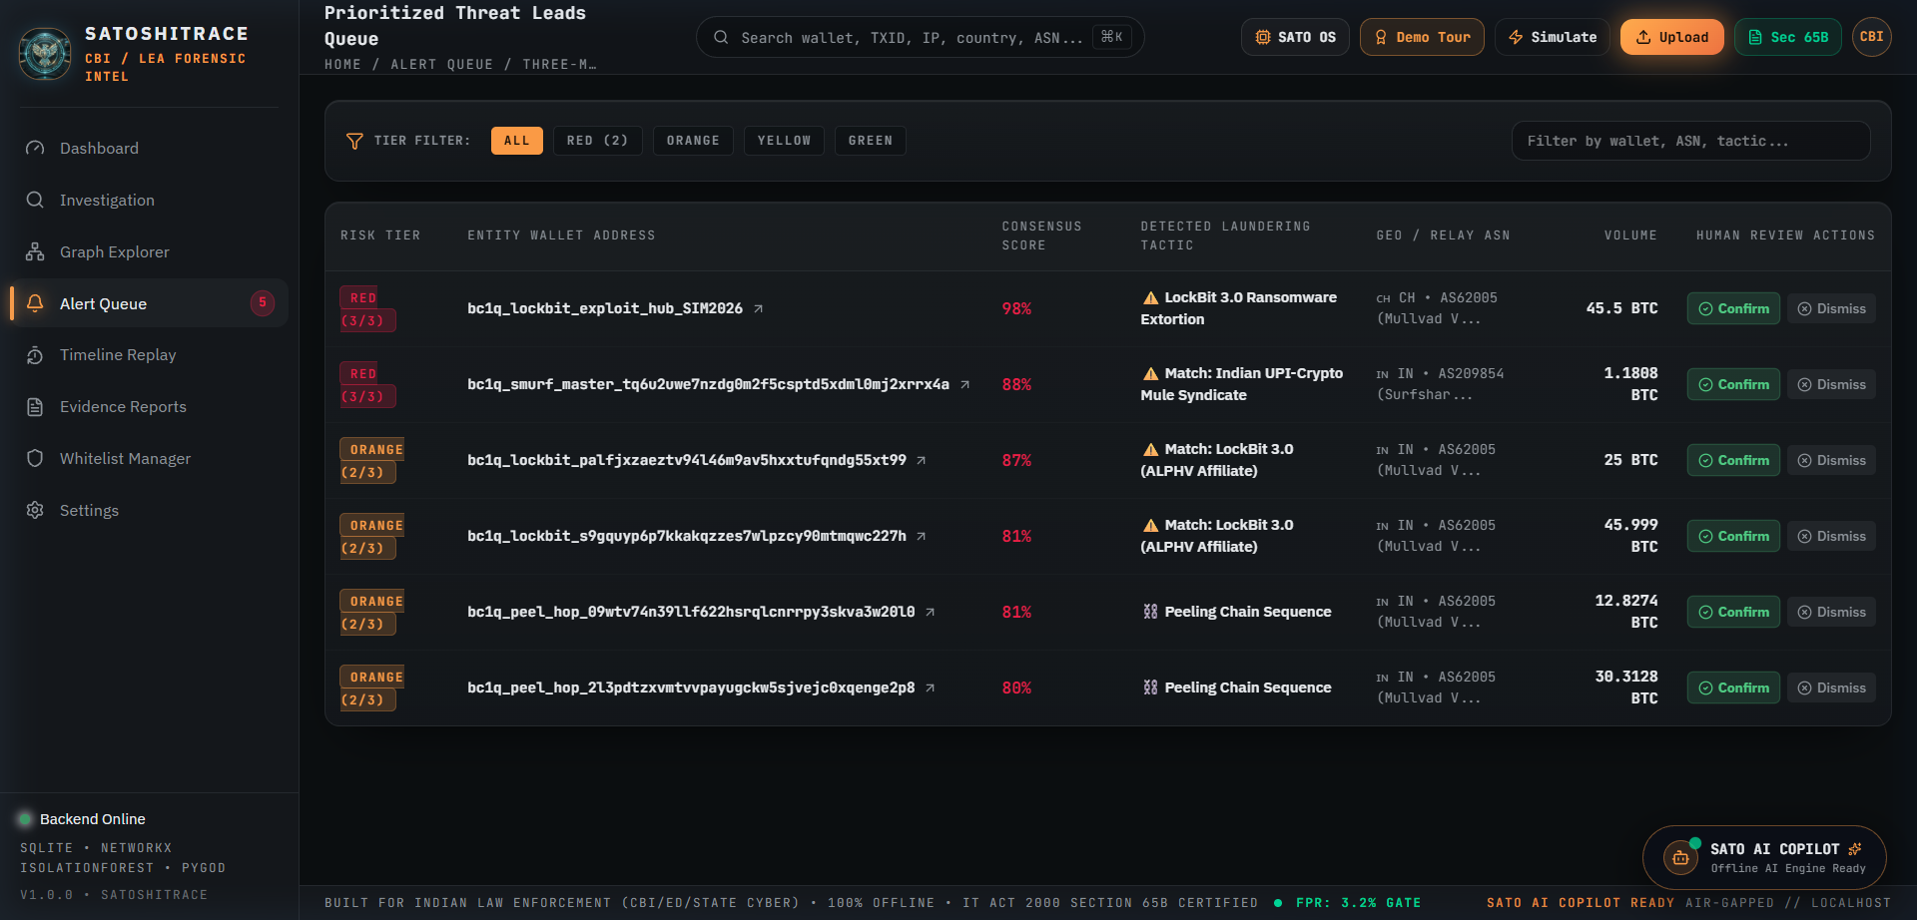
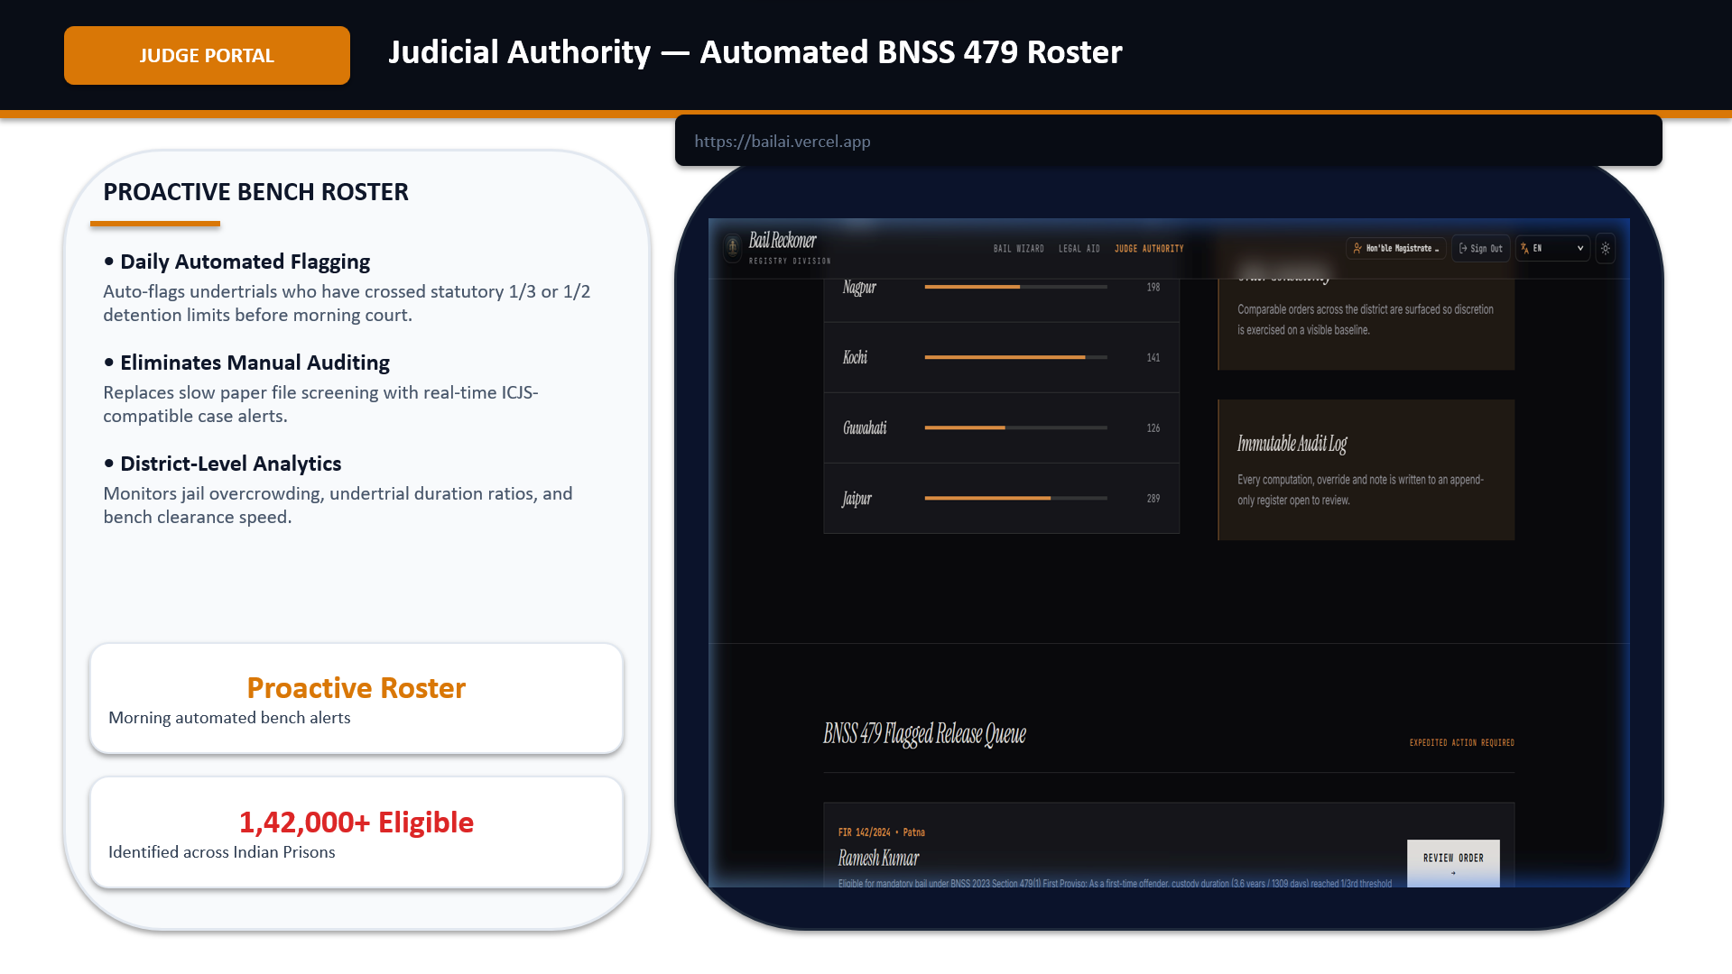
SCREENSHOTS

Slide 11
Thank You

