Slide 1

GROUP-9 Covid19 Prediction
Made by:-
Jay Patel
Jithu manoj

Slide 2
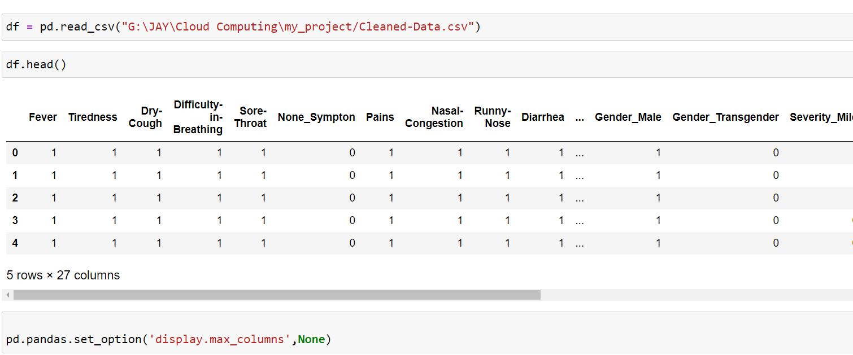
Data frame

Slide 3
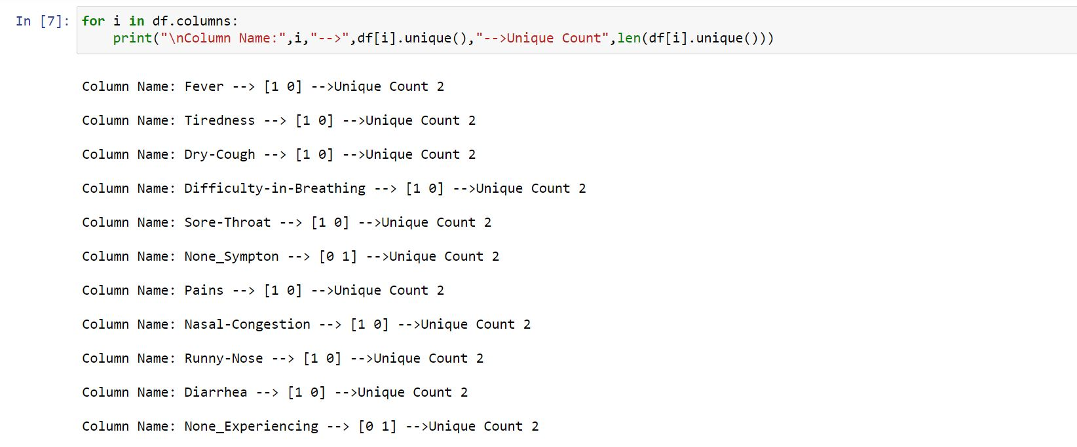
DESCRIBING OUR DATA

Slide 4
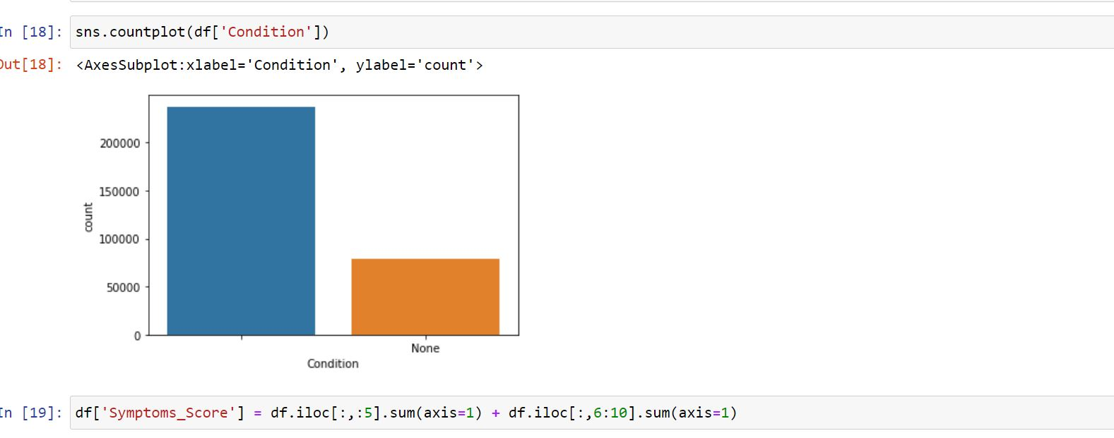
Binary chart for condition column which will be the output of our model

Slide 5
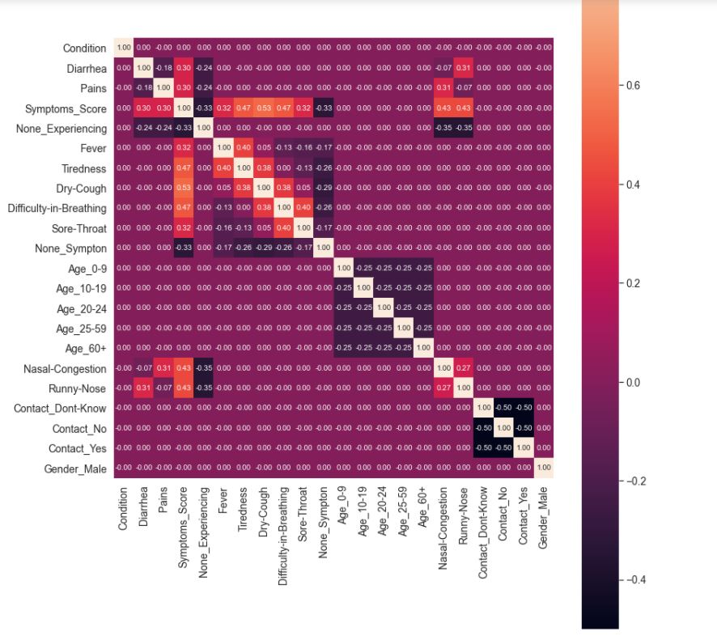
Corelation chart

Slide 6
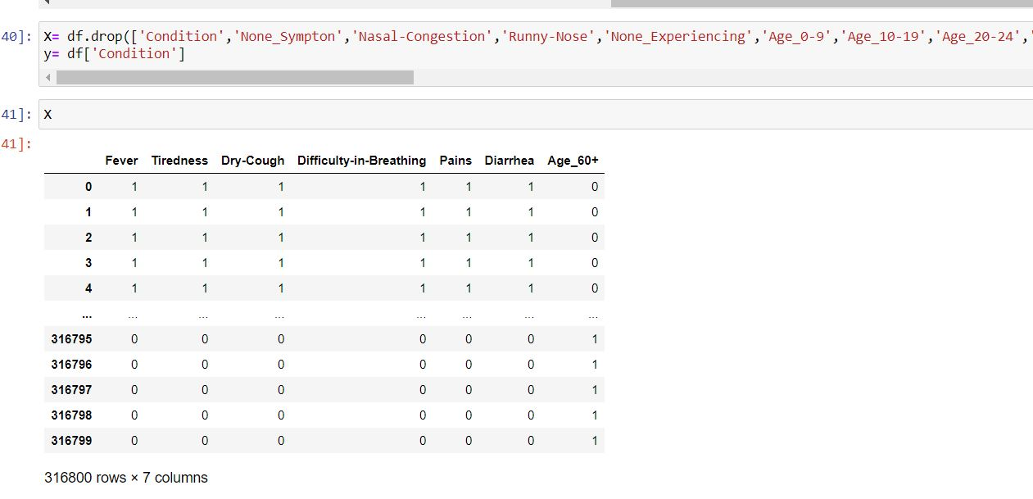
Filtered columns which we will futher use it for our model

Slide 7
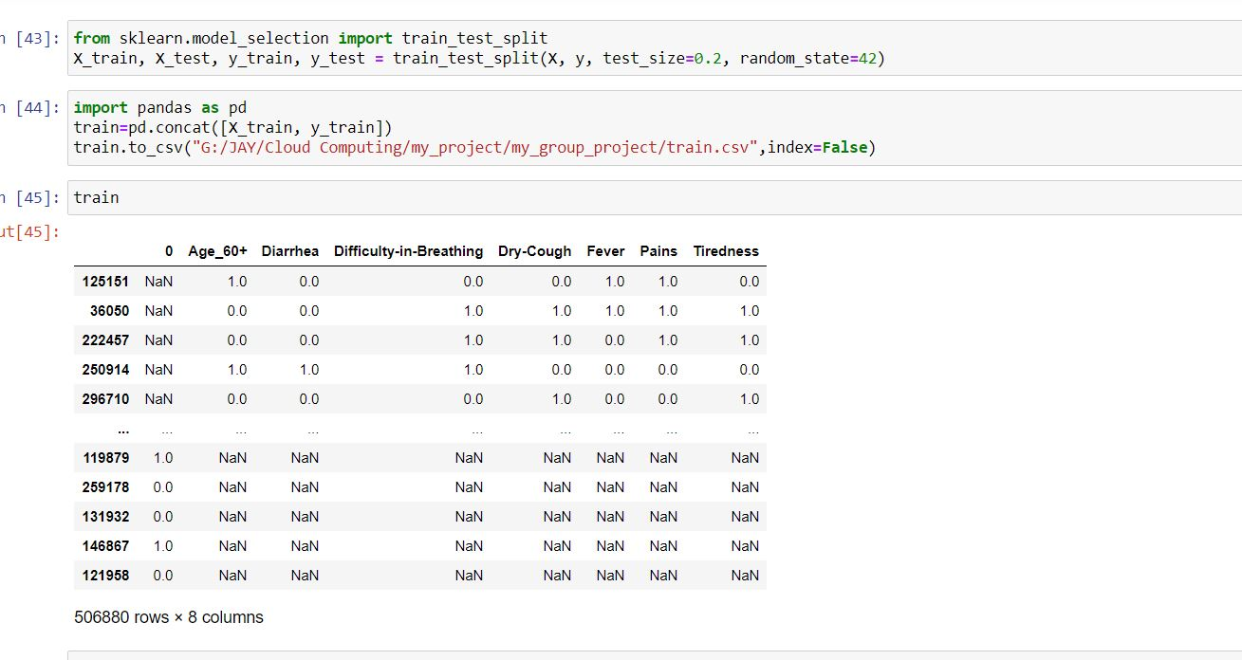
Splitting our data using train test split

Slide 8
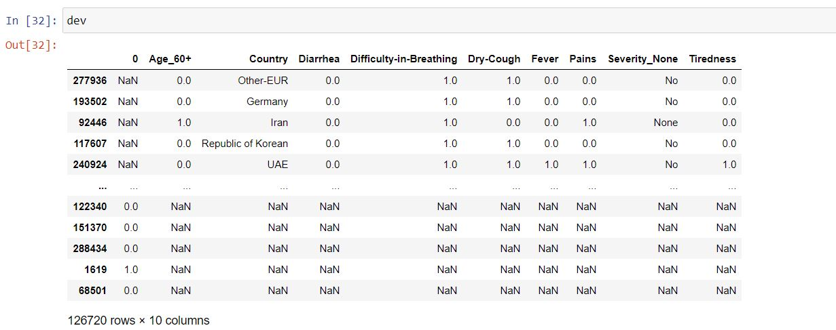
Test.csv

Slide 9
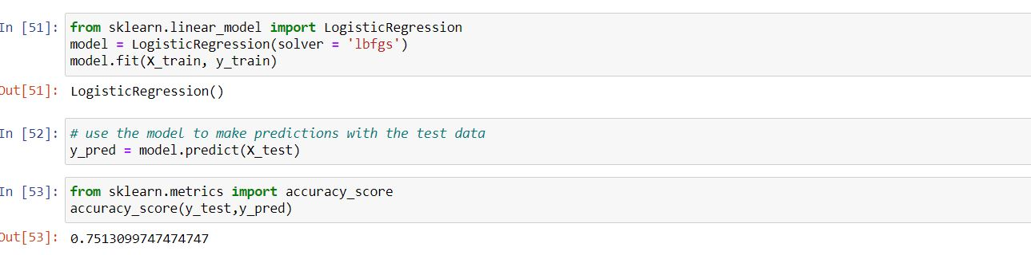
Creating our machine learning model Using logistic Regression

Slide 10
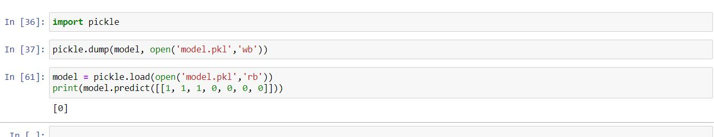
Saving model into pickle file

Slide 11
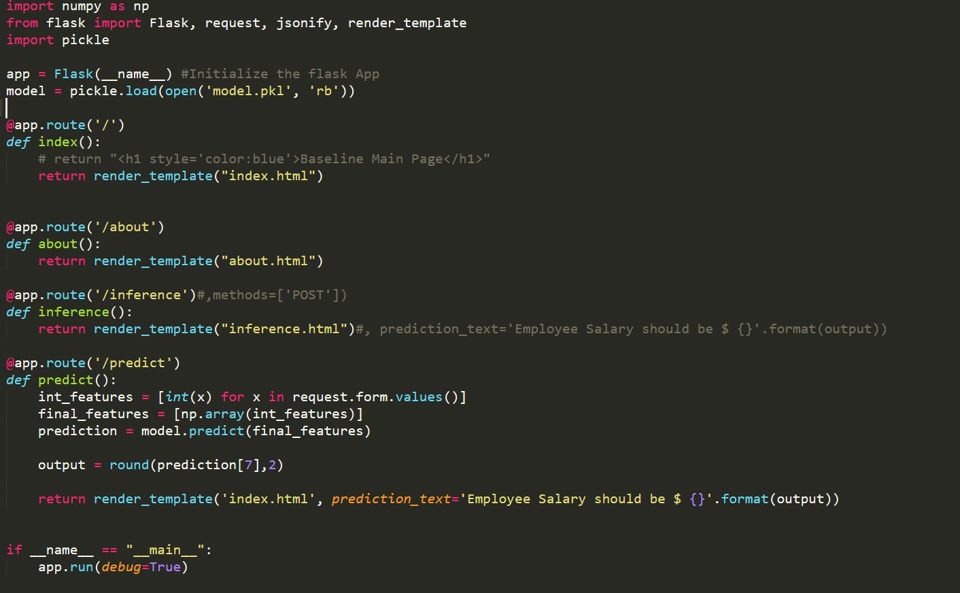
app.py file creating website & deploying model using flask

Slide 12
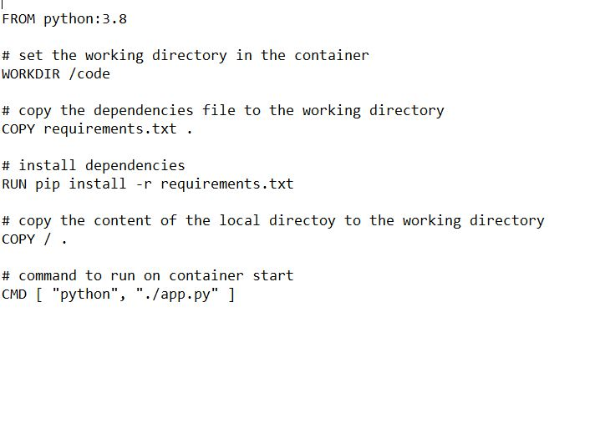
Docker file

Slide 13
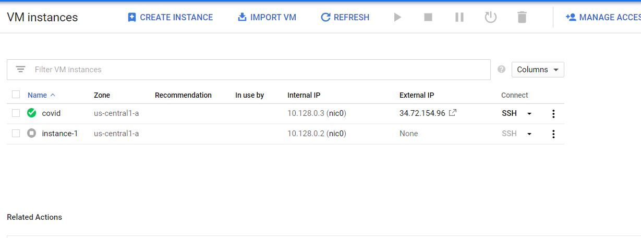
Created instance for deployment

Slide 14
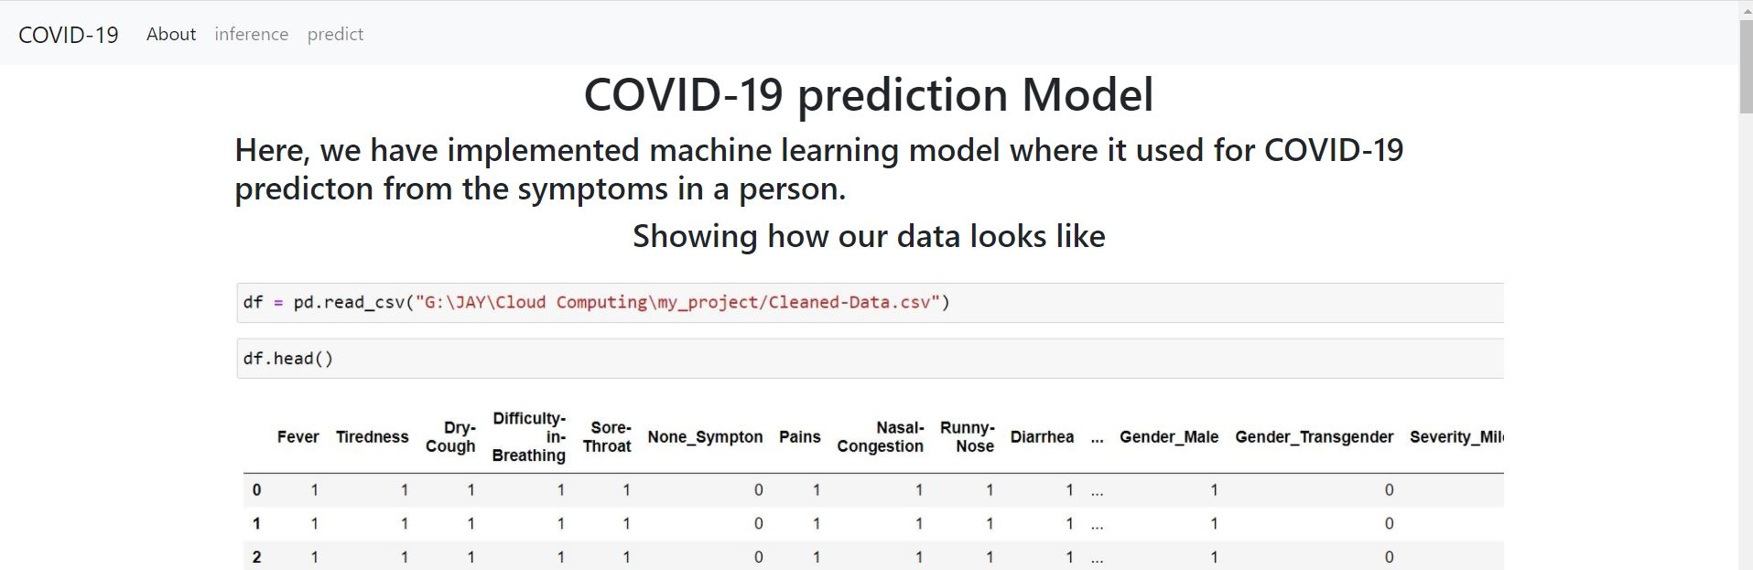
Home page

Slide 15
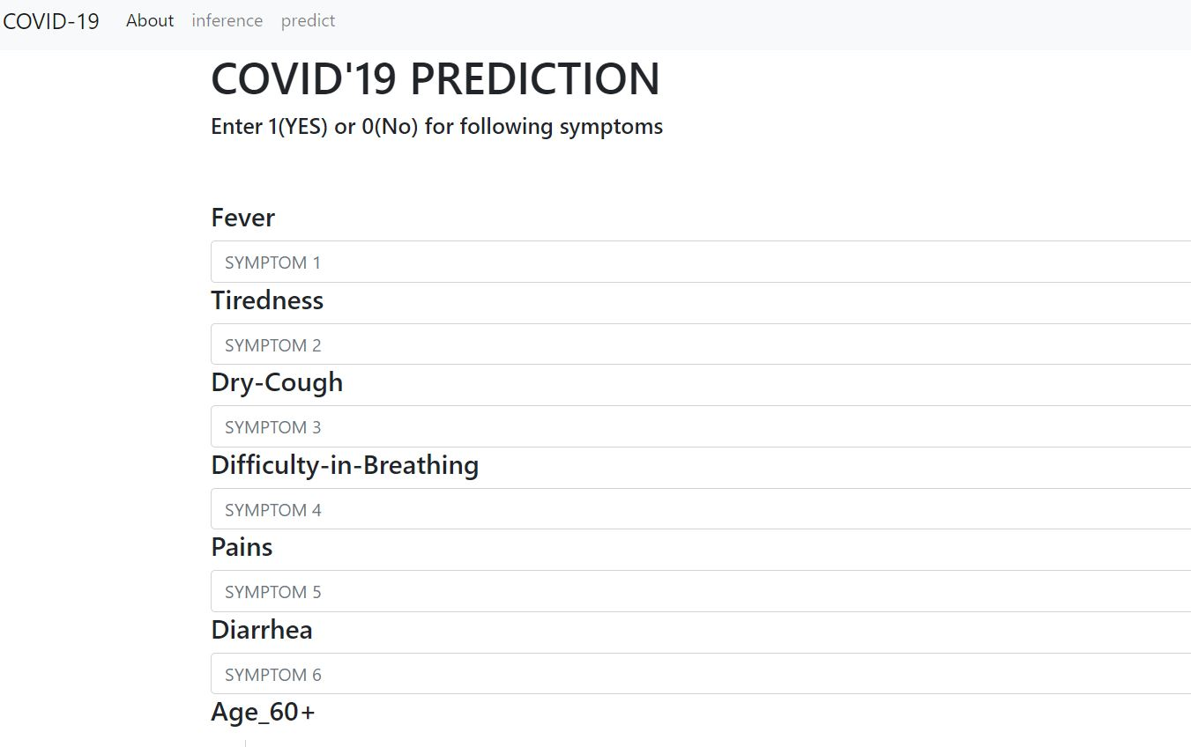
User input

Slide 16
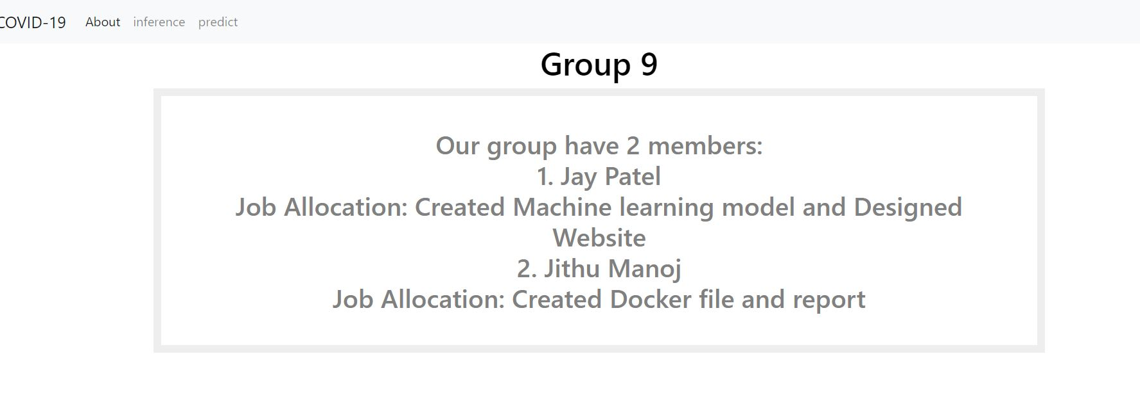
aBout us

Slide 17
Thank you

