Slide 1
Detecting Similarity between Textual Documents using Clojure
Group:
Udbhavsinh Solanki (0873798) Bhavya Faldu (0872906)
Jay Patel (0872908)

Slide 2
Project concept and experimentation: -
We have calculate Jaccard similarity, Cosine Similarity, Euclidean distance between the set of docs given.
In this project we are going to play the role of software forensics expert to analyze the similarity between set of textual documents. Our program produce kind of quantitative measures (e.g. Checksum Coefficients) that identify the similarity between the given documents based on sound algorithms.

Slide 3
First step : - (tf-idf )
Initially, we calculate the tf-idf for the documents given.
As by the word, it stands for term frequency - inverse document frequency. It is statistical value, used for calculating the importance of a word in the document in the corpus( a collection of documents is called corpus).
tf-idf is composed of two words. First one is term frequency and the second is inverse document frequency. we calculate both of them separately. Term frequency is nothing but the number of times a term appears in the document divided by the number words in the document. whereas inverse document frequency is logarithm to the total number of documents in the corpus divided by the number of documents the term actually contains.

Slide 4
Stop words :-
Another important term that we use is ‘stop words’. what is stop words? stop words are nothing but commonly used words like the,a,is etc., These words are given little value so we exclude them from documents after we tokenize the words.

Slide 5
What is Jaccard similarity?
It is the measure of the total number of common words in both the documents divided by total number of words in both the documents.

Slide 6
What is Cosine Similarity?
Here we represent each document as a set of vector. let n be the total number of words in all the documents or corpus. Then each document is represented as a vector of dimensionality n. Then we find the cosine value between two documents using these vectors.

Slide 7
What is the Euclidean distance?
the Euclidean is the distance between two documents represented as vectors.
The distance between two objects that are not points is usually defined to be the smallest distance among pairs of points from the two objects. Formulas are known for computing distances between different types of objects, such as the distance from a point to a line.

Slide 8
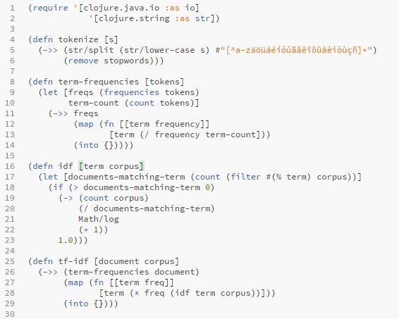
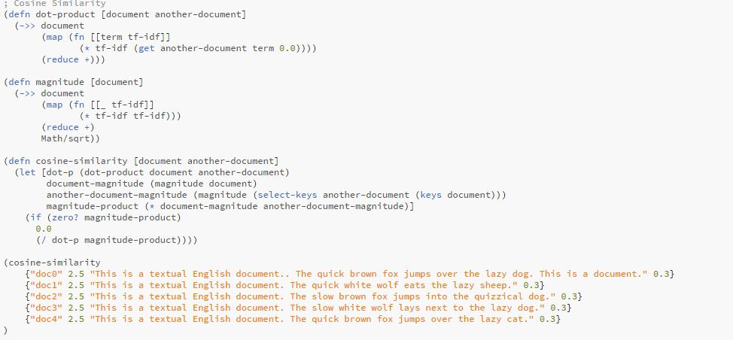
Glimpse on our Clojure file: -

Slide 9
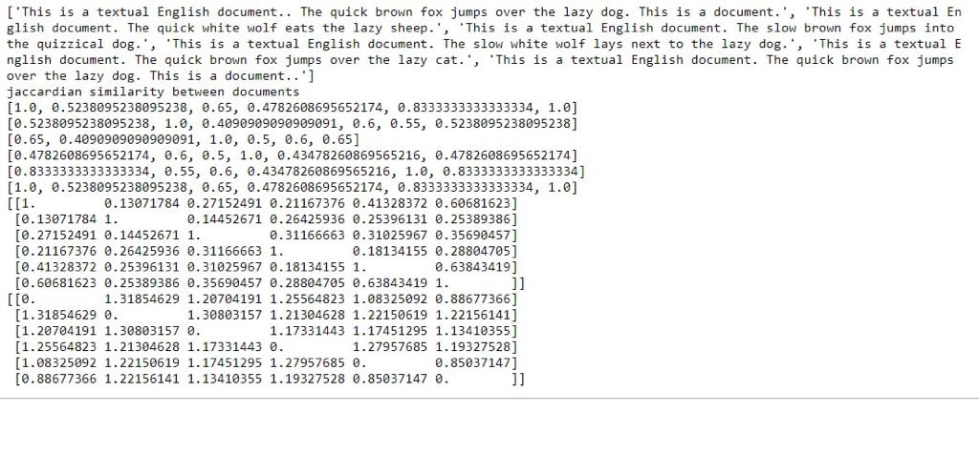
Output showing different types of similarities: -

Slide 10
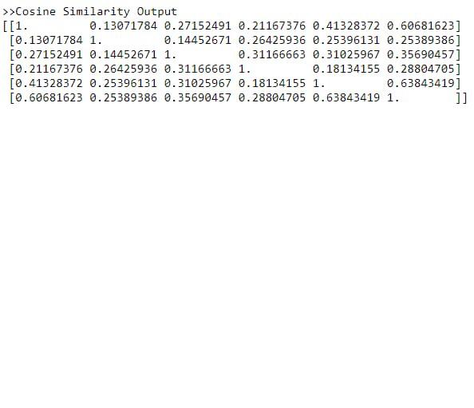
Output showing different types of similarities: -

Slide 11
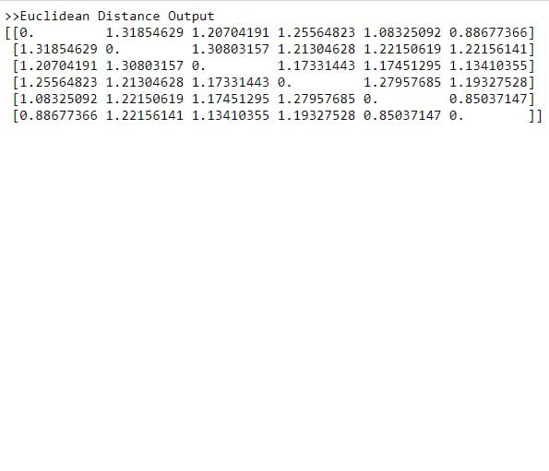
Output showing different types of similarities: -

Slide 12
Thank you….
Eat, Sleep, Study And Repeat…….

