Slide 1
word embedding and textual analytics
IN JULIA
Jay Patel (0872908)
Vivek (0890993)

Slide 2
Text Analytics
Text Analysis is about parsing texts in order to extract machine-readable facts from them. The purpose of Text Analysis is to create structured data out of free text content. The process can be thought of as slicing and dicing heaps of unstructured, heterogeneous documents into easy-to-manage and interpret data pieces.
The dominate model is Called Bag of Words!
Bag of words simply breaks apart the words in the review text into individual word count statistics

Slide 3
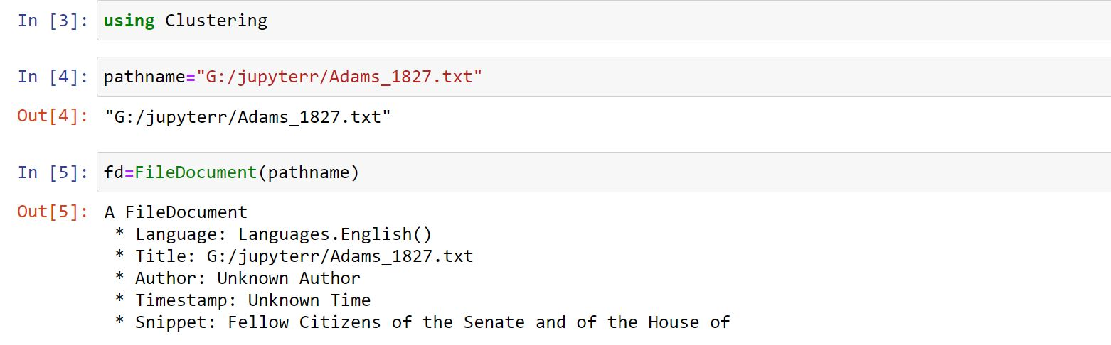
Using text analysis package working on file document https://www.kaggle.com/rtatman/state-of-the-union-corpus-1989-2017?select=Adams_1827.txt

Slide 4
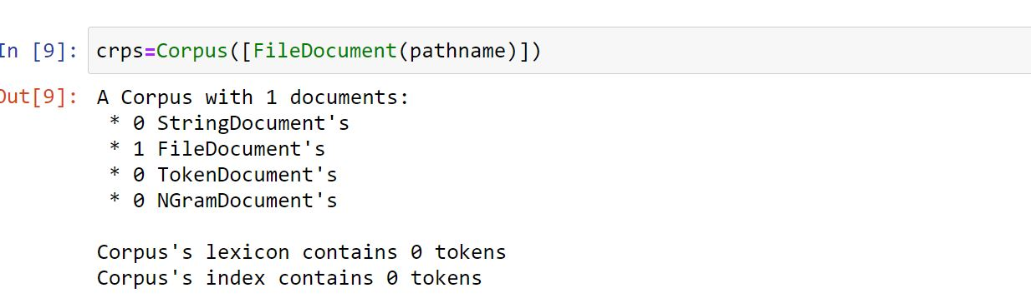
Some of the important terminology related to document analysis Corpus : Structured set of text, obtained by preprocessing raw textual data.

Slide 5
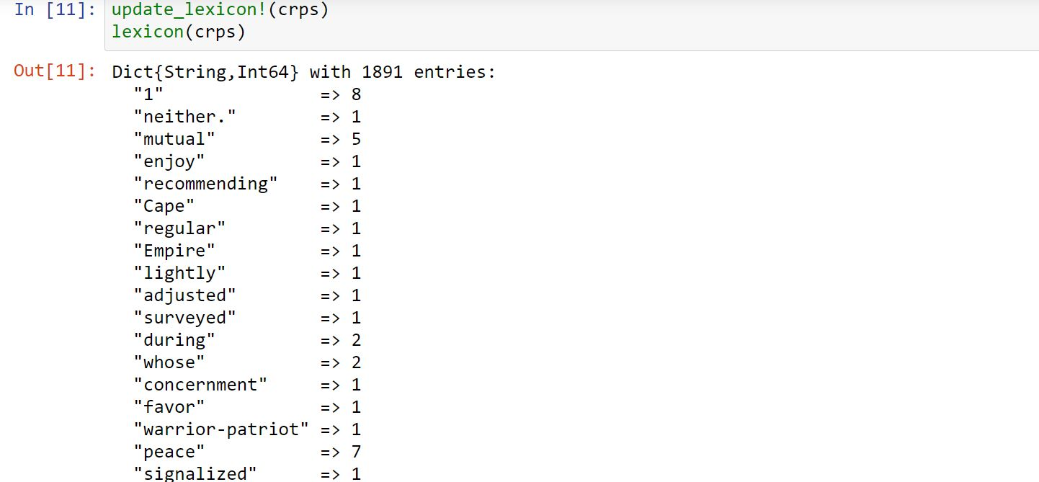
Lexicon Distinctive collection of all the words/terms in the corpus.

Slide 6
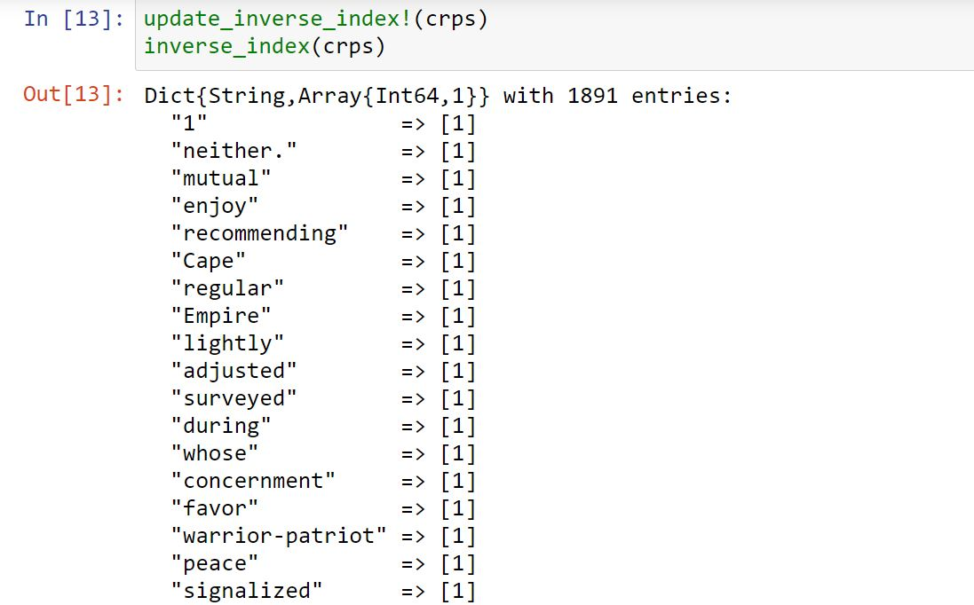
Inverse Index: If we are interested in a specific term, we often want to know which documents in a corpus contain that term. The inverse index tells us this and therefore provides a simplistic sort of search algorithm

Slide 7
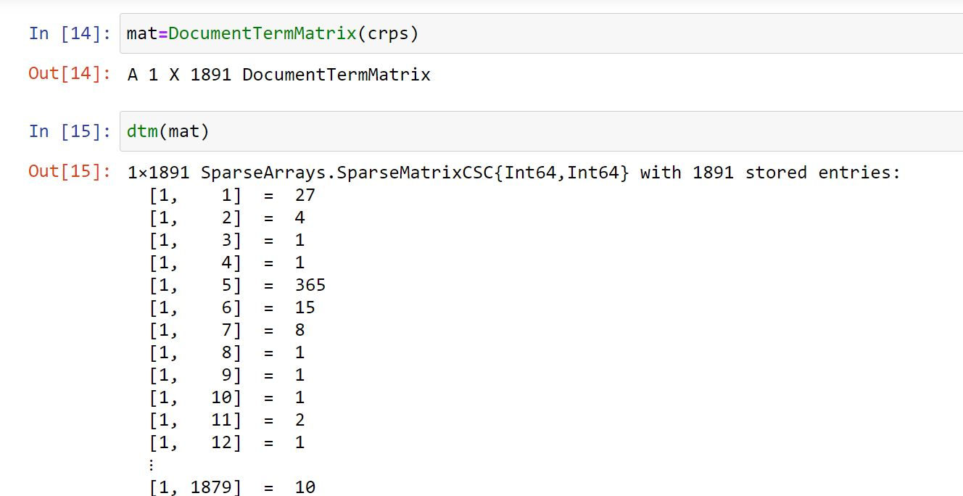
DTM A document-term or term-document matrix consists of frequency of terms that exist in a collection of documents. In document-term matrix, rows represent documents in the collection and columns represent terms whereas the term-document matrix is the transpose of it.

Slide 8
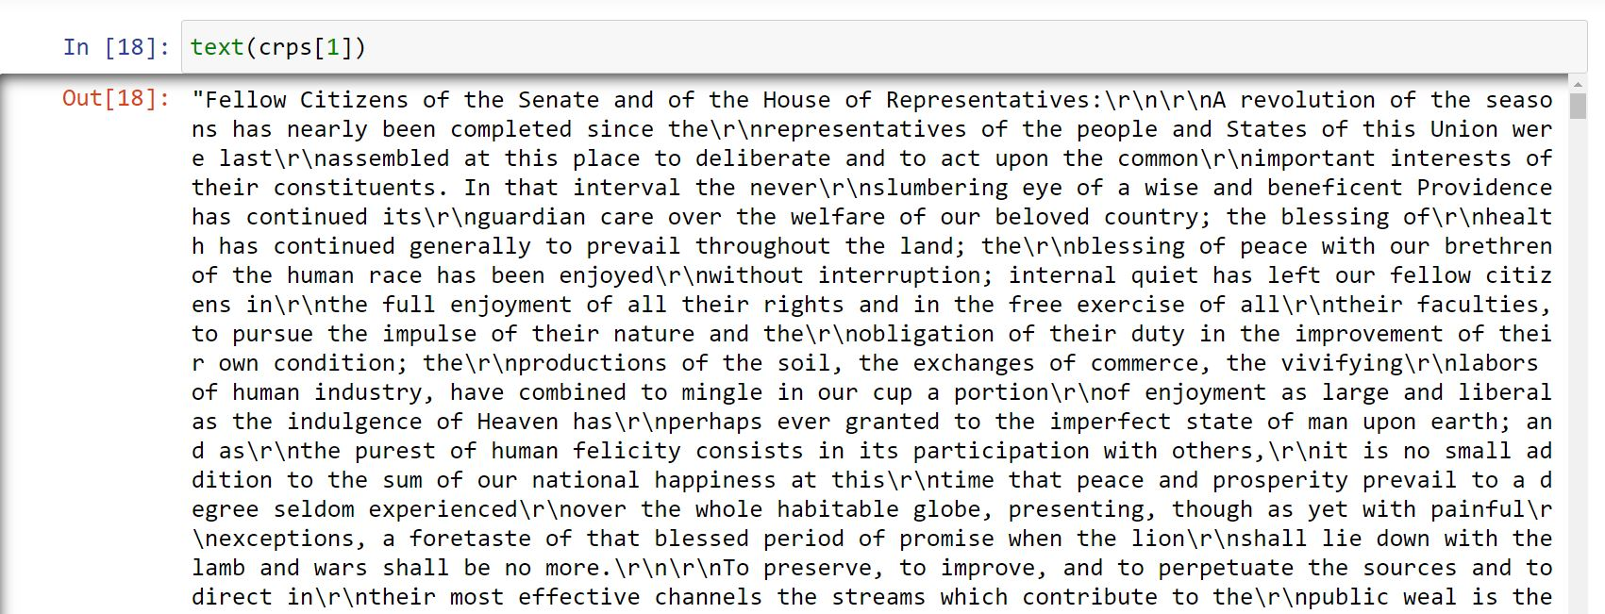
https://www.kaggle.com/rtatman/state-of-the-union-corpus-1989-2017?select=Adams_1827.txt

Slide 9
Word embedding
Word embedding is the collective name for a set of language modeling and feature learning techniques in natural language processing (NLP) where words or phrases from the vocabulary are mapped to vectors of real numbers. Conceptually it involves a mathematical embedding from a space with many dimensions per word to a continuous vector space with a much lower dimension. Word embedding implements language modeling and feature extraction based techniques to map a word to vectors of real numbers

Slide 10
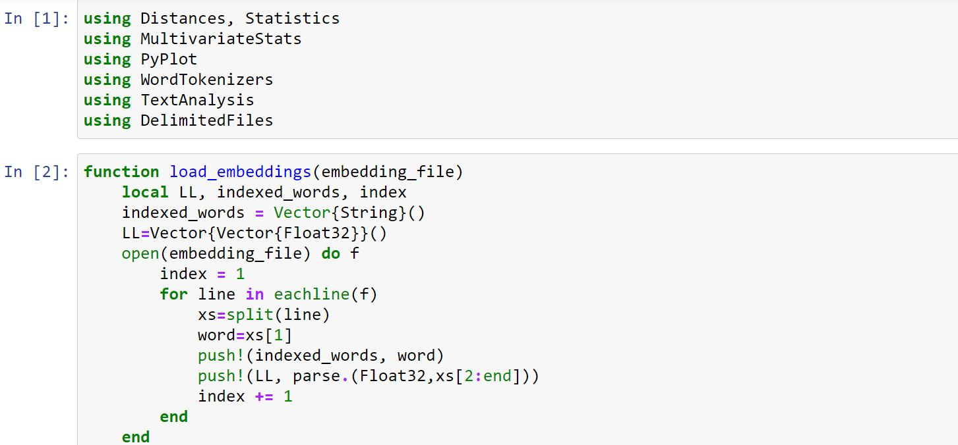
Calling packages & function to load word vector The load_embeddings function takes the input of the embeddings filename and returns two arrays: embeddings– A Float32 Array, each row represents one word as an d dimensional vector vocab– A string array of all the words

Slide 11
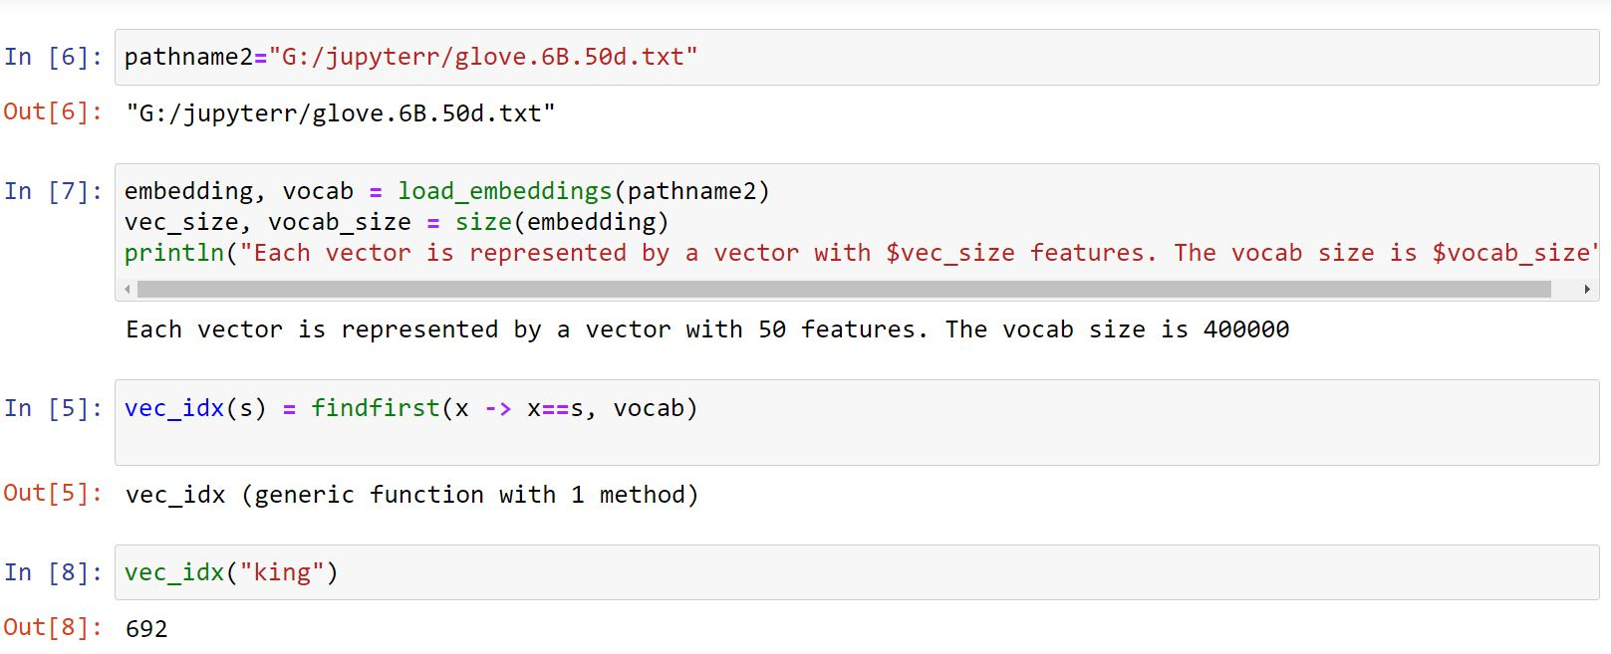
Loading glove vector from wikipidea

Slide 12
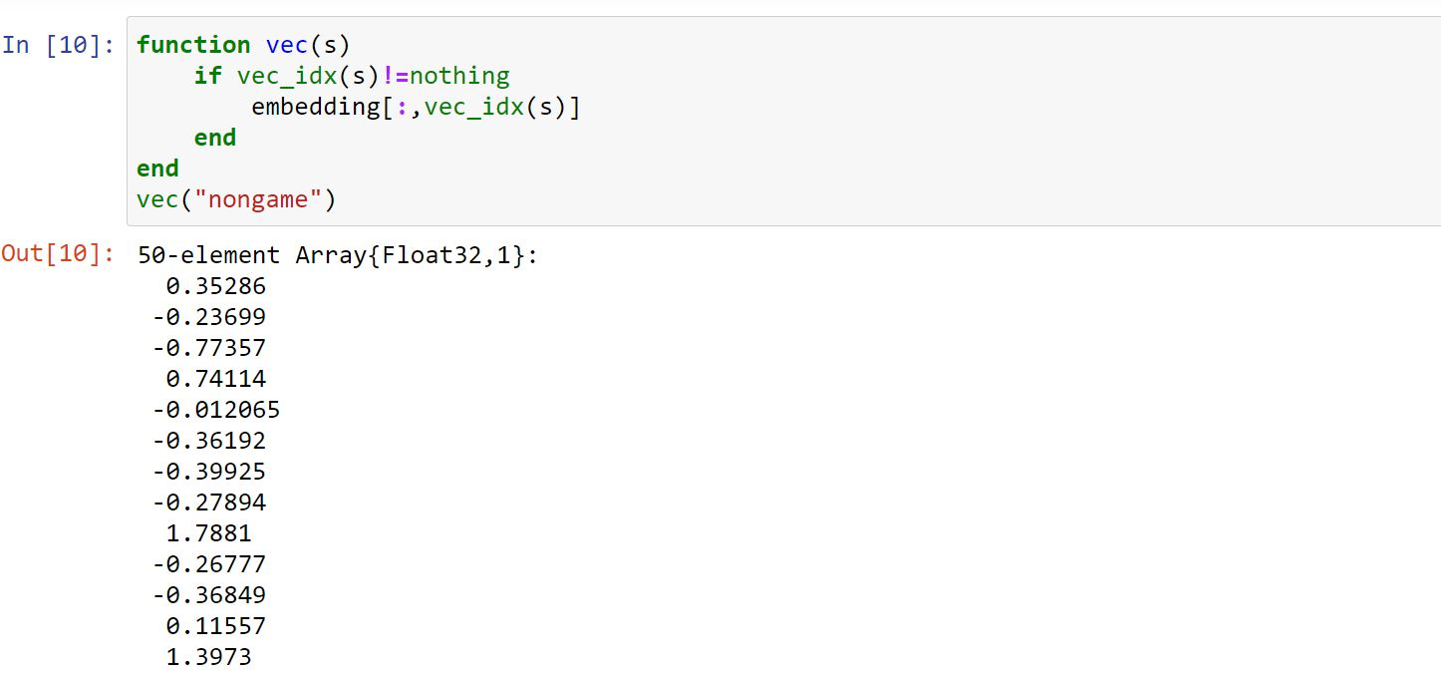
Vector function

Slide 13
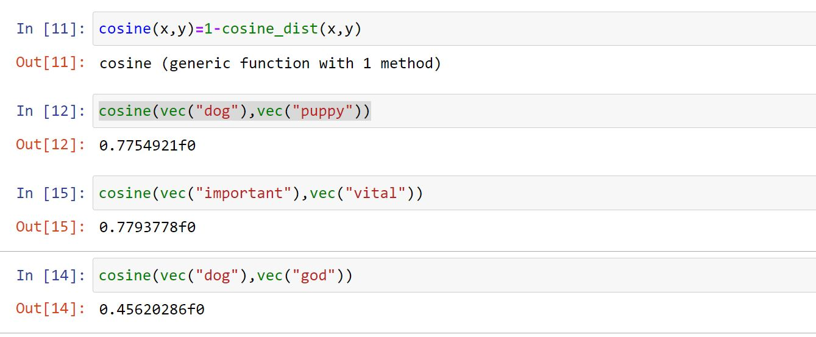
Using cosine distance

Slide 14
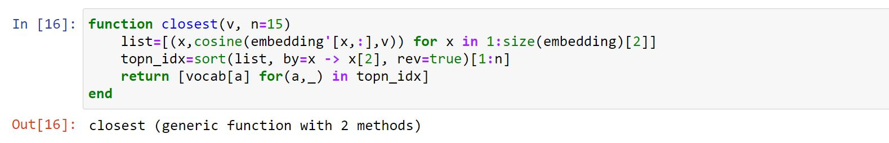
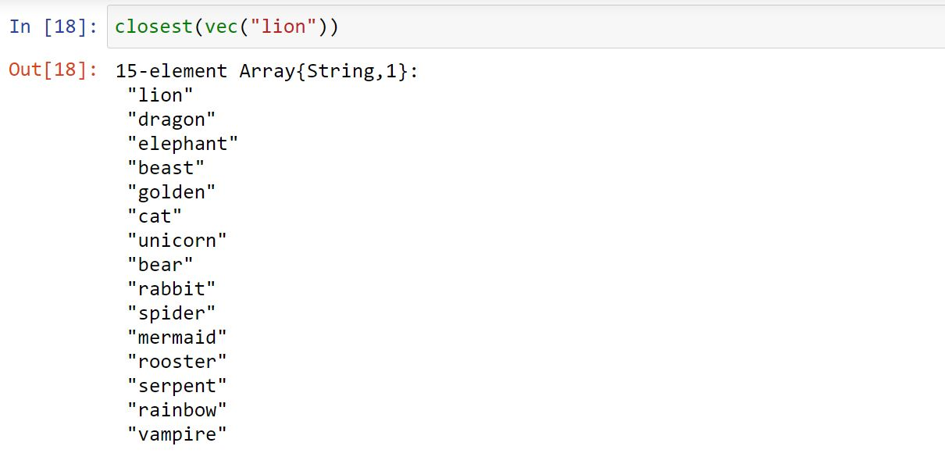
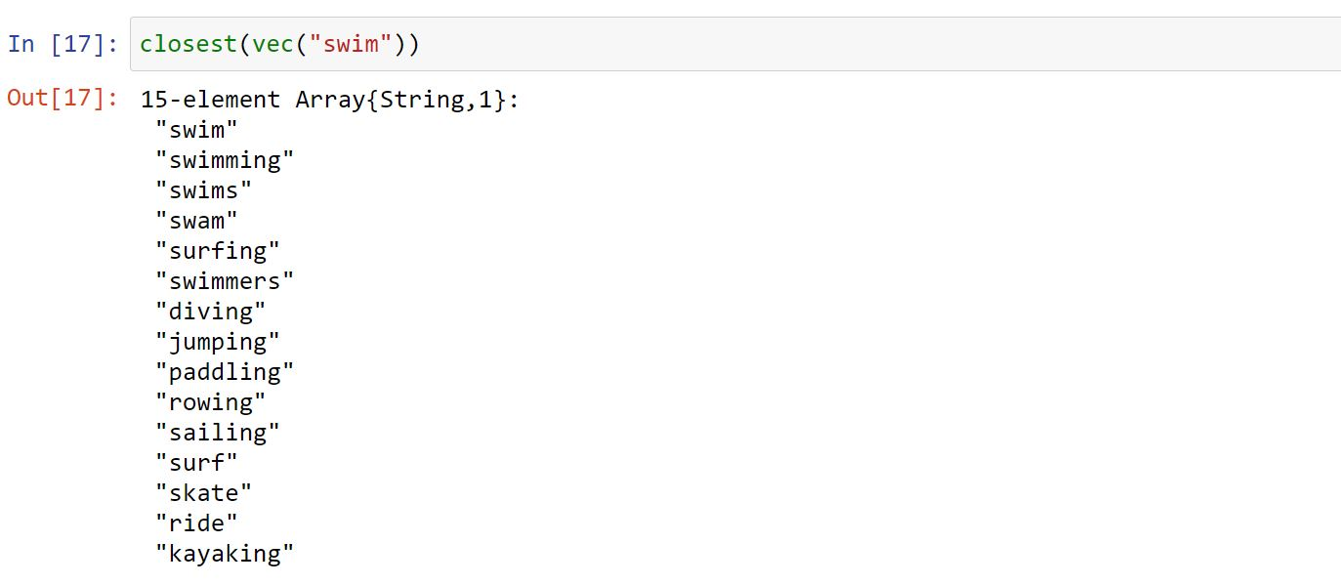

Slide 15
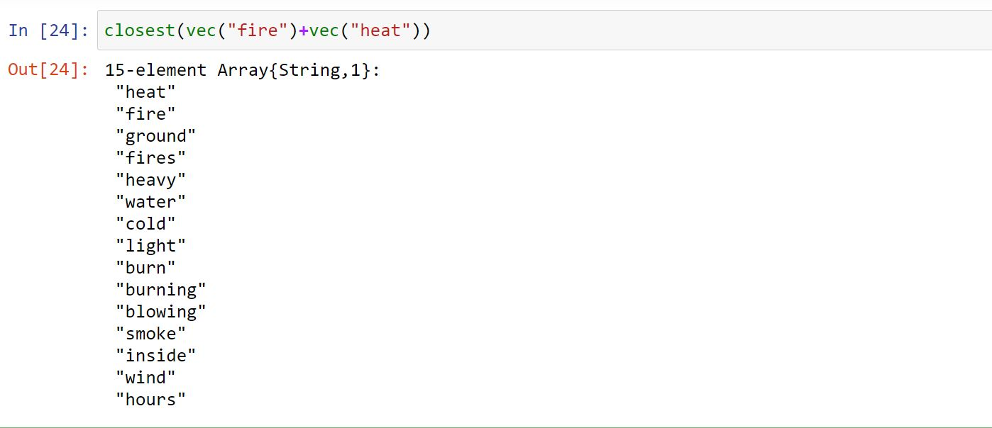
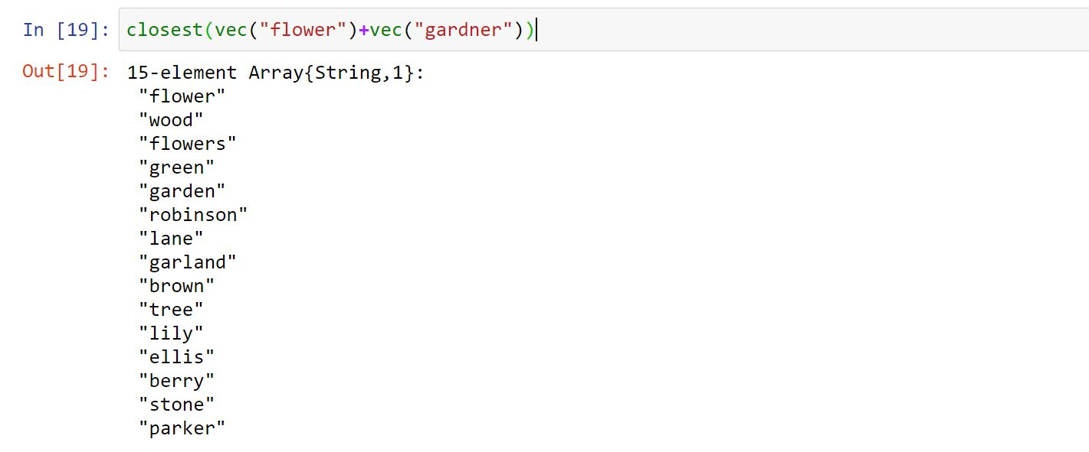
More example of closest().

Slide 16
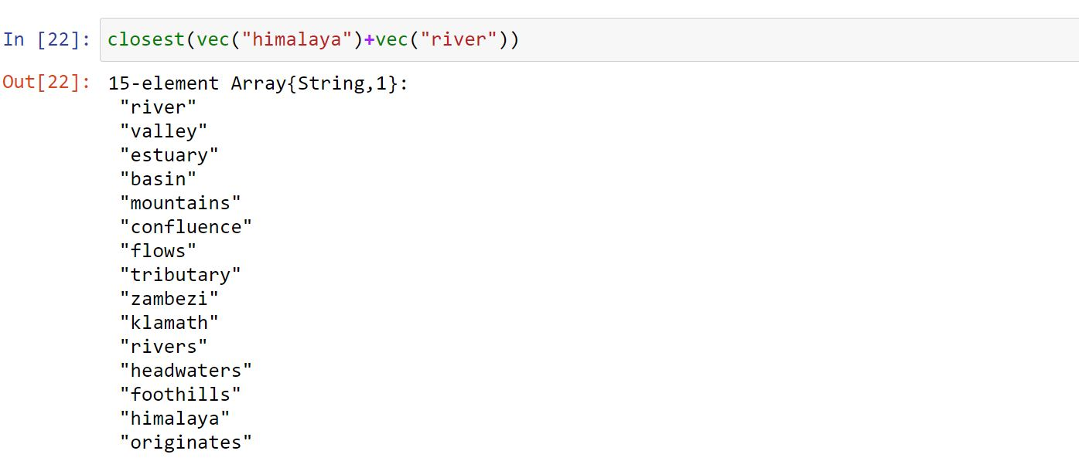
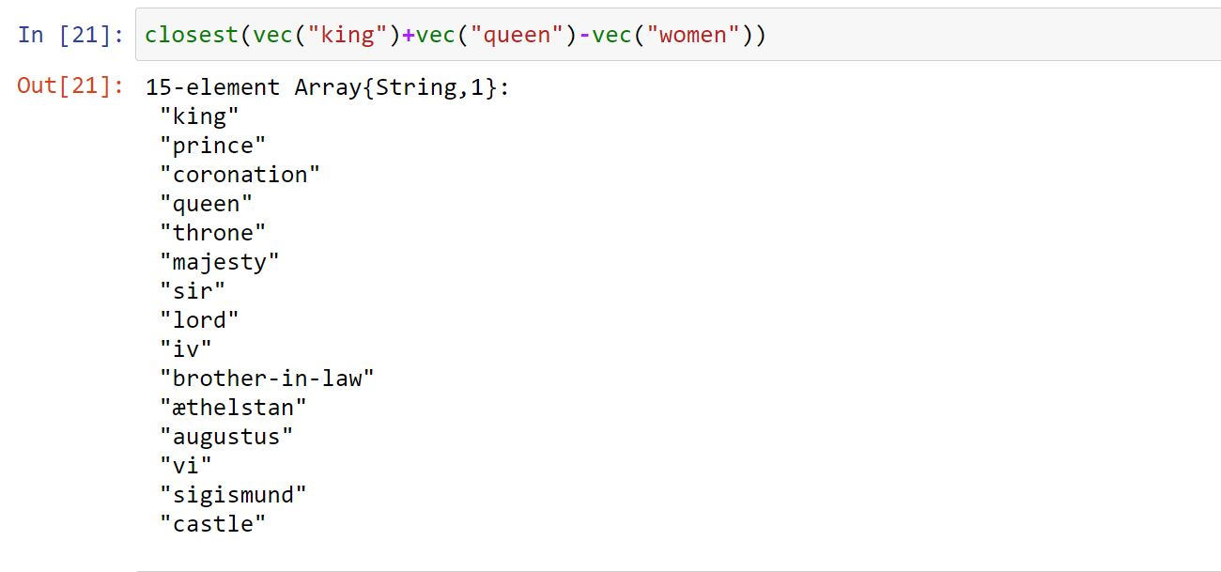

Slide 17
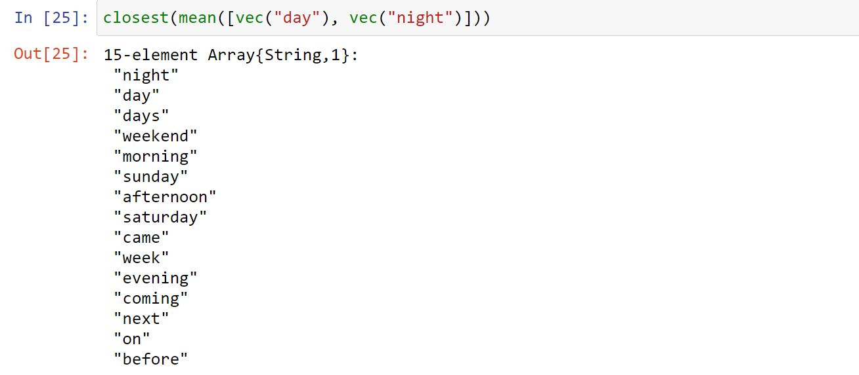

Slide 18
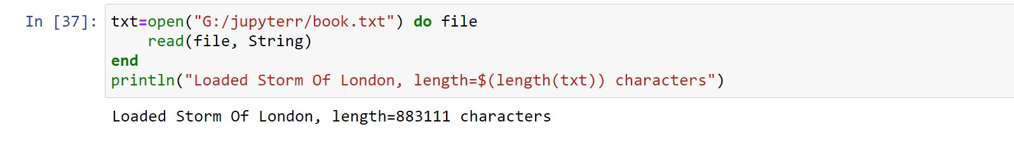
For sentence similarity used storm of London book https://dev.gutenberg.org/ebooks/63939

Slide 19
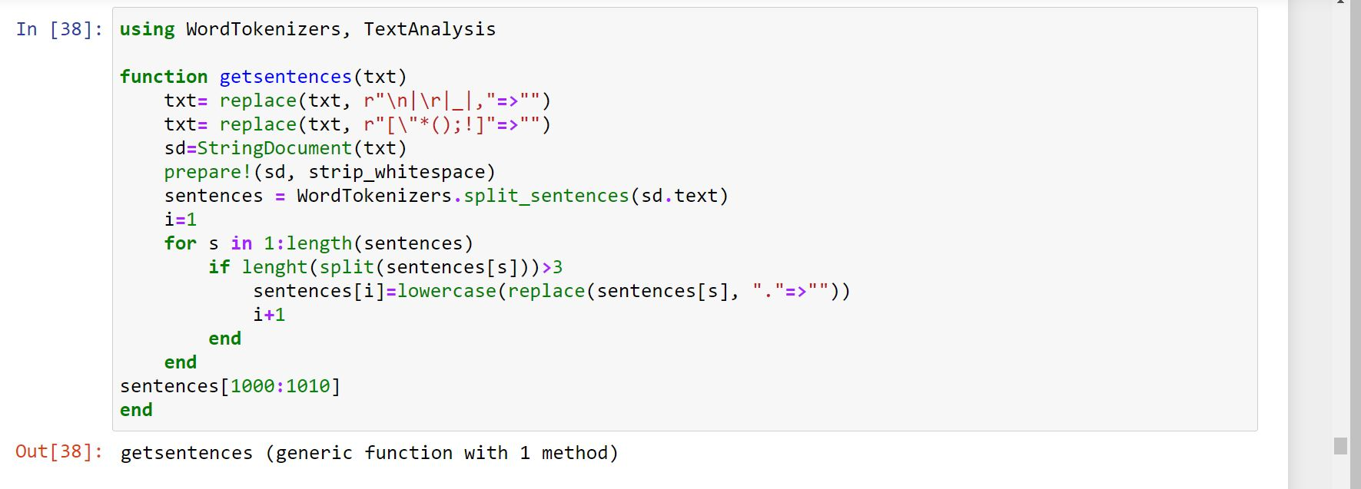
Cleaning our book data

Slide 20
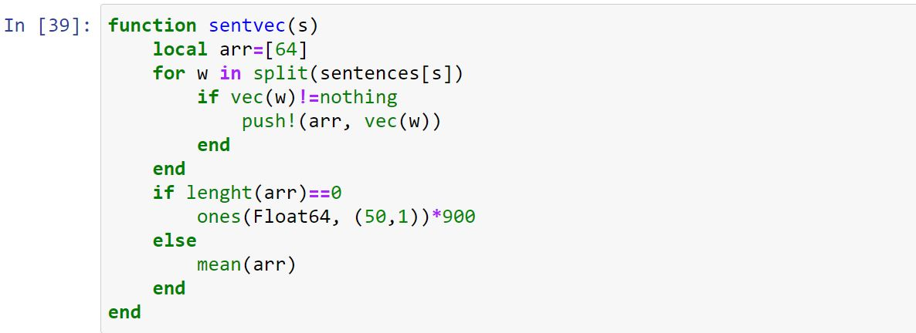
takes the vectors of each word in the array and finds the mean vector of the whole sentence.

Slide 21
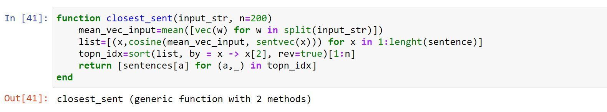
Returns n closest sentences

Slide 22
Thank you ☺ Demo time
Reference :
Lecture 15 slide

