Slide 1
Agile Methodology
Subodh Bhoite

Slide 2
What is Agile?
Agile is a philosophy to rapidly deploy any application in much more organized way.
Agile is nothing but a chain of rapid development & deployment

Slide 3
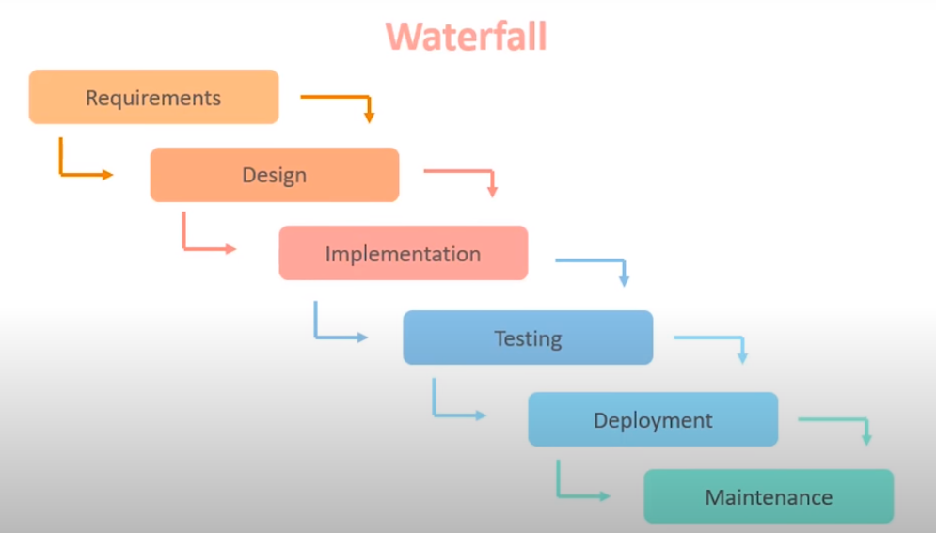
Need of Agile

Slide 4
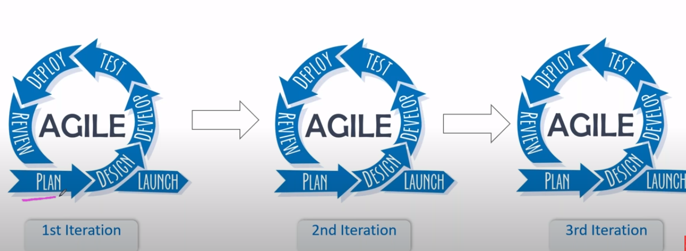
Agile Life Cycle

Slide 5
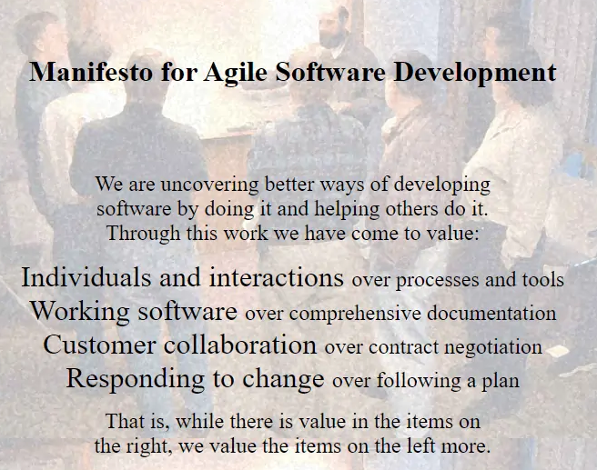

Slide 6
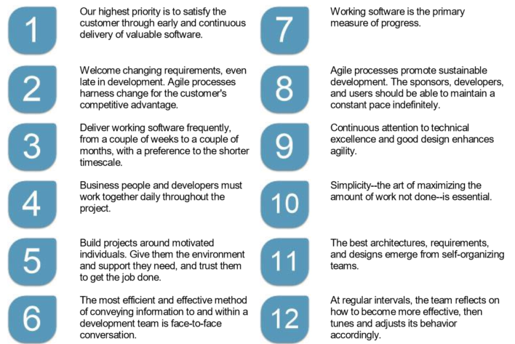
Agile Principles

Slide 7
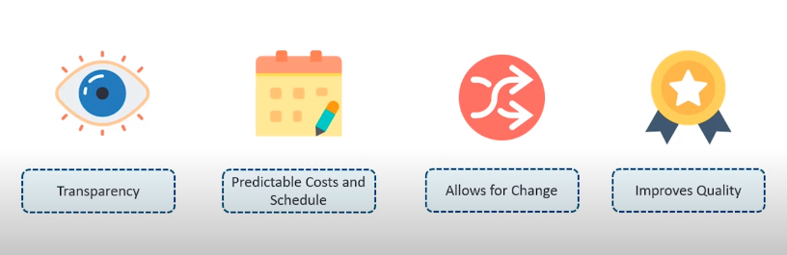
Benefits of Agile

