Slide 1
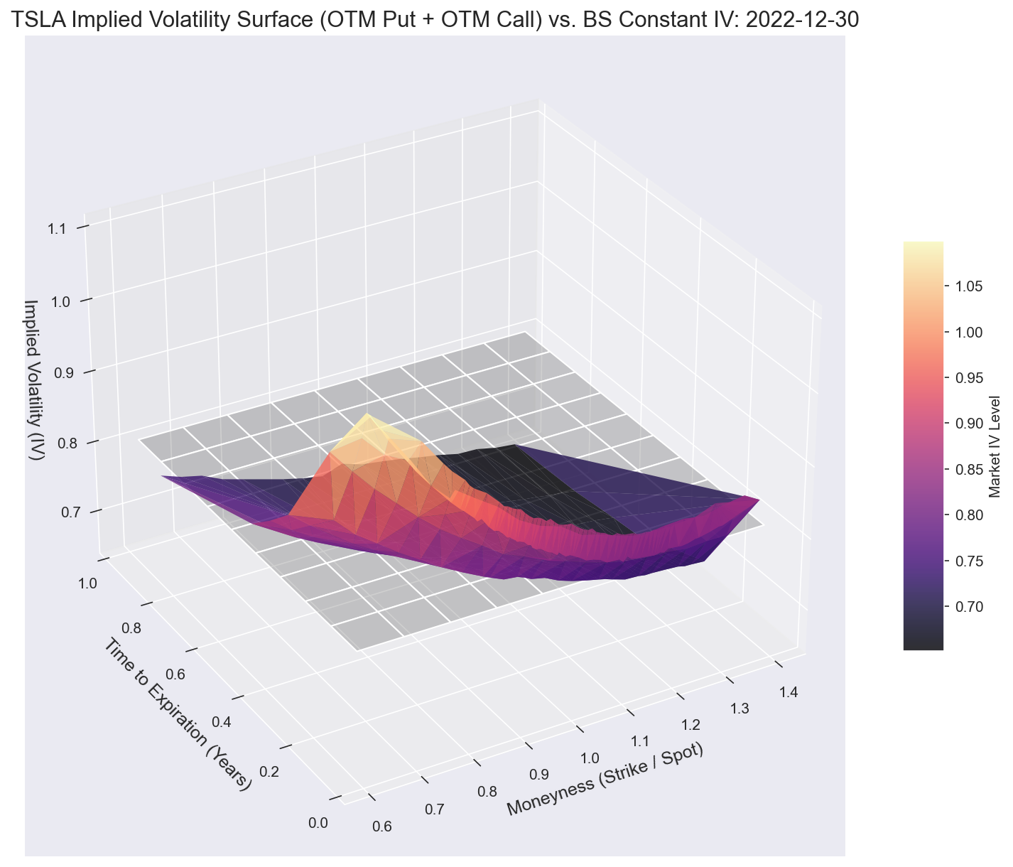
TSLA Implied Volatility Surface
From Raw Options Data to Market Skew and Term Structure
Black-Scholes assumes constant volatility — the market disagrees
IV varies across strikes and maturities, forming a surface
The surface encodes crash risk, regime fear, and event positioning
Dataset: 2.6M TSLA option quotes, 2019–2022 → 638K IVs computed
638,197 IVs Computed
Average IV: 66.70%
Risk-Free Rate: 3.9%

Slide 2
Method
From 2.6 Million Quotes to 638K Implied Volatilities
1
2
3
4
Raw Data
→
Liquidity Filter
→
IV Solver
→
IV Surface
2.6M EOD option quotes
5 criteria → 647K quotes
Newton-Bisection → 638K IVs
Skew · Term Structure · Event Study
Liquidity Filter Criteria:
IV Solver — Hybrid Newton-Bisection:
Call bid > $0.50 — removes penny options
7 < DTE < 365 — tradeable horizon only
|Strike distance| < 40% — smile region only
Volume > 0 — active trading required
Bid-ask spread < 20% of mid — rejects stale quotes
Newton-Raphson: fast convergence near solution
Bisection fallback: when vega < 1e-6 or step escapes bounds
Arbitrage pre-filter: rejects prices outside (S − Ke⁻ʳᵀ, S)
Tolerance: 1e-8 | Max iterations: 100
Fully vectorized over NumPy arrays

Slide 3
The IV Surface
The Market Smiles, Not Flat
Key Observations
Gray plane
= Black-Scholes constant-vol assumption
Colored surface
= what the market actually prices
Put-side elevated
OTM puts carry higher IV — crash insurance premium
Short-maturity spike
Near-term uncertainty priced higher
Smile curvature
IV lowest at ATM, rises on both wings
This surface is the empirical signature of fat tails — features Black-Scholes ignores by assuming log-normality. Heston, SABR, and local vol models were built to fit this shape.

Slide 4
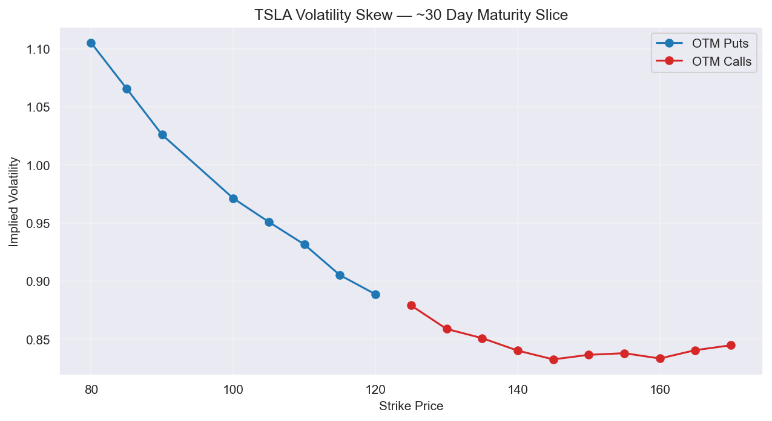
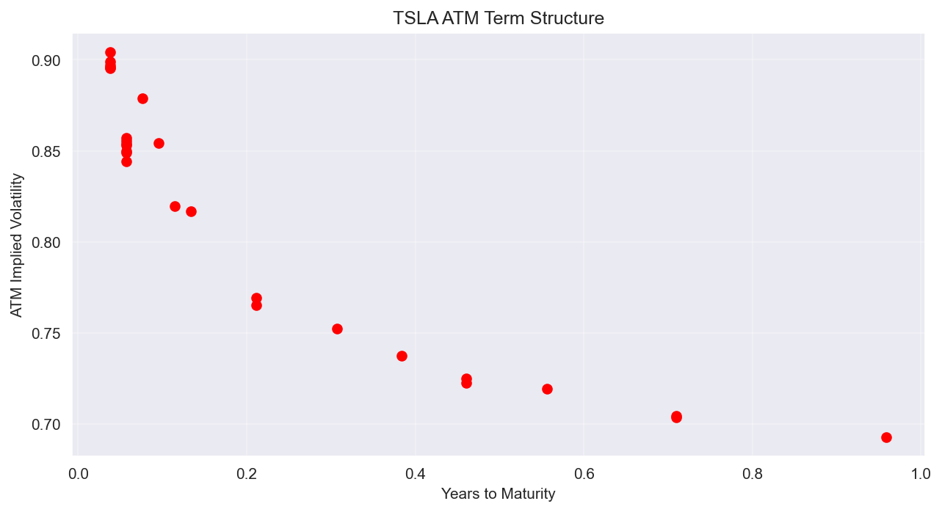
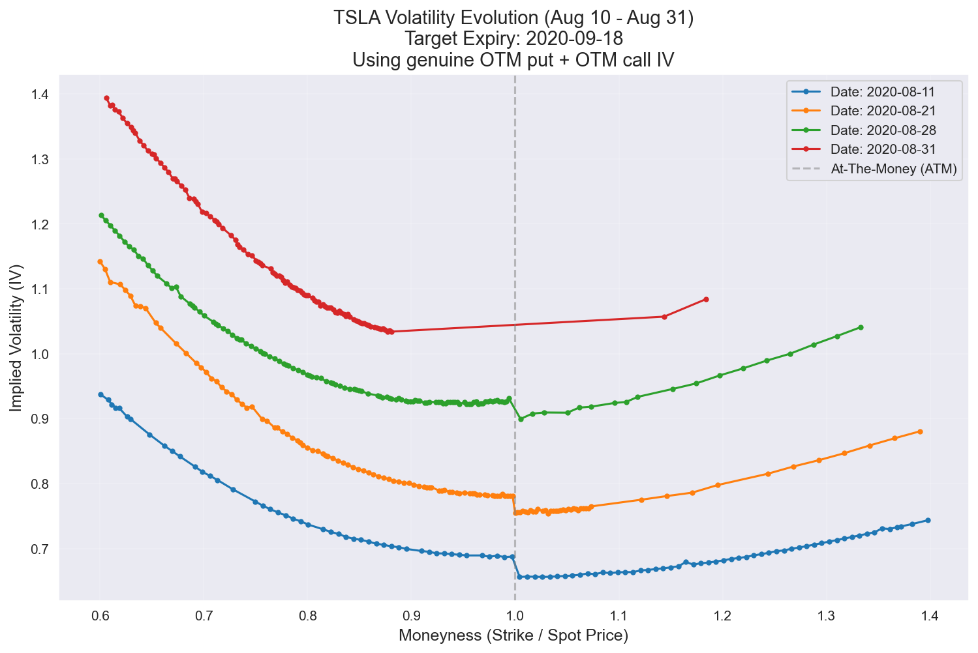
Insights
Skew · Term Structure · Event Study
Volatility Skew — Dec 2022, ~30 DTE
ATM Term Structure — Dec 2022
Put skew: OTM puts expensive = crash insurance premium
Downward slope: near-term stress expected to resolve
Event Study: TSLA 5-for-1 Stock Split (Aug 2020) — Put-call skew compressed to its narrowest point (+3.5 vol pts) as retail FOMO peaked — but never inverted

Slide 5
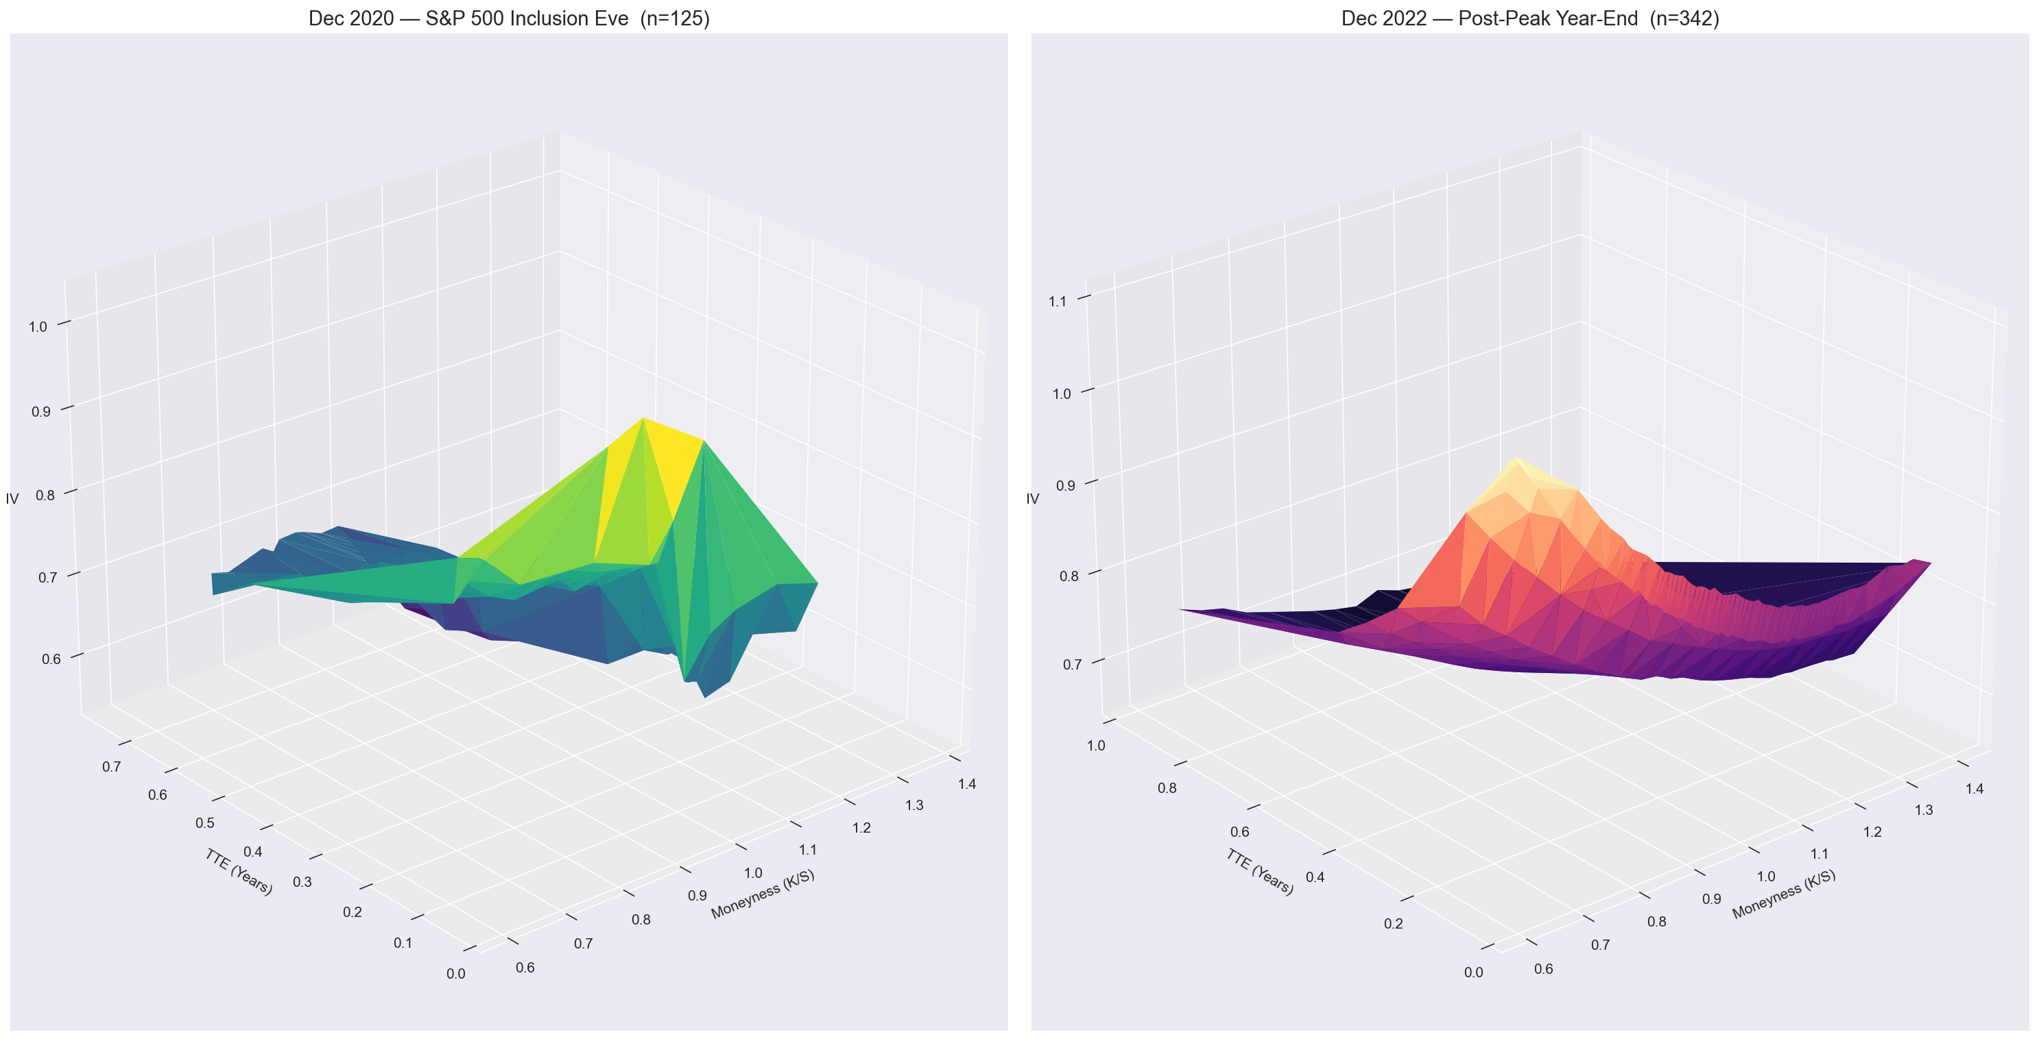
Why It Matters
What the Surface Tells You That Black-Scholes Can't
Black-Scholes Assumes
Market Reality
5 Key Takeaways
Constant volatility
Volatility surface
BS is empirically wrong — market prices a smile
Skew = crash fear, priced in real time
Term structure = when the market expects stress
Surface shape shifts with regime, not just level
Events distort the surface — predictably
Log-normal returns
Fat tails + skewness
Static model
Dynamic, regime-sensitive
One number
A landscape of information
Natural Extensions:
Local Vol (Dupire) · Stochastic Vol (Heston / SABR) · Vol Regime Classifier

