Slide 1
HOME AUTOMATION USING GOOGLE ASSISTANT
Guide name : harsh patel
PATEL DARSHAN(18IT079)
PATEL JAY(18IT088)

Slide 2
WHAT IS HOME AUTOMATION?
A smart home refers to a convenient home setup where appliances and devices can be automatically controlled remotely from anywhere with an internet connection using a mobile or other networked device is called home automation.
Devices in a smart home are interconnected through the internet, allowing the user to control functions such as security access to the home, temperature, lighting, and a home theater remotely..

Slide 3
WHY HOME AUTOMATION?
Your security system knows all about your occupancy of the house. With a little more development it can build an intelligent 'expert system' to predict your usage.
• Your central heating programmer knows the standards of comfort you expect - but doesn't know which rooms are in use.
• By linking just these two you could achieve a reduction in fuel costs and a better match to your requirements

Slide 4
outline
Introduction
Equipments
Circuit diagram
Advantages
Conclusion
Future work
References

Slide 5
INTRODUCTION
Google assistant is AI (Artificial Intelligence) based voice command service. Using voice, we can interact with google assistant and it can search on the internet, schedule events, set alarms, control appliances, etc.
We can control smart home devices including lights, switches, fans and thermostats using our Google Assistant.
In this system, Nodemcu ESP8266i is put in with a Blynk application account with the IFTTT web site then adding to Google Assistant for voice commands. Voice command controls the house appliances.

Slide 6
EQUIOPMENTS
Hardware Used:
NodeMCU – 32-bit ESP8266 development board with Wi-Fi module
Relay module
Three 100 W Bulb
Arduino UNO circuit
Breadboard
Lights
Jumper wires
To build home automation application, I used three different platforms:
Google Assistant
Arduino IDE
IFTTT
Blynk

Slide 7
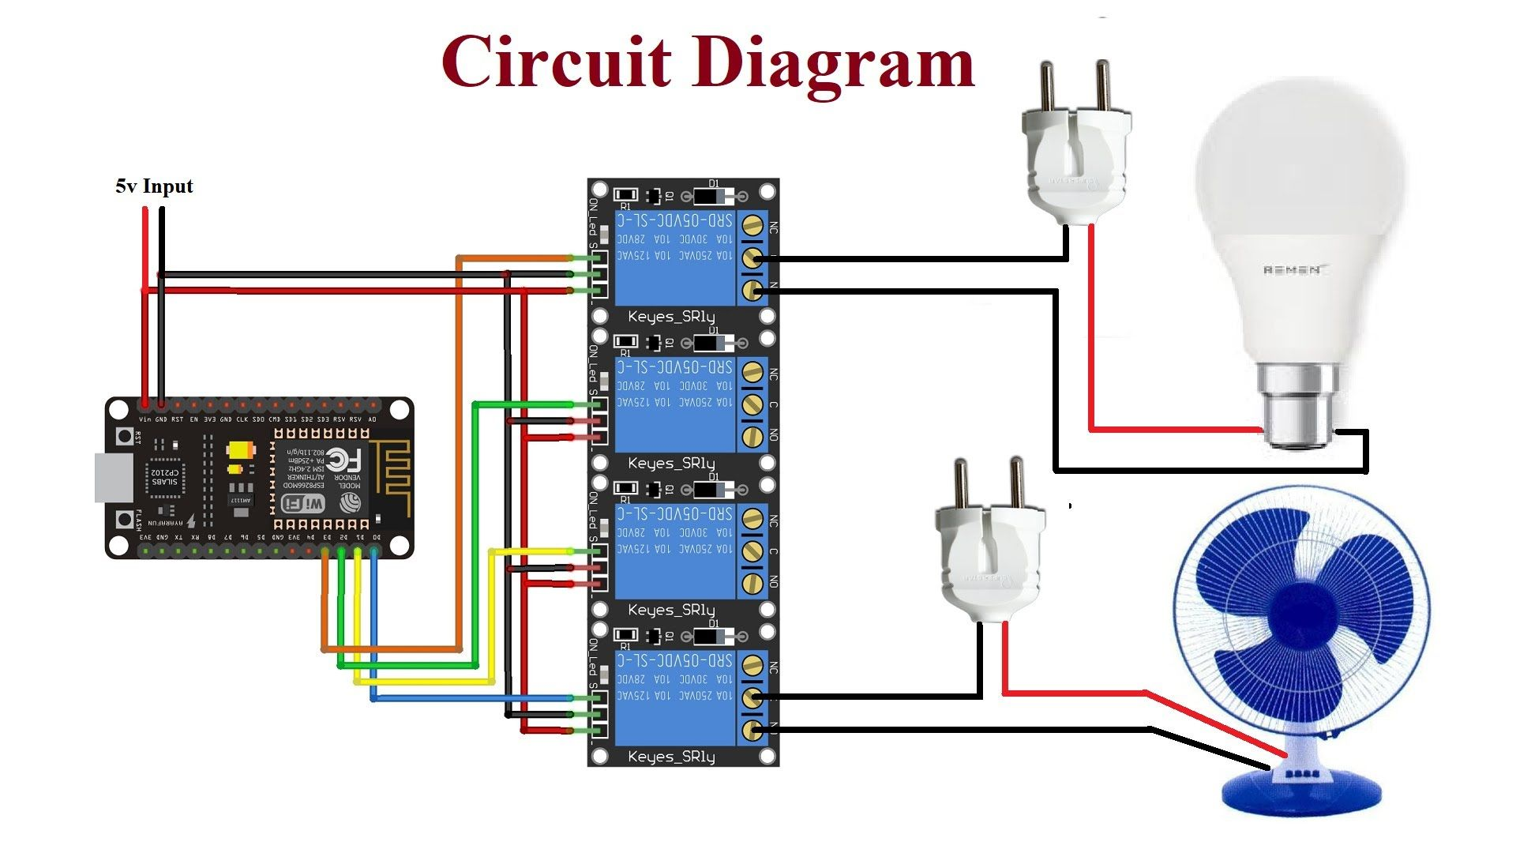
CIRCUIT DIAGRAM

Slide 8
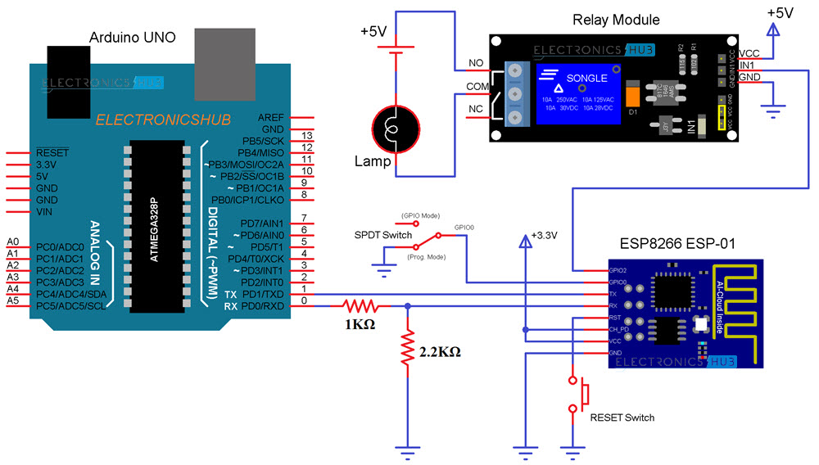
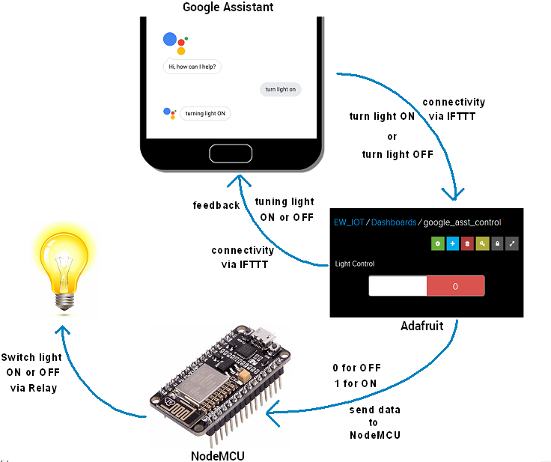
CIRCUIT DIAGRAM

Slide 9
ADVANTAGES
The goal of this project was to develop a home automation system that gives the user complete control over all voice controllable aspects of his or her home.
We can Control your home from mobile devices, including your laptop, tablet, or smartphone.
Program devices to turn on automatically at certain times, or access their settings remotely from anywhere with an Internet connection. When you don’t have to remember to lock the door behind you or switch off the lights, you can turn your attention to more important things.

Slide 10
Application
The home automation can be implemented in:
Home
Restaurants
Company
Collage lab

Slide 11
CONCLUSIONS
In this project, architecture for low cost and flexible home Automation system using Arduino microcontroller is proposed and implemented.
Overall Arduino is easy to understand & its coding is easy.
By implementing this type of system we can ensure that the energy conservation can be done.
we can have the complete control over the home appliances from a long distance. This will Increase the comfortability of human being and it will reduce the Human efforts.
According to this system, a smart voice control home automation system is deployed into the Nodemcu ESP8266 using the Blynk App account with the IFTTT website and Google assistance API within it. Through which a user can home appliances just by giving the voice controls input.

Slide 12
Future Work
The future scope for Google Assistant Controlled Home Automation can be huge.
There are many factors to improve on to make Google Assistant Controlled Home Automation more powerful, intelligent, scalable, and to become better overall for home automation. For example, controlling the speed of the fan, more number of devices can be integrated, like a coffee machine, air conditioner etc.
To make the system respond more faster own private Blynk server can be made. Well, no system is ever perfect. It always has a scope for improvement. One just needs to put on a thinking cap and try and make the system more better.

Slide 13
REFERENCES
[1] https://circuitdigest.com/microcontrollerprojects/google-assistant-based-homeautomation-using-diy-arduino-wifi-shield
[2] https://www.pantechsolutions.net/googleassistant-based-voice-controlled-homeautomation
[3] https://www.hackster.io/babariyasmit/hom e-automation-using-google-assistantbfd1e1
[4] https://create.arduino.cc/projecthub/pawan -kumar3/home-automation-using-googleassistant-88c5c8
[5] https://www.electronicwings.com/nodemc u/control-home-appliances-using-googleassistant

Slide 14
Thank You

