Slide 1
Buck module: remove pins, solder only 5V pin. Place on PCB, fold 5V pin toward C and solder there
Red wire upside through W and I, fold toward V and J respectively
Solder Boost. Fold pins Vo-H, GND-N and Vi-E
Red wire runs underside from H to J-I
Boost Vo over module red wire to R pass-through
Solder 10K underside through S and back through O. A dangles
Prepare C3:
  Solder all pins except G, T, A
  Yellow core pins point up (incl. O), soldered underside. Violet pins must have enough length underside to solder to PCB for support
  Remove bottom spacers. Keep upper spacers
Place C3, fold pins V-W and solder all including upper-pointing pins
Solder 10K’s A leg up to C3. Ensure S-O is linked between PCB and C3
Braid together 1 strand each of black and wrapper wires, solder through T from underside up to C3
Solder 100K topside, through B and A (castillation)
Solder transistor underside at D, G (up to C3), S
Place AHT10 on PCB and insert 4-pin header from underneath. Solder from upside, then remove spacers. Wrap wires underside with C3.
Solder battery wires from B and T underside peeking up and toward connector legs (L, M). Blue wire to Boost Vi underside via B.
Place battery connector, fold pins and solder.
Black wire from M to N is topside, at N fold toward O-S and solder
Relay: clip NC pin and solder underside C, R, I, D
Glue-gun Relay to PCB
Populate LoRa pins except VCC and GND. DIO is NC. Yellow core pins point up, so headers are inserted from above and soldered underside
LoRa VCC and GND are pass-through from underside to Buck module
Wrap SPI wires topside between LoRa and C3
Buck
C
R
I
D
W
V
H
J
T
Boost
N
O
S
G
E
10K
A
B
100K
M
L
#define LORA_POWER 4
#define LORA_MOSI 5
#define LORA_SS 6
#define LORA_MISO 7
#define LORA_SCK 9
#define LORA_RST 10
#define I2C_SCL 2
#define I2C_SDA 1
#define PIN_ADC 0
#define PIN_LED 8
#define PIN_UNUSED 3

Slide 2
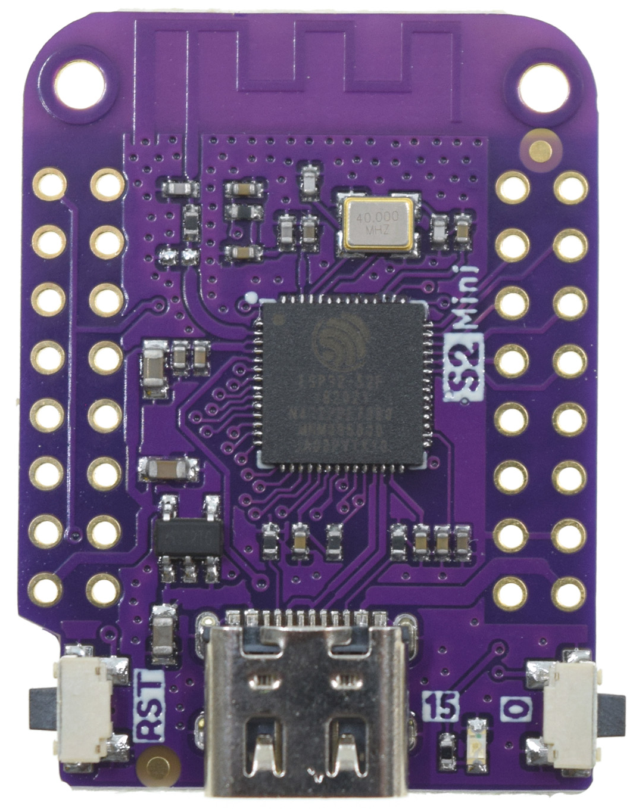
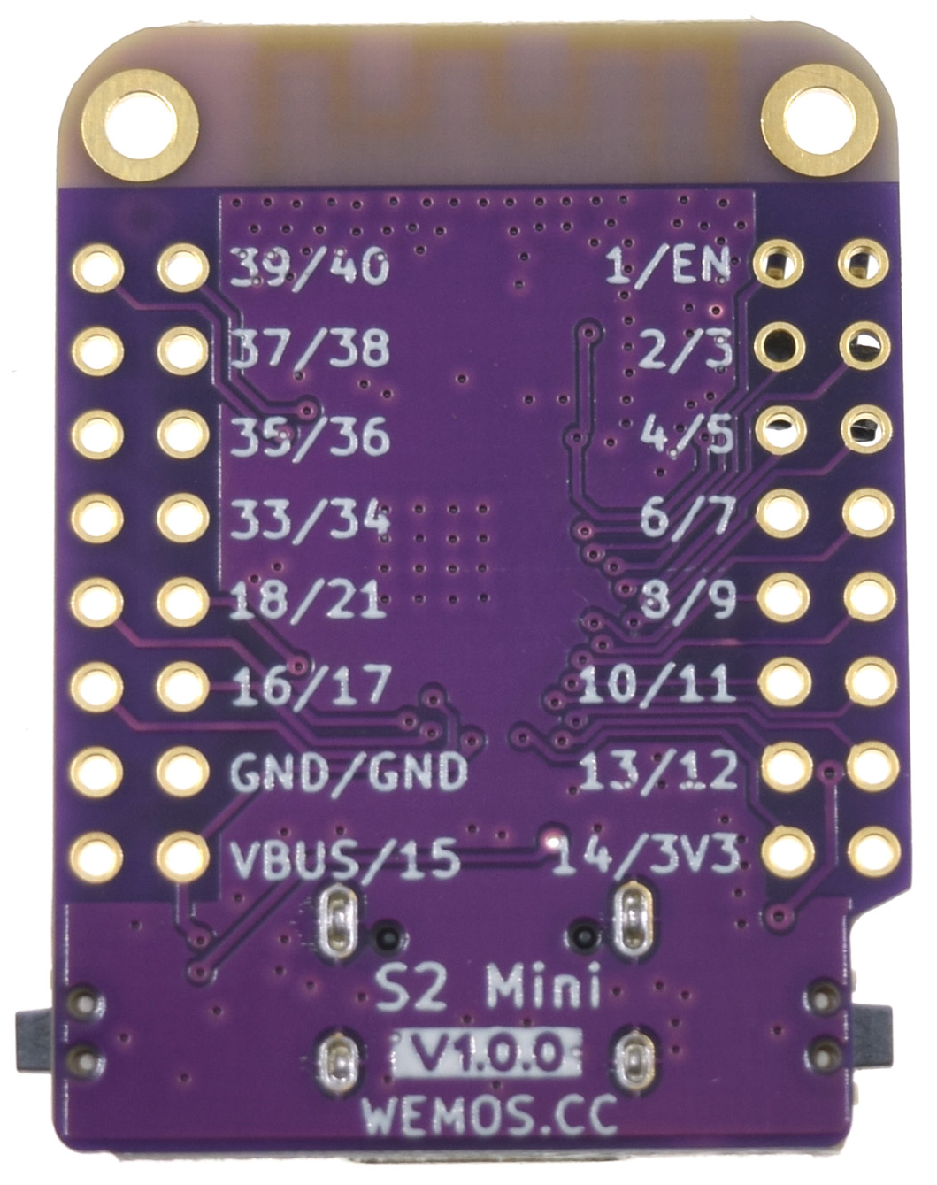
DIO
MOSI
NSS
3V3
MISO
SCK
RST
GND
GND
VCC
SCL
SDA
Vi
Vo
GND
#define LORA_INT 40
#define LORA_MOSI 38
#define LORA_SS 36
#define LORA_MISO 39
#define LORA_SCK 37
#define LORA_RST 35
#define I2C_SCL 11
#define I2C_SDA 12
#define PIN_LED 15
#define MUX_GND_1 33
#define MUX_GND_2 7
#define MUX_3V3_1 34
#define MUX_3V3_2 9
#define MUX_3V3_3 16
#define MUX_5V 18

