Slide 1
actual
Relay
CPU
1K
1K
1K
Cooler
10K
Box
10K

Slide 2
enhanced
USB GND
CPU Fan
1K
Relay
1K
1K
Fan80
10K
10K
10K
1K
Fan120

Slide 3
For USB
USB GND
CPU Fan
100
1K
Relay
1K
1K
Fan80
10K
10K
10K
1K
Fan120

Slide 4
5V
GND
Fan80
Fan120
Relay
CPU Fan
Flash
5V:
Flash
Relay
Pusher (?)
CPU fan
(Light)
12V:
Fan120
Fan80
64x44 M2
Direct:
I2C(4)
Touch in(3)
Flash
PWM
A2
A1
En/
CPU Fan
2K
Relay
Fan120
2K
Fan80
GND
3V3

Slide 5
5V
GND
Fan80
Fan120
Relay
CPU Fan
Flash
5V:
Flash
Relay
CPU fan
12V:
Fan120
Fan80
64x44 M2
Gate pull-down 10K
Flyback 1N4001 (50V)
Solid power 24AWG
Striped single 26AWG
Dotted signal 30AWG
Flash
10K
CPU Fan
10K
PWM
A2
A1
En/
Relay
10K
Fan120
10K
Fan80
10K
GND
3V3

Slide 6
5V:
Flash
Relay
CPU fan
12V:
Fan120
Fan80
64x44 M2
Gate pull-down 47K
Flyback 1N4001 (50V)
Solid power 24AWG
Striped single 26AWG
Dotted signal 30AWG
Flash
10K
CPU Fan
10K
10K
PWM
A2
A1
En/
Relay
10K
Fan120
10K
Fan80
3V3

Slide 7
5V:
Flash
Relay
CPU fan
12V:
Fan120
Fan80
64x44 M2
Gate pull-down 47K
Flyback 1N4001 (50V)
Solid power 24AWG
Striped single 26AWG
Dotted signal 30AWG
Flash
10K
CPU Fan
10K
10K
PWM
A2
A1
En/
Relay
10K
Fan120
10K
Fan80
3V3

Slide 8
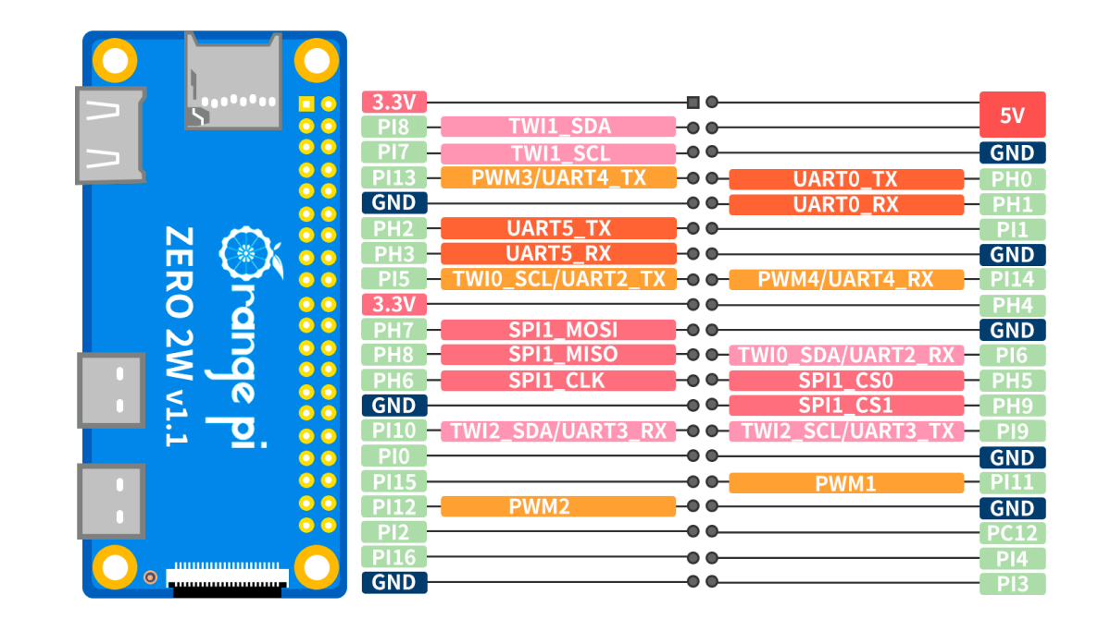
5V:
Flash
Relay
Pusher (?)
(Light)
12V:
Fan120
Fan80
64x44 M2
Direct:
I2C(4)
Touch in(3)
Pusher VCC
PWR 5V
PWR GND
I2C SCL
I2C VCC
I2C GND
I2C SDA
Pusher EN/
Pusher 1
Pusher 2
Pusher PWM
Flash
Relay
Fan80
CPU Fan
Fan120

