Slide 1
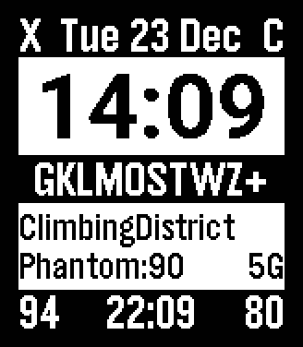
Phone DND
Phone charging
Notifications
Wi-Fi SSID
BT device: battery
Mobile network
Pebble battery %
Phone battery %
Away time

