Slide 1
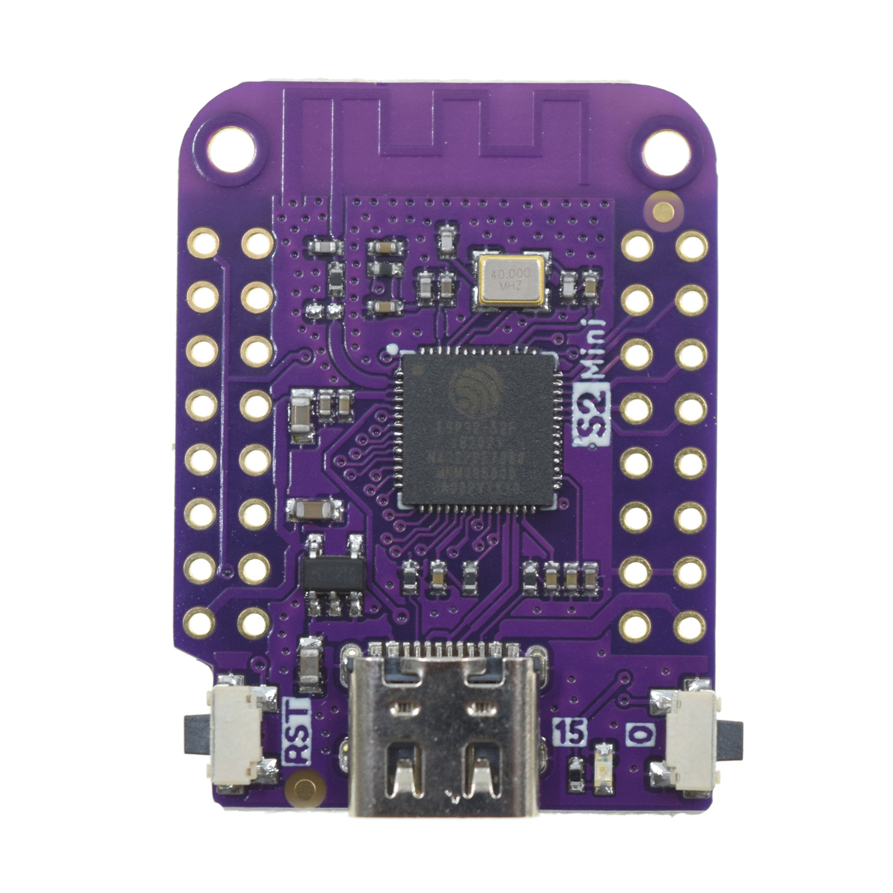
OLED Display
(I2C)
Sensors
1AB
(I2C)
Board ID
Sensors
2AB
(I2C)
Ground
3.3V

Slide 3
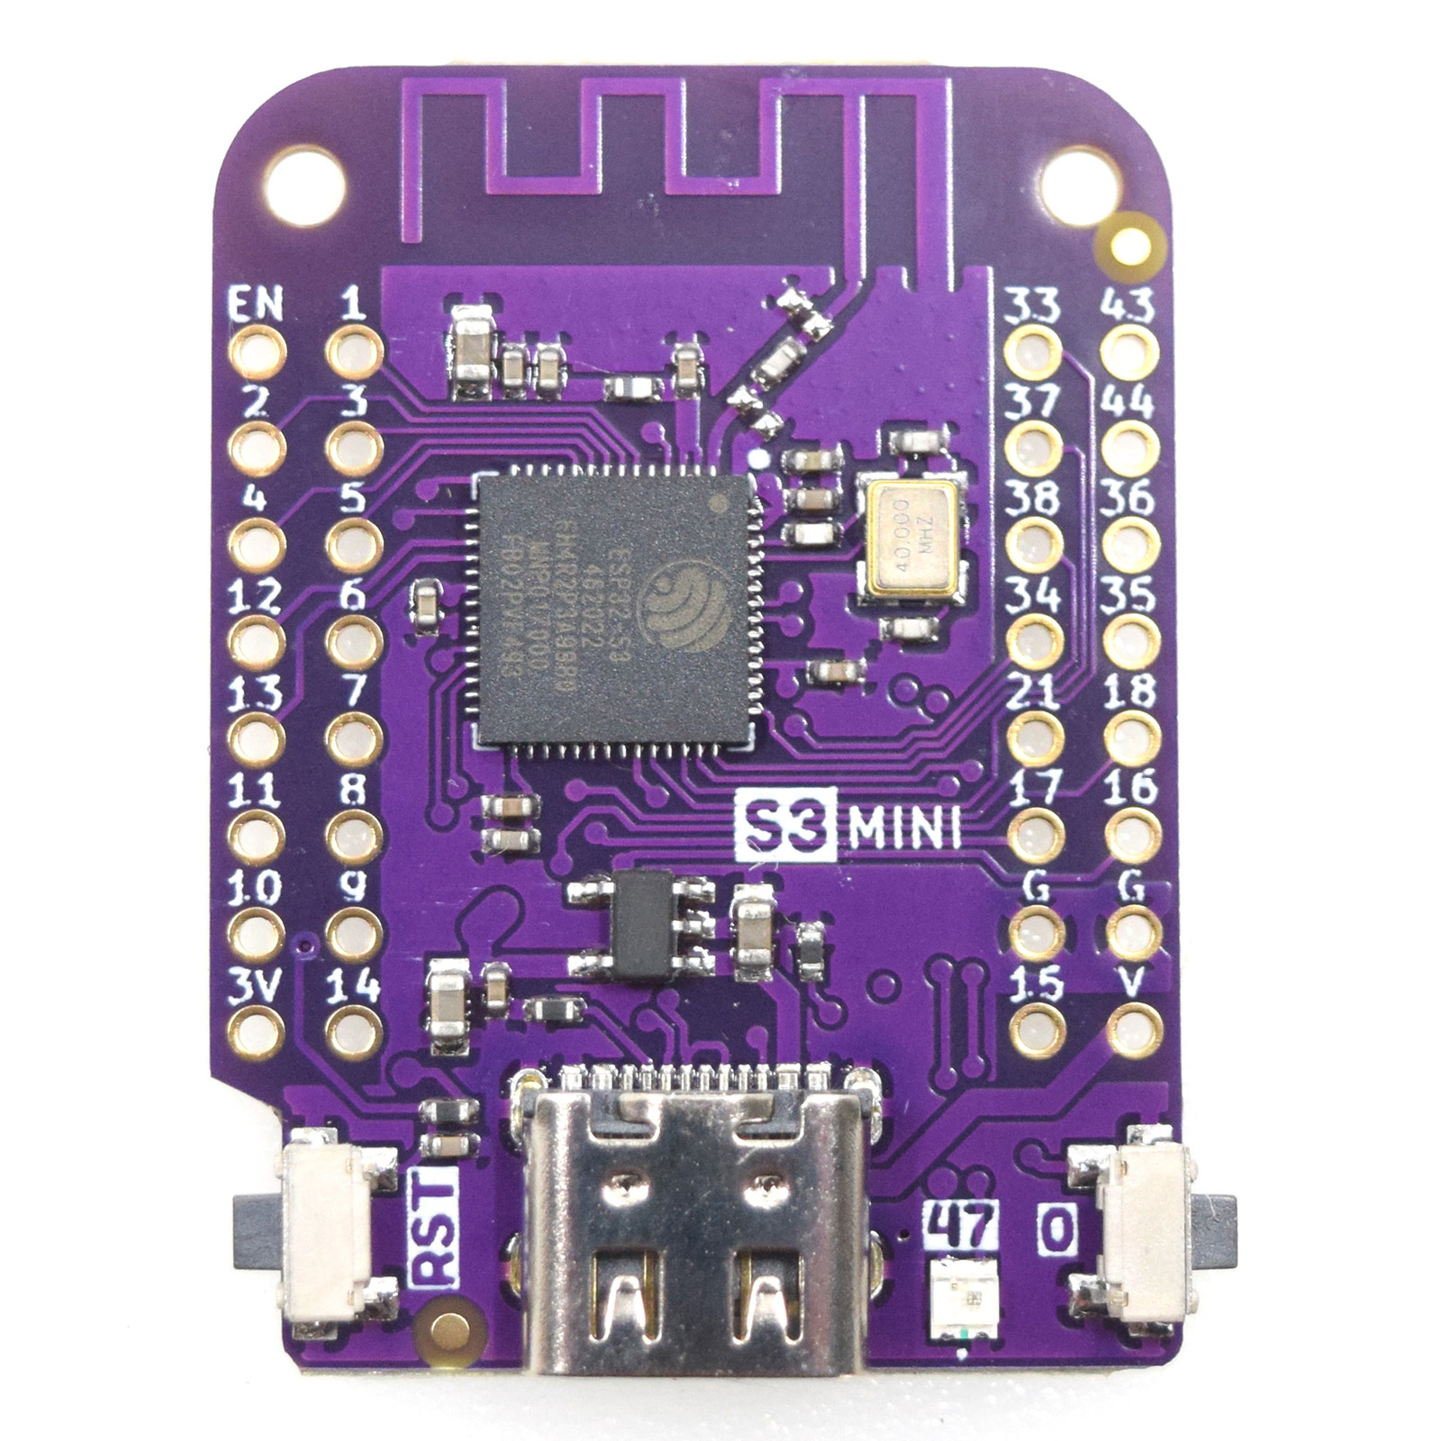
OLED Display
(I2C)
Sensors
2AB
(I2C)
Sensors
1AB
(I2C)
Ground
3.3V

Slide 5
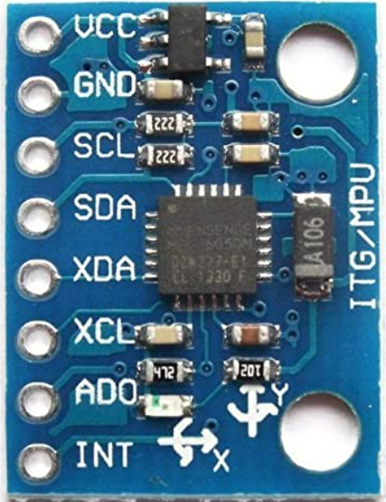

Slide 6
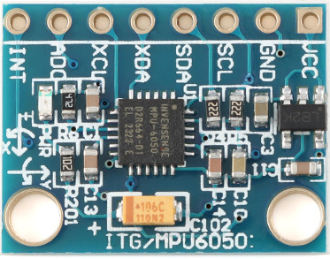
B
A

Slide 7
New Box (V3)
Sensor
2AB
(I2C)
Sensor
1AB
(I2C)

Slide 8
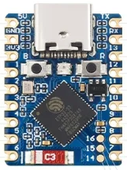
S3 supermini
(V3)
Pin 1 pull high
Sensor
1AB
(I2C)
Sensor
2AB
(I2C)

