Slide 1
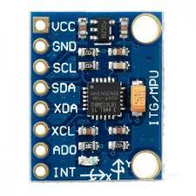

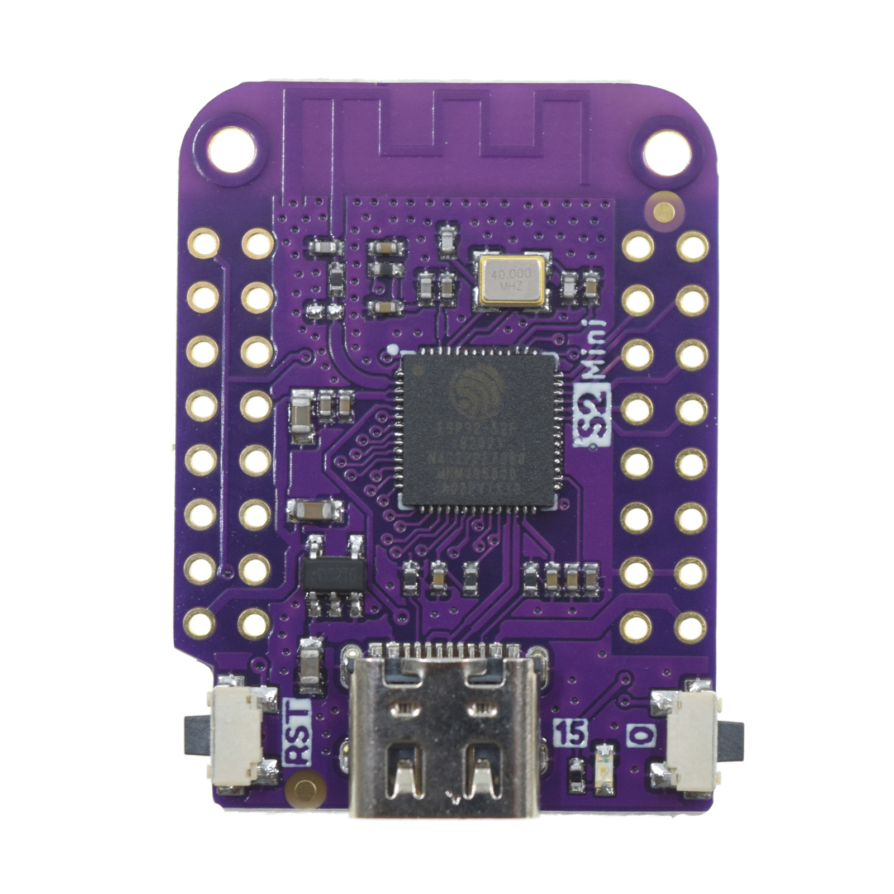
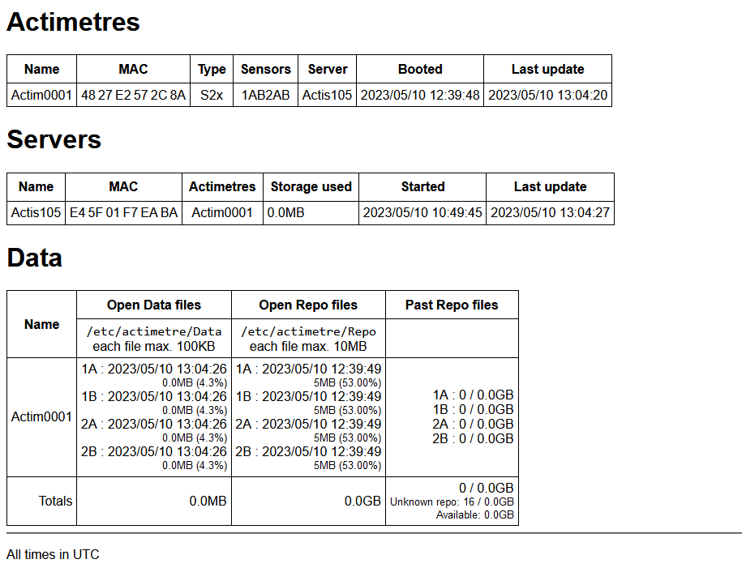

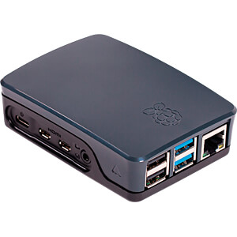

1A
1A
Actimetre-003
Actimetre-001
1B
1B
2A
2A
1A
2B
2B
Actimetre-002
1B
mqtt (v1)
tcp (v2)
2A
2B
Actiservers
Remote data server
acticentral (on one machine, known from the actiservers)
actiserver daemon (on every actiserver)
max 1Mo/1hour
/etc/actimetre/Data/Actim0001-1A_20230510095310.txt
concatenate max 1 Gb/24 hours
/etc/actismetre/Repo/Actim0001-1A_20230510095310.txt
Actim0001-1B_20230510095310.txt
Actim0001-1B_20230510095310.txt
Actim0001-2A_20230510095310.txt
Actim0001-2A_20230510095310.txt
Actim0001-2B_20230510095310.txt
Actim0001-2B_20230510095310.txt

Slide 2
Configuration Actiserver
sudo apt update
sudo apt -y upgrade
sudo apt -y install mosquitto mosquitto-clients apache2 hostapd dnsmasq ntp ntpstat autofs cifs-utils
sudo apt -y autoremove
Configure wlan0 as AP ActisNNN pass NNNanimalerie-eops:
sudo systemctl unmask hostapd
sudo systemctl enable hostapd
sudo DEBIAN_FRONTEND=noninteractive apt install -y netfilter-persistent iptables-persistent
append to /etc/dnsmask.conf:
interface=wlan0 # Listening interface
dhcp-range=192.168.NNN.2,192.168.NNN.250,255.255.255.0,24h
# Pool of IP addresses served via DHCP
domain=wlan # Local wireless DNS domain
address=/gw.wlan/192.168.NNN.1
# Alias for this router
append to /etc/dhcpcd.conf:
interface wlan0
static ip_address=192.168.NNN.1/24
nohook wpa_supplicant
sudo rfkill unblock wlan
Create /etc/hostapd/hostapd.conf:
country_code=FR
interface=wlan0
ssid=ActisNNN
hw_mode=g
channel=7
macaddr_acl=0
auth_algs=1
ignore_broadcast_ssid=0
wpa=2
wpa_passphrase= NNNanimalerie-eops
wpa_key_mgmt=WPA-PSK
wpa_pairwise=TKIP
rsn_pairwise=CCMP
reboot
The ssid ActisNNN and pass NNNanimalerie-eops must be encoded in the actimeter microcode (in reseau.cpp)

Slide 3
Configuration Actiserver (mosquitto et Apache)
sudo pip3 install yattag paho-mqtt
add in /etc/mosquitto/mosquitto.conf:
allow_anonymous true
listener 1883
sudo systemctl restart mosquitto
Apache setup
Getting Started - Apache HTTP Server Version 2.4
sudo a2enmod cgi
sudo a2enmod include
sudo mkdir /var/www/cgi-bin
sudo chown www-data:www-data /var/www/cgi-bin /var/www/html
sudo chmod 775 /var/www/cgi-bin /var/www/html
Add alias in /etc/apache2/conf-available/serve-cgi-bin.conf:
ScriptAlias /bin/ /var/www/cgi-bin/
<Directory "/var/www/cgi-bin">
AllowOverride None
Options +ExecCGI -MultiViews +SymLinksIfOwnerMatch
Require all granted
</Directory>
Add to /etc/apache2/apache2.conf:
[…]
#ServerRoot "/etc/apache2"
ServerName "actimetre.fr"
[…]
<Directory /var/www/>
Options Indexes FollowSymLinks Includes
XBitHack on
AllowOverride None
Require all granted
</Directory>
sudo apache2ctl restart
For Actiserver, set self as "acti"
sudo hostname acti

Slide 4
Structure des fichiers de code sur l’Actiserver
/var/www/cgi-bin/
action.py
register.py
actilib.py (link to -> /etc/actimetre/actilib.py)
/var/www/html/
index.html
/etc/actimetre/
actilib.py
actidaemon.py
Conf/
actimetre.conf
sudo chmod 775 pour tous les fichiers py et html

Slide 5
Structure des fichiers de données sur l’Actiserver
V1: tous ces fichiers sont initialisés et nettoyés par /etc/actimetre/clearall.sh
/etc/actimetre/Conf/
registry.json
actiservers.json
actimetres.json
local.json
/etc/actimetre/Log
server.log
central.log
lib.log
sudo chmod 666 pour tous ces fichiers

Slide 6
démarrage Actiserver
cd /etc/actimetre
./actidaemon.py -ld

