Slide 1
Unit 2
Introduction to Oracle Tools

Slide 2
2.1 Oracle DBA

Slide 3
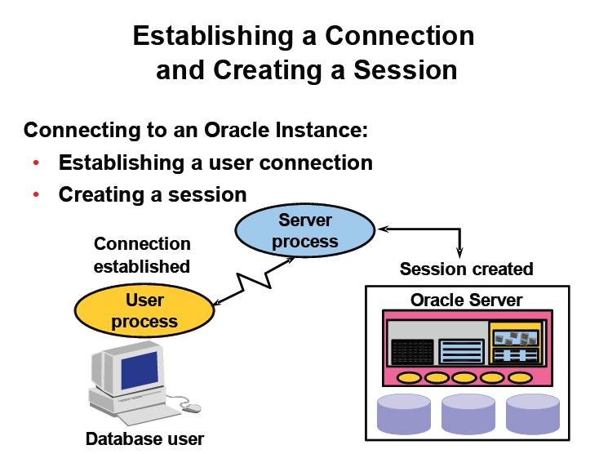

Slide 4
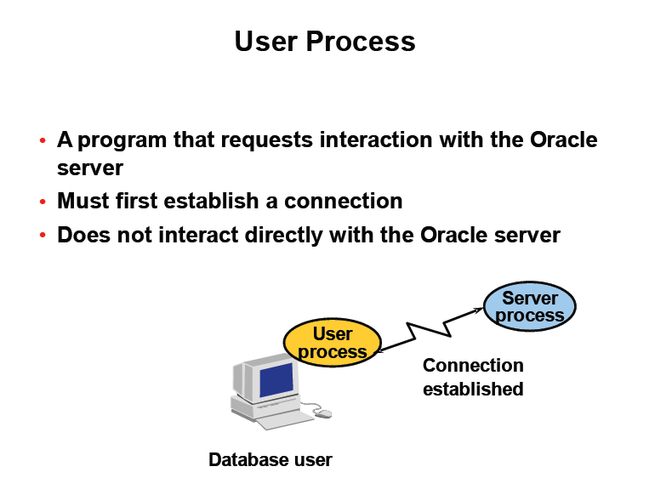

Slide 5
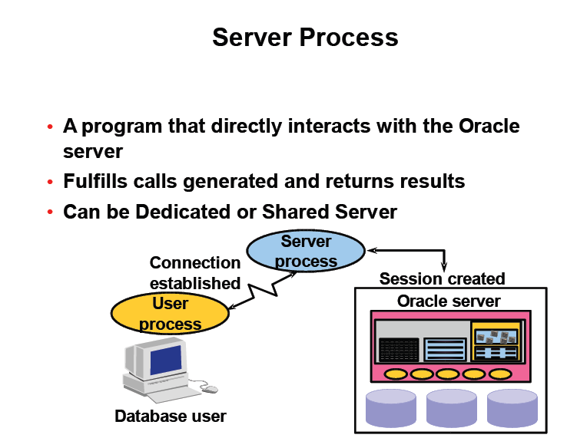

Slide 6
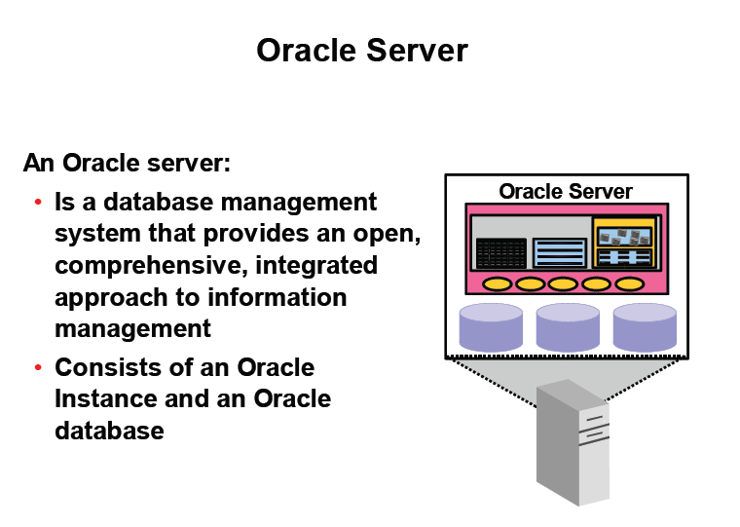

Slide 7
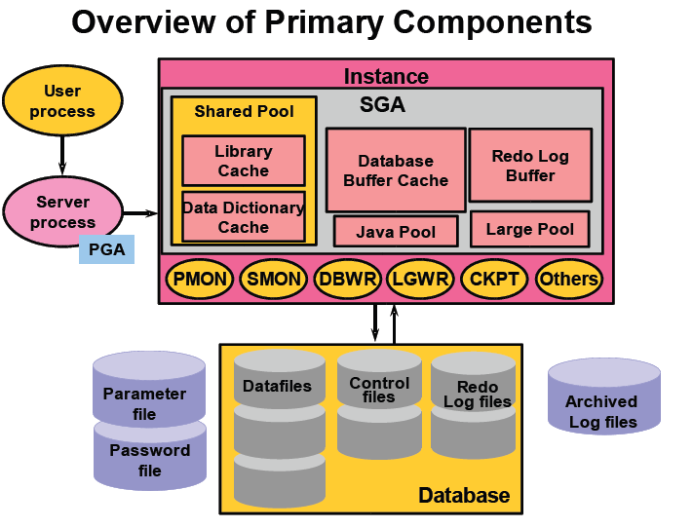

Slide 8
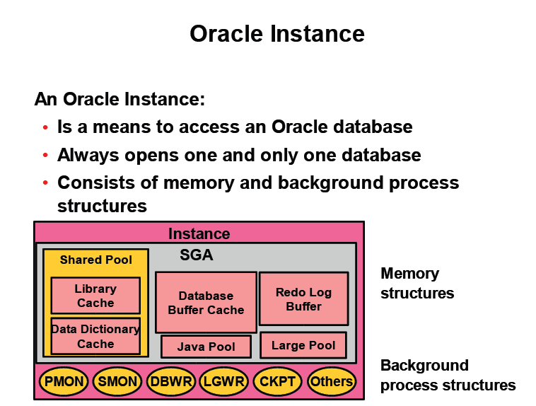

Slide 9
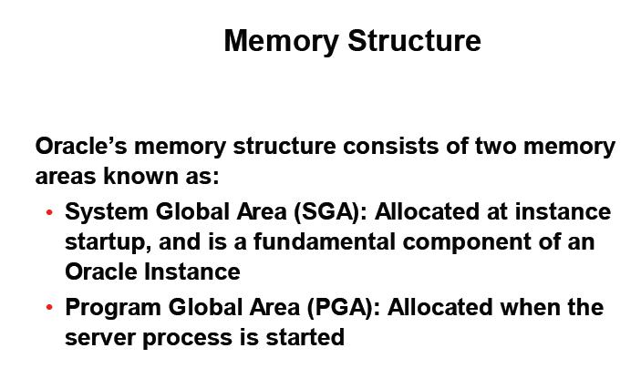

Slide 10
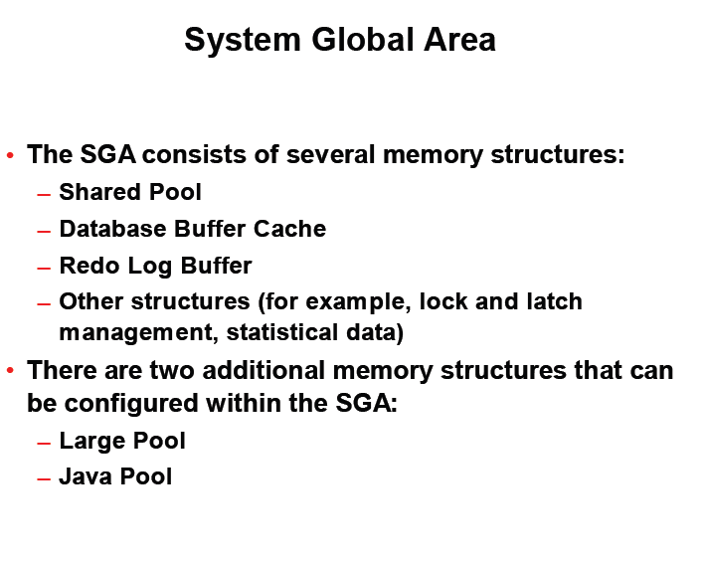

Slide 11
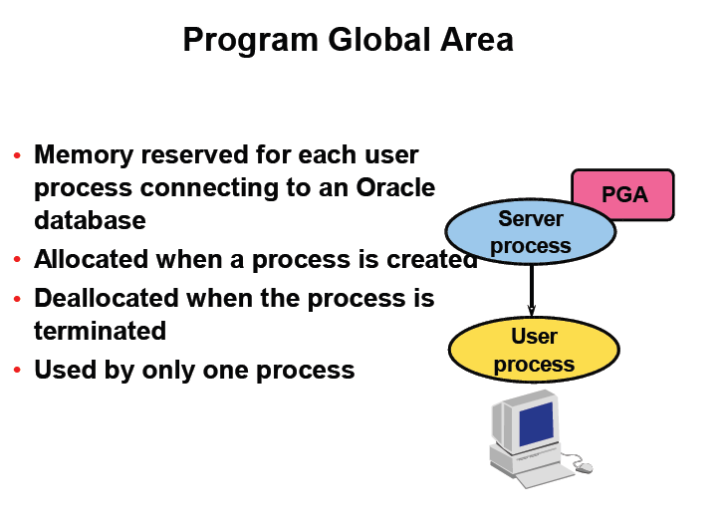

Slide 12
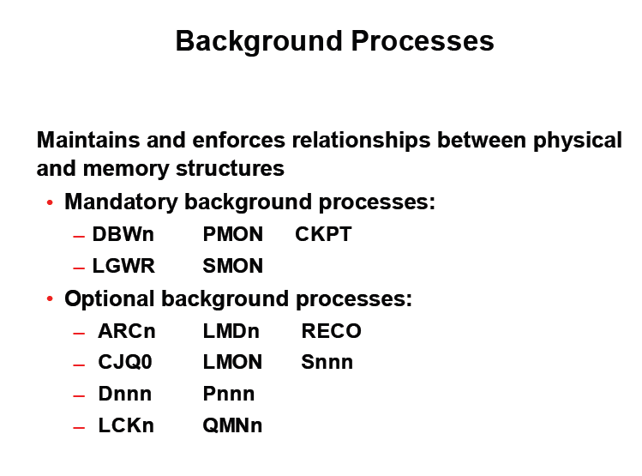

Slide 13
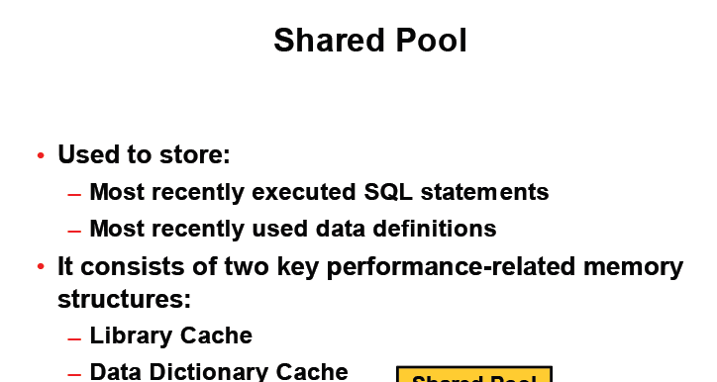

Slide 14
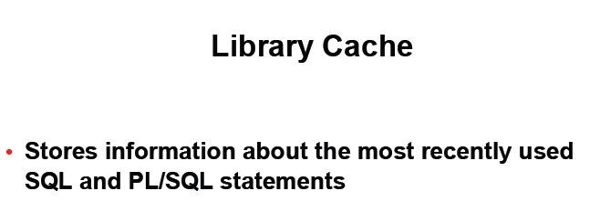

Slide 15
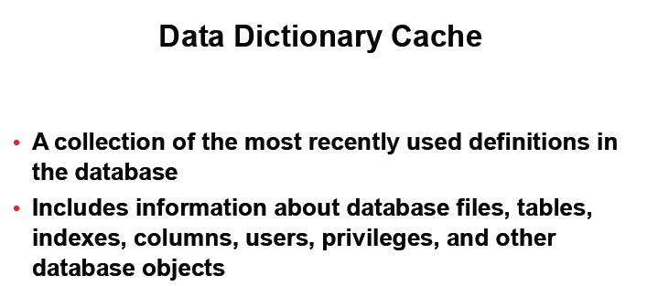

Slide 16
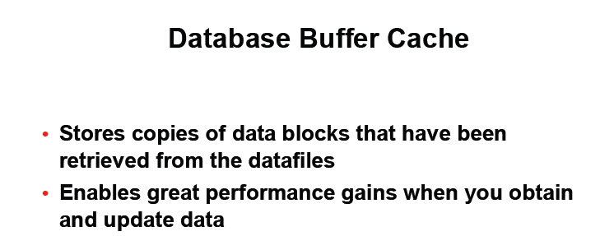

Slide 17
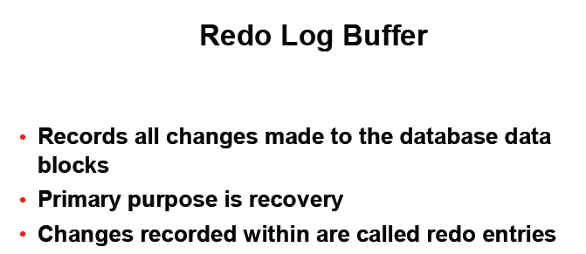

Slide 18
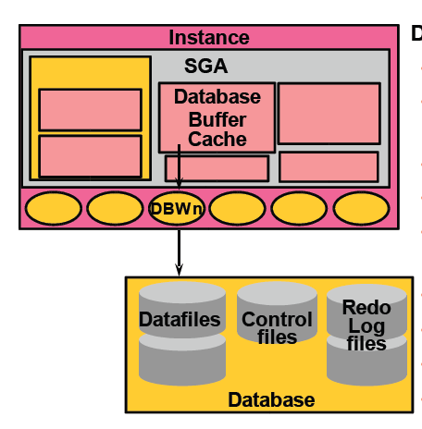

Slide 19
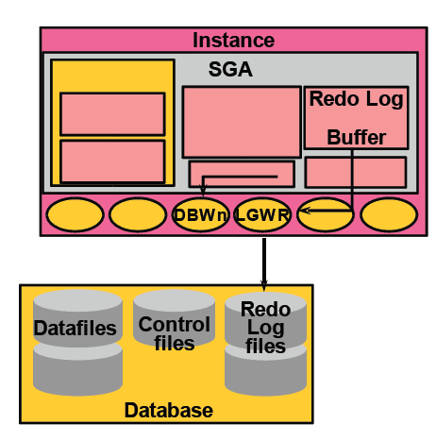

Slide 20
An Oracle Database:
Is a collection of data and treated as a single unit.
The general purpose of a database is to store and retrieve related information.
It consist of three files.
        Data files:
        Control files:
        Redo log file

Slide 21
1.Data files:
Contain actual data in the database.
2.Control files:
Containing information necessary to maintain and verify database integrity.
3.Redo log files:
Containing a record of changes made to the database to enable recovery of the data in case of failures.

Slide 22
The oracle server also uses other files that are not part of the database.
Parameter file:
Define the characteristics of an oracle instance.
Password file:
Authenticates user privileged to start up and shut down an oracle instance.
Archived log file:
Files are offline copies of the redo log files that may be necessary to recover from media failures.

Slide 23
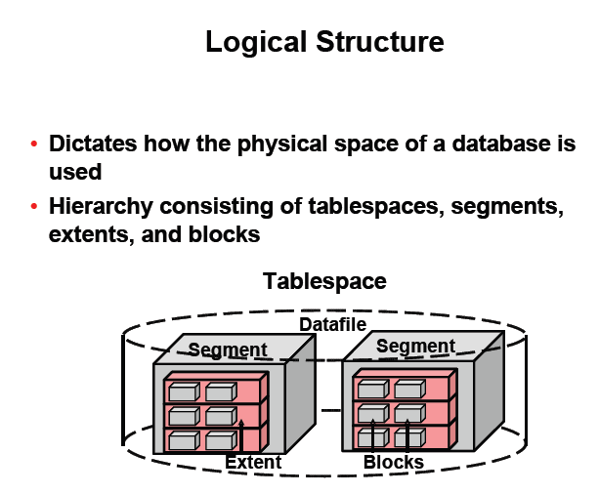

Slide 24
Table Space: A database is divided into one or more logical storage units called table space. Each table must consist of one or more data files, and each data files can belong to only one table space. The above table space illustrate The relationship between databases, tables paces, and data files.
This figure illustrates the following:
    1.Each database is logically divided into one or more table spaces.
    2.One or more data files are explicitly created for each table space to physically store the data of all logical structures in a table space.
    3.The combined size of the data files in a table space is the total storage capacity of the table space.
    4.The combined storage capacity of a database's table spaces is the total storage capacity of the database.

Slide 25
A table space can be online (accessible) or offline (not accessible). A table space is generally online, so that users can access the information in the table space. However, sometimes a table space is taken offline to make a portion of the database unavailable while allowing normal access to the remainder of the database. This makes many administrative tasks easier to perform.
Segment: Collection of extent, used to store particular type of data. There are four types of segment are their 1.Data Segment 2.Index Segment 3.Rollback segment 4. Temporary Segment Segment are used to store particular object in a single table space.

Slide 26
Extent: An extent is a specific number of contiguous data blocks allocated for storing a specific type of information.
Data blocks: also called as a logical blocks, oracle blocks. At the smallest unit, oracle store data in data blocks. One data blocks corresponds to a specific number of bytes of a physical database space on disk.
Schema: A schema is a logical collection of related table and view.

Slide 27
Difference Between Instance And Database.
Instance | Database
1.Refers to the software executing on the server that provides access to the information in the database. | 1. Refers to the physical storage of information.
2. It runs on the computer or server. | 2. It is stored on the disk attached to the server.
3. The instance is logical. | 3. The database is not logical.
4. Instance are temporal | 4. Database with proper maintenance, last forever.
5. It consists of the processing and memory on the database server. | 5. It consists of a physical files and logical structure.

Slide 28
What is DBA? A database administrator (DBA) is a person responsible for the design, implementation, maintenance and repair of an organization's database. They are also known by the titles Database Coordinator or Database Programmer, and is closely related to the Database Analyst, Database Modeler. The role includes the development and design of database strategies, monitoring and improving database performance and capacity, and planning for future expansion requirements. The duties of a database administrator vary depending on job description, corporate and Information Technology (IT) policies and the technical features and capabilities of the DBMS being administered.

Slide 29
Duties of DBA 1. Installation of new software: It is the job of the DBA to install new versions of DBMS software, application software, and other software related to DBMS administration. It is important that the DBA or other IS staff members test new software before it is moved into a production environment.
2. Security administration: One of the main duties of the DBA is to monitor and administer DBMS security. This involves adding and removing users, administering quotas, auditing, and checking for security problems.
3.Data analysis: The DBA analyzes data stored in the database and makes recommendations relating to performance and efficiency of that data storage.
4. Database design: The DBA can be involved at the preliminary database-design stages, eliminating many problems that might occur.

Slide 30
5.Configuration of hardware and software with the system Administrator: In many cases the system software can only be accessed by the system administrator. In this case, the DBA works closely with the system administrator to perform software installations, and to configure hardware and software so that it functions optimally with the DBMS.
6. Data modeling and optimization: By modeling the data, it is possible to optimize the system layouts to take the most advantage of the I/O subsystem.
7. Recoverability is one of the most important and vital duty of a Database Administrator. Any type of error such as, data entry error, hardware failure, software failure, bugs, virus etc. can result in corrupting database.

Slide 31
Backup and Recovery In general, backup and recovery refers to the various strategies and procedures involved in protecting your database against data loss and reconstructing the data should that loss occur. BackUp: A backup is a copy of data. This copy can include important parts of the database such as the control file and datafiles. A backup is a safeguard against unexpected data loss and application errors. If you lose the original data, then you can reconstruct it by using a backup. Backups are divided into physical backups and logical backups. Physical backups, which are the primary concern in a backup and recovery strategy, are copies of physical database files. You can make physical backups with either the Recovery Manager (RMAN) utility or operating system utilities

Slide 32
Backup: In contrast, logical backups contain logical data (for example, tables and stored procedures) extracted with the Oracle Export utility and stored in a binary file. You can use logical backups to supplement physical backups. Recovery: To restore a physical backup of a datafile or control file is to reconstruct it and make it available to the Oracle database server. To recover a restored datafile is to update it by applying archived redo logs and online redo logs, that is, records of changes made to the database after the backup was taken.

Slide 33
Backup and Recovery Solution: You have two methods for performing Oracle backup and recovery: Recovery Manager (RMAN) and user-managed backup and recovery. RMAN is a utility automatically installed with the database that can back up any Oracle8 or later database. RMAN uses server sessions on the database to perform the work of backup and recovery. RMAN has its own syntax and is accessible either through a command-line interface or though the Oracle Enterprise Manager GUI.
One of the principal advantages of RMAN is that it obtains and stores metadata about its operations in the control file of the production database.
An alternative method of performing recovery is to use operating system commands for backups and SQL*Plus for recovery. This method, also called user-managed backup and recovery, is fully supported by Oracle Corporation, although use of RMAN is highly recommended because it is more robust and greatly simplifies administration.

Slide 34
2.2 SQL*Plus

Slide 35
Oracle and Client-Server Technology Oracle server is a multi-user tool that work in a client/server environment. Client/server Programming is a dristributed application program. It has three distinct components, each focusing on a specific job. Three components are 1. Oracle Server 2.Oracle Client Tool 3. Network for connecting the first two component Oracle server’s primary job is to manage data optimally, among multi-users that concurrently request for the same data. Oracle client tools is that part of the system that provides an interface to the user so that the data retrieved from the server can be manipulated. It allows users to pass data manipulation requests to the oracle server. The network and communicatin software is the vehicle that transports data between oracle client tools and the oracle server.

Slide 36
Oracle Client side tools are: 1. Oracle SQL*Plus 2. Oracle Form Designer 3. Oracle Reports Designer 4. Oracle Graphics Oracle SQL*Plus Is a separate tool that come as a part of oracle enterprise server as well as Oracle Workgroup server via which user can communicate interactively with the Oracle server. Oracle provide an interactive SQL tool called SQL*Plus, which allow user to enter ANSI SQL sentences and pass them to the Oracle Engine for execution.
To use ANSI SQL the user must load the SQL*Plus tool in clients memory, link to the server & then communicate with the Oracle Engine loaded on the server.
Note:
Oracle server can be called Oracle DBA, Oracle Engine or Oracle Server interchangeably.

