Slide 1
Customer Relationship Management
By Hiren Mistry

Slide 2
Customer relationship management (CRM)
    Term applied to processes implemented by a company to handle its contact with its customers
    CRM is a software-based approach to handling customer relationships
    Store information on current and prospective customers

Slide 3
Customer relationship management (CRM)
    From the outside, customers interacting with a company perceive the business as a single entity, even with often interacting with a variety of employees in different roles and departments
    CRM is a combination of policies, processes, and strategies implemented by a company that unify its customer interaction and provides a mechanism for tracking customer information

Slide 4
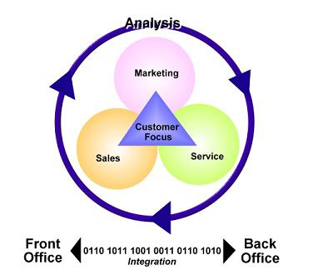
Aspects

Slide 5
Aspect 1 – Front office
    Direct interaction with customers
      Face to face meetings
      Phone calls
      E-mail
      Online services etc

Slide 6
Aspect 2 – Back office
Operations that ultimately affect the activities of the front office
      Billing
      Maintenance
      Planning
      Marketing
      Advertising
      Finance
      Manufacturing

Slide 7
Aspect 3 - Business relationships
Interaction with other companies and partners
      Suppliers/vendors
      Retail outlets/distributors
      Industry networks
This external network supports front and back office activities

Slide 8
Aspect 4 - Analysis
Key CRM data can be analyzed in order to plan
      Target-marketing campaigns
      Conceive business strategies
      Judge the success of CRM activities (e.g., market share, number and types of customers, revenue, profitability)

Slide 9
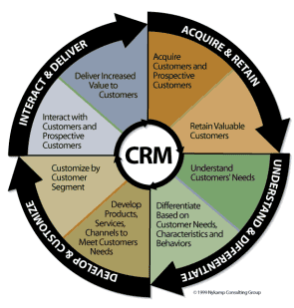
Processes & Systems

Slide 10
1. Understand & differentiate
Understand
      Demographics, purchase patterns & channels
      Segmentation to identify logical unique groups
      Primary research to capture needs and attitudes
      Customer valuation to understand profitability
Differentiate
      Based on the value customers are expected to deliver

Slide 11
2. Develop & Customize
Develop
      Products, services, channels and media can be customized based on the needs of quantitative customer segments
Customize
      Based on the potential value delivered by customer segment

Slide 12
3. Interact & Deliver
Interact
      Not just through marketing, sales and media
      Distribution, shipping, customer service & online
Deliver
      Delivering value is a cornerstone
      Factors including quality, convenience, speed, ease of use, responsiveness and service excellence

Slide 13
4. Acquire & Retain
Acquire
      Learning about customers makes it easy to identify those producing the greatest value
Retain
      Maintain interaction
      Deliver on value
      Customers change as they move through differing life stages
      Modify the service

