Slide 1
UNIT 5 : NODE.JS
5.1 Concepts, working and Features
5.1.1 Downloading Node.js
5.2 Setting up Node.js server(HTTP server)
5.2.1 Installing on window
5.2.2 Components
5.2.2.1 Required modules, Create Server(http.createServer())
5.2.2.2 Request and response

Slide 2
5.3 Built-in Modules
5.3.1 require() function
5.3.2 User defined module: create and include
5.3.3 HTTP module
5.4 Node.js as Web-server:
5.4.1 createServer() , writeHead() method
5.4.2 Reading Query String, Split Query String
5.5 File System Module:
5.5.1 Read Files (readFile())
5.5.2 Create Files(appendFile(),open(),writeFile())
5.5.3 Update Files(appendFile(),writeFile())
5.5.4 Delete Files(unlink())
5.5.5 Rename Files(rename())

Slide 3
Introduction
Node.js is a server-side platform built on Google Chrome's JavaScript Engine (V8 Engine).
Node.js was developed by Ryan Dahl in 2009 and its latest version is 17.13.0.
Node.js is an open source server environment
Node.js is free
Node.js runs on various platforms (Windows, Linux, Unix, Mac OS X, etc.)
Node.js uses JavaScript on the server

Slide 4
Node.js is primarily used for non-blocking, event-driven servers, due to its single-threaded nature.
It's used for traditional web sites and back-end API services, but was designed with real-time, push-based architectures in mind.

Slide 5
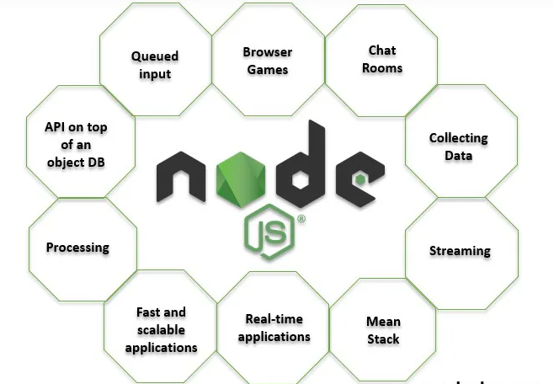


Slide 6
How PHP or ASP handles a file request:
Sends the task to the computer's file system.
Waits while the file system opens and reads the file.
Returns the content to the client.
Ready to handle the next request.

Slide 7
How Node.js handles a file request:
Sends the task to the computer's file system.
Ready to handle the next request.
When the file system has opened and read the file, the server returns the content to the client.

Slide 8
Websites using NODE.JS
Netflix
Trello
Uber

Slide 9
5.1 Concepts, working and Features
Node.js is a cross-platform runtime environment and library for running JavaScript applications outside the browser.
It is used for creating server-side and networking web applications.
It is open source and free to use. It can be downloaded from this link https://nodejs.org/en/ Many of the basic modules of Node.js are written in JavaScript. Node.js is mostly used to run real-time server applications.

Slide 10
The definition given by its official documentation is as follows: “Node.js is a platform built on Chrome's JavaScript runtime for easily building fast and scalable network applications.
Node.js uses an event-driven, non-blocking I/O model that makes it lightweight and efficient, perfect for data-intensive real-time applications that run across distributed devices.

Slide 11
Working of Node.JS
Node.js accepts the request from the clients and sends the response, while working with the request node.js handles them with a single thread.
To operate I/O operations or requests node.js use the concept of threads. Thread is a sequence of instructions that the server needs to perform.
It runs parallel on the server to provide the information to multiple clients. Node.js is an event loop single-threaded language. It can handle concurrent requests with a single thread without blocking it for one request.

Slide 12
Features:
Asynchronous and Event Driven − All APIs of Node.js library are asynchronous, that is, non-blocking. It essentially means a Node.js based server never waits for an API to return data. The server moves to the next API after calling it and a notification mechanism of Events of Node.js helps the server to get a response from the previous API call.
Very Fast − Being built on Google Chrome's V8 JavaScript Engine, Node.js library is very fast in code execution.

Slide 13
Single Threaded but Highly Scalable − Node.js uses a single threaded model with event looping. Event mechanism helps the server to respond in a non-blocking way and makes the server highly scalable as opposed to traditional servers which create limited threads to handle requests. Node.js uses a single threaded program and the same program can provide service to a much larger number of requests than traditional servers like Apache HTTP Server.
No Buffering − Node.js applications never buffer any data. These applications simply output the data in chunks.
License − Node.js is released under the MIT license (Massachusetts Institute of Technology)

Slide 14
Open source: Node.js has an open source community which has produced many excellent modules to add additional capabilities to Node.js applications.

Slide 15
Where to use NODE.JS?
I/O bound Applications
Data Streaming Applications
Data Intensive Real-time Applications (DIRT)
JSON APIs based Applications
Single Page Applications

Slide 16
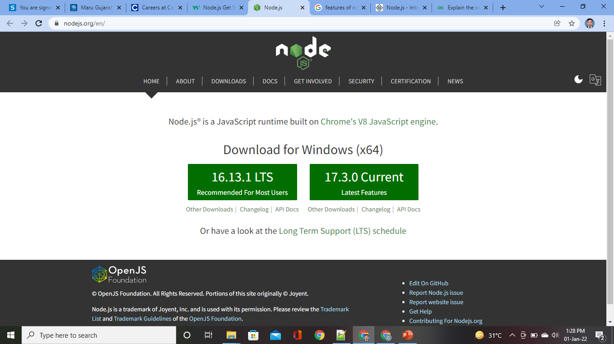
5.1.1 Downloading Node.js
https://nodejs.org/en/

Slide 17
5.2 Setting up Node.js server(HTTP server)
5.2.1 Installing on window
5.2.2 Components
5.2.2.1 Required modules, Create Server(http.createServer())
5.2.2.2 Request and response

Slide 18
5.2.1 Installing on window

Slide 19
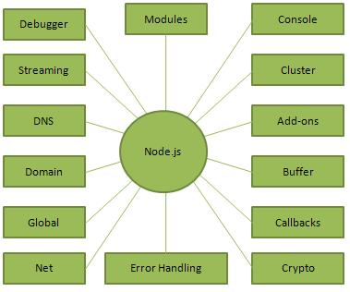
5.2.2 Components

Slide 20
Import required modules: The "require" directive is used to load a Node.js
module.
Create server: You have to establish a server which will listen to client's request similar to Apache HTTP Server.
Read request and return response: Server created in the second step will read HTTP request made by client which can be a browser or console and return the response.

Slide 21
5.2.2.1 Required modules, CreateServer(http.createServer())
Require Modules: Method require() is used to consume modules. It allows you to include modules in your app. You can add built-in core Node.js modules, community-based modules (node_modules), and local modules too.
Node.js follows the CommonJS module system, and the built-in require function is the easiest way to include modules that exist in separate files. The basic functionality of require is that it reads a JavaScript file, executes the file, and then proceeds to return the exports object.

Slide 22
var module = require('module_name’);
As per above syntax, specify the module name in the require() function. The require() function will return an object, function, property or any other JavaScript type, depending on what the specified module returns.
Example: var http = require("http");

Slide 23
Create server: In the second component, you have to use created http instance and call http.createServer() method to create server instance and then bind it at port 8081 using listen method associated with server instance. Pass it a function with request and response parameters and write the sample implementation to return "Hello World".

Slide 24
Example:
const http = require('http');
const port=process.env.PORT || 3000;
const server=http.createServer((req,res)=>{
res.statusCode=200;
res.setHeader("Content-Type","text/html")
res.end('<h1>Chirag</h1>');
})
server.listen(port,()=>{
console.log('Server is listeining on port ${port}');
});

Slide 25
5.2.2.2 Request and response
When an HTTP request hits the server, node calls the request handler function with a few handy objects for dealing with the transaction, request and response.

Slide 26
const http = require('http');
const server = http.createServer((request, response) => {
// Code to Execute
});

Slide 27
5.3 Built-in Modules
5.3.1 require() function
5.3.2 User defined module: create and include
5.3.3 HTTP module

Slide 28
5.3.1 require() function
Node.js follows the CommonJS module system, and the built-in require function is the easiest way to include modules that exist in separate files.
The basic functionality of require is that it reads a JavaScript file, executes the file, and then proceeds to return the exports object.

Slide 29
5.3.2 User defined module: create and include
Modules are the collection of JavaScript codes in a separate logical file that can be used in external applications on the basis of their related functionality. Modules are popular as they are easy to use and are reusable.
Sometimes it is required that, when you are implementing a Node.js application for a use case, you might want to keep your business logic separately. In such cases you create a Node.js module with all the required functions in it.

Slide 30
Module in Node.js is a simple or complex functionality organized in single or multiple JavaScript files which can be reused throughout the Node.js application.
Each module in Node.js has its own context, so it cannot interfere with other modules or pollute global scope. Also, each module can be placed in a separate .js file under a separate folder.

Slide 31
Create modules(exports)
The module.exports is a special object which is included in every JavaScript file in the Node.js application by default.
The module is a variable that represents the current module, and exports is an object that will be exposed as a module.
So, whatever you assign to module.exports will be exposed as a module.

Slide 32
To create a module in Node.js, the exports keyword is used. This keyword tells Node.js that the function can be used outside the module.
A Node.js Module is a .js file with one or more functions.

Slide 33
Syntax:
exports.<function_name> = function (argument_1, argument_2, .. argument_N)
{
/* function body */
}
exports – is a keyword which tells Node.js that the function is available outside the module.
function_name – is the function name using which we can access this function in other programs.

Slide 34
Example:
caller.js
function add(a,b)
{
return a+b;
}
module.exports.add=add

Slide 35
caller.js
exports.add=function add(a,b)
{
return a+b;
}
//module.exports.add=add

Slide 36
app.js
var calc=require('./caller.js')
result=calc.add(4,5)
console.log("The Output is--->"+result)

Slide 37
5.3.3 HTTP module

Slide 38
5.4 Node.js as Web-server:
5.4.1 createServer() , writeHead() method
5.4.2 Reading Query String, Split Query String

Slide 39
5.4.1 createServer(),writeHead() method

Slide 40
writeHead()
This property is an inbuilt property of the ‘http’ module which sends a response header to the request. The status code is a 3-digit HTTP status code, like 404.

Slide 41
Syntax:
response.writeHead(statusCode[, statusMessage][, headers]);
statusCode <number>: It accepts the status codes that are of number type.
statusMessage <string>: It accepts any string that shows the status message.
headers <Object>: It accepts any function, array, or string.

Slide 42
Example:

Slide 43
5.4.2 Reading Query String, Split Query String

Slide 44
5.5 File System Module:
5.5.1 Read Files (readFile())
5.5.2 Create Files(appendFile(),open(),writeFile())
5.5.3 Update Files(appendFile(),writeFile())
5.5.4 Delete Files(unlink())
5.5.5 Rename Files(rename())

Slide 45
5.5.1 Read Files (readFile())

Slide 46
5.5.2 Create Files(appendFile(),open(),writeFile())

Slide 47
5.5.3 Update Files(appendFile(),writeFile())

Slide 48
5.5.4 Delete Files(unlink())

Slide 49
5.5.5 Rename Files(rename())

