Slide 1
Unit-1
Introduction to Java

Slide 2
Unit-1
1.1 Properties of Java
1.2 Comparison of java with C++
1.3 Java Compiler, Java Interpreter
1.4 Identifier, Literals, Operators, Variables, Keywords, Data Types
1.5 Branching: If – Else, Switch
1.6 Looping: While, Do-while, For
1.7 Type Casting

Slide 3
Unit-1
1.1 Properties of Java
1.2 Comparison of java with C++
1.3 Java Compiler, Java Interpreter
1.4 Identifier, Literals, Operators, Variables, Keywords, Data Types
1.5 Branching: If – Else, Switch
1.6 Looping: While, Do-while, For
1.7 Type Casting

Slide 4
Introduction
Introduced in 1991 by James Gosling, Patrick Naughton, Chris Warth, Ed Frank, and Mike Sheridan at SUN MICROSYSTEM known as “Oak”
Renamed in 1995 which called Java.
On 27th January, 2010 take over by ORACLE.
Pure/True Object Oriented
Two Types of Programs can be created:
  Applications
  Applet

Slide 5
Over time new enhanced versions of Java have been released. The current version of Java is Java 1.8 which is also known as Java 8.

Slide 6
Applications :
An application is a program (Similar to C) that runs on the Computer under its operating System. Java applications can directly be executed by using the Java interpreter.
In Java, all code must reside inside a class. Classes contain data members and methods that operate data members of the class. A Java program may contain one or more classes of which only one class defines a main method.

Slide 7
The Java compiler (javac) translates the source code into bytecode and creates a new file with extension .class. The Java compiler requires that a source file use .java filename extension.
To run the program, you must use the java interpreter called java because the output of javac is not code that can be directly executed

Slide 8
Applet :
An Applet is a small window based program that runs on an HTML page.
To run java Applets, we need a java-enabled Web Browser, i.e. Internet Explorer, Netscape Navigator, Mozilla Firefox etc.
An Applet is actually a tiny Java program, dynamically downloaded across the network, just like an image, sound file or a video clip.
Applet is also called “Intelligent Program”, because it can react to user input and dynamically change

Slide 9
There are basically 2 types of Java.
  1. Core Java
  2. Advance Java

Slide 10
Features/Buzzwords/Properties of Java Language:
Pure / True Object Oriented
Compiled And Interpreted
Platform-Independent & Portable
Robust
Distributed
Multithreaded
Simple and familiar
Dynamic
Strongly-typed programming language
Automatic memory management

Slide 11
Difference between C and Java
Java is an Object Oriented language and has mechanism to define class and objects where as C is not.
Java is Object Oriented language while C is Structured or Procedural Programming Language.
Java does not include the C unique keywords goto, sizeof and typedef.
Java does not contain the data types struct, union and enum.
Java does not define the type modifiers keywords signed and unsigned.
Java does not support Pointer type.
Java does not contain #include, #define where C can.

Slide 12
Difference between C++ and Java
Java is a true object oriented language while C++ is basically C with object oriented extension.
Java does not support Pointers.
There are no header files in Java.
Java does not support Global variables. Every variables and methods are declared within class.
Java does not support operator overloading.
Java does not support Multiple Inheritance of classes. This is accomplished using a new feature called “Interface”.

Slide 13
Difference between C++ and Java
Java has replaced the destructor function with the finalize() function.
Java is a built upon C and C++ and also add some new features. While C++ is a superset of C, Java is neither a superset nor a subset of C or C++.
Java is platform independent while C++ is platform dependent.
In Java, Objects are passed by reference only, in C++ Objects are passed by value or reference.

Slide 14
1. | C++ was developed by Bjarne Stroustrup. Development began in 1979. | Java was developed by James Gosling and his team. Development began in 1991.
2. | C++ is a compiled language. | Java is both compiled and interpreted.
3. | C++ supports conditional compilation and inclusion. | Java does not support conditional compilation.
4. | C++ programs are platform dependent. They need to be compiled for a particular platform. | Java programs are platform independent. Java programs are written for Java Virtual Machine (JVM) and wherever a JVM is installed, Java program will run without needing recompilation.
5. | C++ does support operator overloading. Function overloading is also available. | Java does not support operator overloading. However, function overloading is possible.

Slide 15
6. | C++ fully support pointers. | Java has restricted support for pointers. Pointers are supported internally you can not writer pointer programs.
7. | C++ supports structures. | Java does not support structures.
8. | C++ supports unions. | Java does not support unions.
9. | C++ does not have built-in support for threads. | Java fully supports threads.
10. | C++ supports manual object management through new and delete keywords. | Java relies on automatic garbage collection. It does not support destructors the way C++ does.
11. | C++ supports goto statement (however the use of goto is discouraged as not considered a good practice) | Java does not support goto statement (although goto is a reserved keyword in Java)

Slide 16
12. | C++ supports multiple inheritance. | Java does not really support multiple inheritance. But similar results can be achieved through the use of interfaces.
13. | C++ provides support both for call by value and call by reference. | Java supports only call by value.
14. | C++ does not support comments within source code. | In Java programs, you can write comments using /** … */
15. | C++ has no support for the unsigned right shift operator ( >>> ). | Java supports the unsigned right shift >>> operator.
16. | C++ provides virtual keyword to support function overriding. | Java does not support virtual keyword. All the non-static Java functions are by default virtual in nature, and therefore, can be overridden.

Slide 17
JDK and it’s uses
JDK comes with a collection of tools that are used for developing and running Java program.
It is a bundle of software that you can use to develop Java based applications.
Java Development Kit is needed for developing java applications.

Slide 18
JDK include below :
  Javac: The java Compiler, which translates sourcecode to bytecode files that the interpreter can understand.
  Java: Java interpreter, which runs applications by reading and interpreting bytecode files.
  Appletviewer: it enables us to run java applets without actually using a java compatible browser.
  Javadoc: It creates HTML format documentation from java source code files.
  Jdb: Java debugger, which helps us to find errors.

Slide 19
JRE (Java Runtime Environment)
Since it is a newer language, it is not natively supported by all operating systems.
Therefore, a Java Runtime Environment may need to be installed on your computer.
Developed by SUN MICROSYSTEM and includes the Java Virtual Machine.
If the JRE is not installed on a computer, Java programs may not be recognized by the Operating System and will not run.
The JRE software provides a runtime environment in which Java programs can be executed.

Slide 20
JVM (Java Virtual Machine)
JVM (Java Virtual Machine) is an abstract machine. It is a specification that provides runtime environment in which java bytecode can be executed.
JVMs are available for many hardware and software platforms (i.e. JVM is platform dependent).

Slide 21
What it does
  The JVM performs following operation:
    Loads code
    Verifies code
    Executes code
    Provides runtime environment
JVM provides definitions for the:
    Memory area
    Class file format
    Register set
    Garbage-collected heap
    Fatal error reporting etc.

Slide 22
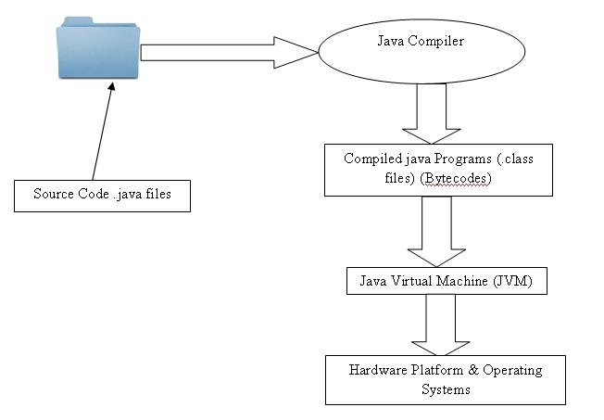
JVM (Java Virtual Machine)

Slide 23
Java Compiler
Java Interpreter
Java debugger
Applet viewer

Slide 24
Program Features
        Java is case sensitive language.
        All statements must be end with the semicolon.
        Java is a built upon C and C++. It derives its syntax from C and the object oriented features are influenced by C++.

Slide 25
General Program Structure:
Document Section
Package Statement
Import Statement
Interface Statement
Class Definitions
Main method class
{
public static void main(String args[])
}

Slide 26
Document Section
Document Section comprise a set of comment lines giving the name of the program, the author and other details, which the programmer would like to refer at a later stage

Slide 27
Package Statement
The first statement allowed in Java is a package statement. Package statement declares a package name and informs the compiler that the classes defined here belongs to this package.
Syntax : package <name>
The package statement is optional, That is, our classes should not have to be part of a package.

Slide 28
Import Statement
This is similar to #include syntax in C
Syntax :
import packagename.classname;
Example: Import student.test;
    This statement instruct the interpreter to load the test class contained in the package student.

Slide 29
Interface Statement
An interface is like class but includes a group of method declaration.
This is also an optional section and is used only when we wish to implement the multiple inheritance features in the program.

Slide 30
Class Definitions
A Java program may contain multiple class definitions.
Classes are primary and essential elements of Java program.

Slide 31
Main method class
Since every java stand alone program requires a main method as its starting point, this class is an essential part of Java program, All Java applications begin execution by calling main().
A Simple java program may contain only this part.

Slide 32
Main method class
The public keyword is an access specifier, which allows the programmer to control the visibility of class members. When a class member is preceded by public, then that member may be accessed by code outside the class in which it is declared. In this main() must be declared as a public, since it must be called by code outside of its class when the program is started.
The keyword static means the entry point of the program will not change
The keyword void simply tells the compiler that the main() does not return a value.

Slide 33
Main method class con’t
String args[] declares a parameter named args, which is an array of instances of the class String. In this case, args receives any command –line arguments present when the program is executed. If there are no parameters required for a given method, you still need to include the empty parentheses.
System is a predefined class that provides access to the system, and out is the output stream that is connected to the console.
out is actually accomplished by the built-in println() method, pritntln() method displays the String which is passes to it.

Slide 34
Simple Java Program
public class HelloWorld {
//method main(): ALWAYS the APPLICATION entry point
public static void main (String[] args) { System.out.println ("Hello World !");
}
}

Slide 35
Compile and Run Java Code
For compiling this program
  javac HelloWorld.java
For running this program
  java HelloWorld

Slide 36
Java Basic Syntax
Case Sensitivity:
  Java is case sensitive it means Hello and hello would have different meaning.
Class Names:
  First letter should be in upper case.
  If class name contain many name then all word first letter should be in upper case. Ex. MyFirstJavaClass

Slide 37
Method Names:
  Starts with lower case letter.
  If name contain many words then inner word start with upper case. Ex. myMethodName()
Program File Name:
  Name of the file exactly match with the class name.
  When you saving the file using class name and append .java to the end of file name. ex. MyFirstJavaClass.java

Slide 38
Identifiers
They are used for naming classes, methods, variables, arrays, labels, packages and interface in a program.
Each variable has a name by which it is identified in the program.
It's a good idea to give your variables valuable names that are closely related to the values they hold. In a simple word they are used name Java language Entities.

Slide 39
Identifiers
They follow the below rules:
  They can have alphabets, digits, and the underscores and dollar sign characters. (i.e. a-z, A-Z, 0-9, _, $)
  They must not begin with digit.
  Uppercase and Lower case letters are distinct.
    Eg. test is not same as Test.
  They can be of any length.
  They can also contain currency symbol. (i.e. $)

Slide 40
Literals
Literals represent constant values to be stored in variables.
A literal is a value that can be written directly into a Java program.
Java language specifies five major types of literals. They are
    Integer Literals
    Floating Point Literal
    Character Literals
    String Literals
    Boolean Literals

Slide 41
Operators
  Assignment Operator
    =,+=,-=,*=,/=,%=
  Arithmetic Operator
    +,-,*,/,%
  Relational Operator
    <,>,<=,>=,==,!=
  Logical Operator
    &&,||,!
  Increment and Decrement Operator
    ++,--

Slide 42
Operator
  Conditional Operator
        It Contains character pair ? : ternary operator
    Example: int value = a < b ? a : b;
    expr1 ? expr2 : expr3
    expr1 is evaluated first, if it is true (nonzero), then the expression expr2 is evaluated and becomes the value of the conditional expression. If expr1 is false, expr3 is evaluated and its value becomes the value of the conditional expression.

Slide 43
Operator
  Bitwise Operator
    Used to evaluated data at bit level
        & Bitwise AND
        | Bitwise OR
        ^ Bitwise Exclusive OR
        ~ One’s Complement
        << Shift left
        >> Shift Right

Slide 44
Variables
Variables are used in a java program to contain data that change during the execution of program.
Variables are useful to store the meaningful values which are used during the program execution.

Slide 45
How to Declare a Variable?
In Java before using the Variable we must have to define it. To declare a Variable the following basic Syntax is used.
  type identifier [= value][,identifier[=value]…];

Slide 46
Example for Variable
  int x, y , z; // declares three integers called //x, y, z
  byte b = 99; // initialize b as byte
  int o = 8, p, q = 10 ; // declares three //integers and initialize o and q
  double pi = 3.14159; // declares pi as //double with approximate value
  char c = ‘c’; // declares the c as //character with value ‘c’

Slide 47
The following are legal variable names:
MyVariable
myvariable
MYVARIABLE
x
i
_myvariable
$myvariable
_9pins

Slide 48
The following are not legal variable names:
My Variable // Contains a space
4pins // Begins with a digit
a+c // The plus sign is not an alphanumeric //character
testing1-2-3 // The hyphen is not an alphanumeric //character
document’s // Apostrophe is not an //alphanumeric character
Java_&_C++ // ampersand is not an alphanumeric //character

Slide 49
Keywords
abstract | continue | goto | package | synchronized
assert | default | if | private | this
boolean | do | implements | protected | throw
break | double | import | public | throws
byte | byte | instanceof | return | transient
case | extends | int | short | try
catch | final | interface | static | void
char | finally | long | strictfp | volatile
class | float | native | Super | while
const | for | new | switch

Slide 50
Data types
Integers
  This group includes byte, int, short, long. It is for signed numbers.
Floating Point numbers
  This group includes float and double, it represent the numbers with fractional parts.
Characters
  This group includes char, it represent symbols in a character set, like letters and numbers.
Boolean
  This group includes boolean, it represents the true / false values .

Slide 51
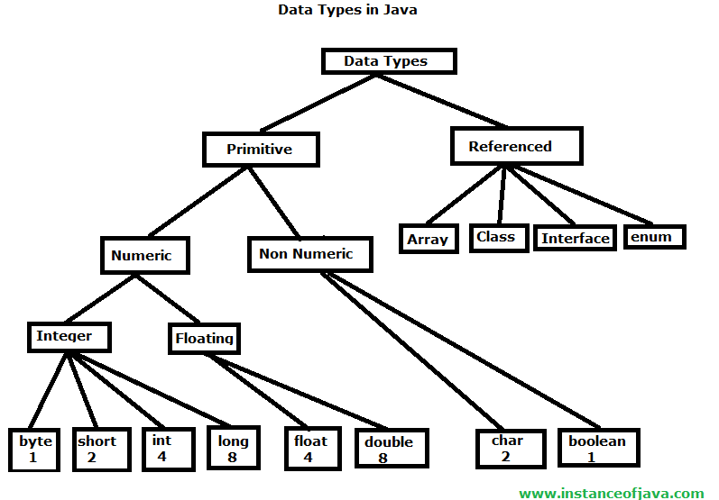
Data Types

Slide 52
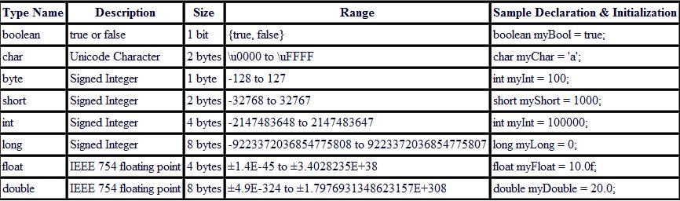

Slide 53
What is Control Structures ?
The main purpose of Control Statement is to control the flow of the program.
The control statements includes decision making and loops.

Slide 54
Types
Selection Statement (Branching)
  If – else
  Nested If
  Switch
Iteration Statement (Looping)
  While
  Do-while
  For
  Jump Statement
  Break
  Continue
  return

Slide 55
IF…ELSE Statement
Syntax:
  if(condition)
  {
  Statement1;
  }
  else
  {
    Stetment2;
    }

Slide 56
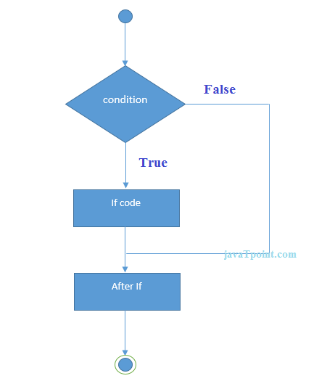
IF…ELSE Statement

Slide 57
Example:
public class Test
{
public static void main(String[] args)
{
int a=5,b=10;
if(a<b)
{
System.out.println(“a ”+a);
}
else
{
System.out.println(“b ”+b);
}
}
}

Slide 58
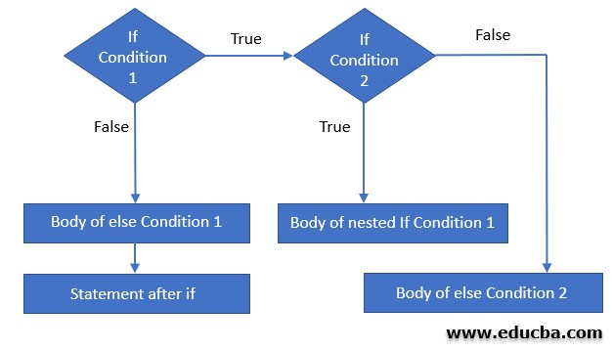
Nested IFs Statement

Slide 59
Example:
if(i == 10)
{
if(j < 20)
a = b;
if(k > 100)
c = d;
else
a = c;
}
else
{
a= d;
}

Slide 60
Switch Statement
Syntax:
  switch(expression)
  {
  case value1:
  //statements;
  break;
  case value2:
  //statements;
  break;
  default:
  //statements;
  break;
  }

Slide 61
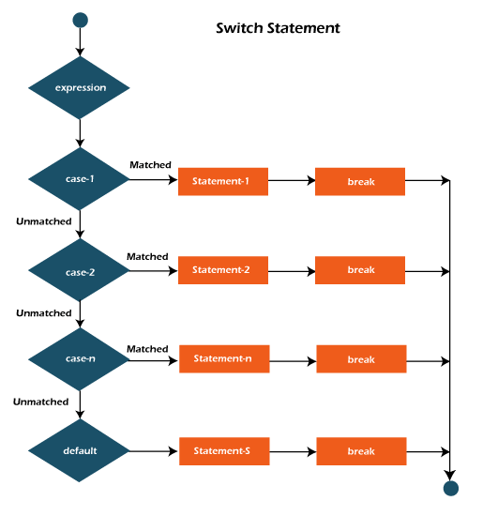
Switch Statement

Slide 62
Example:
char c = ‘C';
switch(c)
{
case 'A':
System.out.println("Assignment");
break;
case 'B':
System.out.println("Quiz");
break;
case 'C':
System.out.println("Viva");
break;
default:
System.out.println("Invalid Choice");
break;
}

Slide 63
While Loop
Syntax:
  while( condition )
  {
  //Loop body which we want to execute until
  the condition become false
  }

Slide 64
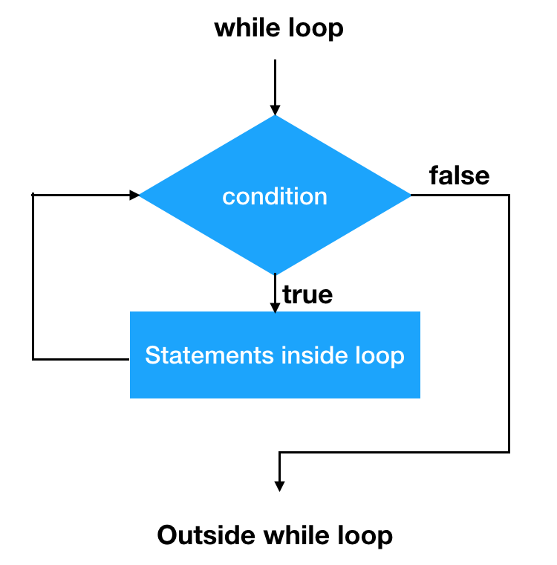
While Loop

Slide 65
Example:
public class Test
{
public static void main(String[] args)
{
int n=0;
while(n < 10)
{
System.out.println(“Value of n = “+n);
n++;
}
}

Slide 66
do…while Loop
Syntax:
  do
  {
  // Body of Loop
  }while( condition )

Slide 67
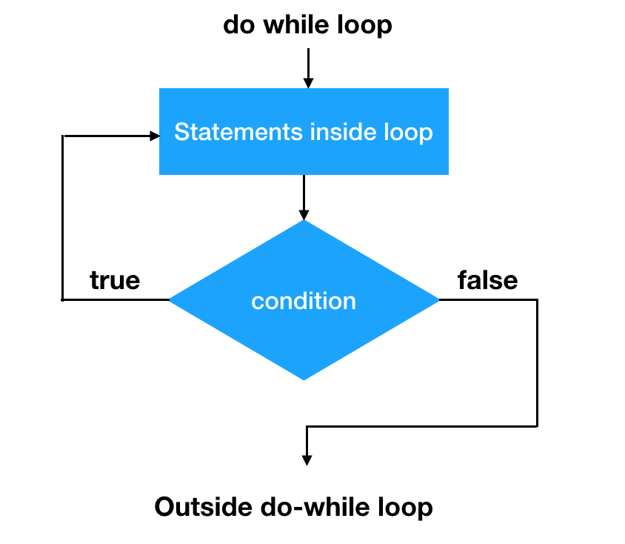
do…while Loop

Slide 68
Example:
public class Test
{
public static void main(String[] args)
{
int n=10;
do{
System.out.println(“Value of n = “+n);
n--;
}
while(n > 0)
}
}

Slide 69
for Loop
Syntax:
  for(initialization; condition; iteration)
  {
  //Body of Loop.
  }

Slide 70
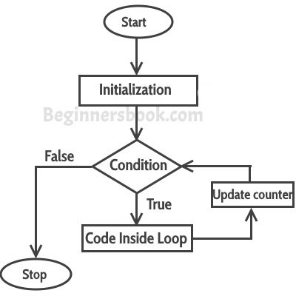
for Loop

Slide 71
Example:
public class Test
{
public static void main(String[] args)
{
int n=10;
for(n=10; n>0; n--)
{
System.out.println(“Value of n = “+n);
}
}
}

Slide 72
Break Statement
public class Test
{
public static void main(String[] args)
{
for(int i=10; i<100; i++)
{
if(i == 10) break;
System.out.println(“Value of i = “+i);
}
System.out.println(“Loop Complete”);
}
}

Slide 73
Continue Statement
public class Test
{
public static void main(String[] args)
{
for(int i=10; i<10; i++)
{
System.out.println(“Value of i = “+i);
if(i%2 == 0) continue;
System.out.println(“ “);
}
}
}

Slide 74
Return Statement
public class Test
{
public static void main(String[] args)
{
boolean t = true;
System.out.println(“Before the return”);
if (t) return;
System.out.println(“This won’t execute”);
}
}

Slide 75
Type Casting
Assigning a value of one type to a variable of another type is known as Type Casting.
  Widening Casting(Implicit)
  Narrowing Casting(Explicitly done)

Slide 76
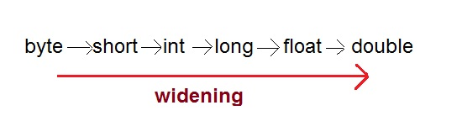
Widening Casting(Implicit)
Automatic Type casting take place when,
  the two types are compatible
  the target type is larger than the source type.

Slide 77
Example:
public class Test
{
public static void main(String[] args)
{
int i = 100;
long l = i; //no explicit type casting required
float f = l; //no explicit type casting required
System.out.println("Int value "+i);
System.out.println("Long value "+l);
System.out.println("Float value "+f);
}
}
OUTPUT:
Int value 100
Long value 100
Float value 100.0

Slide 78
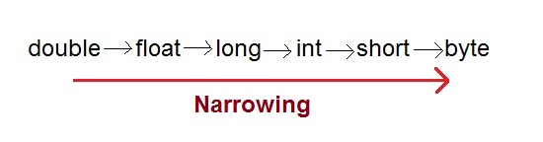
Narrowing Casting(Explicitly done)
When you are assigning a larger type value to a variable of smaller type, then you need to perform explicit type casting.

Slide 79
Example:
public class Test
{
public static void main(String[] args)
{
double d = 100.04;
long l = (long)d; //explicit type casting required
int i = (int)l; //explicit type casting required
System.out.println("Double value "+d);
System.out.println("Long value "+l);
System.out.println("Int value "+i);
}
}
OUTPUT:
Double value 100.04
Long value 100
Int value 100

