Slide 1
Unit-4
Threads and Packages

Slide 2
Unit-4
4.1 Thread
4.1.1 Introduction to Threads, Thread Model 4.1.2 Priority of Threads
4.2 Package Naming, Type Imports
4.2.1 Package Access, Package Contents
4.2.2 Package Object and Specification

Slide 3
Introduction
Threads allows a program to operate more efficiently by doing multiple things at the same time.
Threads can be used to perform complicated tasks in the background without interrupting the main program.

Slide 4
A thread, in the context of Java, is the path followed when executing a program. All Java programs have at least one thread, known as the main thread, which is created by the Java Virtual Machine (JVM) at the program’s start, when the main() method is invoked with the main thread.
In Java, creating a thread is accomplished by implementing an interface and extending a class. Every Java thread is created and controlled by the java.lang.Thread class.
A single-threaded application has only one thread and can handle only one task at a time. To handle multiple tasks in parallel, multi-threading is used: multiple threads are created, each performing a different task.

Slide 5
Introduction
Windows can execute several programs simultaneously; this ability is known as multitasking. In System’s terminology it is called “Multithreading”.
Java programs that contain only a single sequential flow of control is called single-threaded programs. Every program has at least one thread.
A Thread is similar to program that have single flow of control.

Slide 6
Java enables us to use multiple flows of control in developing programs.
Each flow of control may be thought of as a separate tiny program (or module) known as thread that runs in parallel to others.
A Program that contains multiple flows of control is known as multithreaded program.

Slide 7
Multithreading is a conceptual programming where a program (process) is divided into two or more subprograms (processes), which can be implemented at the same time in parallel.
The java interpreter handles the switching of control between the threads in such a way that it appears they are running concurrently.
Multithreading enables programmers to do multiple things at one time.
They can divide a long program into threads and executes them in parallel.

Slide 8
EXAMPLES
VIVA
PRACTICAL LAB ( SOLVING ERROR )
PRACTICAL EXAM
BUS STATION

Slide 9



Slide 10
Difference between thread and process
Process | Thread
A program in execution is often referred as process. | A thread is a subset(part) of the process.
A process consists of multiple threads. | A thread is a smallest part of the process that can execute concurrently with other parts(threads) of the process.
A process is sometime referred as task. | A thread is often referred as lightweight process.
A process has its own address space. | A thread uses the process’s address space and share it with the other threads of that process.
The creation of new processes require duplication of the parent process. | New threads are easily created.
A process does not have control over the sibling process, it has control over its child processes only. | Threads have control over the other threads of the same process.

Slide 11
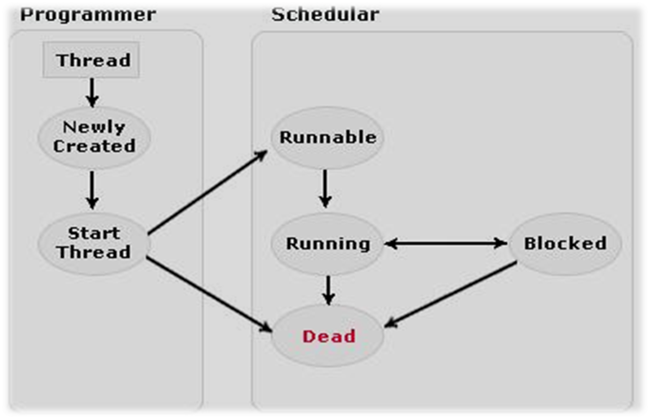
Thread Life Cycle
start()
run()
sleep(), wait()

Slide 12
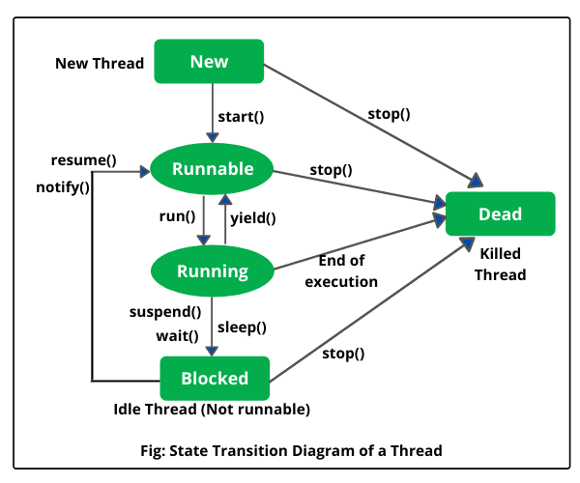

Slide 13
New state (Born)
After the creations of Thread instance the thread is in this state but before the start() method invocation. At this point, the thread is considered not alive.

Slide 14
Runnable (Ready-to-run) state
A thread start its life from Runnable state. A thread first enters runnable state after the invoking of start() method but a thread can return to this state after either running, waiting, sleeping or coming back from blocked state also.

Slide 15
Running state (Execution)
A thread is in running state that means the thread is currently executing. There are several ways to enter in Runnable state but there is only one way to enter in Running state: the scheduler select a thread from runnable pool.

Slide 16
Dead state (Exit)
A thread can be considered dead when its run() method completes. If any thread comes on this state that means it cannot ever run again.

Slide 17
Blocked state (Waiting)
A thread can enter in this state because of waiting the resources that are hold by another thread.

Slide 18
Method | Return Type | Description
currentThread( ) | Thread | Returns an object reference to the thread in which it is invoked.
getName( ) | String | Retrieve the name of the thread object or instance.
start( ) | void | Start the thread by calling its run method.
run( ) | void | This method is the entry point to execute thread, like the main method for applications.
sleep( ) | void | Suspends a thread for a specified amount of time (in milliseconds). Throws InterruptedException.
isAlive( ) | boolean | This method is used to determine the thread is running or not.

Slide 19
Continue..
Method | Return Type | Description
activeCount( ) | int | This method returns the number of active threads in a particular thread group and all its subgroups.
interrupt( ) | void | The method interrupt the threads on which it is invoked.
yield( ) | void | By invoking this method the current thread pause its execution temporarily and allow other threads to execute.
join( ) | void | join(long millisec) Throws InterruptedException. This method is invoked on a thread. This is not returned until either the thread has completed or it is timed out respectively.

Slide 20
The Main Thread
When a Java program starts up, one thread begins running immediately. This is usually called the main thread of your program, because it is the one that is executed when your program begins.
  It is the thread from which other “child” threads will be spawned.
  Often it must be the last thread to finish execution because it performs various shutdown actions

Slide 21
Although the main thread is created automatically when your program is started, it can be controlled through a Thread object. To do so, you must obtain a reference to it by calling the method currentThread( ), which is a public static member of Thread.

Slide 22
Creating Thread
You can implement the Runnable interface.
You can extend the Thread class, itself.

Slide 23
import java.lang.*;
public class Counter implements Runnable
{
Thread T;
  public void run()
    {
    ....
    }
    }

Slide 24
import java.lang.*;
public class Counter extends Thread
{
  public void run()
  {
    ....
  }
}

Slide 25
Example
class threadDemo1
{
public static void main(String a[])
{
try
{
for(int i=1;i<=10;i++)
{
System.out.println(i);
Thread.sleep(1000);
}
}
catch(Exception e)
{
System.out.println("Errrrror");
}
}
}

Slide 26
Write a program to accept a string from command line and display each character in revrse at the interval of 1 second.
class threadrev
{
public static void main(String a[])
{
String s=a[0];
try
{
for(int i=s.length()-1;i>=0;i--)
{
System.out.println(s.charAt(i));
Thread.sleep(1000);
}
}
catch(Exception e)
{
System.out.println("Errrrror");
}
}
}

Slide 27
Thread Priority
In the Java programming language, every thread has a priority. By default, a thread inherits the priority of its parent thread. You can increase or decrease the priority of any thread with the setPrioritymethod.

Slide 28
Each thread have a priority. Priorities are represented by a number between 1 and 10. In most cases, thread scheduler schedules the threads according to their priority (known as preemptive scheduling). But it is not guaranteed because it depends on JVM specification that which scheduling it chooses.

Slide 29
Thread Priority
Thread.MIN_PRIORITY
  The minimum priority of any thread (an int value of 1)
Thread.MAX_PRIORITY
  The maximum priority of any thread (an int value of 10)
Thread.NORM_PRIORITY
  The normal priority of any thread (an int value of 5)

Slide 30
setPriority()
  This is method is used to set the priority of thread.
getPriority()
  This method is used to get the priority of thread.

Slide 31
Example
public class ThreadPriority extends Thread
{
private String threadName;
ThreadPriority(String threadName)
{
this.threadName = threadName;
}
public void run()
{
System.out.println("Running [" + threadName + "]");
for (int i = 1; i <= 2; i++)
{
System.out.println("[" + threadName + "] => " + i);
try
{
Thread.sleep(500);
}
catch (InterruptedException e)
{
System.out.println(e.toString());
}
}
}
public static void main(String[] args)
{
ThreadPriority thread1 = new ThreadPriority("First");
ThreadPriority thread2 = new ThreadPriority("Second");
ThreadPriority thread3 = new ThreadPriority("Third");
ThreadPriority thread4 = new ThreadPriority("Fourth");
ThreadPriority thread5 = new ThreadPriority("Fifth");
thread1.setPriority(Thread.MIN_PRIORITY);
thread2.setPriority(2);
thread3.setPriority(Thread.NORM_PRIORITY);
thread4.setPriority(8);
thread5.setPriority(Thread.MAX_PRIORITY);
System.out.println("get"+thread5.getPriority());
thread1.start();
thread2.start();
thread3.start();
thread4.start();
thread5.start();
}
}

Slide 32
Thread Synchronization
When two or more threads need access to a shared resource, they need some way to ensure that the resource will be used by only one thread at a time.
The process by which this is achieved is called synchronization.
Synchronization in java is the capability to control the access of multiple threads to any shared resource.
Java Synchronization is better option where we want to allow only one thread to access the shared resource.

Slide 33
Why use Synchronization?
To prevent thread interference.
To prevent consistency problem.

Slide 34
synchronized statement
Synchronizing a method is the best way to restrict the use of a method one thread at a time.
synchronized(object)
{
// statements to be synchronized
}

Slide 35
Interthread Communication
Java provides a very efficient way through which multiple-threads can communicate with each-other. This way reduces the CPU’s idle time.
i.e. A process where, a thread is paused running in its critical region and another thread is allowed to enter (or lock) in the same critical section to be executed.
This technique is known as Interthread communication which is implemented by some methods.

Slide 36
Inter-thread communication or Co-operation is all about allowing synchronized threads to communicate with each other.
Cooperation (Inter-thread communication) is a mechanism in which a thread is paused running in its critical section and another thread is allowed to enter (or lock) in the same critical section to be executed.

Slide 37
It is implemented by following methods of Object class:
wait()
notify()
notifyAll()

Slide 38
wait( )
  tells the calling thread to give up the monitor and go to sleep until some other thread enters the same monitor and calls notify( ).

Slide 39
Con’t
notify()
  wakes up the first thread that called wait() on the same object.

Slide 40
Con’t
notifyAll()
  wakes up all the threads that called wait() on the same object. The highest priority thread will run first.

Slide 41
Example

Slide 42
What is Monitor?
A monitor can be considered as a building which contains a special room. The special room can be occupied by only one customer(thread) at a time. The room usually contains some data and code.
Key to synchronization is the concept of the monitor.
A monitor is an object that is used as a mutually exclusive lock.
Only one thread own a monitor at a given time. When a thread acquires a lock, it is said to have entered the monitor.

Slide 43
What is Deamon Thread?
Daemon thread is a low priority thread that runs in background to perform tasks such as garbage collection.
Daemon threads will be terminated by the JVM when there are none of the other threads running, it includes main thread of execution as well.

Slide 44
public class DaemonThread extends Thread
{
public DaemonThread()
{
setDaemon(true);
}
public void run()
{
System.out.println("Is this thread Daemon? - "+isDaemon());
}
public static void main(String a[])
{
DaemonThread dt = new DaemonThread();
// even you can set daemon constrain here also
// it is like dt.setDeamon(true)
dt.start();
}
}

Slide 45
Introduction
Java allows you to group classes in a collection called a package.
Packages are convenient for organizing your work and for separating your work from code libraries provided by others.
Java applications often comprise a very large number of classes.
In order to provide for management of all these classes, they are arranged into groupings known as packages, with each package containing a logical group of related classes.

Slide 46
A package is the Java version of a library. A package refers simply to a group of related class files in the same directory and having in each class file a package.
Package in Java is a mechanism to encapsulate a group of classes, sub packages and interfaces.

Slide 47
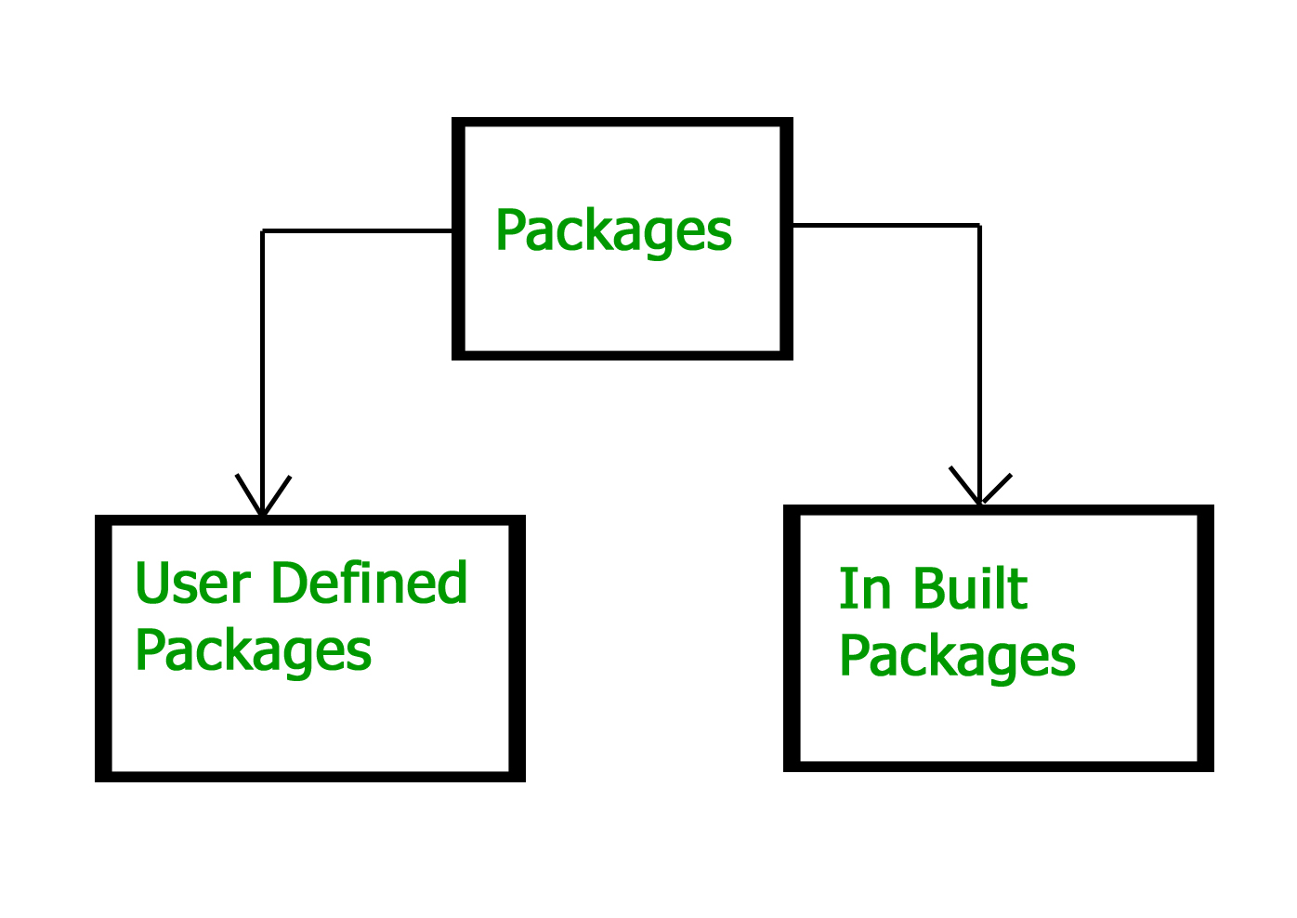
Types of packages:

Slide 48
Java API Packages (BUILT-IN)
JAVA
lang
util
io
awt
net
applet

Slide 49
Java API Packages
java.lang
  Contains String, math function, thread etc.
java.util
  Contains vector, Date etc.
java.io
  Input/Output Support classes
java.awt
  contains GUI based environment, like menu, button, list etc.
  java.net
  Classes for networking
java.applet
  For creating applet class and implementation

Slide 50
Example
import java.util.*;
class pkg
{
public static void main(String args[])
{
Date d = new Date();
System.out.println(d);
}
}

Slide 51
USER DEFINED PACKAGE / Package Naming
Package names are written in all lowercase to avoid conflict with the names of classes or interfaces.
Companies use their reversed Internet domain name to begin their package names.
Example: com.example.XTPL for a package named XTPL created by a programmer at example.com.

Slide 52
java.lang.Math.sqrt(x)
Package Name
Class Name
Method Name

Slide 53
Con’t
Legalizing Package Names
Domain Name | Package Name Prefix
clipart-open.org | org.clipart_open
free.fonts.int | int_.fonts.free
poetry.7days.com | com._7days.poetry

Slide 54
Creating Packages
To create a package, you choose a name for the package.
put a package statement with that name at the top of every source file that contains the types (classes, interfaces, etc…) that you want to include in the package.

Slide 55
Syntax
package packageName;
class className
{
  //Class Body
}

Slide 56
Importing Packages
In a Java source file, import statements occur immediately following the package statement (if it exists) and before any class definitions.

Slide 57
general form of the import statement:
import pkg1[.pkg2].(classname/*);
  pkg1 is the name of a top-level package,
  pkg2 is the name of a subordinate package inside the outer package separated by a dot (.).
  Finally, you specify either an explicit classname or a star (*),

Slide 58
import java.util.Date;
import java.io.*;

Slide 59
import java.util.*;
class MyDate extends Date
{
}
OR
class MyDate extends java.util.Date
{
}

Slide 60
Access Protection
 | Private | No modifier | Protected | Public
Same class | Yes | Yes | Yes | Yes
Same package subclass | No | Yes | Yes | Yes
Same package non-subclass | No | Yes | Yes | Yes
Different package subclass | No | No | Yes | Yes
Different package non-subclass | No | No | No | Yes

Slide 61
Example:
NOTE:
WRITE ALL THE NEXT 4 SLIDES CODE

Slide 62
BCA package - > class fy
package BCA;
public class fy
{
public fy()
{
System.out.println("FY");
}
}

Slide 63
BCA package - > class sy
package BCA;
public class sy extends fy
{
public sy()
{
System.out.println("SY");
}
}

Slide 64
BCA package - > class ty
package BCA;
public class ty extends sy
{
public ty(){
System.out.println("TYBCA");
}
}

Slide 65
ACCESSING PACKAGE CLASS
import BCA.*;
class pkgtest
{
public static void main(String args[])
{
ty t =new ty();
}
}

Slide 66
Now compile files as follows using –d option:
javac –d . fy.java
javac pkgtest.java
java pkgtest
The -d keyword specifies the destination for where to save the class file.

Slide 67
There are three ways to access the package from outside the package.
  import package.*;
  import package.classname;
  fully qualified name.

Slide 68
Advantage of Java Package
1) Java package is used to categorize the classes and interfaces so that they can be easily maintained.
2) Java package provides access protection.
3) Java package removes naming collision.

