Slide 1
UNIT 3: Introduction to mySql
3.1. Types of tables in MySQL
3.2. Query in MySQL: Select, Insert, Update, Delete
3.3. Order By
3.4. Database connectivity of PHP with MySQL
3.5. Functions of MySQL

Slide 2
What is MySQL ?
MySQL is an open source relational database management system.
It includes the SQL server and client programs for accessing the server.
Widely used by web application developers, together with PHP and APACHE
It is pronounced My-es-que-el
(Not My-Sequel)

Slide 3
4.1 Types of Tables OR Database Engines
The basic table / Database types are
  ISAM
  MyISAM
  InnoDB
  BerkeleyDB (BDB)
  MERGE
  MEMORY (HEAP)
  Archive
  CSV

Slide 4
The most important feature to make all the table types above distinction is transaction-safe or not.
Only InnoDB and BDB tables are transaction safe and only MyISAM tables support full-text indexing and searching feature.

Slide 5
INNODB is the default table type when you create table without declaring which storage engine to use.

Slide 6
ISAM Indexed Sequential Access Method
ISAM had been deprecated and removed from version 5.x.
All of it functionality entire replace by MyISAM. ISAM table has a hard size 4GB and is not portable.

Slide 7
MyISAM
MyISAM table work very fast but not transaction-safe.
The size of MyISAM table depends on the operating system and the data file are portable from system to system.
With MyISAM table type, you can have 64 keys per table and maximum key length of 1024 bytes.

Slide 8
InnoDB
InnoDB table type is default when you create table.
Different from MyISAM table type, InnoDB table are transaction safe and supports row-level locking.
Foreign keys are supported in InnoDB tables.
The data file of InnoDB table can be stored in more than one file so the size of table depends on the disk space

Slide 9
Like the MyISAM table type, data file of InnoDB is portable from system to system.
the disadvantage of InnoDB in comparison with MyISAM is it take more disk space.
The InnoDB tables fully support ACID (Atomicity, Consistency Isolation, Durability)compliant and transactions. They are also optimal for performance.

Slide 10
BerkeleyDB (BDB)
BDB is similar to InnoDB in transaction safe. It supports page level locking but data file are not portable.

Slide 11
MERGE
Merge table type is added to treat multiple MyISAM tables as a single table so it remove the size limitation from MyISAM tables.

Slide 12
MEMORY (HEAP)
Heap table is stored in memory so it is the fastest one. Because of storage mechanism, the data will be lost when the power failure and sometime it can cause the server run out of memory.
Heap tables do not support columns with AUTO_INCREMENT, BLOB (Binary Large Object) and TEXT characteristics.

Slide 13
Archive
The archive storage engine allows you to store a large number of records, which for archiving purpose, into a compressed format to save disk space.
The archive storage engine compresses a record when it is inserted and decompress it using the zlib library as it is read.

Slide 14
The archive tables only allow INSERT and SELECT statements. The ARCHIVE tables do not support indexes, so it is required a full table scanning for reading rows.

Slide 15
CSV
The CSV storage engine stores data in comma-separated values (CSV) file format.
A CSV table brings a convenient way to migrate data into non-SQL applications such as spreadsheet software.

Slide 16
CSV table does not support NULL data type. In addition, the read operation requires a full table scan.

Slide 17
Data Types
MySQL supports the large number of Data types
Main four Data Types:
  Numeric Data Type
  String Data Type
  Date and Time Data Type

Slide 18
1. Numeric Data Type
TINYINT
SMALLINT
MEDIUMINT
INT
BIGINT
DECIMAL
FLOAT
DOUBLE
BIT

Slide 19
2. String Data Type
CHAR
VARCHAR
BINARY
VARBINARY
TINYBLOB
BLOB
MEDIUMBLOB
LONGBLOB
TINYTEXT
TEXT
MEDIUMTEXT
LONGTEXT
ENUM

Slide 20
3. Date & Time Data Type
DATE
TIME
DATETIME
TIMESTAMP
YEAR

Slide 21
Special Data Types
GEOMETRY
POINT
LINESTRING
POLYGON
GEOMETRYCOLLECTION
MULTILINESTRING
MULTIPOINT
MULTIPOLYGON

Slide 22
Type | Size | Description
CHAR[Length] | Length bytes | A fixed-length field from 0 to 255 characters long.
VARCHAR(Length) | String length + 1 bytes | A fixed-length field from 0 to 255 characters long.
TINYTEXT | String length + 1 bytes | A string with a maximum length of 255 characters
TEXT | String length + 2 bytes | A string with a maximum length of 65,535 characters.
MEDIUMTEXT | String length + 3 bytes | A string with a maximum length of 16,777,215 characters.
LONGTEXT | String length + 4 bytes | A string with a maximum length of 4,294,967,295 characters.
TINYINT[Length] | 1 byte | Range of -128 to 127 or 0 to 255 unsigned.
SMALLINT[Length] | 2 bytes | Range of -32,768 to 32,767 or 0 to 65,535 unsigned.
MEDIUMINT[Length] | 3 bytes | Range of -8,388,608 to 8,388,607 or 0 to 16,777,215 unsigned

Slide 23
INT[Length] | 4 bytes | Range of -2,147,483,648 to 2,147,483,647 or 0 to 4,294,967,295 unsigned
BIGINT[Length] | 8 bytes | Range of -9,223,372,036,854,775,808 to 9,223,372,036,854,775,807 or 0 to 18,446,744,073,709,551,615 unsigned
FLOAT | 4 bytes | A small number with a floating decimal point.
DOUBLE[Length, Decimals] | 8 bytes | A large number with a floating decimal point.
DECIMAL[Length, Decimals] | Length +1 bytes or Length + 2 bytes | A DOUBLE stored as a string, allowing for a fixed decimal point.
DATE | 3 bytes | In the format YYYY-MM-DD
DATETIME | 8 bytes | In the format YYYY-MM-DD HH:MM:SS.
TIMESTAMP | 4 bytes | In the format YYYYMMDDHHMMSS; acceptable range ends in the year 2037.
TIME | 3 bytes | In the format of HH:MM:SS.
ENUM | 1 or 2 bytes | Short for enumeration, that is, each column can have one of several possible values.
SET | 1, 2, 3, 4, or 8 bytes | Like ENUM except that each column can have more than one of several possible values.

Slide 24
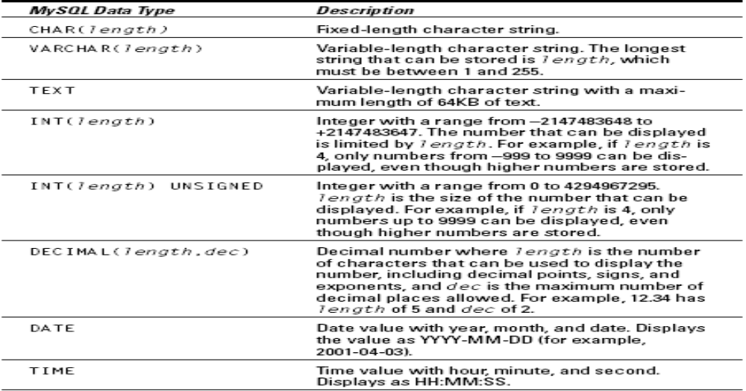
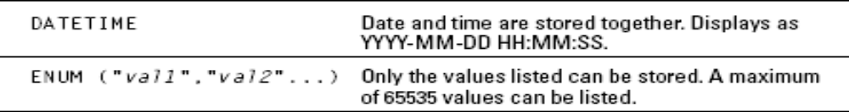
Quick Example of data types

Slide 25
Alias
You can give a table or a column another name by using an alias.
This can be a good thing to do if you have very long or complex table names or column names.

Slide 26
Syntax
SELECT column_name AS alias_name
FROM table_name;

Slide 27
ORDER BY
SELECT column_name(s)
FROM table_name
ORDER BY column_name(s) ASC|DESC

Slide 28
TRUNCATE
TRUNCATE TABLE TABLE_NAME

Slide 29
4.4 Database connectivity of PHP with MySQL
1. OPEN LOCALHOST AND GO TO PHP MYADMIN
2. MAKE DATABASE IN MYSQL (EG. VNSGU)
3. CREATE TABLE IN GIVEN DATABASE (EG. STUD_MST)
4. CREATE A FOLDER IN WWW DIRECTORY (C:/WAMP/WWW/DATABASE)
5. OPEN TEXT EDITOR IE. NOTEPAD,NOTEPAD++, SUBLIME
6. WRITE PHP CODE TO CONNECT DATABASE
MYSQLI_CONNECT("localhost","root","","vnsgu");
mysqli_connect() will establish connection beteween PHP and Mysql
7. SAVE FILE WITH .PHP EXTENSION
8. OPEN LOCALHOST IN BROWSER
9. RUN THE SAVED FILE

Slide 30

4.5 MySQL Functions

Slide 31
mysqli_connect()
Open a new connection to the MySQL server:
Syntax:
mysqli_connect(host,username,password,dbname,port,socket);

Slide 32
Parameter | Description
host | Optional. Specifies a host name or an IP address
username | Optional. Specifies the MySQL username
password | Optional. Specifies the MySQL password
dbname | Optional. Specifies the default database to be used
port | Optional. Specifies the port number to attempt to connect to the MySQL server
socket | Optional. Specifies the socket or named pipe to be used

Slide 33
example
<?php
$con = mysqli_connect("localhost", "root", "", "dbname");
if (!$con)
{
die('Could not connect: ' . mysqli_error());
}
mysqli_close($con);
?>

Slide 34
mysqli_query()
The mysqli_query() function executes a query on a MySQL database.
This function returns the query handle for SELECT queries, TRUE/FALSE for other queries, or FALSE on failure.

Slide 35
mysqli_query(connection,query,resultmode);
Parameter | Description
connection | Required. Specifies the MySQL connection to use
query | Required. Specifies the query string
resultmode | Optional. A constant. Either: MYSQLI_USE_RESULT (Use this if we have to retrieve large amount of data) MYSQLI_STORE_RESULT (This is default)

Slide 36
example
<?php
$con = mysqli_connect("localhost", "root", "", "dbname");
if (!$con)
{
die('Could not connect: ' . mysqli_error());
}
$sql = "SELECT * FROM Person";
mysqli_query($con,$sql);
// some code
mysqli_close($con);
?>

Slide 37
mysqli_num_rows()
The mysqli_num_rows() function returns the number of rows in a recordset.
This function returns FALSE on failure.

Slide 38
mysqli_num_rows(result)
Parameter | Description
result | Required. Specifies which data pointer to use. The data pointer is the result from the mysqli_query() function

Slide 39
<?php
$con = mysqli_connect("localhost", "root", "", "dbname");
if (!$con)
{
die('Could not connect: ' . mysql_error());
}
$sql = "SELECT * FROM person";
$result = mysqli_query($con,$sql);
echo mysqli_num_rows($result);
mysqli_close($con);
?>

Slide 40
mysqli_num_fields()
The mysqli_num_fields() function returns the number of fields (columns) in a recordset.
This function returns FALSE on failure.

Slide 41
mysqli_num_fields(result)
Parameter | Description
result | Required. Specifies which data pointer to use. The data pointer is the result from the mysqli_query() function

Slide 42
<?php
$con = mysqli_connect("localhost", "root", "", "dbname");
if (!$con)
{
die('Could not connect: ' . mysqli_error());
}
$sql = "SELECT * FROM person";
$result = mysqli_query($con,$sql);
echo mysqli_num_fields($result);
mysqli_close($con);
?>

Slide 43
mysqli_affected_rows()
The mysqli_affected_rows() function returns the number of affected rows in the previous SELECT, INSERT, UPDATE, REPLACE, or DELETE query.
This function returns the number of affected rows on success, or -1 if the last operation failed.

Slide 44
mysqli_affected_rows(connection)
Parameter | Description
connection | Optional. Specifies the MySQL connection. If not specified, the last connection opened by mysql_connect() or mysql_pconnect() is used.

Slide 45
<?php
$con = mysqli_connect("localhost", "root", "", "dbname");
if (!$con)
{
die("Could not connect: " . mysqli_error());
}
mysqli_query($con,"DELETE FROM mytable WHERE id < 5");
$rc = mysqli_affected_rows($con);
echo "Records deleted: " . $rc;
mysqli_close($con);
?>

Slide 46
mysqli_fetch_array()
The mysqli_fetch_array() function returns a row from a recordset as an associative array and/or a numeric array.
This function gets a row from the mysqli_query() function and returns an array on success, or FALSE on failure or when there are no more rows.

Slide 47
mysqli_fetch_array(result,resulttype)
Parameter | Description
result | Required. Specifies a result set identifier returned by mysqli_query(), mysqli_store_result() or mysqli_use_result()
resulttype | Optional. Specifies what type of array that should be produced. Can be one of the following values: MYSQLI_ASSOC MYSQLI_NUM MYSQLI_BOTH

Slide 48
<?php
$con = mysqli_connect("localhost", "root", "", "dbname");
if (!$con)
{
die('Could not connect: ' . mysqli_error());
}
$sql = "SELECT * from Person WHERE Lastname='Refsnes'";
$result = mysqli_query($con, $sql);
print_r(mysql_fetch_array($result));
mysql_close($con);
?>

Slide 49
mysqli_fetch_assoc()
The mysqli_fetch_assoc() function returns a row from a recordset as an associative array.
This function gets a row from the mysqli_query() function and returns an array on success, or FALSE on failure or when there are no more rows.

Slide 50
mysqli_fetch_assoc(result)
Parameter | Description
result | Required. Specifies which data pointer to use. The data pointer is the result from the mysqli_query() function

Slide 51
<?php
$con = mysqli_connect("localhost", "root", "", "dbname");
if (!$con)
{
die('Could not connect: ' . mysqli_error());
}
$sql = "SELECT * from Person WHERE Lastname=‘Patel'";
$result = mysqli_query($con,$sql);
print_r(mysqli_fetch_assoc($result));
mysqli_close($con);
?>

Slide 52
mysqli_fetch_object()
The mysqli_fetch_object() function returns a row from a recordset as an object.
This function gets a row from the mysqli_query() function and returns an object on success, or FALSE on failure or when there are no more rows.

Slide 53
mysqli_fetch_object(result)
Parameter | Description
result | Required. Specifies which data pointer to use. The data pointer is the result from the mysql_query() function

Slide 54
<?php
$con = mysqli_connect("localhost", "root", "", "dbname");
if (!$con)
{
die('Could not connect: ' . mysqli_error());
}
$sql = "SELECT * from Person";
$result = mysqli_query($con,$sql);
while ($row = mysqli_fetch_object($result))
{
echo $row->FirstName . "<br />";
}
mysqli_close($con);
?>

Slide 55
mysqli_error()
The mysqli_error() function returns the error description of the last MySQL operation.
This function returns an empty string ("") if no error occurs.

Slide 56
mysqli_error(connection)
Parameter | Description
connection | Optional. Specifies the MySQL connection.

Slide 57
<?php
$con = mysqli_connect("localhost","wrong_user","wrong_pwd“,”dbname”);
if (!$con)
{
die(mysqli_error());
}
mysqli_close($con);
?>

Slide 58
mysqli_close()
Close a previously opened database connection:
This function returns TRUE on success, or FALSE on failure.

Slide 59
mysqli_close(connection)
Parameter | Description
Connection | Required. Specifies the MySQL connection to close.

Slide 60
Processing search query in backend using AJAX
AJAX is about updating parts of a web page, without reloading the whole page.
AJAX = Asynchronous JavaScript and XML.
AJAX is a technique for creating fast and dynamic web pages.
Examples of applications using AJAX: Google Maps, Gmail, Youtube, and Facebook tabs.

Slide 61
AJAX is based on internet standards, and uses a combination of:
  XMLHttpRequest object (to exchange data asynchronously with a server)
  JavaScript/DOM (to display/interact with the information)
  CSS (to style the data)
  XML (often used as the format for transferring data)

