Slide 1
UNIT 2 : Input/Output Statements and Operators:
2.1 Input/Output statements:
2.1.1 Concepts of Header files (STDIO,CONIO)
      2.1.1.1 Concepts of pre-compiler directives.
      2.1.1.2 Use of #inlcude and #define
2.2 Input/Output Statements:
2.2.1 Input statements : scanf(), getc(), getch(), gets(), getchar()
2.2.2 Output Statements: printf(), putc(),puts(), putchar()
2.2.3 Type specifiers (formatting strings) : %d, %ld, %f, %c, %s, %lf

Slide 2
2.3 Operators :
  2.3.1 Arithmetic operators ( +, -, *, /, %, ++, --, )
  2.3.2 Logical Operators ( &&, ||, ! )
  2.3.3 Relational Operators ( >, <, ==, >=, <=, != )
  2.3.4 Bit-wise operators ( &, |, ^ , <<, >>)
  2.3.5 Assignment operators ( =, +=, -=, *=, /=, %=)
  2.3.6 Ternary Operator and use of sizeof() function.
2.4 Important Built-in functions:
  2.4.1 Use of <string.h> : ( strlen, strcmp, strcpy, strcat,strrev)
  2.4.2 Use of <math.h> : (abs(), floor(), round(), ceil(), sqrt(), exp(), log(), sin(), cos(), tan(), pow() and trunc())

Slide 3
2.1 Input/Output statements:
2.1.1 Concepts of Header files (STDIO,CONIO)
      2.1.1.1 Concepts of pre-compiler directives.
      2.1.1.2 Use of #inlcude and #define

Slide 4
Concept of Header Files
A header file is a file with extension .h which contains C function declarations and macro definitions to be shared between several source files.
There are two types of header files: the files that the programmer writes(User Defined Header File) and the files that comes with your compiler(Built In Header File).

Slide 5
Include Syntax
#include <file>
#include "file"

Slide 6
stdio.h
The header file stdio.h stands for Standard Input Output. It has the information related to input/output functions.
printf(), scanf(), getc(), putc() etc are in stdio.h

Slide 7
conio.h
The header file conio.h stands for Console Input Output.
clrscr(), getch(), getche(), etc are in conio.h

Slide 8

Concepts of pre-compiler directives

Slide 9
Use of #inlcude
The #include preprocessor directive is used to paste code of given file into current file. It is used include system-defined and user-defined header files. If included file is not found, compiler renders error.

Slide 10
Include Syntax
#include <file>
#include "file"

Slide 11
Example:
#include<stdio.h>
#include<conio.h>
void main()
{
printf(“FYBCA”);
getch();
}
Output:
FYBCA

Slide 12
#define
The #define directive allows the definition of macros within your source code.
Macro definitions are not variables and cannot be changed by your program code like variables.
You generally use this syntax when creating constants that represent numbers, strings or expressions

Slide 13
Syntax
#define CNAME value
  CNAME : The name of the constant. Most C programmers define their constant names in uppercase, but it is not a requirement of the C Language.
  Value : The value of the constant.

Slide 14
Example:
#include<stdio.h>
#include<conio.h>
#define PI 3.14
void main()
{
printf(“%f”,PI);
getch();
}
Output:
3.140000

Slide 15
2.2 Input/Output Statements:
2.2.1 Input statements : scanf(), getc(), getch(), gets(), getchar()
2.2.2 Output Statements: printf(), putc(),puts(), putchar()
2.2.3 Type specifiers (formatting strings) : %d, %ld, %f, %c, %s, %lf

Slide 16
Input means to provide the program with some data to be used in the program and Output means to display data on screen or write the data to a printer or a file.
C programming language provides many built-in functions to read any given input and to display data on screen when there is a need to output the result.

Slide 17
2.2.1 Input Statements
Formatted Input: scanf()
Unformatted Input: getc(), getchar(), gets(), getch()

Slide 18
Formatted I/O Statements or scanf()
When we accept the data using scanf() function, it is formatted statement.
It refers to an input data that has been arranged in a particular format.
Example:
123 3.14 VNSGU

Slide 19
Syntax:
scanf(“Control String”, Arg1, Arg2, Arg3… Argn);
Where
  Control string is
    format specifier or control string. It contains field specification which direct the interpretation of input data.
    Control string specify the field format in which the data is to be entered.
    Generally, Control String consist the conversion character % and data type character.
  Arg1, Arg2, Arg3… Argn specifies the address location of the data.

Slide 20
Example:
void main()
{
int a;
float b;
char c;
clrscr();
printf("Enter integer, float character:");
scanf("%d%f%c",&a,&b,&c);
printf("You have Entered : %d%f%c",a,b,c);
getch();
}

Slide 21
Inputting Integer values
Inputting Float values
Inputting Character values
Inputting String values

Slide 22
Inputting Integer values
To input Integer values %d format specifier is used.

Slide 23
Example:
void main()
{
int a;
clrscr();
printf("Enter integer:");
scanf("%d",&a);
printf("You have Entered : %d",a);
getch();
}

Slide 24
Inputting Float values
To input Float values %f format specifier is used.

Slide 25
Example:
void main()
{
float b;
clrscr();
printf("Enter float :");
scanf("%f",&b);
printf("You have Entered : %f",b);
getch();
}

Slide 26
Inputting Character values
To input Character values %c format specifier is used.

Slide 27
Example:
void main()
{
char c;
clrscr();
printf("Enter character:");
scanf("%c", &c);
printf("You have Entered : %c",c);
getch();
}

Slide 28
Inputting String values
To input String values %s format specifier is used.

Slide 29
Example:
void main()
{
char c[100];
clrscr();
printf("Enter character:");
scanf("%s", c);
printf("You have Entered : %s",c);
getch();
}

Slide 30
Unformatted Input:
  getc()
  getchar()
  gets()
  getch()

Slide 31
getc()
It reads a single character from a given input stream and returns the corresponding integer value (typically ASCII value of read character) on success.
Syntax:
  int getc(FILE *stream);

Slide 32
Example:
#include<stdio.h>
#include<conio.h>
void main()
{
char c;
clrscr();
c=getc(stdin);
printf("You have entered %c",c);
getch();
}

Slide 33
getchar()
This function is used to take input of a single character.
Syntax:
  var name=getchar();

Slide 34
Example
#include<stdio.h>
#include<conio.h>
void main()
{
char c;
clrscr();
c=getchar();
printf("You have entered %c",c);
getch();
}

Slide 35
gets()
This function is used to take input of a String:
Syntax:
  gets(String Variable);

Slide 36
Example:
#include<stdio.h>
#include<conio.h>
void main()
{
char c[50];
clrscr();
gets(c);
printf("You have entered %s",c);
getch();
}

Slide 37
getch()
Getch is used to hold the output sceen and wait until user gives any type of input(i.e. Until user press any key ) so that they can read the character and due to this we able to see the output on the screen.
Syntax:
  int getch(void);

Slide 38
getch() also reads a single character from the keyboard. But it does not use any buffer.

Slide 39
Example:
#include<stdio.h>
#include<conio.h>
void main()
{
clrscr();
printf("%c",getch());
getch();
}

Slide 40
2.2.2 Output Statements
Formatted Output: printf()
Unformatted Output: putc(), puts(), putchar()

Slide 41
Formatted Output or printf()
printf(“Control String”,Arg1,Arg2,Arg3,….Argn);
  Where
  Control String consist the one of the following:
    Characters that will be printed on the screen as they appear
    Format Specification that defines the output format for display its item
    Escape Sequence characters like \n,\t,\b etc…
  Arg1, Arg2, Arg3… Argn are the variables or constant which we want to print.

Slide 42
Example:
void main()
{
int a;
float b;
char c;
clrscr();
printf("Enter integer, float character:");
scanf("%d%f%c",&a,&b,&c);
printf("You have Entered : %d\n%f\n%c",a,b,c);
getch();
}

Slide 43
Displaying Integer values
Displaying Float values
Displaying Character values
Displaying String values

Slide 44
Displaying Integer values
To Display Integer values %d format specifier is used.

Slide 45
Example:
void main()
{
int a;
clrscr();
printf("Enter integer:");
scanf("%d",&a);
printf("You have Entered : %d",a);
getch();
}

Slide 46
Displaying Float values
To Display Float values %f format specifier is used.

Slide 47
Example:
void main()
{
float b;
clrscr();
printf("Enter float :");
scanf("%f",&b);
printf("You have Entered : %f",b);
getch();
}

Slide 48
Displaying Character values
To Display Character values %c format specifier is used.

Slide 49
Example:
void main()
{
char c;
clrscr();
printf("Enter character:");
scanf("%c", &c);
printf("You have Entered : %c",c);
getch();
}

Slide 50
Displaying String values
To Display String values %s format specifier is used.

Slide 51
Example:
void main()
{
char c[100];
clrscr();
printf("Enter character:");
scanf("%s", c);
printf("You have Entered : %s",c);
getch();
}

Slide 52
Escape Sequence:
Escape Sequence is also known as Backslash Character(\).
It is composed of two or more characters starting with backslash \.
For example: \n represents new line.

Slide 53
Escape Sequence | Meaning
\a | Alarm or Beep
\b | Backspace
\f | Form Feed
\n | New Line
\r | Carriage Return
\t | Tab (Horizontal)
\v | Vertical Tab
\\ | Backslash
\' | Single Quote
\" | Double Quote
\? | Question Mark
\0 | Null

Slide 54
Unformatted Output:
  putc()
  puts()
  putchar()

Slide 55
putc()
It writes a character (an unsigned char) specified by the argument char to the specified stream and advances the position indicator for the stream.
Syntax:
  int putc(int char, FILE *stream)

Slide 56
Example:

Slide 57
puts()
This function is used to print a String:
Syntax:
  puts(String Variable);

Slide 58
Example:
#include<stdio.h>
#include<conio.h>
void main()
{
char c[50];
clrscr();
gets(c);
puts(c);
getch();
}

Slide 59
putchar()
This function is used to take print a single character.
Syntax:
  putchar(char variable);

Slide 60
Example:
#include<stdio.h>
#include<conio.h>
void main()
{
char c;
clrscr();
c=getchar();
putchar(c);
getch();
}

Slide 61
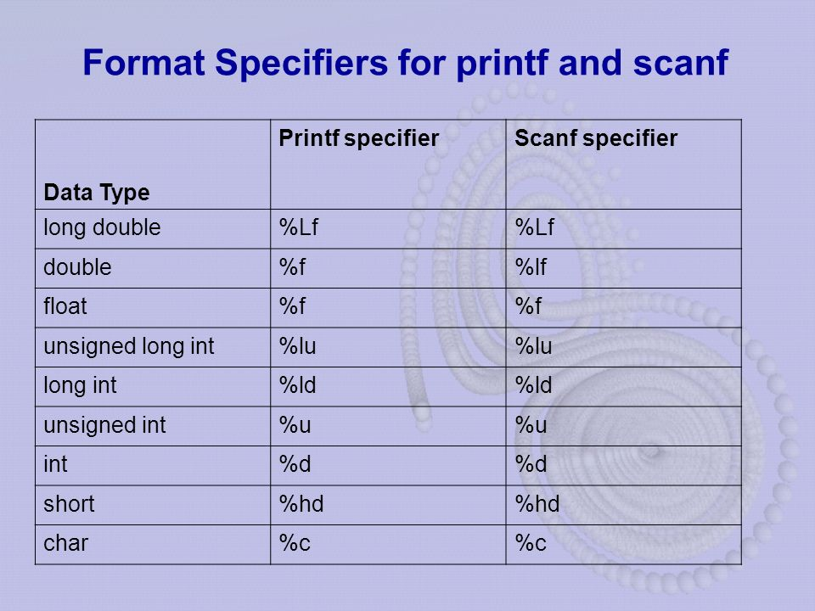
2.2.3 Type specifiers (formatting strings)

Slide 62
2.1 Operators
Operators are symbols that indicates the type of operations, ‘C’ has to perform on data or value of variables.
OR
An operator is a symbol that operates on a value or a variable.

Slide 63
‘C’ has a wide range of operators to perform various operations.
  1 Arithmetic operators ( +, -, *, /, %, ++, -- )
  2 Logical Operators ( &&, ||, ! )
  3 Relational Operators ( >, <, ==, >=, <=, != )
  4 Bit-wise operators ( &, |, ^ , <<, >>)
  5 Assignment operators ( =, +=, -=, *=, /=, %=)
  6 Ternary Operator and use of sizeof() function.

Slide 64
1. Arithmetic Operator
An arithmetic operator performs mathematical operations such as addition, subtraction, multiplication, division etc on numerical values (constants and variables).

Slide 65
Operator | Meaning of Operator
+ | addition or unary plus
- | subtraction or unary minus
* | multiplication
/ | division
% | remainder after division (modulo division)

Slide 66
Example:
// Working of arithmetic operators
#include <stdio.h>
#include <conio.h>
void main()
{
int a = 9,b = 4, c;
c = a+b;
printf("a+b = %d \n",c);
c = a-b;
printf("a-b = %d \n",c);
c = a*b;
printf("a*b = %d \n",c);
c = a/b;
printf("a/b = %d \n",c);
c = a%b;
printf("a Modulo b = %d \n",c);
getch();
}

Slide 67
Output:
a+b = 13
a-b = 5
a*b = 36
a/b = 2
a Modulo b=1

Slide 68
Unary Operator
Unary operators are special operators that operate upon one operand only.
Operator | Meaning of Operator
++ | Increment
-- | Decrement

Slide 69
Increment operators are used to increase the value of the variable by one and decrement operators are used to decrease the value of the variable by one in C programs.
Syntax:
Increment operator:
    ++var_name; (or) var_name++;
  Decrement operator:
    – -var_name; (or) var_name – -;
Example:
Increment operator : ++ i ; i ++ ;
Decrement operator : – – i ; i – – ;

Slide 70
Operator | Operator/Description
Pre increment operator (++i) | value of i is incremented before assigning it to the variable i
Post increment operator (i++) | value of i is incremented after assigning it to the variable i
Pre decrement operator (--i) | value of i is decremented before assigning it to the variable i
Post decrement operator (i--) | value of i is decremented after assigning it to variable i

Slide 71
Example:
// Working of unary operators
#include <stdio.h>
#include <conio.h>
void main()
{
int a = 5;
printf("a = %d \n",a);
printf("a++ = %d \n",a++);
printf("++a = %d \n",++a);
printf("a-- = %d \n",a--);
printf("--a = %d \n",--a);
printf("a = %d \n",a);
getch();
}

Slide 72
Output:
a = 5
a++ = 5
++a = 7
a-- = 7
--a = 5
a = 5

Slide 73
2. Logical Operator
These operators are used to perform logical operations on the given expressions.

Slide 74
Operator | Description
&& | Called Logical AND operator. If both the operands are non-zero, then the condition becomes true.
|| | Called Logical OR Operator. If any of the two operands is non-zero, then the condition becomes true.
! | Called Logical NOT Operator. It is used to reverse the logical state of its operand. If a condition is true, then Logical NOT operator will make it false.

Slide 75
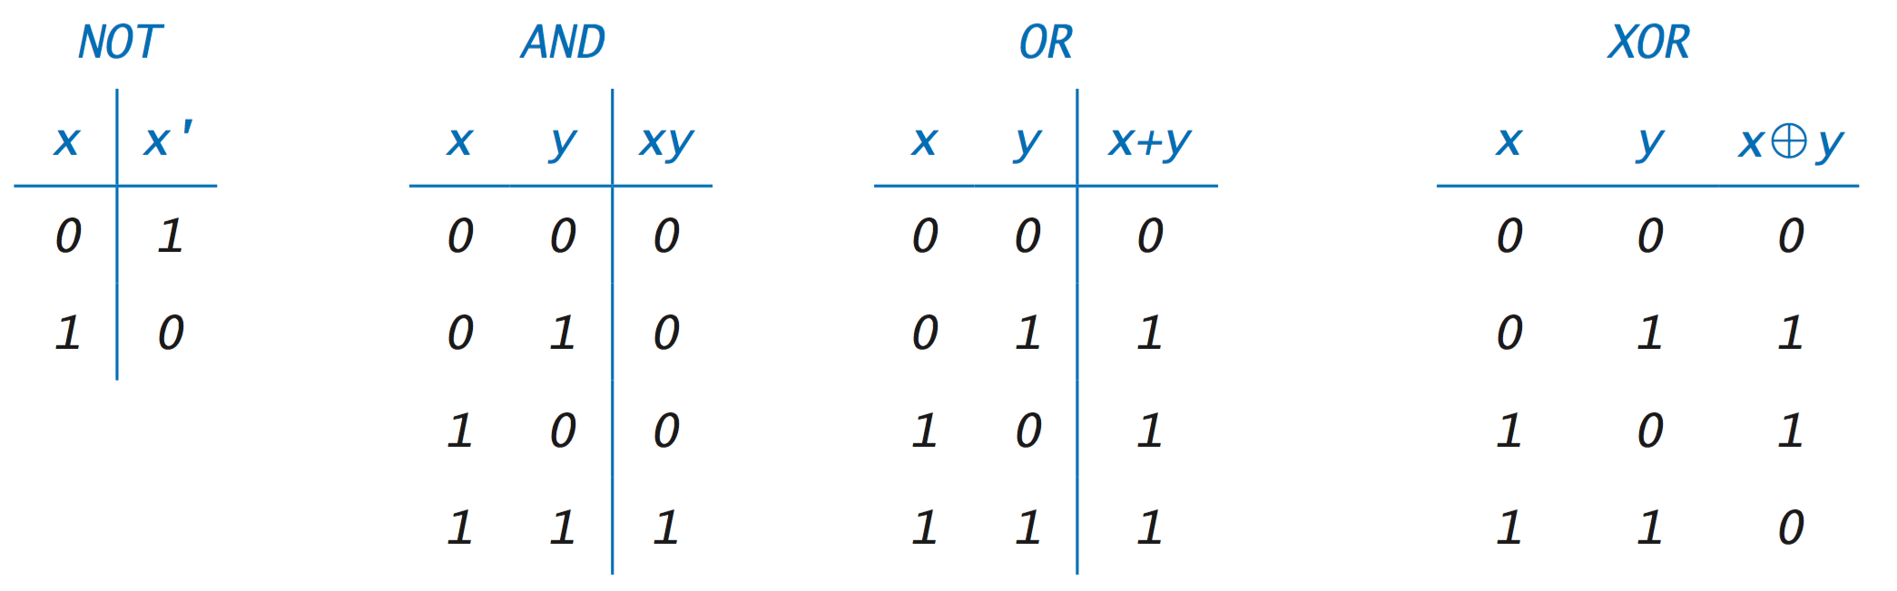
Truth Table

Slide 76
Example:
#include<stdio.h>
#include<conio.h>
void main()
{
int a = 5, b = 5, c = 10, result;
result = (a == b) && (c > b);
printf("%d \n", result);
result = (a == b) && (c < b);
printf("%d \n", result);
result = (a == b) || (c < b);
printf("%d \n", result);
result = (a != b) || (c < b);
printf("%d \n", result);
result = !(a != b);
printf("%d \n", result);
result = !(a == b);
printf("%d \n", result);
getch();
}

Slide 77
3. Relational or Comparison Operator
A relational operator checks the relationship between two operands.
If the relation is true then the result of the relational expression is 1, if the relation is false then the result of the relational expression is 0.

Slide 78
Operator | Description
== | Checks if the values of two operands are equal or not. If yes, then the condition becomes true.
!= | Checks if the values of two operands are equal or not. If the values are not equal, then the condition becomes true.
> | Checks if the value of left operand is greater than the value of right operand. If yes, then the condition becomes true.
< | Checks if the value of left operand is less than the value of right operand. If yes, then the condition becomes true.
>= | Checks if the value of left operand is greater than or equal to the value of right operand. If yes, then the condition becomes true.
<= | Checks if the value of left operand is less than or equal to the value of right operand. If yes, then the condition becomes true.

Slide 79
Operator | Description | Example | Result
> | Greater than | 1 > 2 | 0
>= | Greater than or equal to | 3 >= 2 | 1
< | Smaller than | 10 < 5 | 0
<= | Smaller than or equal to | 6 <= 7 | 1
== | equal to | 98==98 | 1
!= | not equal to | 10 != 9 | 1

Slide 80
Example:
#include<stdio.h>
#include<conio.h>
void main()
{
int x = 12, y = 13;
printf("x = %d\n", x);
printf("y = %d\n\n", y);
printf("x > y : %d\n", x > y);
printf("x >= y : %d\n", x >= y);
printf("x < y : %d\n", x < y);
printf("x <= y : %d\n", x <= y);
printf("x == y : %d\n", x == y);
printf("x != y : %d\n", x != y);
getch();
}

Slide 81
Output:
x = 12
y = 13
x > y : 0
x >= y : 0
x < y : 1
x <= y : 1
x == y : 0
x != y : 1

Slide 82
4. Bitwise Operators
&, |, ^ , <<, >>

Slide 83
Operators | Meaning of operators
& | Bitwise AND
| | Bitwise OR
^ | Bitwise XOR
<< | Shift left
>> | Shift right

Slide 84
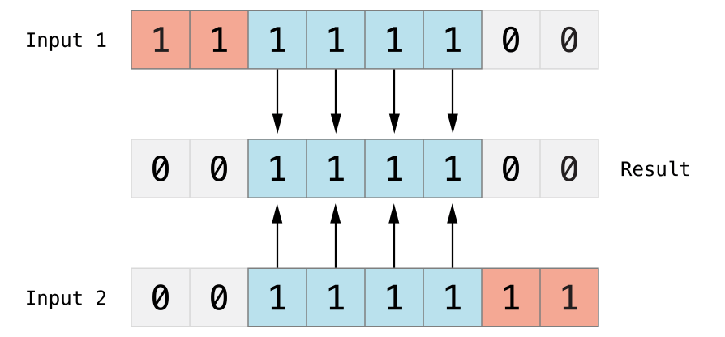
Bitwise &
The bitwise AND operator (&) combines the bits of two numbers. It returns a new number whose bits are set to 1 only if the bits were equal to 1 in both input numbers:

Slide 85
Example:
#include<stdio.h>
#include<conio.h>
void main()
{
int a=7,b=5;
clrscr();
printf("%d",(a&b)); // Bitwise &
}
Output:
5

Slide 86
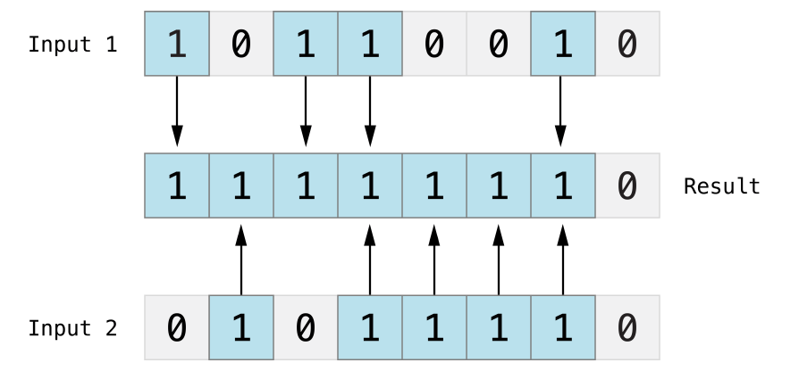
Bitwise |
The bitwise OR operator (|) compares the bits of two numbers. The operator returns a new number whose bits are set to 1 if the bits are equal to 1 in either input number:

Slide 87
Example:
#include<stdio.h>
#include<conio.h>
void main()
{
int a=7,b=5;
clrscr();
printf("%d",(a|b)); // Bitwise |
}
Output:
7

Slide 88
Bitwise ^ (XOR)
The bitwise XOR operator, or “exclusive OR operator” (^), compares the bits of two numbers. The operator returns a new number whose bits are set to 1 where the input bits are different and are set to 0 where the input bits are the same:

Slide 89
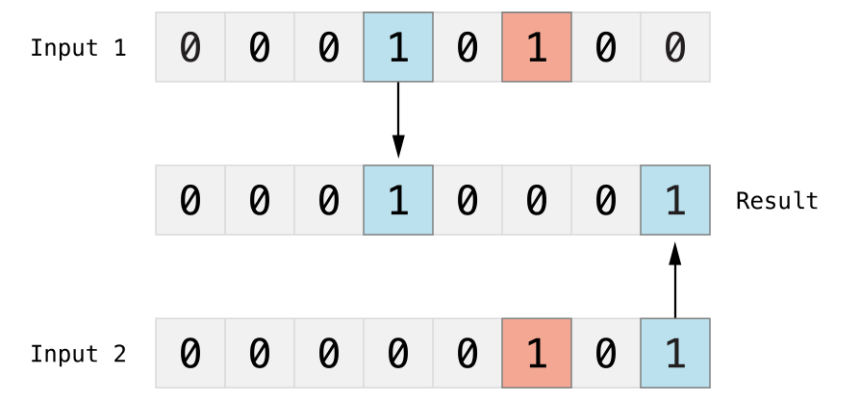

Slide 90
Example:
#include<stdio.h>
#include<conio.h>
void main()
{
int a=7,b=5;
clrscr();
printf("%d",(a^b)); // Bitwise XOR
}
Output:
2

Slide 91
Bitwise << (Shift Left)
<< (left shift) Takes two numbers, left shifts the bits of the first operand, the second operand decides the number of places to shift.
Or in other words left shifting an integer “x” with an integer “y” (x<<y)

Slide 92
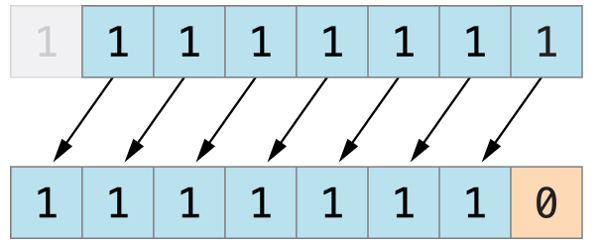

Slide 93
Example:
#include<stdio.h>
#include<conio.h>
void main()
{
int a=7;
clrscr();
printf("%d",(a<<1)); // Bitwise Left Shift
}
Output:
14

Slide 94
Bitwise >> (Shift Right)
>> (right shift) Takes two numbers, right shifts the bits of the first operand, the second operand decides the number of places to shift.
Or in other words right shifting an integer “x” with an integer “y” (x>>y)

Slide 95
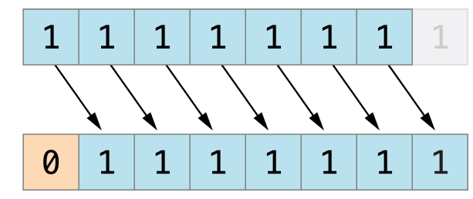

Slide 96
Example:
#include<stdio.h>
#include<conio.h>
void main()
{
int a=7;
clrscr();
printf("%d",(a>>1)); // Bitwise RightShift
}
Output:
3

Slide 97
5. Assignment Operator
Operator | Description | Example
= | Simple assignment operator. Assigns values from right side operands to left side operand | C = A + B will assign the value of A + B to C
+= | Add AND assignment operator. It adds the right operand to the left operand and assign the result to the left operand. | C += A is equivalent to C = C + A
-= | Subtract AND assignment operator. It subtracts the right operand from the left operand and assigns the result to the left operand. | C -= A is equivalent to C = C - A

Slide 98
*= | Multiply AND assignment operator. It multiplies the right operand with the left operand and assigns the result to the left operand. | C *= A is equivalent to C = C * A
/= | Divide AND assignment operator. It divides the left operand with the right operand and assigns the result to the left operand. | C /= A is equivalent to C = C / A
%= | Modulus AND assignment operator. It takes modulus using two operands and assigns the result to the left operand. | C %= A is equivalent to C = C % A

Slide 99
Example:
#include<stdio.h>
#include<conio.h>
void main()
{
int a = 5, c;
c = a; // c is 5
printf("c = %d\n", c);
c += a; // c is 10
printf("c = %d\n", c);
c -= a; // c is 5
printf("c = %d\n", c);
c *= a; // c is 25
printf("c = %d\n", c);
c /= a; // c is 5
printf("c = %d\n", c);
c %= a; // c = 0
printf("c = %d\n", c);
getch();
}

Slide 100
Output:
c = 5
c = 10
c = 5
c = 25
c = 5
c = 0

Slide 101
6. Conditional or Ternary or ?: Operator
Conditional operators return one value if condition is true and returns another value is condition is false.

Slide 102
Syntax:
  Expr1 ? Expr2 : Expr3
Expr1 will be condition, it will executes first,
If Expr1 is true then Expr2 will be executed
If Expr1 is false then Expr3 will be executed

Slide 103
  Expr1 ? Expr2 : Expr3
FALSE
TRUE

Slide 104
Example:
// Working of Conditional operator
#include <stdio.h>
#include <conio.h>
void main()
{
int a = 5,b=7,c;
c=a < b ? a : b;
printf("%d",c);
getch();
}

Slide 105
Output:
5

Slide 106
sizeof() Operator
It returns the size of a variable. It can be applied to any data type, float type, pointer type variables.
When sizeof() is used with the data types, it simply returns the amount of memory allocated to that data type.
The output can be different on different machines like a 32-bit system can show different output while a 64-bit system can show different of same data types.

Slide 107
Example:
#include <stdio.h>
int main() {
int a = 16;
printf("Size of variable a : %d\n",sizeof(a));
printf("Size of int data type : %d\n",sizeof(int));
printf("Size of char data type : %d\n",sizeof(char));
printf("Size of float data type : %d\n",sizeof(float));
printf("Size of double data type : %d\n",sizeof(double));
return 0;
}
Output:
Size of variable a : 2
Size of int data type : 2
Size of char data type : 1
Size of float data type : 4
Size of double data type : 8

Slide 108
Expressions
An expression is a combination of variables, constants and operators.
every expression results in some value of a certain type that can be assigned to a variable.

Slide 109
Arithmetic Expression
Boolean OR Logical Expression

Slide 110
Arithmetic Expression
An arithmetic expression contains only arithmetic operators and operands.
An Arithmetic expression is a combination of variables, constants and arithmetic operators(+,-,*,/,%).

Slide 111
Example:
5+7
8/2
a+a
a-b

Slide 112
Boolean OR Logical Expression
A Boolean expression is a logical statement that is either TRUE or FALSE.
An Boolean expression is a combination of variables, constants and Logical operators(&&,||,!).

Slide 113
Example:
a<b && a<c
b>a || b>c
!(a>b)

Slide 114
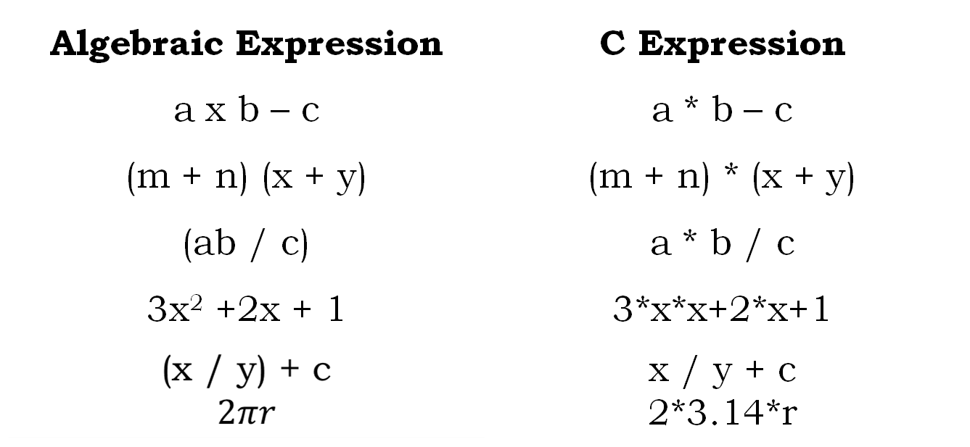

Slide 115
Evaluation & Assignment Of Expression
Expressions are evaluated using an assignment statement of the form.
Variable = expression;
Variable is any valid C variable name. When the statement is encountered, the expression is evaluated first and then replaces the previous value of the variable on the left hand side. All variables used in the expression must be assigned values before evaluation is attempted.

Slide 116
Operator Priorities
Operator precedence determines the grouping of terms in an expression and decides how an expression is evaluated. Certain operators have higher precedence than others; for example, the multiplication operator has a higher precedence than the addition operator.

Slide 117
For example, x = 7 + 3 * 2;
here, x is assigned 13, not 20 because operator * has a higher precedence than +,
so it first gets multiplied with 3*2 and then adds into 7.

Slide 118
Category | Operator | Associativity
Postfix | () [] -> . ++ - - | Left to right
Unary | + - ! ~ ++ - - (type)* & sizeof | Right to left
Multiplicative | * / % | Left to right
Additive | + - | Left to right
Shift | << >> | Left to right
Relational | < <= > >= | Left to right
Equality | == != | Left to right
Bitwise AND | & | Left to right
Bitwise XOR | ^ | Left to right
Bitwise OR | | | Left to right
Logical AND | && | Left to right
Logical OR | || | Left to right
Conditional | ?: | Right to left
Assignment | = += -= *= /= %= | Right to left
Comma | , | Left to right

Slide 119
#include<stdio.h>
#include<conio.h>
void main()
{
int a = 20;
int b = 10;
int c = 15;
int d = 5;
int e;
e = a + b * c + d;
printf("%d\n", e );
e = (a+b)+(c+d);
printf("%d\n" , e );
e = (a + b) * (c / d);
printf("%d\n", e );
e = (a-b)+(c-d);
printf("%d\n" , e );
getch();
}

Slide 120
Output
175
50
90
20

Slide 121
Important Built-in functions:
  2.4.1 Use of <string.h> : ( strlen, strcmp, strcpy, strcat,strrev)
  2.4.2 Use of <math.h> : (abs(), floor(), round(), ceil(), sqrt(), exp(), log(), sin(), cos(), tan(), pow() and trunc())

Slide 122
String Functions
strlen()
strcmp()
strcpy()
strcat()
strrev()
strlwr()
strupr()

Slide 123
strlen()
strlen() function calculates the length of string.
Syntax:
  strlen(string_name);
here string_name is the string which we want length
Function strlen() returns the value of type integer.

Slide 124
Example:
#include<stdio.h>
#include<conio.h>
#include<string.h>
void main()
{
char a[50]="VNSGU";
clrscr();
printf("%d",strlen(a));
printf("\n%d",strlen("20BCA"));
getch();
}
Output :
5
5

Slide 125
strcmp()
strcmp() compares two string and returns value 0, if the two strings are equal.
Function strcmp() takes two arguments, i.e, name of two string to compare
Syntax:
  strcmp(string1,string2);

Slide 126
Example:
#include<stdio.h>
#include<conio.h>
#include<string.h>
void main()
{
char a[50]="VNSGU";
char b[50]="VNSGU";
clrscr();
printf("%d",strcmp(a,b));
getch();
}
Output :
0

Slide 127
strcpy()
strcpy() copies the content of one string to the content of another string.
Syntax:
  strcpy(destination,source);
Here, source and destination are both the name of the string. This statement, copies the content of string source to the content of string destination.

Slide 128
Example:
#include<stdio.h>
#include<conio.h>
#include<string.h>
void main()
{
char a[50]="VNSGU";
char b[50]="";
clrscr();
strcmp(b,a);
printf("%s",b);
getch();
}
Output :
VNSGU

Slide 129
strcat()
strcat() concatenates(joins) two strings.
It takes two arguments, i.e, two strings and resultant string is stored in the first string specified in the argument.
Syntax:
  strcat(first_string,second_string);

Slide 130
Example:
#include<stdio.h>
#include<conio.h>
#include<string.h>
void main()
{
char a[50]="VNSGU";
char b[50]="SURAT";
clrscr();
strcmp(a,b);
printf("%s",a);
getch();
}
Output :
VNSGUSURAT

Slide 131
strrev()
The strrev() function is used to reverse the given string.
Syntax:
  strrev(string);

Slide 132
Example:
#include<stdio.h>
#include<conio.h>
#include<string.h>
void main()
{
char a[50]="VNSGU";
clrscr();
printf("%s",strrev(a));
getch();
}
Output :
UGSNV

Slide 133
Mathematical Functions
abs()
floor()
round()
ceil()
sqrt()
exp()
log()
sin()
cos()
tan()
pow()
trunc()

Slide 134
abs()
abs ( ) function in C returns the absolute value of an integer.
The absolute value of a number is always positive. Only integer values are supported in C.
Syntax :
  int abs ( int n );

Slide 135
Example:
#include<stdio.h>
#include<conio.h>
#include<math.h>
void main()
{
int a=-77;
clrscr();
printf("%d",abs(a));
printf("\n%d",abs(88));
getch();
}
Output :
77
88

Slide 136
floor()
floor( ) function in C returns the nearest integer value which is less than or equal to the floating point argument passed to this function.
Syntax
  double floor ( double x );

Slide 137
Example:
#include<stdio.h>
#include<conio.h>
#include<math.h>
void main()
{
float a=7.77;
clrscr();
printf("%f",floor(a));
getch();
}
Output :
7.000000

Slide 138
round()
round( ) function in C returns the nearest integer value of the float/double/long double argument passed to this function.
If decimal value is from ”.1 to .5″, it returns integer value less than the argument. If decimal value is from “.6 to .9″, it returns the integer value greater than the argument.
Syntax:
  double round (double a);

Slide 139
Example:
#include<stdio.h>
#include<conio.h>
#include<math.h>
void main()
{
float a=7.77;
clrscr();
printf("%f",round(a));
getch();
}
Output :
8.000000

Slide 140
ceil()
ceil( ) function in C returns nearest integer value which is greater than or equal to the argument passed to this function.
Syntax:
  double ceil (double x);

Slide 141
Example:
#include<stdio.h>
#include<conio.h>
#include<math.h>
void main()
{
float a=7.77;
clrscr();
printf("%f",ceil(a));
getch();
}
Output :
8.000000

Slide 142
sqrt()
sqrt( ) function in C is used to find the square root of the given number.
Syntax:
  double sqrt (double x);

Slide 143
Example:
#include<stdio.h>
#include<conio.h>
#include<math.h>
void main()
{
clrscr();
printf("%f",sqrt(64));
getch();
}
Output :
8.000000

Slide 144
exp()
The exp() function computes the exponential (Euler's number) raised to the given argument.
Syntax:
  double exp( double arg );

Slide 145
Example:
#include<stdio.h>
#include<conio.h>
#include<math.h>
void main()
{
clrscr();
printf("%f",exp(1));
getch();
}
Output :
2.718282

Slide 146
log()
log( ) function is used to calculates natural logarithm.
Syntax:
  double log( double arg );

Slide 147
Example:
#include<stdio.h>
#include<conio.h>
#include<math.h>
void main()
{
clrscr();
printf("%f",log(10));
getch();
}

Slide 148
sin()
sin() function in C are used to calculate sine values.
Syntax:
  double sin( double arg );

Slide 149
Example:
#include<stdio.h>
#include<conio.h>
#include<math.h>
void main()
{
clrscr();
printf("%f",sin(10));
getch();
}

Slide 150
cos()
cos() function in C are used to calculate cosine values.
Syntax:
  double cos( double arg );

Slide 151
Example:
#include<stdio.h>
#include<conio.h>
#include<math.h>
void main()
{
clrscr();
printf("%f",cos(10));
getch();
}

Slide 152
tan()
tan() function in C are used to calculate tangent values.
Syntax:
  double tan( double arg );

Slide 153
Example:
#include<stdio.h>
#include<conio.h>
#include<math.h>
void main()
{
clrscr();
printf("%f",tan(10));
getch();
}

Slide 154
pow()
pow( ) function in C is used to find the power of the given number.
Syntax:
  double pow (double base, double exponent);

Slide 155
Example:
#include<stdio.h>
#include<conio.h>
#include<math.h>
void main()
{
clrscr();
printf("%f",pow(5,2));
getch();
}
Output :
25.000000

Slide 156
trunc()
Truncates a double value after the decimal point and gives the integer part as the result. The return value and the arguments are of the type double.
Syntax:
double trunc(double x);

Slide 157
Example:
#include<stdio.h>
#include<conio.h>
#include<math.h>
void main()
{
clrscr();
printf("%f",trunc(5.55));
getch();
}
Output :
5.000000

