Slide 1
UNIT 3 : DECISION MAKING STATEMENTS
3.1 if statements :
  3.1.1 simple if statements
  3.1.2 if…else statements
  3.1.3 if…else if….else statements
  3.1.4 Nested if statements.
3.2 Switch..case statements
  3.2.1 Use of break and default
  3.2.2 Difference between switch and if statements

Slide 2


Slide 3
Control Statement or Control Structure
Control Statements or Control Structures are used to control the flow of Program.
Control structures are the statements that control the flow of the source code.

Slide 4
There are three categories of flow controls:
  Branching or Selection Statement
  Looping or Iterative Statement
  Jumping

Slide 5
3.1. Branching or Conditional Statement or if Statement
Branching are decision making statements.
The C language programs follows a sequential form of execution of statements. Many times it is required to alter the flow of sequence of instructions. C language provides statements that can alter the flow of a sequence of instructions.

Slide 6
3.1.1. Simple if Statement
3.1.2. if…else Statement
3.1.3. Nested if Statement
3.1.4. Ladder if or elseif Statement

Slide 7
3.1.1. Simple if Statement
When we need to execute a block of statements only when a given condition is true then we use if statement.

Slide 8
Syntax:
if (test - condition)
{
//Statement
}
Next statements

Slide 9
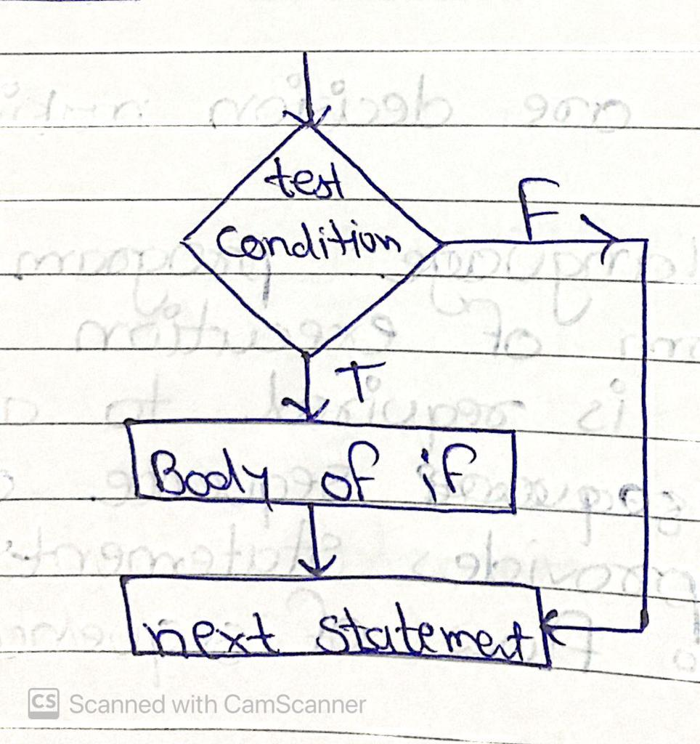
Flowchart:

Slide 10
Example:
void main()
{
int a=10,b=20;
clrscr();
if(a<b)
{
printf("Inside IF");
}
printf("\nOutside IF");
getch();
}
OUTPUT:
Inside IF
Outside IF

Slide 11
3.1.2. if…else Statement
An if statement can be followed by an optional else statement, which executes when the Boolean expression is false.

Slide 12
Syntax:
if(test - condition)
{
// True Statements
}
else
{
// False Statements
}

Slide 13
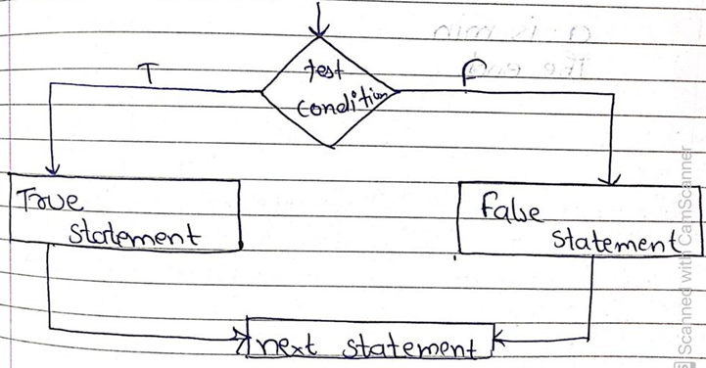
Flowchart:

Slide 14
Example:
void main()
{
int a=10,b=20;
clrscr();
if(a<b)
{
printf("Inside IF");
}
else
{
printf("\nInside ELSE");
}
getch();
}
OUTPUT:
Inside IF

Slide 15
3.1.3. Nested if Statement
If statement within if statement is known as nested if statement.

Slide 16
Syntax:
if(test - condition 1)
{
if(test - condition 2)
{
// True Statement
}
}
else
{
if(test - condition 3)
{
// False Statement
}
}

Slide 17
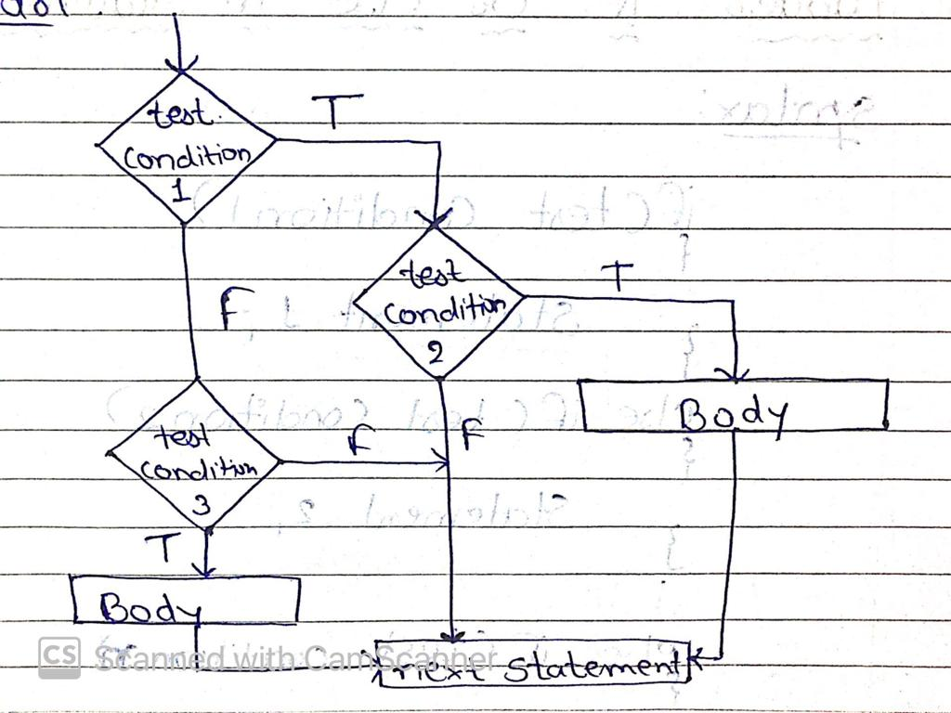
Flowchart:

Slide 18
Example:
void main()
{
int a=10,b=20,c=30;
clrscr();
if(a<b)
{
if(b<c)
printf("Inside IF");
}
else
{
printf("\nInside ELSE");
}
getch();
}
OUTPUT:
Inside IF

Slide 19
3.1.4. Ladder if or elseif Statement
else-if statements in C is like another if condition, it's used in a program when if statement having multiple decisions.

Slide 20
Syntax:
if(test - condition 1)
{
// Statement 1
}
else if(test - condition 2)
{
// Statement 2
}
...
...
...
else if(test - condition n)
{
// Statement n
}
else
{
// Else Statement
}
next- statement

Slide 21
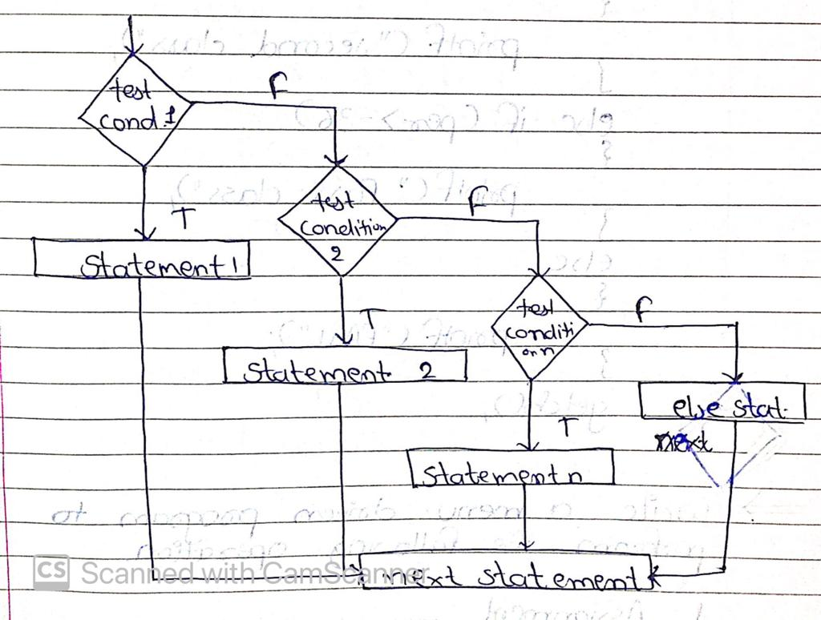
Flowchart:

Slide 22
Example:
void main()
{
int c;
clrscr();
printf("\n1. Sunday");
printf("\n2. Monday");
printf("\n3. Tuesday");
printf("\n4. Wednesday");
printf("\n5. Thursday");
printf("\n6. Friday");
printf("\n7. Saturday");
printf("\nEnter Your Choice:(1 to 7):");
scanf("%d",&c);
if(c==1)
printf("Sunday");
else if(c==2)
printf("Monday");
else if(c==3)
printf("Tuesday");
else
printf("Invalid Chioce");
getch();
}
/*W A Menu Driven Program to perform the follwing task
1. Sunday
2. Monday
3. Tuesday
4. Wednesday
5. Thursday
6. Friday
7. Saturday */
#include<stdio.h>
#include<conio.h>

Slide 23
3.2 Switch Case or Selection Statement
Switch case is used to select one option from one or more option.
Switch is used for only int, char and enum data.
We can also use nested switch (switch within switch).

Slide 24
Syntax:
switch(expression)
{
case value1:
Statement 1;
break;
case value2:
Statement 2;
break;
...
...
...
case valuen:
Statement n;
break;
default:
default Statement;
break;
}
next- statement;

Slide 25
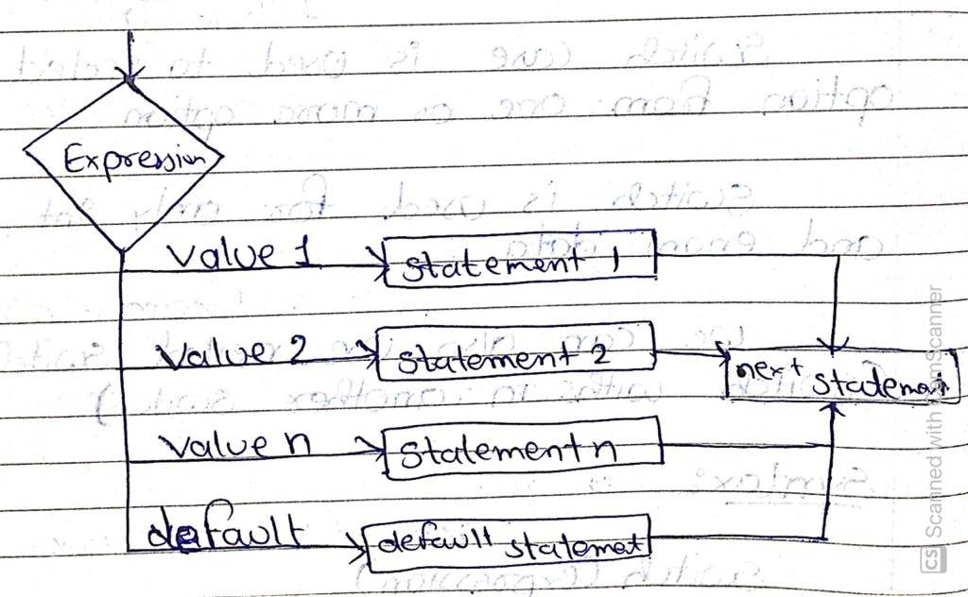
Flowchart:

Slide 26
Example:
#include<stdio.h>
#include<conio.h>
void main()
{
char c;
clrscr();
printf("Enter your choice:");
scanf("%c",&c);
switch(c)
{
case 'A':
printf("Assignment");
break;
case 'B':
printf("Quiz");
break;
case 'C':
printf("Viva");
break;
default:
printf("Invalid Choice");
break;
}
getch();
}

Slide 27
Rules of Switch case.
Case label should be unique.
Case label must be ends with : (colon).
Case label must have constant value or constant expression.
Case label must be int, char or enum.
Case label should not be floating point number.
Default label is optional.

Slide 28
break statement takes control out of loop.
Two or more case may share one break operation.
Nesting is also possible.
Relational operations are not allowed in switch case.

Slide 29
3.2.1 Use of break
You can use the break statement to end processing of a particular labeled statement within the switch statement.
It branches to the end of the switch statement. Without break , the program continues to the next labeled statement, executing the statements until a break or the end of the statement is reached.

Slide 30
Use of default
A switch statement can have an optional default case, which must appear at the end of the switch.
The default case can be used for performing a task when none of the cases is true. No break is needed in the default case.

Slide 31
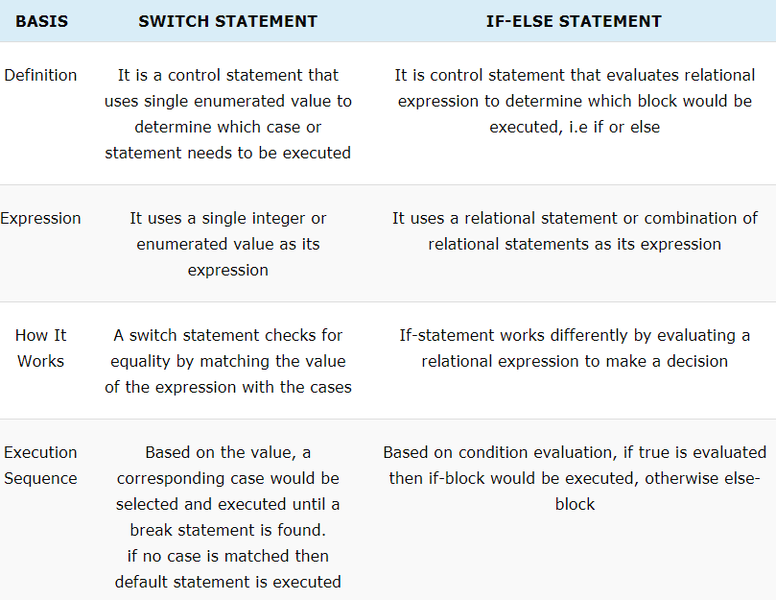
3.2.2 Difference between switch and if statements

Slide 32
