Slide 1
UNIT 4 : ITERATIVE STATEMENTS
4.1 Use of goto statement for iteration
4.2 while loop
4.3 do..while loop
4.4 for loop
4.5 Nested while, do..while and for loops
4.6 Jumping statement: (break and continue)

Slide 2
Control Statement or Control Structure
Control Statements or Control Structures are used to control the flow of Program.
Control structures are the statements that control the flow of the source code.

Slide 3
There are three categories of flow controls:
  Branching or Selection Statement
  Looping or Iterative Statement
  Jumping

Slide 4
Looping or Iteration or Iterative Statements
A Loop executes the sequence of statements many times until the stated condition becomes false.
OR
Looping is the way to execute a set of instructions any number of times.

Slide 5
4.1 Use of goto statement for iteration
The goto statement is known as jump statement in C.
As the name suggests, goto is used to transfer the program control to a predefined label.
The goto statment can be used to repeat some part of the code for a particular condition.

Slide 6
Syntax:
label:
….
Code to Execute
….
….
goto label;

Slide 7

Example:

Slide 8
4.2 while loop
A while loop in C programming repeatedly executes a target statement as long as a given condition is true.

Slide 9
Syntax:
  while(Test Condition)
  {
    //Body of Loop
  }
  Next-statements;

Slide 10
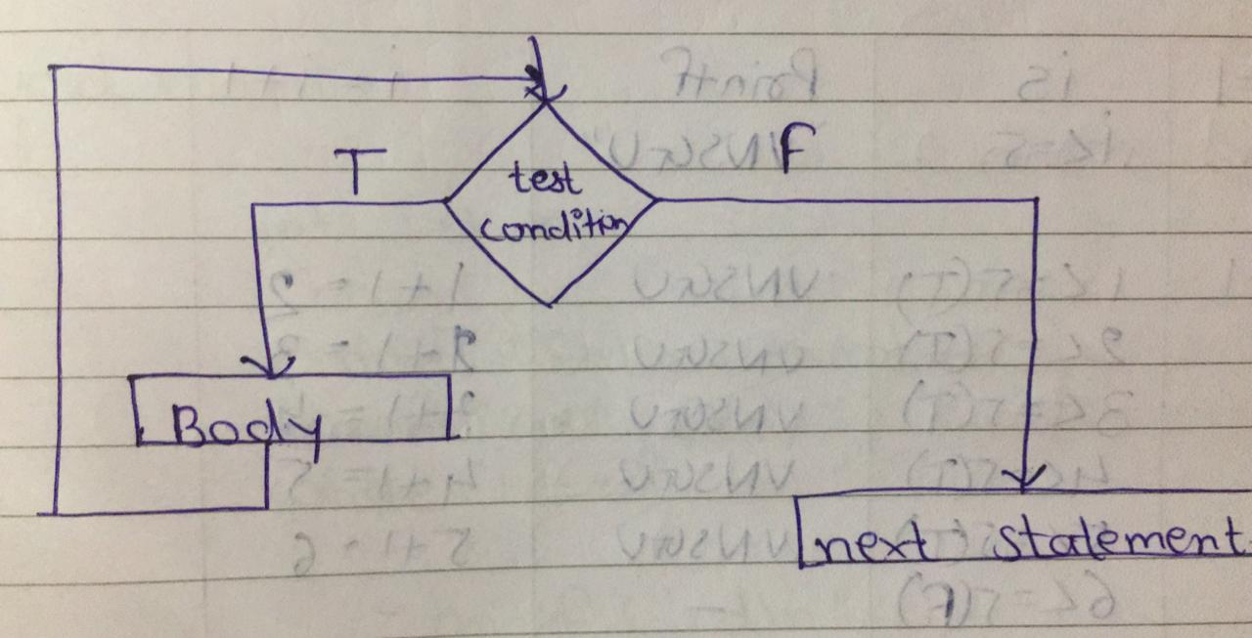
Flowchart:

Slide 11
Example:
#include<stdio.h>
#include<conio.h>
void main()
{
int i=1,n;
clrscr();
printf("Enter any number :");
scanf("%d",&n);
while(i<=n)
{
printf("%d",n);
i=i+1;
}
getch();
}

Slide 12
4.3 do..while loop
The do..while loop is similar to the while loop with one important difference.
The body of do...while loop is executed at least once. Only then, the test expression is evaluated.

Slide 13
Syntax:
  do
  {
    //body of loop
  }while(Test-Condition);

Slide 14
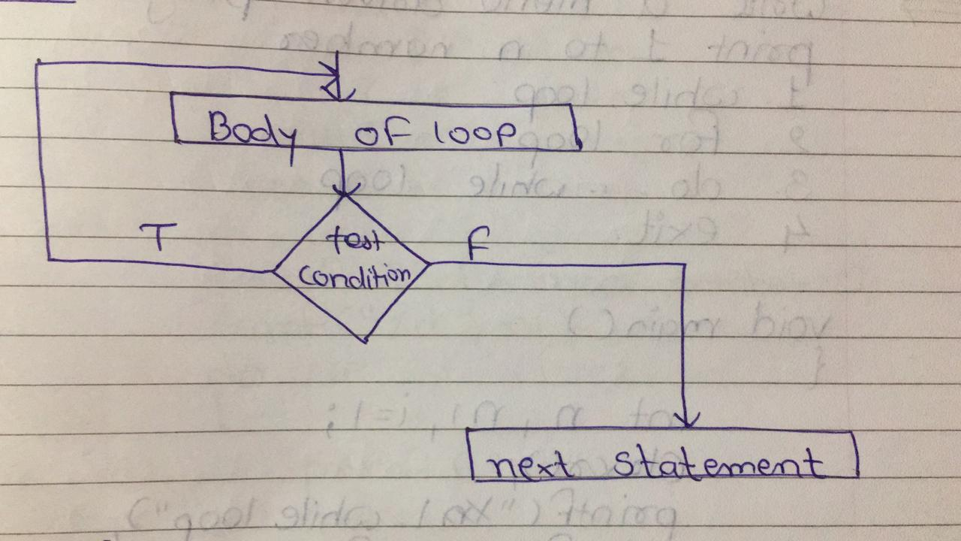
Flowchart:

Slide 15
Example:
#include<stdio.h>
#include<conio.h>
void main()
{
int i=1,n;
clrscr();
printf("Enter any number :");
scanf("%d",&n);
do
{
printf("%d",n);
i=i+1;
}while(i<=n);
getch();
}

Slide 16
4.4 for loop
A for loop is a repetition control structure that allows you to efficiently write a loop that needs to execute a specific number of times.

Slide 17
Syntax:
for ( initialization; Test- Condition; Increment/Decrement )
{
Body of Loop;
}

Slide 18
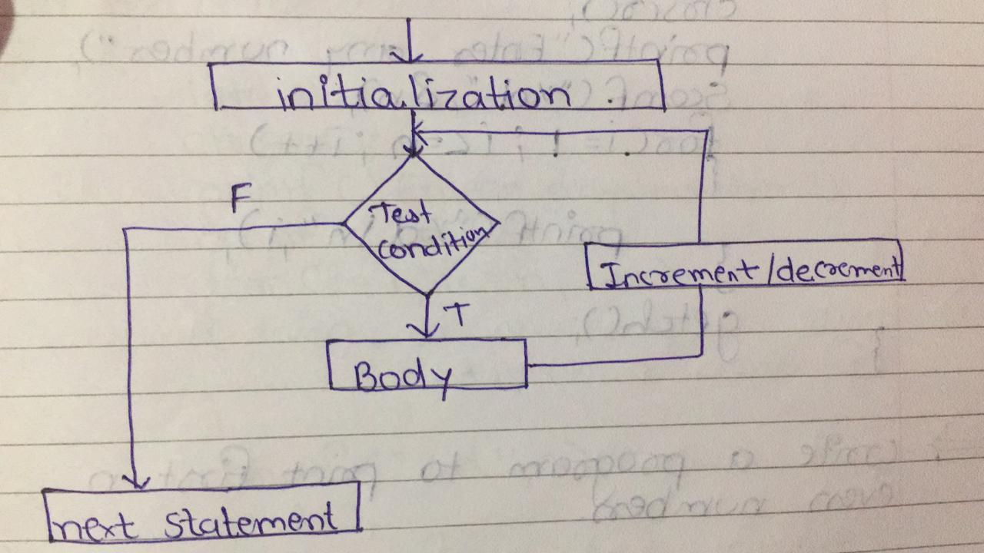
Flowchart:

Slide 19
How for loop works?
The initialization statement is executed only once.
Then, the test expression is evaluated. If the test expression is evaluated to false, the for loop is terminated.
However, if the test expression is evaluated to true, statements inside the body of for loop are executed, and the update expression is updated.
Again the test expression is evaluated.

Slide 20
Example:
#include<stdio.h>
#include<conio.h>
void main()
{
int i=1,n;
clrscr();
printf("Enter any number :");
scanf("%d",&n);
for(i=1;i<=n;i++)
{
printf("%d",n);
}
getch();
}

Slide 21
Entry Control Loop
  while loop
  for loop
Exit Control Loop
  do…while loop

Slide 22
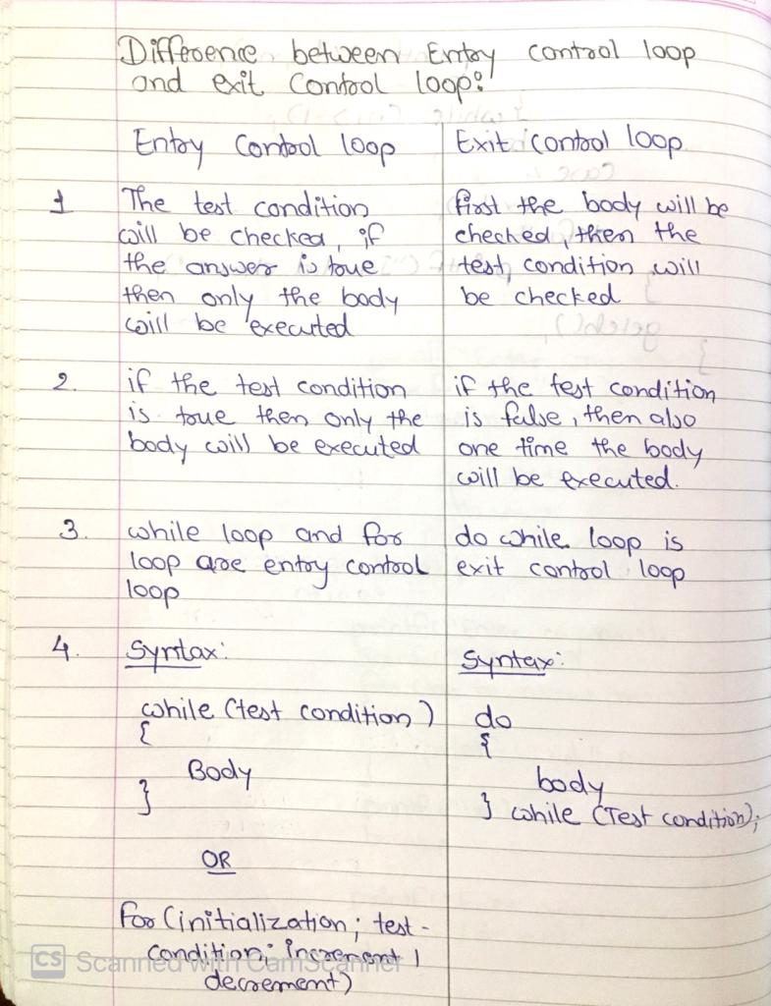
Difference between Entry Control Loop and Exit Control Loop

Slide 23
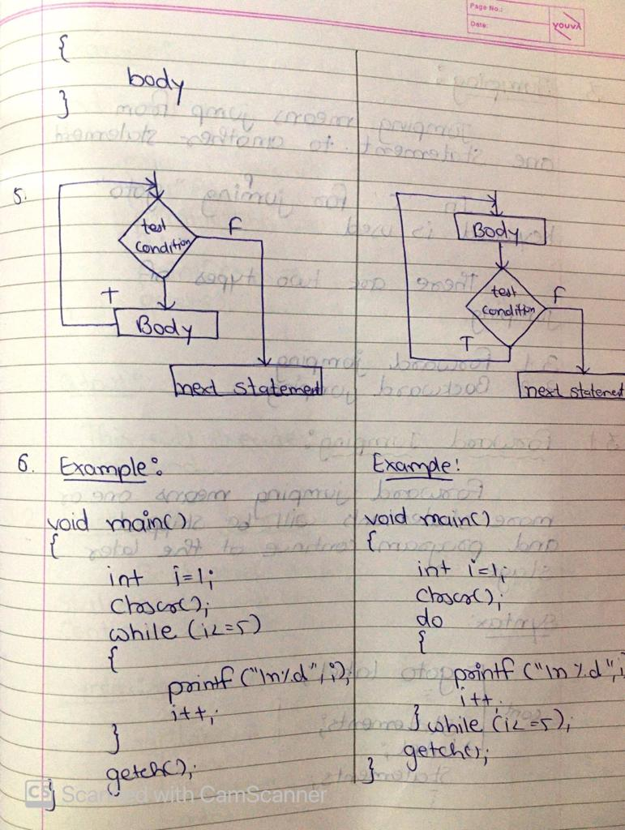

Slide 24
4.5 Nested while, do..while and for loops
Loop inside another loop is known as Nested Loop.

Slide 25
Nested While Loop
Syntax:
  while(Test Condition1)
  {
  while(Test Condition2)
  {
    //Body of Loop
  }
  Next-statements;
  }
  Next-statements;

Slide 26
Example:
void main()
{
int i=1,j=1,n;
clrscr();
while(i<=10)
{
j=1;
while(j<=i)
{
printf("*");
j++;
}
printf("\n");
i++;
}
getch();
}

Slide 27
Nested Do…While Loop
Syntax:
  do
  {
  do
  {
    //body of loop
  }while(Test-Condition1);
  }while(Test-Condition2);

Slide 28
Example:
void main()
{
int i=1,j=1,n;
clrscr();
do
{
j=1;
do
{
printf("*");
j++;
}while(j<=i);
printf("\n");
i++;
}while(i<=10);
getch();
}

Slide 29
Nested For Loop
Syntax:
for ( initialization; Test- Condition1; Increment/Decrement )
{
for ( initialization; Test- Condition2; Increment/Decrement )
{
Body of Loop;
}
}

Slide 30
Example:
void main()
{
int i=1,j=1,n;
clrscr();
for(i=1;i<=10;i++)
{
for(j=1;j<=i;j++)
{
printf("*");
}
printf("\n");
}
getch();
}

Slide 31
Infinite Loop
Never Ending Loop is known as Infinite Loop.
Example:
  for(;;)
    printf(“VNSGU”);

Slide 32
4.6 Jumping statement: (break)
When the break statement is executed inside a loop, the loop will be terminated and program control returns at the next statement of the loop.
Syntax:
  break;

Slide 33
Note: Basically break is used for breaking(terminate) the loop as well as switch case.

Slide 34
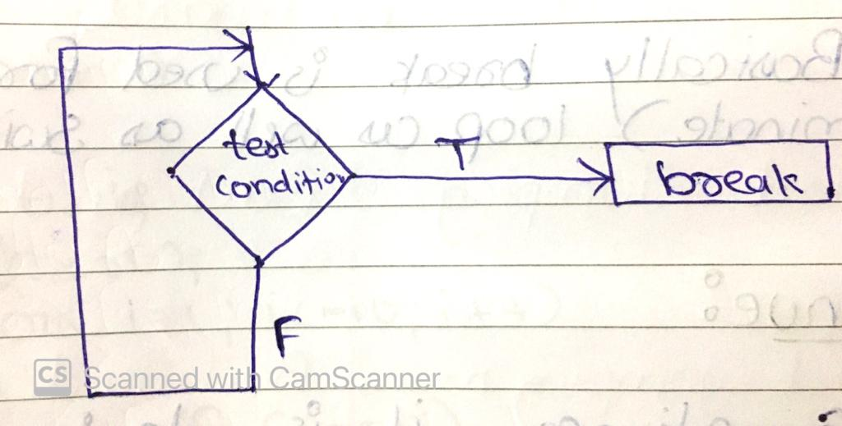
Flowchart

Slide 35
Example
void main()
{
int i=1;
clrscr();
for(i=1;i<=10;i++)
{
if(i==5)
break;
printf("%d",i);
}
getch();
}
OUTPUT:
1234

Slide 36
4.6 Jumping statement: (continue)
Sometimes it is desirable to skip some statement inside the loop, in such case continue statements are used.
Continue forces the next iteration of the loop to take place and skipping any code in between.
Syntax:
  continue;

Slide 37
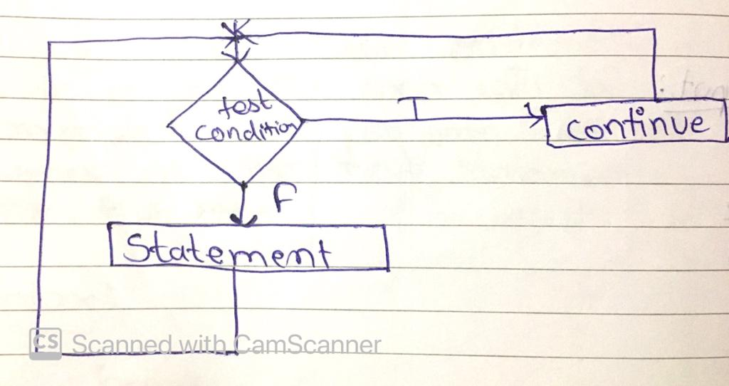
Flowchart

Slide 38
Example
void main()
{
int i=1;
clrscr();
for(i=1;i<=10;i++)
{
if(i==5)
continue;
printf("%d",i);
}
getch();
}
OUTPUT:
1234678910

