Slide 1

Team Details
AU2040014 | Jay Patel
AU2040022 | Aharnish Pithva
AU2040159 | Kenil Vaghani
AU2040198 AU2040248 | Viraj Langhnoda Kahan Shah
Transform Game
Image courtesy of https://realpython.com/arcade-python-game-framework/

Slide 2
Introduction
We are making a 2player python based game named ‘Transform Game’.
main aim is to provide users new concept with Great entertainment.
Here multiple objects interacting in the XY plane using positions and vectors - can be visualized and be controlled using keys.
. It is example of a problem-solving game that uses LA in the background to check for the optimal solution or winning criteria, etc.
Collision detection is the computational problem of detecting the intersection of two or more objects.
Collision detection algorithms can be divided into operating on 2D and 3D objects. Here we are using with 2D objects.

Slide 3
Making a game using Linear Transformation at its core. Player can move in his 2dimensional space. On the right is another copy of the world which is skewed (Linearly transformed with respect to a matrix (which can be manually modified)). And it will detect collision in both dimensions.
Background

Slide 4
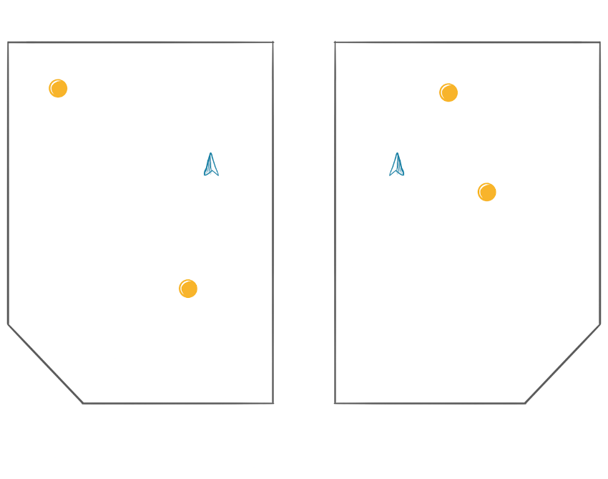

Illustration
Making a game using Linear Transformation at its core.
The player can move in his 2-dimensional space.
On the right is another copy of the world which is skewed (Linearly transformed concerning a matrix (which can be manually modified)).
It will detect collision in both dimensions, hence the user will not be able set with the environment of the game as this feature will make user more active.
Here two particles move on the same plane and there is one player to operate them.
Similarly, there is another plane which is a mirror image of first one and in this plane there are also two particle which are operated by the second player.
Quantity of particles in both the plane will be changed as user goes on upper level. There is a 45’ wall so that particle interact and change its direction and vector.

Slide 5
MOTIVATION
Learning Linear Algebra while practicing to code.
Using vectors in 2 separate coordinate systems to find position of each entity and finding if they collide with a range around each entity (Hit Box).
It is intended to make the brain become more adaptable.

Slide 6
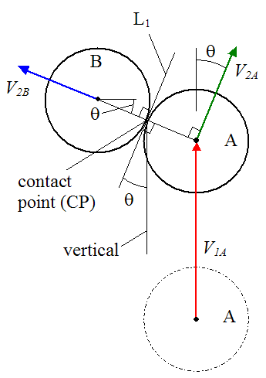
Literature Survey
We are optimizing collision detection in this project.
Billiards balls hitting each other are a classic example applicable within the science of collision detection.
Transform game is similar to all this rules, collision and angle details in billiard game. In our game white ball will look like a person and other coloured ball in billiard will be particles in this game.

Slide 7
Literature Survey
Our survey mainly focused on collision detection and it’s implementation in python because our concept is different and other details can’t available on web sites, books, and other sources.
As we know that Collision detection algorithms optimize the task of detecting collisions by maintaining a set of neighbours for every particle in the set and only checking for collisions between neighbouring particles.
This small things makes lot expects while implementation of logic in game.

Slide 8
Literature Survey
This is same as checking if two circle intersect at more than 0 points in standard coordinate geometry.
R₁
Circular Collision Detection
Distance between them d
Position Vector a
R₂
Position Vector b
If R₁ + R₂ ≤ d then
Collision Detected

Slide 9
Literature Survey
Optimizing Collision Detection
R₁
If the number of entities increase, the number of calculation also increases before each frame is rendered.
To shorten the process of checking if two entity are colliding, first a square hitbox is checked and if they intersect with each other, it will check with greater accuracy whether it is inside circle or outside.
Distance between them d
Position Vector a
R₂
Position Vector b
If Square Hitbox is colliding, then
If R₁ + R₂ ≤ d then
Collision Detected

Slide 10
Contributions
Idea/Theme of game. | Aharnish
Vector based movements (Game Engine) | Aharnish, Kenil, Jay
Collision detection based on ALA. | Aharnish
Graphical User Interface using python (TKinter) | Viraj, Kenil
Random Entity generation | Jay
Report | Viraj,Kenil
Power point slides | Kahan

Slide 11
Mathematical Model
we will refer our defined bounding shape of a visible object as an object. Let us consider collision between an object in motion and another object in still.
If the square hitbox is colliding then R1+R2<d then collision is detected.

