Slide 1
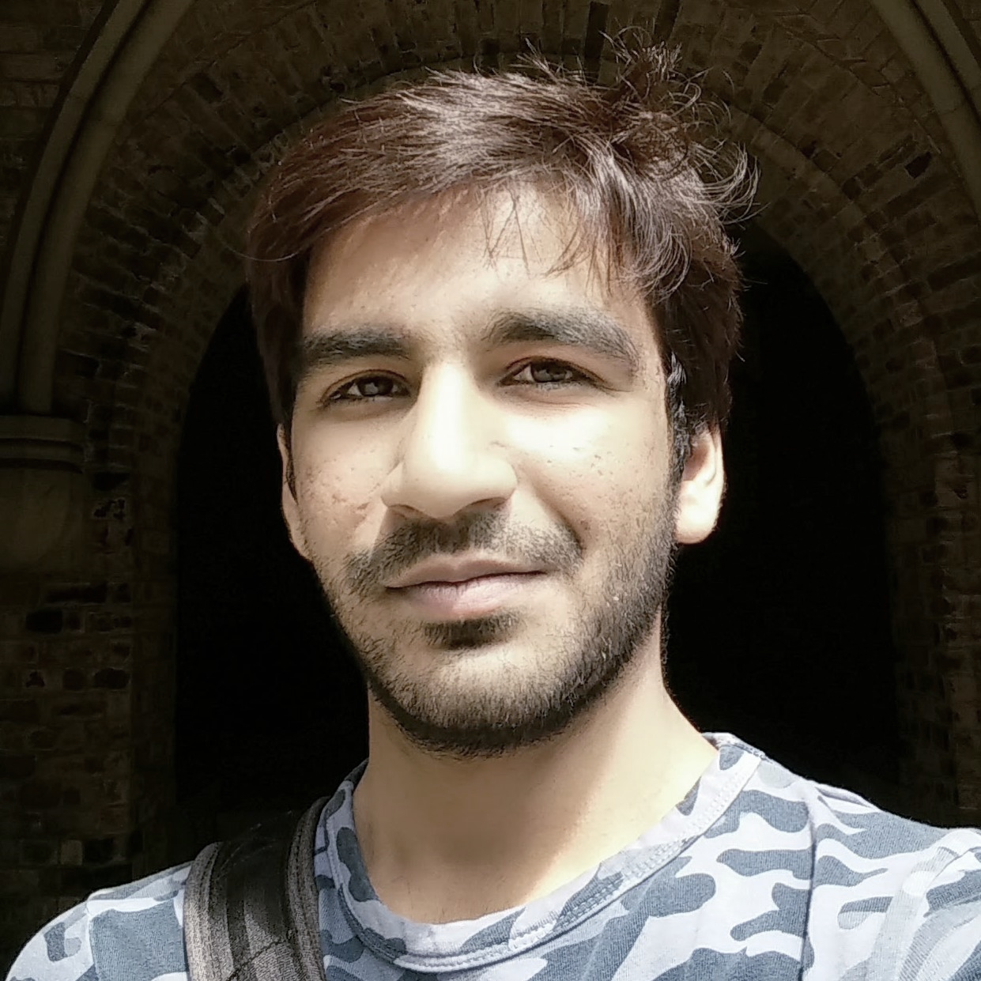
Hello, WORLD!!
This is JAYPATEL
I am an INDUSTRIAL ENGINEER
②
①
❶
❼
/jay2jaykp
Greetings,
I am writing this letter in support of my application for the job posted under Summer Work-Study in Career Learning Network. I believe I would be well suitable for the job as per the description.
I am a Master student here, in University of Toronto and I am pursuing my degree as an Industrial Engineering, focusing specifically on the field of Big Data and Information Modelling.
Last summer, I learned the fundamental of Web Design and Development and started working on my portfolio website. I did couple of independent work just for sharpening my skills. I have profound experience working with python programming language. Apart from that, I also confronted some other programming languages such as java while exploring android development and C# when I undertook a visual studio project.
Last semester, I took one course from iSchool about UX/UI designing and worked with the external clients to understand and build the meaningful User Interface which are simple but powerful. The course taught me comprehensive methodologies of building prototypes and testing them with real users and troubleshoot the existing UI problem with industry recognized methods.
Since my main focus is Data Science, I took several courses which are directly related to the field of Data Science. Moreover, I also very fond of Machine Learning aspect of Data Science. I learned how big data works and how scalability plays an important role in it with the tools such as Spark and Hadoop. I recently did my course project with Spark Environment and build the analytics results in reproducible notebook environment which is available in GitHub.
The job description is something I would love to get experience in.
Hoping for a favorable reply.
Thank you for the consideration.
Regards,
Jay Patel
ABOUTME
I am an international student pursuing Masters of Engineering in Department of Mechanical And Industrial Engineering with the emphasis on Information Engineering and Big Data.
OBJECTIVE
A self-motivated and self-taught web-developer wants to put his skills and knowledge towards job which brings meaning and satisfaction in creation.
CONTACT
❿
+1 647-878-5411
→
jayk.patel@mail.utoronto.ca

jaypatel.site

