Slide 1
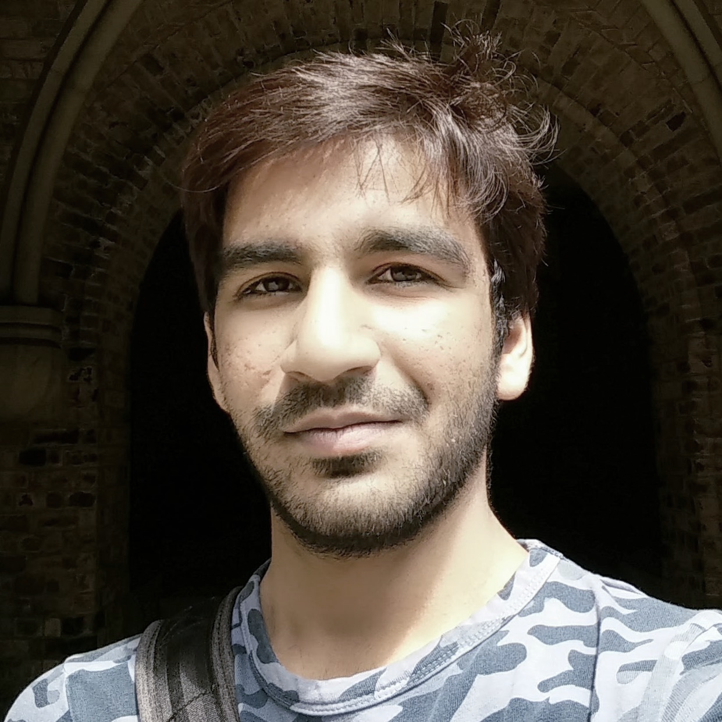

Hello, WORLD!!
This is JAYPATEL
I am an INDUSTRIAL ENGINEER
②
①
❶
❼
/jay2jaykp
EXPERT IN
❻

280 Wellesley St E,
Toronto, ON
M4X1G7
python     
JavaScript     
SQL     
❿
HTML/CSS     
WordPress     
+1 647-878-5411
EDUCATION

→
2017-2019 | INDUSTRIALENGINEERING
University of Toronto | I am currently pursuing M.Eng Degree from Department of Mechanical & Industrial Engineering with the emphasis on Information Engineering from UofT.
2012-2016 | MECHANICALENGINEERING
GTU | I did my undergrad in Mechanical Engineering in Gujarat Technological University (GTU), INDIA.
jayk.patel@mail.utoronto.ca

http;//jaypatel.site
>
def Objective():
return(
“A self-taught web-developer and a master student looking for an opportunity in TA in CS courses to learn more through experience of teaching”
)
EXPERIENCE

2017 | FREELANCE WEBDESIGNER
 | I have been learning Web Development out of interest while my undergrad. I got serious about it after arriving Canada.
2015-2016 | CAD/CAMDESIGNER
 | During my undergrad, I did CAD/CAM drawing for some small size firms. I am a proficient CAD software user such as Autodesk Inventor and Autodesk Fusion.

Slide 2

Hello, WORLD!!
This is JAYPATEL
I am a INDUSTRIAL ENGINEER
②
①
❶
❼
/jay2jaykp
Hello,
I am writing this letter to support my intention to apply for the TA position in APS106, Fundamentals of Computer Programming. I found this job posting in my university email Newsletters.
I am an international student from India, doing my masters in Industrial Engineering in University of Toronto. I am planning to get certification of Information Engineering by taking courses that focus on Data Analytics, UX/UI design and Information Modelling.
I have completed two masters’ courses with the majority of course work was in the python programming language. Therefore, I have become very agile at it.
Besides, python and general BigData Analytics, that I am considering my future career, I am also very interested in Web Development. I am a self-taught web developer with couple of projects to at my disposal.
My father is a high-school principle in India and whenever I got time, I used to go to his school and to exchange some ideas with the young-minds. I may not be a teacher to them but certainly a guide to direct them in right path.
I may not be an experience candidate but I accept all learning-challenge that come across in becoming expert in what I do.
I believe technology has evolve enough and the knowledge of technology in the sense of programming should not be a “skill” anymore but a general knowledge to every human in the path of evolution.
I hope I would be an excellent appointee if get selected. Thank you for your consideration.
Regards,
Jay Patel

280 Wellesley St E,
Toronto, ON
M4X1G7
❿
+1 647-878-5411
→
jayk.patel@mail.utoronto.ca

http;//jaypatel.site
>
def Objective():
return(
“A self-taught web-developer and a master student looking for an opportunity in TA in CS courses to learn more through experience of teaching”
)

