Slide 1
Swaasthya
Your Health Companion

Slide 2
Problem Statement
In recent times due to COVID-19 most of the people die due unavailability of proper diagnosis and medical services.
During these COVID times, going to the hospital for minor diseases can be pretty dangerous so we have made this self-assessment app which could diagnose around 41 diseases knowing the symptoms of the disease.
This could be very helpful in those regions where proper medical services are not available in hand.

Slide 3
Description
Swaasthya is a self-assessment app.
This app can predict the possible diseases the user has if given at least 4 symptoms.
It also shows the information about the disease and the preventive measures that could help cure the disease.
We were also planning to show the nearby hospitals such as eye hospital, dentist etc. by knowing the user's location.

Slide 4
Technologies Used
Machine Learning
Deep Learning
Flutter
Flask
Node.js
Heroku
MongoDB

Slide 5
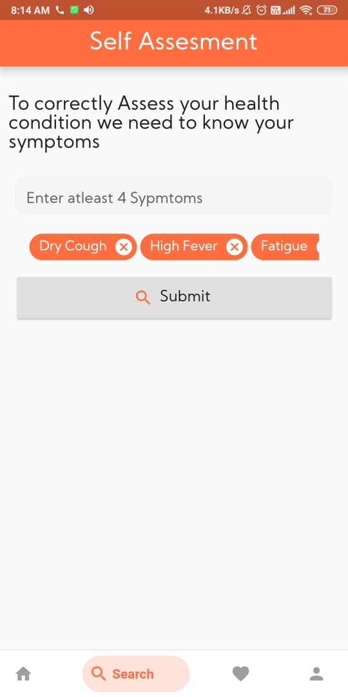
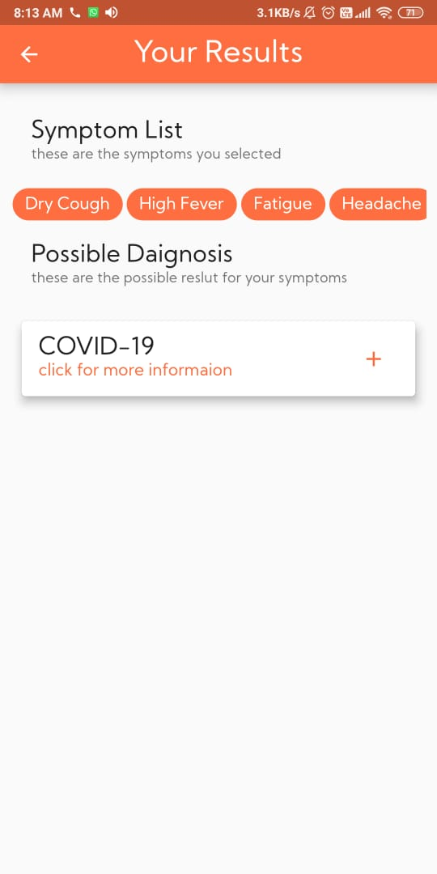
Screenshots

Slide 6
Challenges Faced
The most difficult challenge was finding the data because to make the model work accurately we needed a large amount of data for that purpose we scraped various websites and finally merged all the data.
We used both ML and DL models for prediction but to find which model is accurate we released the app in a testing phase where we shared the app with our family members and friends who had medical expertise.
After analyzing the results obtained from the database we found out the Best model and incorporated it in our app.

Slide 7
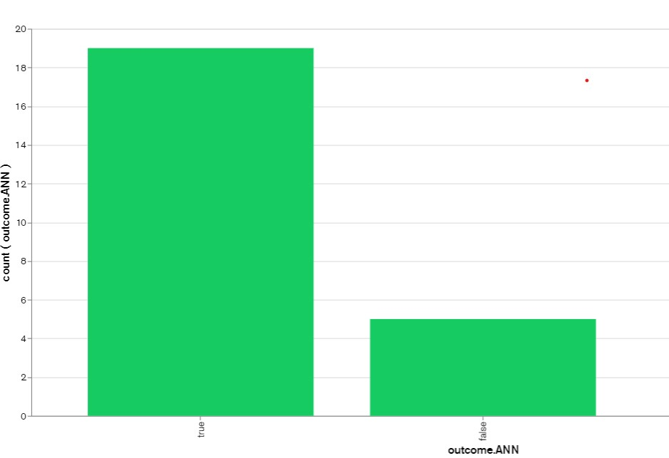
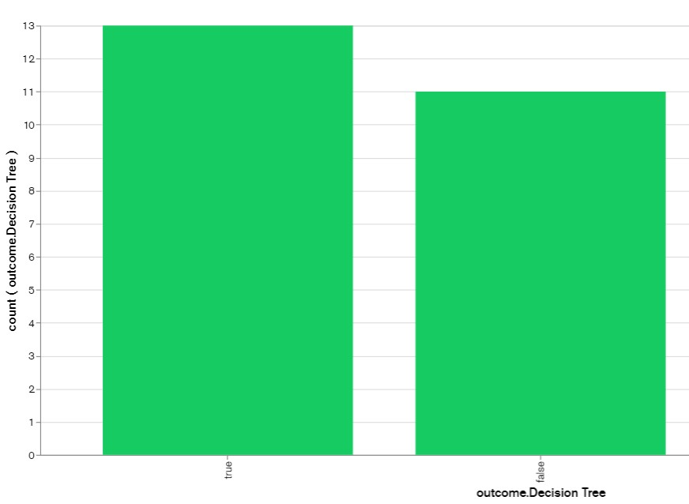
Testing results
Best Model
Worst Model

Slide 8
Features
Disease detection using symptoms
Calling the Ambulance
Maintaining the medical history of the user
Storing important information of the user (i.e. blood group, etc.) for quick access during emergencies.
Checks BMI to predict Obese or not
Gives information about the disease and also preventive measures that should be taken care of while dealing with the disease.
Light Weight

Slide 9
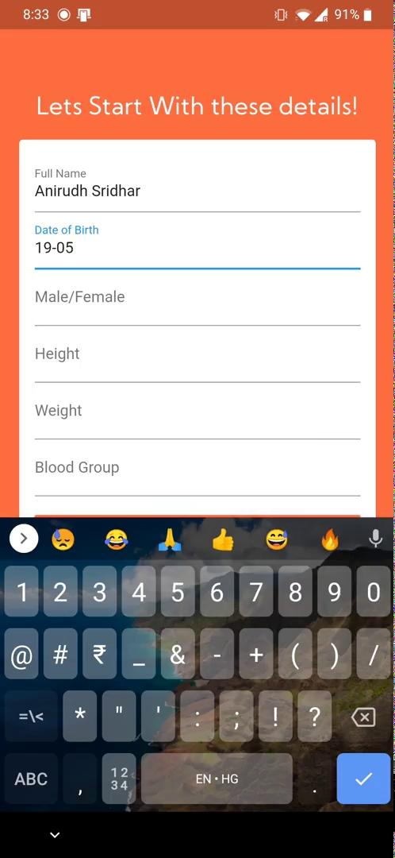
Video Demo

Slide 10
Thank You

