Slide 1
Systems Engineering: Risk Management Part II
CSULA – ECST Department
EE 4130
Prof. Joel K. Harris
2 April 2018

Slide 2

Reviewing From Last Lecture
An issue has already occurred - a risk may occur in the future….

Slide 3
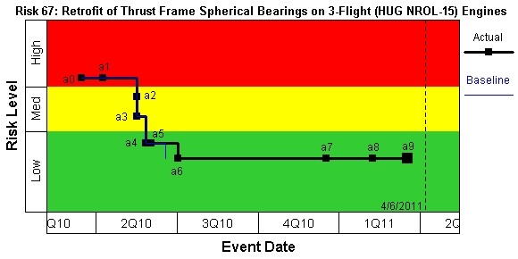
Risk Management Steps - ∅ Three: Risk Handling/Planning (2 of 2)
Risk Burndown Chart (aka “Waterfall Chart”)
Risk Mitigation Event Table
Source: PWR IPPDControl tool, EPP RiskControl database

Slide 4
Risk Management Steps - ∅ Four: Risk Control/Monitoring (1 of 2)
Risk monitoring is continuous, consistent, and progressive
Each risk mitigation event is tracked until its closure
Wherever possible, objective evidence of event closure is provided
The overall project/program risk profile is provided to our customer on a regular basis by means of a risk report (see next chart)

Slide 5
Risk Management Steps - ∅ Four: Risk Control/Monitoring (2 of 2)

Slide 6
Risk Statement Characteristics
A risk must be clearly stated before it can be effectively managed
Risk Source
Antecedent
Consequent
Interface requirements are poorly defined on this project,
therefore
integration problems may be encountered
resulting in schedule delays and cost overruns.
Risk Statement
A good risk statement usually has only one antecedent, but may have one or more consequents
Notes:
A risk must be clearly stated before it can be effectively managed
The components of a risk statement are “Condition” and “Consequence”
In writing risk statements, the condition and consequence format shown provides a complete picture of the risk. It can be read as follows: Given a specific <condition> there is a possibility that a certain <consequence> will occur.
Here is a sample risk statement: Interface requirements are poorly defined on this project, therefore, integration problems may be encountered resulting in schedule delays and cost overruns.
A good risk statement usually has only one condition, but may have one or more consequences.

Slide 7
Risk Statement
Risk Source or Context (Root Cause)
Total Loss or Opportunity Cost
Antecedent
Consequent
Antecedent: a single phrase briefly describing a current key circumstance or situation that is causing concern, doubt, anxiety, or uncertainty
Consequent: a single phrase or sentence that describes the key, undesirable outcome or outcomes of the current condition
Risk Source or Context: provides additional information about the risk, such as contributing factors and related issues beyond the risk condition
Total Loss or Opportunity Cost: the ultimate loss or the opportunity cost resulting from the risk consequence
Notes:
Lets define the terms associated with the risk statements:
Condition: is a single phrase briefly describing a current key circumstance or a situation that is causing concern, doubt, anxiety, or uncertainty
Consequence: is a single phrase or sentence that describes the key, undesirable outcome or outcomes of the current condition
Risk Source or Context: provides additional information about the risk such as, contributing factors and related issues beyond the risk condition
Total Loss or Opportunity Cost: is the ultimate loss or the opportunity cost resulting from the risk consequence

Slide 8
Questions to Ask to Validate Attributes and Clarity of Risk Statements
Is the risk statement clear and concise?
Will most project members understand it?
Is there a clear condition or source of concern?
Is there a clearly stated consequent?
Is there only one condition followed by one (or more) consequents?
Notes:
The positive attributes of a risk statement may be validated by asking the following questions:
Is the risk statement clear and concise?
Will most project members understand the statement?
Does the statement contain a clear condition or source of concern?
Is there a clearly stated consequence? A condition that does not have the threat of a consequence is not the source of a risk.
Is there only one condition per risk followed by one or more consequences? If there are two or more conditions, each should be associated with a separate, stand alone risk.

Slide 9
Are these good or bad Risk Statements?
1. “The hardware test failed”
2. “There is a hardware test risk”
3. “The current hardware test plan is not defined”
4. “Given that there is a lack of a thorough hardware test plan, there is a possibility that untested environmental conditions may result in mission failure.”
Notes:
Lets review 4 risk statements to identify if they are good or bad statements.
Number one is not a good risk statement because the event has already occurred and therefore it is an issue but not a risk.
Number two is not good because it does not provide the risk condition or the consequence.
Number three is bad because it provides the condition but not the consequence.
Number four is a good risk statement because it provide the condition and consequence, it is clear and easy to understand, and it has only one condition and one consequence.
There are four sample risk statements provided on this page but only one of them is a good risk statement.

Slide 10
Risk Statement Example 1
What Makes Up a Risk Statement?
Must be a FACT or perceived to be FACT
Must be REALITY BASED
Can have NO ambiguity attached
Example:
“Given that the Main Injector redesign will reduce outer row mixture ratio and increase fuel injector resistance, there is a possibility that the fuel repress temperature may be below minimum, and the pressure at EPL may be above maximum requirements of the SCD.”
(condition) - (consequent)
Risk context or supporting information can be provided in another area
A good risk statement must be ACTIONABLE and have ONE condition and ONE or More consequences per statement

Slide 11
Risk Statement Example 2
What Makes Up a Risk Statement?
Must be a FACT or perceived to be FACT
Must be REALITY BASED
Can have NO ambiguity attached
Example:
“Given that there is uncertainty in Howmet's ability to support RS-68A casting development and delivery requirements, there is a possibility that the hardware will not be available when needed.”
(antecedent) - (consequent)
Risk context or supporting information can be provided in another area
A good risk statement must be ACTIONABLE and have ONE condition and ONE or More consequents per statement

Slide 12
In Class Risk Statement Individual Exercise
Create a risk statement for the following threat to a system being developed:
….

Slide 13
The Risk Management Plan
Risk Management Plan
Program Management (PM) should establish the basic approach and working structure it will use, and document that approach in a Risk Management Plan (RMP)
An example RMP format summary may include:
Introduction
Program Summary
Risk Management Strategy and Process
Responsible/Executing Organization
Risk Management Process and Procedures
Risk Identification
Risk Assessment
Risk Handling Methodologies
Risk Planning/Mitigation Process
Risk Control/Monitoring Method

Slide 14
Schedule Risks: A Challenging Dimension of Risk Management
Of the 3 dimensions of any risk item’s consequences (technical, cost, or schedule), schedule-leading risks are by far THE most vexing/difficult to manage…
Why is this??
Perception that schedule risks cannot be controlled
There is no risk mitigation plan that will reduce them
Schedule risks are unpredictable/unstable and as such, are nearly impossible to analyze
The major reason for the above beliefs: how we perceive and contend with program schedules…
Notes:
14

Slide 15
An Example of a “Mitigated” Schedule Risk (1 of 2)
Notes:
15

Slide 16
An Example of a “Mitigated” Schedule Risk (2 of 2)

Slide 17
Schedule Risk: An Elementary Example
Notes:
17

Slide 18
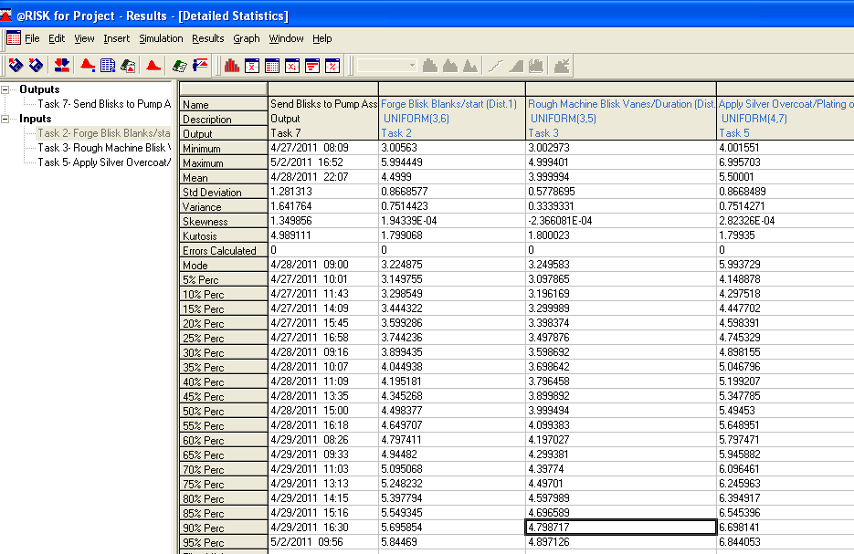
Detailed Stats for Schedule Risk Model/Case using @Risk

Slide 19
Sample Histograms For Selected Schedule Risk Items
Notes:
19

Slide 20
Sample CDF For A Schedule Risk Item
Notes:
20

Slide 21
Risk Reference Sources
“Risk Management Guide for DoD Acquisition” – 5th Edition, June 2003 - DAU website (www.acc.dau.mil)
“INCOSE Systems Engineering Handbook” – V 3.1, August 2007
“Program Management Book of Knowledge (PMBoK)” – 3rd Edition – 2004.
"Effective Risk Management: Some Keys to Success", by E. Conrow, 2nd Edition, (AIAA)
NASA Risk Management portal/website (www.hq.nasa.gov/office/codeq/risk/index.htm)
Notes:
21

Slide 22
….Th-th-that’s All Folks!!
Questions??

