Slide 1
EE 4130 Systems Engineering “Chapter 5 Summary”
Prof Joel Harris
4 April 2018
CSULA – ECST Department

Slide 2
2 - Detailed design Strategies

Slide 3
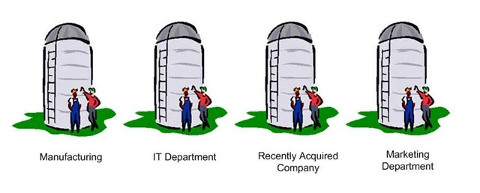
The phenomenon of “siloing”
?
?
?
Mechanical Design
Software Engineering
Systems Engineering

Slide 4
Top Down/Bottom Up Design Methodology

Slide 5
Component/resource Source Alternatives

Slide 6
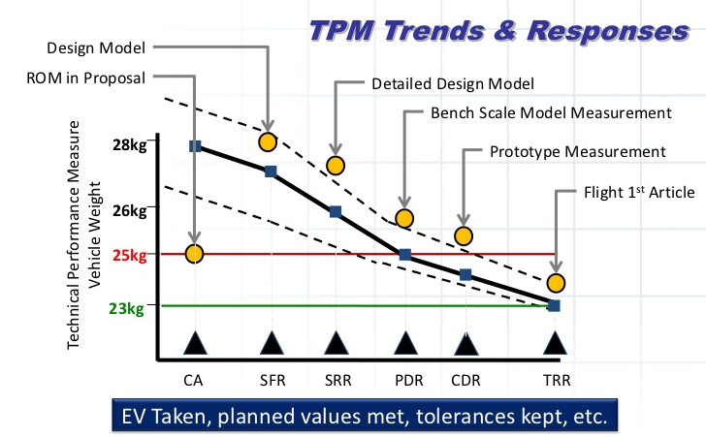
TPM Progression example: “mass budget”

Slide 7
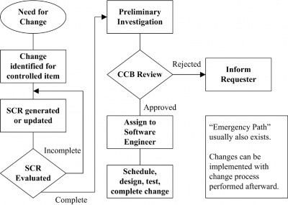
Configuration Management Overview
Change Request generated or updated
Assign to Cognizant Engineer
Change Request Evaluated

