Slide 1
EE 4130 Systems Engineering: “Theory of Constraints”
9 April 2018
Prof. Joel K. Harris
CSULA – ECST Department

Slide 2
What is the “Theory of Constraints”?
The Theory of Constraints (TOC) is a systems-oriented process improvement methodology that is based on the theory that a system has a single goal (which is to make money), and that such systems are composed of multiple linked activities, one or more of which acts as a constraint on the whole system.
TOC is a methodology to focus on removing and exploiting the constraint, in order to optimize throughput. Identification of constraints allows management to take action to alleviate the constraint in the future…

Slide 3
Theory of Constraints (cont’d)
“The core idea in the Theory of Constraints is that every real system such as a profit-making enterprise must have at least one constraint”.
“Either you manage constraints or they manage you. The constraints will determine the output of the system, whether they are acknowledged and managed or not”

Slide 4
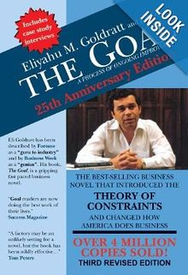
Background
The Theory of Constraints was first described by Dr. Eliyahu M. Goldratt in his novel, The Goal, which was originally released in 1984. Subsequently, he formally introduced the theory in his book, Theory of Constraints, which was originally published in 1990.

Slide 5
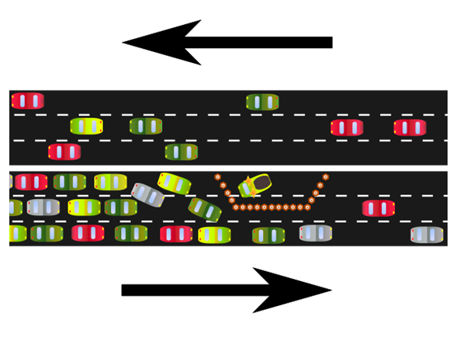
Constraint – An Example
A constraint is anything that impedes a system from achieving its goal or the level of performance desired. A constraint can be viewed as a structural bottleneck which determines the maximum capacity of a system.

Slide 6
Constraint (cont’d)
Any system can only produce as much as its “critically constrained" resource…
Constraint
Process 1
Process 2
Process 3
Process 4
60 units
Per day
70 units
Per day
40 units
Per day
60 units
Per day
Maximum Throughput = 40 units per day

Slide 7
Constraints(cont’d)
Constraints can be internal to the project (i.e. something which can easily be controlled or changed) or external (i.e. a constraint for which the project has no immediate control, but is often something for which the project can take some action to resolve in the medium to long term).

Slide 8
Constraints & Variation
Extra costs exist when there is a significant variation between the capacities of different processes within a company. This is because the processes with higher capacity will be underutilized, resulting in unnecessary depreciation, labor or operating expenses associated with those processes.

Slide 9
Constraints & Variation (cont’d)
A key idea behind the Theory of Constraints is that by identifying and resolving the most significant constraint in a system, it will allow for all of the other processes to operate at a higher volume. Consequently, significant value will be added, as this will lower fixed costs in producing the system/product (less depreciation, labor, factory overhead) while increasing production, thereby leading to higher revenue.

Slide 10
Constraints and Variation (cont’d)
Therefore, applying the Theory of Constraints will prioritize solving whatever is the most significant constraint because solving that problem is likely to have the biggest positive impact compared to other possible improvements. A similar concept can also be applied within particular teams or processes.

Slide 11

“Bottleneck” Importance
The maximum speed of the process is the speed of the slowest operation involved in the process…
Any improvements will be wasted, unless/until the bottleneck is relieved/eliminated.

Slide 12
Basic Steps of the TOC
Identify the constraint
Decide how to exploit the constraint
Subordinate everything else to the decision you make in step 2
Elevate the constraint
Go back to step 1 and repeat.

Slide 13
1: Identify the constraint
A system is like a chain so, if the goal is to increase the capacity of the chain, strengthening any link other than the weakest is a waste of time and effort. In order to identify the constraint, you should find a way to measure the capacity of each process step and then track throughput against the capacity, to determine where capacity utilization is the highest.
Internal Constraints
Process constraints
Machine time, etc.
Policy constraints
No overtime, etc.
External Constraints
Material constraints
Insufficient materials
Other constraints
Insufficient demand

Slide 14
2: Exploit the constraint
Once the constraint has been identified, the next step is to identify the key factors that determine the capacity of that process, and which of those can be manipulated to increase the capacity of the process.
Example: it may be a shortage of machines, the speed at which the machines run, the amount of downtime [due to poor preventative maintenance], a shortage of certain tools or spare parts, etc.

Slide 15
3: Subordinate Everything Else
At this stage, solving the constraint should be a top priority.
This includes overcoming any resistance to solving the constraint, including any incorrect assumptions that prevent the constraint from being solved.

Slide 16

4: Elevate the Constraint
The capacity of the constraining process needs to be increased up to above the next most significant constraint in the system in order to remove the bottleneck.
Even better, it would be to elevate the capacity of the constraining process up to a level which is equal to the capacity of the entire system.

Slide 17

5: Go back to step 1
The Theory of Constraints is a continuous improvement process. When one constraint has been broken (the weakest link of the chain has been strengthened) another constraint will always be created (the new “weakest link”).
Therefore, it requires one to go back to step 1 to continue the loop to remove the constraints.

