Slide 1
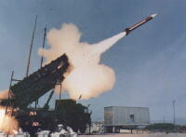
Patriot Missile Failure Case Study

Slide 2
Background
Patriot Missile Air Defense System
Long-range, all-altitude, all-weather air defense system
To counter tactical ballistic missiles, cruise missiles and advanced aircraft.
Scud missiles
Series of tactical ballistic missiles developed by the Soviet Union during the Cold War
Notes:
During this slide , a general introduction about the Patriot and the scud are given.
Patriot is the primary surface-to-air missile (SAM) system used by the United States Army and several allied nations. It is manufactured by the Raytheon Company of the United States.
Phased Array TRacking to Intercept Of Target.
Patriot was used initially as an anti-aircraft system, but in 1988 it was upgraded to provide limited capability against tactical ballistic missiles as PAC-1 (Patriot Advanced Capability-1). The most recent upgrade, called PAC-3, is a nearly total system redesign, intended from the outset to engage and destroy tactical ballistic missiles.
A tactical ballistic missile is a ballistic missile designed for short-range battlefield use.
Scud missile (including derivatives) is one of the few ballistic missiles to be used in actual warfare. Soviet-made, mobile, single-stage, single-warhead, liquid-fueled, short-range ballistic missile .
Scud was first deployed by the Soviets in the mid-1960s. The missile was originally designed to carry a 100-kiloton nuclear warhead or a 2,000 pound conventional warhead, with ranges from 100 to 180 miles. Its principal threat was its warhead potential to hold chemical or biological agents.
The Iraqis modified Scuds for greater range, largely by reducing warhead weight, enlarging their fuel tanks and burning all of the fuel during the early phase of flight .
The Iraqis had four versions: Scud itself (180-km range), longer-range Scud , Al Hussein (650-km) and Al Abbas (800-km).

Slide 3
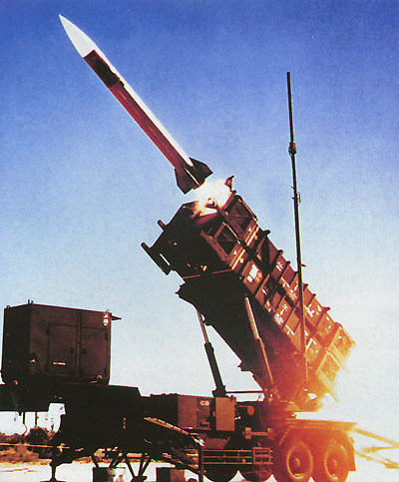
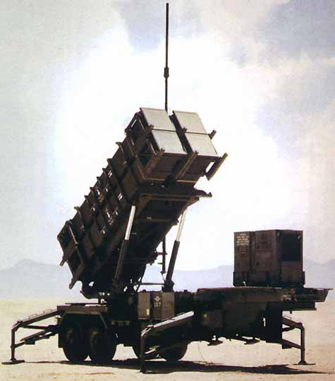
Patriot Missile Defense System
Notes:
In the first picture we can see a patriot missile being launched whereas in the second one we can see the Launching system.

Slide 4
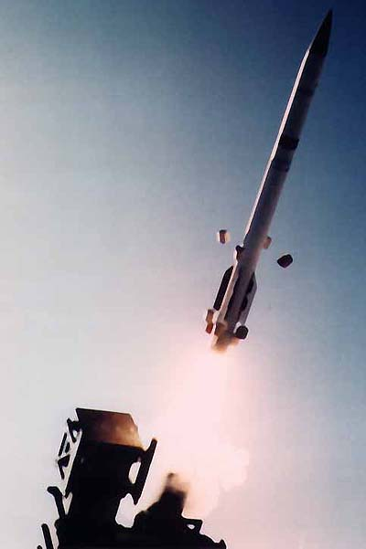
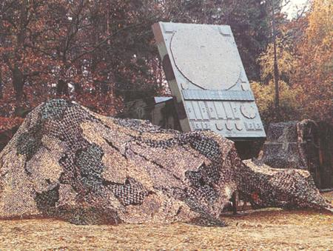
More Pictures Of The System
Notes:
In the second picture we can see a Radar Transceiver which is used to spot the enemy aircrafts and missiles. It calculates the exact location of the hostile missile at a future instant of time and fires the missile.

Slide 5
Specifications - Patriot Missile Air Defense System
Missile body length 520 centimeters
Missile body diameter 40 centimeters
Fins four delta shaped fins
Fin diameter 85 centimeters
Warhead high explosive
Guidance track-via-missile (TVM)
Propulsion single stage solid fuel rocket motor
Range 70 kilometers
Maximum altitude>24 kilometers
Time of flight minimum nine seconds maximum < three and a half minutes
Notes:
The different specifications of the patriot missile are given.

Slide 6
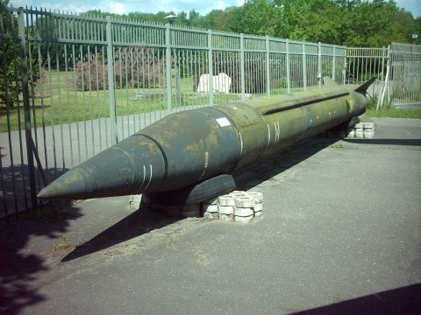
SCUD Missile Image
Notes:
Here we can see the scud missile. It can have both chemical and biological warheads.

Slide 7
SCUD Missile Series
 |  | Scud B | Al Hussein | Al Abbas
Length (ft.) |  | 36.8 | 41 | 47.6
Warhead Wt (lbs.) |  | 2,200 | 1,100 | 308-550
Max Range (miles) |  | 186 | 373+ | 500-560
Diameter (in) |  | 35 | 35 | 35
Accuracy(mi) |  | 0.62 | 1-2 | 1.9-3.1
Notes:
These are the different specifications of SCUDS.

Slide 8
What Happened?
Date: February 25, 1991
Location: Dhahran, Saudi Arabia
Theatre: The Gulf War
Event: Operation Desert Storm
An American Patriot Missile battery failed to intercept an incoming Iraqi Scud missile.
The Scud struck an American Army barracks, killing 28 soldiers and injuring more than ninety.
Notes:
This is the incident that occurred due to a computer fault. It happened on the 25th of February 1991 in Dhahran, Saudi Arabia during the Gulf War. Due to a software problem the Patriot missile system failed to intercept an incoming Iraqi Scud killing 28 soldiers from the US Army's 14th Quartermaster Detachment. This was done as part of the operation Desert Storm.

Slide 9
Technical Details
To predict where the Scud will next appear, both time and velocity must be expressed as real numbers.
The time in tenths of second as measured by the system's internal clock was multiplied by 1/10 to produce the time in seconds.
24 bit fixed point register.
Notes:
In this slide, the various technical aspects of the software problem that caused the disaster are explained. The main limitation is the size of the registers which introduces the chopping error. This error is compounded with the time of operation. The longer the system operates continuously, higher the error that is introduced. So, the system has to be restarted at some particular instants so that the error introduced does not affect its operation.

Slide 10
Technical Details (cont’d)
1/10 has a non-terminating binary expansion and is truncated at 24 bits after the radix point.
Small chopping error x large number = a significant tracking error
The incoming Scud was outside the "range gate" that the Patriot tracked.

Slide 11
Calculation of Tracking Error
The binary expansion of 1/10 is 0.0001100110011001100110011001100…….
The 24 bit register in the Patriot stored 0.00011001100110011001100
Error introduced is 0.0000000000000000000000011001100...
Notes:
This is how the error is introduced. 1/10 s value is approximated and hence the chopping error when multiplied with a large number produces a significant error which leads to inaccuracy in the prediction.

Slide 12
More Calculations …
Time for which it was running is 100 hours.
Multiplying by the number of tenths of a second in 100 hours gives 0.000000095×100×60×60×10 = 0.34 seconds
Speed of the Scud missile = 1,676 meters/sec
Distance traveled during the time of the accumulated time error = 0.5 km
Notes:
In this case we assume that the system has been in operation for at least 100 hours. This was the actual scenario when the mishap took place. Speed of the scud missile is approximately equal to 1676 m/sec . So we calculate the error introduced due to the chopping of the 1/10 value . This shows that the error crept in is 0.34 seconds which leads to a change of 0.5 Km.

Slide 13
Who Is Responsible?
Raytheon SMS (the Patriot's designer)
Army (publicized distorted performance metrics to the government/media)
Missile battery operators, and many other factors…….
Notes:
Raytheon who designed the patriot must not have allowed the usage of the patriot as an anti missile system as it is primarily an anti aircraft missile without the necessary modifications.
Army must not have used an antiaircraft missile as an anti missile system without proper testing.
The communication must have been faster as there was a software update which reached Dhahran a day after the mishap that could have saved the day for the 28 soldiers.
Operators who used it for more than the time they are supposed to use.
They cannot be completely blamed because the exact time after which the system must be restarted was not clear.

Slide 14
Lessons Learned
Testing in computer-controlled systems must be very robust.
Special care must be taken when redesigning a system for a new use--when the uses seem very similar.
Communication among the designers, programmers, and operators of a safety-critical system is imperative (⇒ systems engineering)
Notes:
These are some of the lessons to be learned so that such unfortunate incidents do not occur.

Slide 15
References
http://www.ima.umn.edu/~arnold/disasters/patriot.html
GAO report on the Patriot Missile Failure (I will post this in Moodle)

