Slide 1
EE 4130 – Systems Engineering: Work Breakdown Structure (WBS)
Prof. Joel Harris
CSULA ECST Department
23 April 2018

Slide 2
Work Breakdown Structure (WBS)
Q: What the heck does WBS have to do with systems engineering, anyhow??
A: Just about everything….!!
Systems Engineering
Project Management

Slide 3
How SE and PM Are Interrelated
“….program management is ultimately responsible for the products of systems engineering, for managing risk, and for managing (controlling) the configuration of the products that make up the system.”
“As a result, it can be useful to consider systems engineering as a cross-product process and the systems engineering organization as a cross-product staff function serving program management.”**
** SMC Systems Engineering Primer and Handbook

Slide 4
WBS Topic Outline
Purpose
Definition
Structure
Guidelines
Work Packages
Implementation
Exercise

Slide 5
WBS - Purpose
To plan a project, the total scope of work must be:
identified
subdivided into manageable segments/”chunks”
assigned to individuals responsible to do the work
documented

Slide 6
WBS - Definition
“A deliverable, oriented grouping of project elements which organizes and defines the total scope of the project…. Each descending level represents an increasingly detailed definition of a project component.”

Slide 7
WBS - Guidelines
Should reflect how the Project Management plans to manage the project
Emphasis must be on meeting project objectives
The larger or more complex the project, the more levels in the WBS
If work is needed that requires effort or funding, it should be included in the WBS
It should reflect the total effort
The WBS is a critical tool for systems engineering to take the “pulse” of the project, how it is progressing in its life cycle….

Slide 8
Guidelines - continued
The WBS typically Includes three types of project work:
Product
Specifically assigned to a physical product as a unique deliverable
This subset is sometimes referred to as the Product Breakdown Structure
Integration
Used when products/subsystems are brought together as a unit
It can be at any level
Support
“Level of Effort”, Administration, Expenses, Improvement Practices, Supplier/Contractor Management, etc.

Slide 9
Guidelines (cont’d)
Sometimes, the top level in the WBS should be the project phases themselves…
Often though, a work breakdown structure is constructed for each phase of the project, rather than the entire life cycle/duration of the effort…

Slide 10
WBS - Structure

Slide 11
WBS – Product Based Version

Slide 12
WBS – Integration Based Version

Slide 13
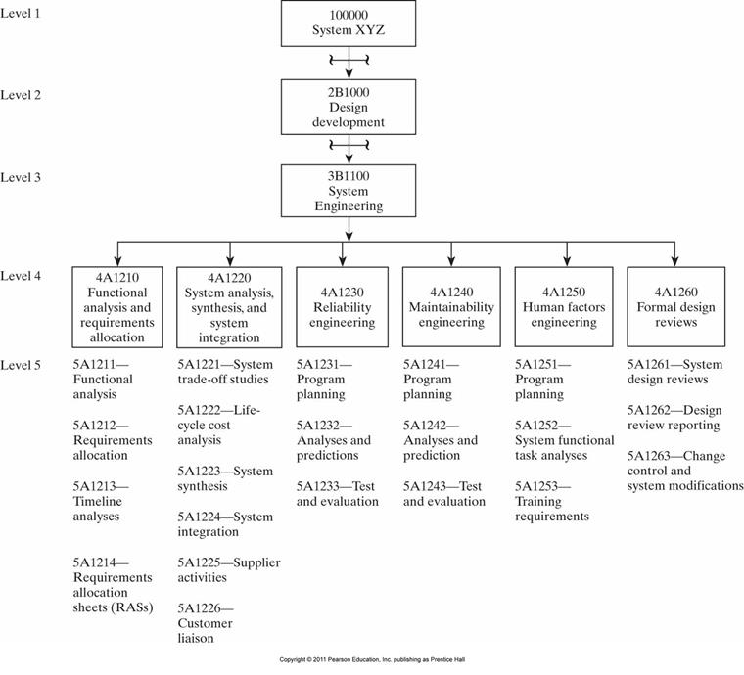
Contract WBS (CWBS)

Slide 14
Typical Integration Elements
Regulatory
Permitting
Legal
Intellectual Property
Logistics
SOP’s
Training
Spares Philosophy and Provisioning
HES (Health, Environment, Safety)
Quality Assurance
Communications
Systems Engineering
Purchasing
Hazard Analysis
Value Improving Practices
Others?

Slide 15
WBS – Support Based Version

Slide 16
WBS – “Work Packages”
Are the lowest agreed level/smallest unit of deliverable for management purposes
Enable delegation of responsibility and authority
Uses the RAM matrix to delineate roles and authority…
Results in ownership and accountability
They are the building blocks of the Project Baseline Plan
Provide a common basis for
Estimation of Scope, Time, Resources, and Risk
Comparison between plan and actual ⇒ Earned Value Tracking

Slide 17
How to build a WBS…
Begin with the project charter, focusing on Objectives and Deliverables
Break the main product(s) down into sub-products
Set the structure to match how the project is to be managed
Lowest level not too detailed, not too large
Is there a need for Integration?
Identify support activities
Check for completeness - is all the effort included?
Develop a coding structure if needed
Assign work package managers - CAMs

